Slide 1
Container Solution: Docker & Kubernetes
2022.04.01 - Toshiba Software Development (Vietnam) Co., Ltd

Slide 2
Contents
01
Overview Docker
02
Overview Kubernetes
03
Case study 1 – WESOpt project
04
Case study 2 – MIA project
05
Next direction
Notes:
+ Important questions:
Why use docker ?
What is docker ?

Slide 3

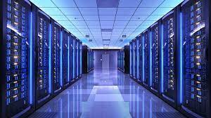


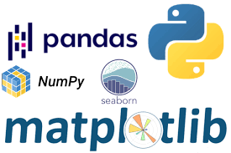
Why use docker ?
What are basic ingredients need for ML development environment ?
Compute (GPUs)
Storage (datasets)
Source control (git)
Frameworks & libraries (APIs)
Issues
Compative
Ref: https://aws.amazon.com/blogs/opensource/why-use-docker-containers-for-machine-learning-development/

Slide 4
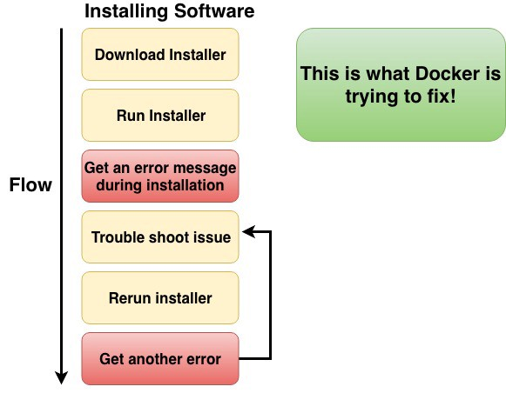
Why use containers ?
Ref: https://aws.amazon.com/blogs/opensource/why-use-docker-containers-for-machine-learning-development/
Notes:
+ container ~ virtual machine

Slide 5
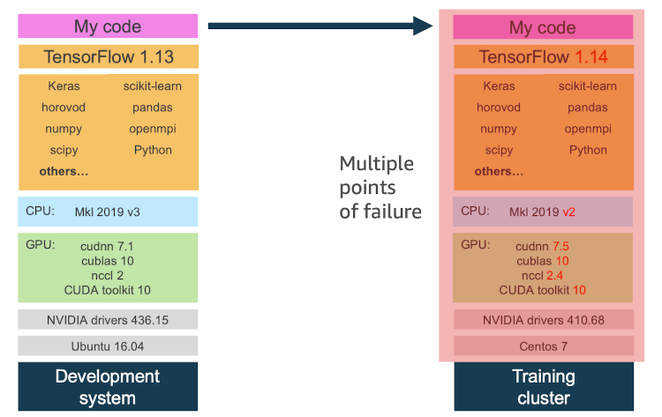
Why use containers ?
Ref: https://aws.amazon.com/blogs/opensource/why-use-docker-containers-for-machine-learning-development/
Notes:
+ container ~ virtual machine

Slide 6
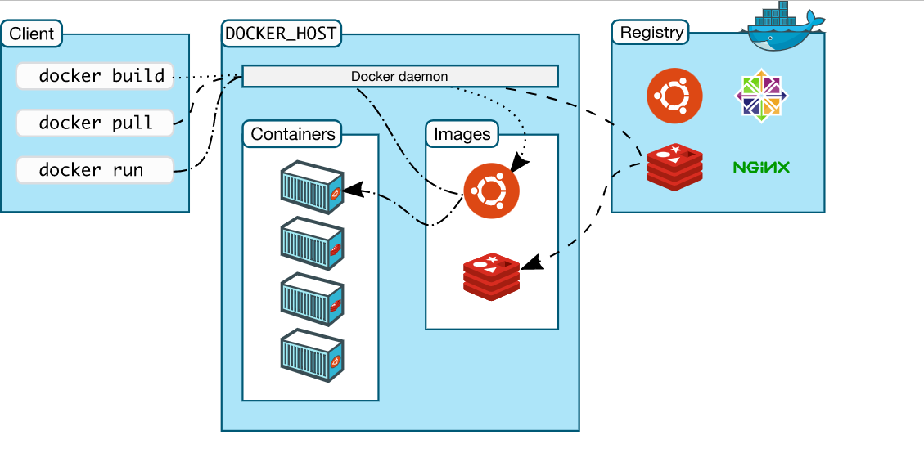
Docker architecture (1)
Ref: https://docs.docker.com/get-started/overview/
Notes:
CLI- command line interface

Slide 7
Docker architecture (2)
Docker client:
the primary way that user interact with docker host (terminal).
Send RESTfull request to docker daemon.
Ref: https://docs.docker.com/get-started/overview/

Slide 8
Docker architecture (3)
Docker daemon:
Listens & adapt docker API request from client
Managers docker objects (images, containers …)
Ref: https://docs.docker.com/get-started/overview/

Slide 9
Docker architecture (4)
Registry: Stores docker images
Ref: https://docs.docker.com/get-started/overview/

Slide 10
Docker architecture (5)
Images:
A read-only template with instructions for creating docker container.
In order to build own image, we can create Dockerfile.
Ref: https://docs.docker.com/get-started/overview/

Slide 11
Docker architecture (6)
Docker host
Registry
Docker daemon
(3)
(2)
Ubuntu:18.04
(1)
Containers
Images
Client
(4)
centos
Ubuntu:18.04
Ubuntu:18.04
$ docker run ubuntu:18.04
(5)
Ubuntu:16.04
Run :
Pull :
Ref: https://docs.docker.com/get-started/overview/
Notes:
CLI- command line interface

Slide 12
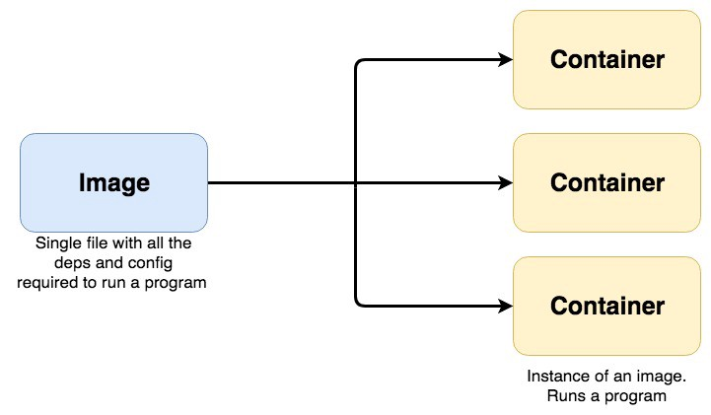
Docker images & Docker file
Docker image: a collection of files {source code, dependencies, libraries …} for deploying containers.
Docker container:
A virtualized run-time environment provides isolation capabilities for the execution of applications.
Provide a portable & lightweight environment for deploying applications.
Dockerfile:
A script of instructions can build images automatically.
Dockerfile statements:
Ref: https://www.whitesourcesoftware.com/free-developer-tools/blog/docker-images-vs-docker-containers/
Notes:
+ Docker image:
- 1 file dung de thuc hien code trong docker container ~ 1 tập các bước để x.dựng container.
(bản chất) docker image ~
+ portable:
+ lightweight:

Slide 13
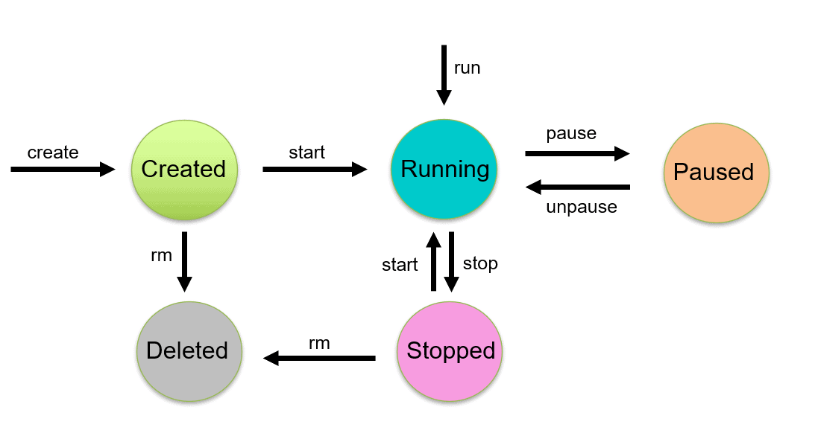
Lifecycle of Docker Container
$ docker create --name <container_name> <image_name>
Ref: https://k21academy.com/docker-kubernetes/docker-container-lifecycle-management/
Notes:
+

Slide 14
Lifecycle of Docker Container
$ docker start <container_name>
Ref: https://k21academy.com/docker-kubernetes/docker-container-lifecycle-management/
Notes:
+

Slide 15
Lifecycle of Docker Container
$ docker start <container_name>
Ref: https://k21academy.com/docker-kubernetes/docker-container-lifecycle-management/
Notes:
+

Slide 16
Lifecycle of Docker Container
$ docker run -it <container_name>
Ref: https://k21academy.com/docker-kubernetes/docker-container-lifecycle-management/
Notes:
+

Slide 17
Share Data Between the Docker Container & the Host
Share data between host to container
Share data between containers (assume container_1 mounted with Host):
Manager outside disk with docker
$ docker run -d –it –-name container_name –v path_host:path_cont image_id:TAG
$ docker run –it --volumns-from container_1 image_id:TAG
Ref: https://xuanthulab.net/chia-se-du-lieu-giua-docker-host-va-container.html
Notes:
+ Anh xa thu muc may host vao container
+ Chia se du lieu giua cac container
+ Chia se du lieuj qua volume
+ Tao volume, docker volume create
+ Gan o dia volume vao container
+ Tao o dia anh xa den thu muc host

Slide 18
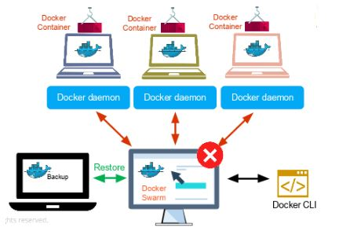
Docker Swarm (1)
Docker Swarm:
The cluster management & orchestration features in the Docker Engine.
Help end-user in creating & deploying a cluster of Docker nodes (node ~ Docker daemon)
Key concepts:
Nodes: an instance of the Docker Engine. Two types of nodes:
Manager node: (1) Receives a service definition from user then (2) dispatches units of work (tasks) to worker nodes.
Worker: Receives & executes tasks from manager node.
Services & tasks:
Service: The definition of tasks to execute on manager node or worker nodes.
Task: the commands run inside the container.
Load balancing
Expose the ports for services to an external load balancer.
Source
Ref:
https://xuanthulab.net/chia-se-du-lieu-giua-docker-host-va-container.html
https://docs.docker.com/engine/swarm/key-concepts/
https://stackoverflow.com/questions/45079988/ingress-vs-load-balancer
Notes:
+ Trong thuc te, khi trien khai 1 du an, project can chay tren nhieu host (virtual private server – may chu ao rieng) ~> kho quan ly, k the config, deploy cho tung con host => docker swarm
Cong cu: cac tinh nang dieu phoi & quan ly cum docker host (~ containers)
+ Key concepts:
Node ~ 1 instance cua Docker enginer cu the => {Docker Engine ~ a client-server application}. Một máy vật lý or máy ảo chạy docker.
Load balancing: (confirm ki)

Slide 19
Docker Swarm (2)
Feature highlights:
Cluster management integrated
Decentralized design
Declarative service model
Scaling
Desired state reconciliation
Multi-host networking
Service discovery
Load balancing
Secure by default
Rolling updates
Ref:
https://xuanthulab.net/chia-se-du-lieu-giua-docker-host-va-container.html
https://docs.docker.com/engine/swarm/key-concepts/
Notes:
+ Trong thuc te, khi trien khai 1 du an, project can chay tren nhieu host (virtual private server – may chu ao rieng) ~> kho quan ly, k the config, deploy cho tung con host => docker swarm
Cong cu: cac tinh nang dieu phoi & quan ly cum docker host)
+ Feature highlights
-

Slide 20
Deploying an app to a Swarm
Share data between host to container
Share data between containers (assume container_1 mounted with Host):
Manager outside disk with docker
$ docker run -d –it –-name container_name –v path_host:path_cont image_id:TAG
$ docker run –it --volumns-from container_1 image_id:TAG
Ref:
https://docs.docker.com/engine/swarm/swarm-tutorial/create-swarm/
https://github.com/docker/labs/blob/master/swarm-mode/beginner-tutorial/README.md
Notes:
+ Anh xa thu muc may host vao container
+ Chia se du lieu giua cac container
+ Chia se du lieuj qua volume
+ Tao volume, docker volume create
+ Gan o dia volume vao container
+ Tao o dia anh xa den thu muc host

Slide 21
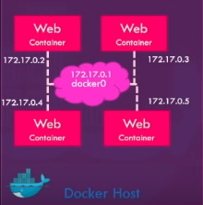
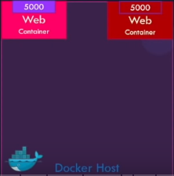
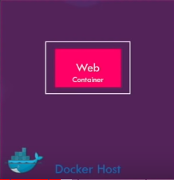
Docker networking
Docker networking: establish communication between Docker containers and the outside world via the host machine
Network drivers:
Bridge network | Host network | None network
Applications run in standalone containers Use: multiple containers communicate on the same docker host. | Remove network isolation between the container & docker host. Use the host’s networking directly. Use: Network stack should not be isolated from Docker host. | Disable all networking Used in conjunction with a customer network driver.
Notes:
+ Docker network: ket noi giua cac containers voi nhau, container voi ben ngoai hoac ket noi giua cac cum (swarm) docker containers
+ Bridge:
- Use: chay cac ung dung duoi dang cac container doc la can giao tiep voi nhau (ip address) => tranh conflict port problem
+ Host: duoc cap boi host. ~> limit: need a linux host to use it. Can not run multiple containers on the same host having same port.
+ None: ngat tat ca ket noi ~> containers k the truy cap cac mang b.ngoai or voi cac containers khac
+ Ref:
https://earthly.dev/blog/docker-networking/
https://www.youtube.com/watch?v=fqMOX6JJhGo
https://docs.docker.com/network/
https://stackoverflow.com/questions/41083328/what-is-the-use-of-docker-host-and-none-networks
https://www.bogotobogo.com/DevOps/Docker/Docker-Bridge-Driver-Networks.php
https://www.aquasec.com/cloud-native-academy/docker-container/docker-networking/

Slide 22
Bridge networks
Docker networking: establish communication between Docker containers and the outside world via the host machine
Advantages of Docker Networking:
They share a single operating system & maintain containers in an isolated environment.
Help in the fast to delivery of software
Help in application portability
Notes:
+ Docker network: ket noi giua cac containers voi nhau, container voi ben ngoai hoac ket noi giua cac cum (swarm) docker containers
+ Bridge:
- Use: chay cac ung dung duoi dang cac container doc la can giao tiep voi nhau (ip address) =>
+ Host: public network,
+ None: ngat tat ca ket noi
+ Ref:
https://www.simplilearn.com/tutorials/docker-tutorial/docker-networking?source=sl_frs_nav_playlist_video_clicked
https://earthly.dev/blog/docker-networking/
https://www.youtube.com/watch?v=fqMOX6JJhGo
https://docs.docker.com/network/
https://stackoverflow.com/questions/41083328/what-is-the-use-of-docker-host-and-none-networks
https://www.bogotobogo.com/DevOps/Docker/Docker-Bridge-Driver-Networks.php
https://www.aquasec.com/cloud-native-academy/docker-container/docker-networking/

Slide 23
Build docker image
Docker file:
Syntax: [INSTRUCTION] [ARGUMENT]
Layered architecture:
Layer 1: Base OS layer
Layer 2: Changes in apt packages
Layer 3: Changes in pip packages
Layer 4: Source code
Layer 5: Update Entrypoint
In order to reduce docker image size:
Use a smaller image base (ex: alpine)
Use a .dockerignore file
Beware of update & unnecessary packages
Use multi-stage build (Pros & cons)
Consider layer caching and reduce number of layer (RUN, COPY & ADD)
Ref:
https://phoenixnap.com/kb/docker-image-size
https://kipalog.com/posts/Docker-image-in-production---cau-chuyen-1GB-hay-100MB

Slide 24
Docker compose
Ref:

Slide 25
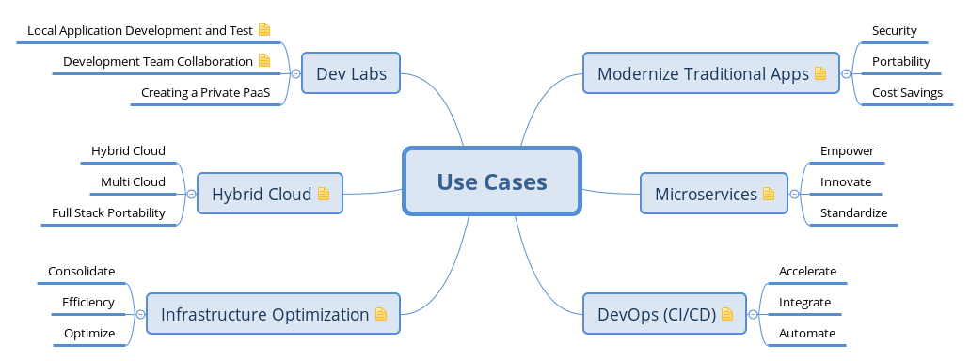
Case study
Notes:
+ container ~ virtual machine

Slide 26
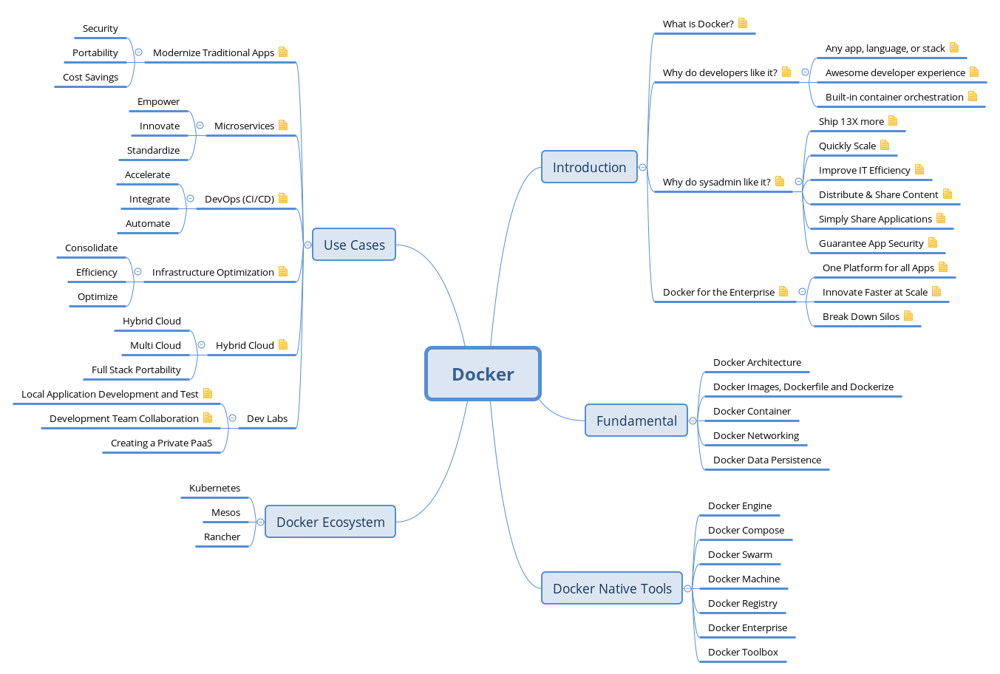
Summary
Notes:
+ container ~ virtual machine

Slide 27
Reference:
Docker & Kubernetes Complete Tutorial link
Docker 101 devopsz
Play with docker link
Notes:
1. Docker:
+ Overview
- why use docker ?
/ develop an application stack with a lot of # components (~ version)
/ compatible with the underlysing OS or just temporarily
/ the compatibility between the services & the libraries & dependencies on the OS
/ change components of project
- what is docker ?
+ Achitecture
- image & container
+ Connection details
- lifecycle of container: cmd (run, ps, ps -a, stop, rm, images, rmi, pull, attach & detach, ...)
- volumn ~> detail run command line
- inspect container & container logs
+ Docker swarm
+ Docker network
- default networks {brigde, none, host}
- user-defined networks
- inspect network
- embedded dns
+ Docker file ~> docker images
- Layered architecture (failure)
+ Docker compose
2. Kunernetes
+ K8S overview (suggest ver {microk8s, k3s }; {kind, minikube} - gioi thieu)
+ Deployment co ban
+ Expose service on K8S
+ Manage on K8S
+ Logging & monitoring
+ Storage
+ Rolling update application
+ Tich hop jenkins
3. Appendix
https://docs.docker.com/engine/swarm/how-swarm-mode-works/nodes/
https://cognitiveclass.ai/courses/docker-essentials/
https://dockerlabs.collabnix.com/

