Slide 2

SESSION-BASED RECOMMENDER SYSTEM
FOR RETAIL PRODUCTS
Web Mining - Fall 2024
Vo Dinh Dat
Doan The Vinh
Doan Ngoc Cuong
Le Trung Kien
Pham Quang Trung
20210860
20210940
20210141
20214907
20214935
Our work are at: https://github.com/datvodinh/otto-recommendation-system.git

Slide 3
Introduction

Slide 4
INTRODUCTION
Background: E-commerce platforms generate vast data on user interactions (clicks, carts, orders).
Challenge: Predicting user actions in anonymous sessions using only session-based data.
Relevance: Improves personalization and sales strategies for retailers.

Slide 5
Data

Slide 6
Data
2.1. Dataset Overview
Source: OTTO e-commerce dataset (12M sessions, 220M events).
Event Types:
Clicks (89.8% of interactions).
Add-to-cart (7.8%).
Orders (2.4%).
Challenges:
High sparsity (only 0.0005% possible interactions observed).
Large scale: ~1.8M unique products.

Slide 7
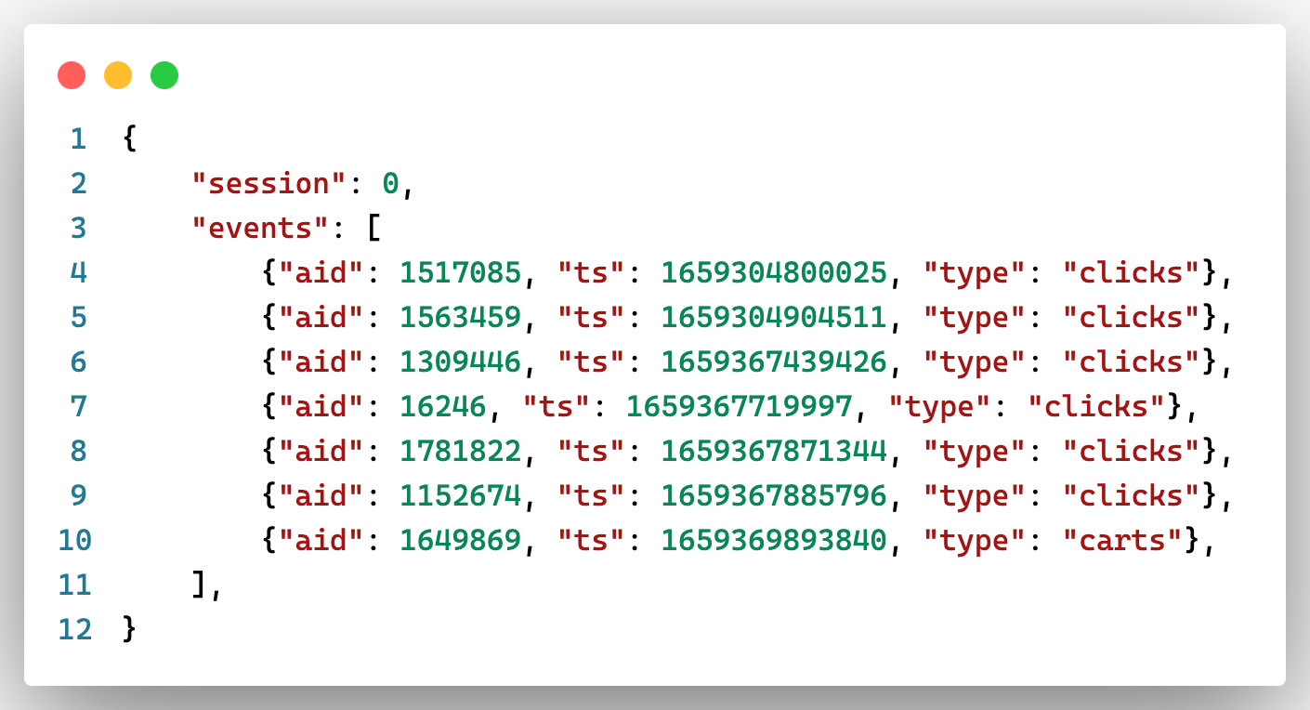
Data
2.2 Data Format

Slide 8
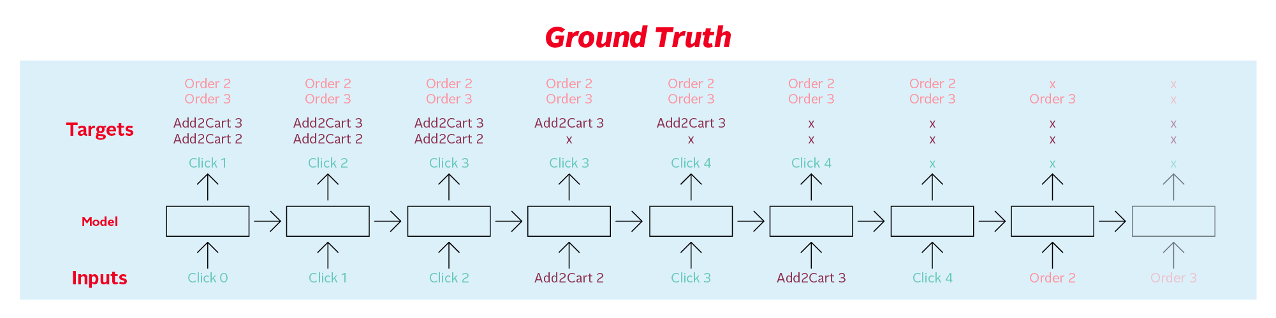
Data
2.3 Data Processing
2.3.1 Labels Generation

Slide 9
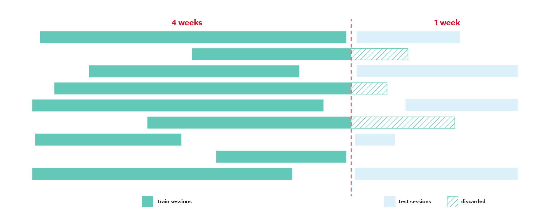
Data
2.3 Data Processing
2.3.2 Data Splitting

Slide 10
Method

Slide 11
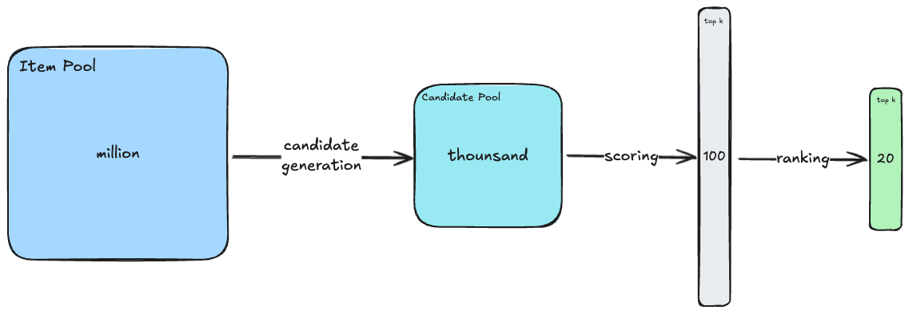
Method 1
Method 1: Classical Pipeline
Candidate Generation: Use co-visitation matrices (e.g., click-to-click, cart-to-order).
Feature Engineering: Extract 200+ features (co-visitation, embeddings, session-level, item-level, temporal).
Ranking: Train XGBoost to rank candidate items for clicks, carts, and orders.

Slide 12
Method 1
1.1 Candidate Generation
Approach:
Based on Co-visitation Matrix:
Click-to-click, Cart-to-cart, Buy-to-buy.
Assign weights based on time and interaction type.
Enhance diversity by incorporating weights for recent interactions.
Benefits:
Improve recommendations for popular or contextually related products.

Slide 13
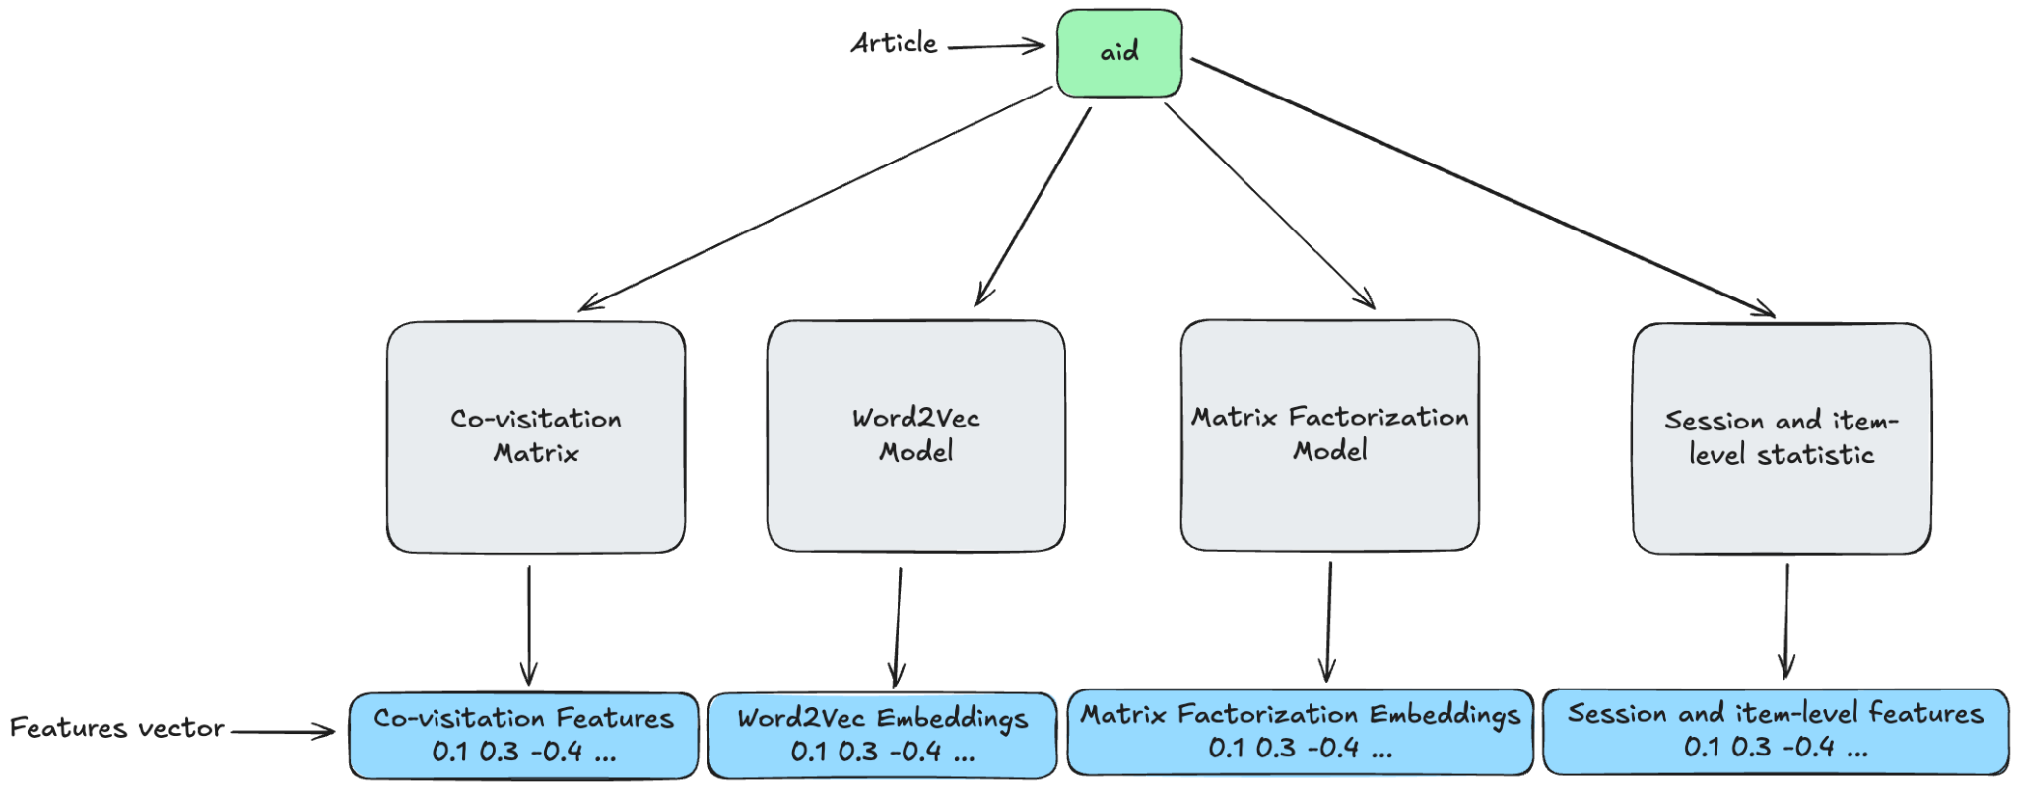
Method 1
1.2 Feature Engineering
Feature Types:
Session-level: Frequency, interaction timing.
Item-level: Popularity, rank in the session.
Temporal Features: Time since the last interaction.
Similarity Features: Item-item similarity (using Word2Vec or Matrix Factorization).
Total Features: ~200.

Slide 14
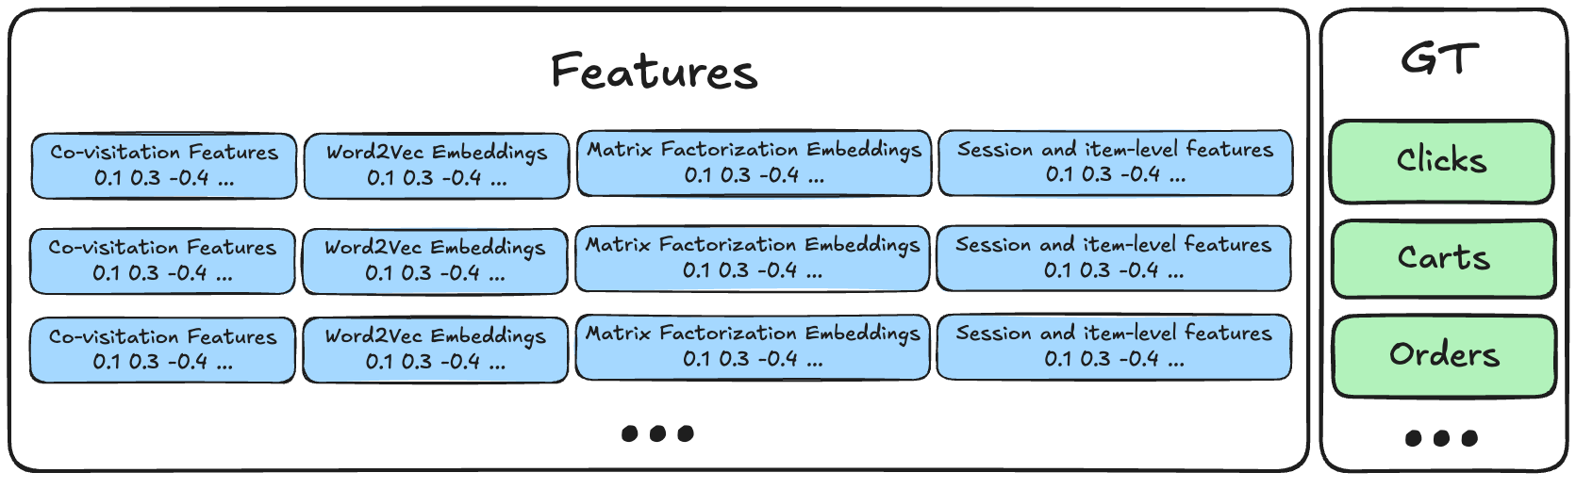
Method 1
1.3 Reranking
Process:
Assign labels:
1: If the product was clicked, added to cart, or ordered.
0: Otherwise.
Filter data: Retain only sessions with at least one positive label.

Slide 15
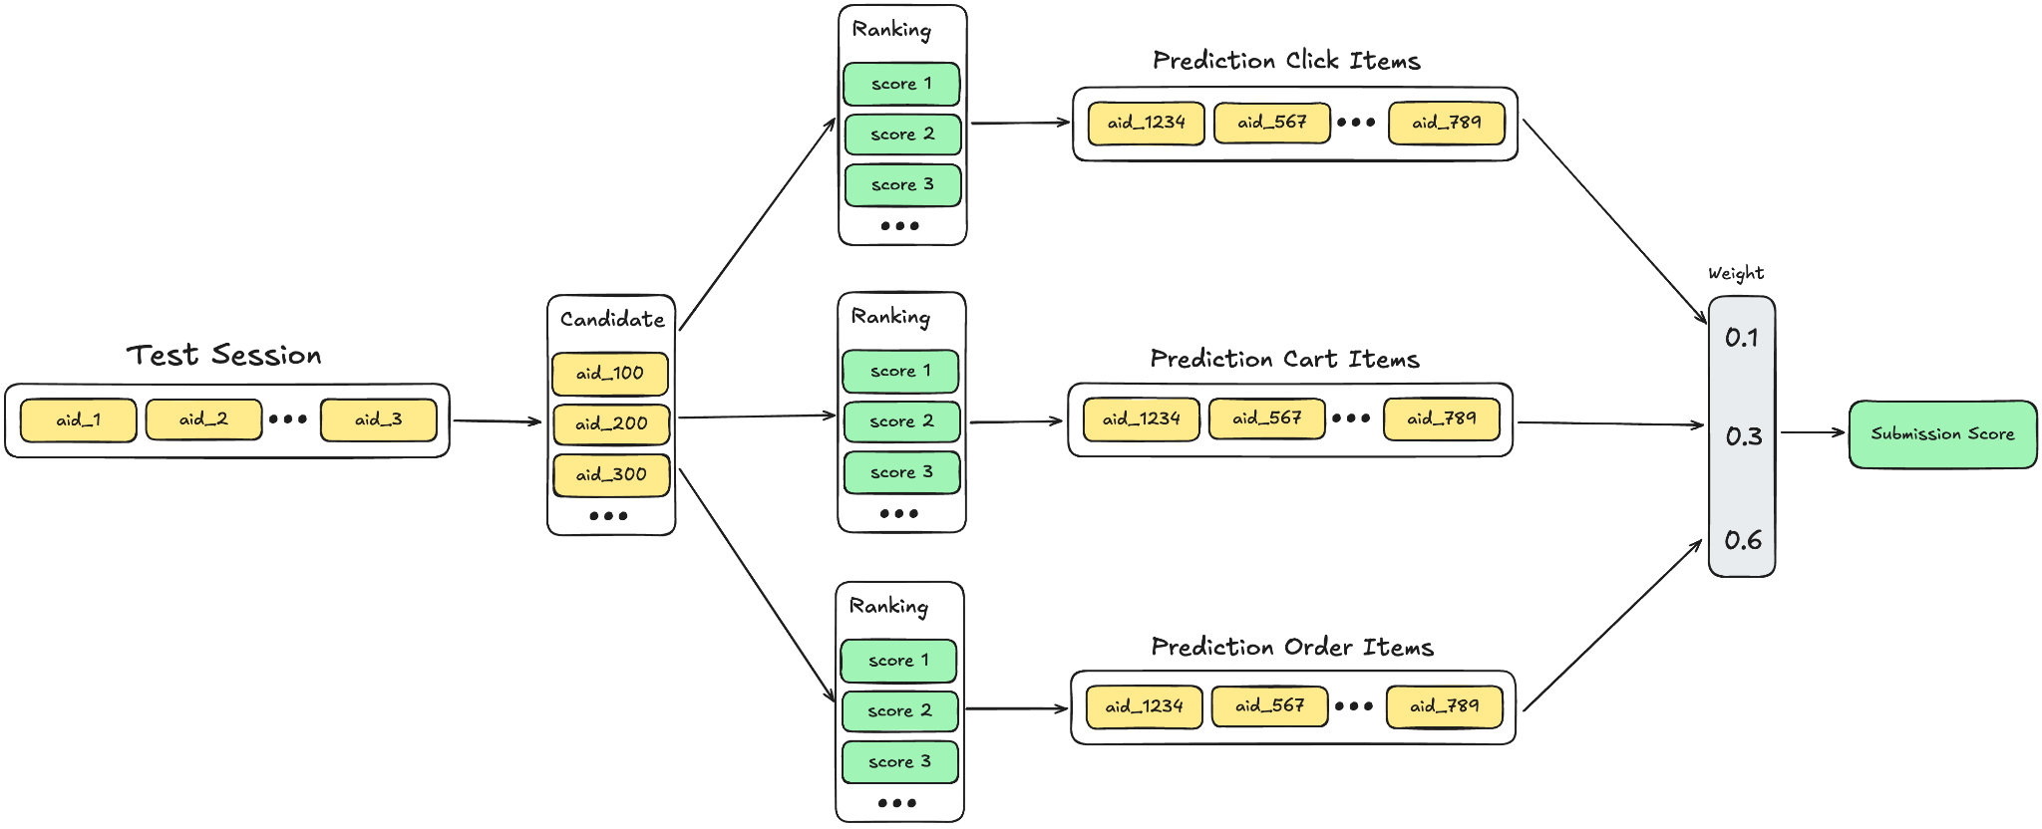
Method 1
1.4 Prediction:

Slide 16
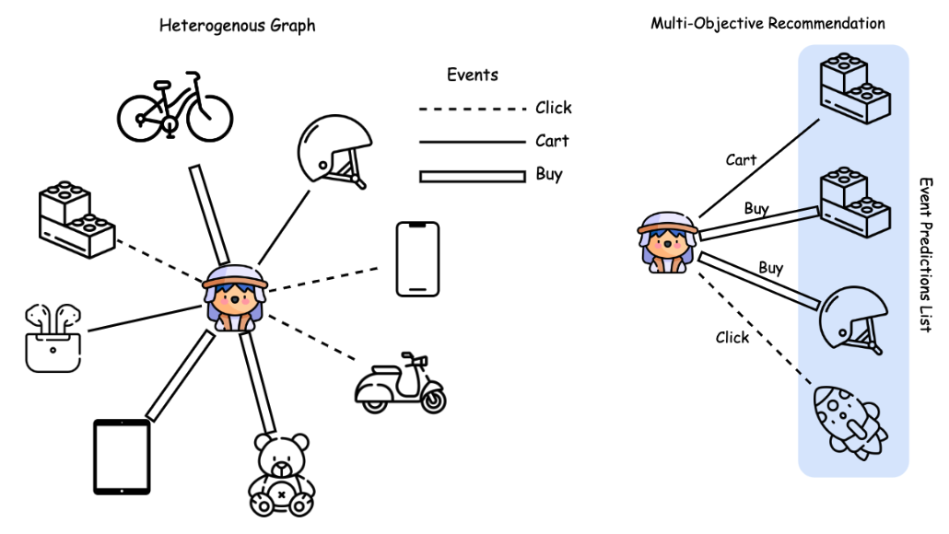
Method 2
Method 2: Graph Neural Networks (GNN)
Represent data as a heterogeneous graph with sessions and products as nodes.
Predict links between nodes based on action types.

Slide 17
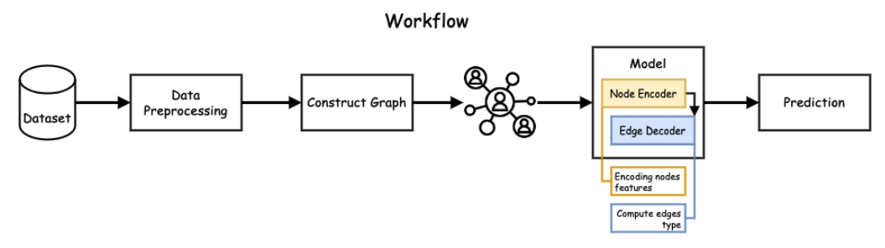
Method 2

Slide 18
Method 3 - RNN
The RNN-based approach using LSTM for modeling sequential user interactions faced scalability challenges due to the large dataset (1.8 million products and 3 action types).
Despite using embedding layers and dropout for regularization, the product embedding matrix alone required over 28 GB of memory, exceeding available hardware resources. Sparse embeddings and other optimizations were insufficient, making training infeasible.
The approach was abandoned in favor of scalable alternatives like Word2Vec with candidate retrieval and ranking models, highlighting the difficulty of scaling deep learning models for large item vocabularies within limited resources.
Hyperparameter | Value
NUM_PRODUCTS | 1,855,603
NUM_ACTIONS | 3
PRODUCT_EMBEDDING_DIM | 16
ACTION_EMBEDDING_DIM | 6
RNN_UNITS | 16
NUM_LSTM_LAYERS | 2
DROPOUT | 0.3

Slide 19
Evaluation

Slide 20
Metrics
Metrics
Evaluation Metrics
Metric: Recall@20 (weighted by click, cart, and order importance).
Score Calculation:

Slide 21
Result
Method | Recall@20
Covisitation Matrix (Our) | 0.161
GNN (Our) | 0.486
Word2Vec (Kaggle) | 0.533
Co-visitation + LGBM Ranker (Kaggle) | 0.551
Co-visitation + Word2Vec + Factorization + XGBoost (Our) | 0.573

Slide 22
Discussion

Slide 23
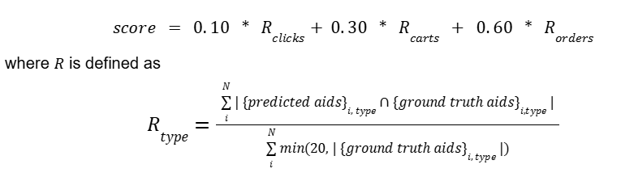
Metrics
Metrics
Evaluation Metrics
Metric: Recall@20 (weighted by click, cart, and order importance).
Score Calculation:

Slide 24
Conclusion

Slide 25
Conclusion & Future Work
Conclusion & Future Work
Conclusion: SBRS effectively predicts session-based actions, enhancing personalization in e-commerce.
Future Work:
Incorporate Transformer-based embeddings.
Address cold-start problem with auxiliary data.
Perform hyperparameter tuning for ranking models.

Slide 26
Contribution

Slide 27
Contribution
Member | Task | Workload
Võ Đình Đạt | Basic Co-visitation matrix generation. Generate candidates based on all the given models, embeddings and matrices. Implement the XGBoost Ranking model. | 20%
Đoàn Ngọc Cường | Converting the dataset to a more optimal format (Parquet). Implement Matrix Factorization model and training code for the training session. Implement prediction pipeline. | 20%
Lê Trung Kiên | Implement Graph Neural Network. Start combining predictions from different models using ensembling methods. Validate and hyperparameter tuning for all methods. | 20%
Phạm Quang Trung | Clean and preprocess the dataset (handle missing values, data transformation). Weighted Co-visitation matrix generation. Feature engineering (session-level features, interaction types, time-based features). | 20%
Đoàn Thế Vinh | Explore the OTTO dataset (understand data structure, distribution, event types). Implement the Word2Vec model and training code for the training session. Explore stacking or blending techniques for ensembling the models. | 20%

Slide 28
REFERENCES
Hamilton, W. L., Ying, Z., & Leskovec, J. (2017). Inductive Representation Learning on Large Graphs. Advances in Neural Information Processing Systems, 30.
Kaggle. (2024). OTTO Recommender Systems Challenge. [Online]. Available: https://www.kaggle.com/competitions/otto-recommender-system
Koren, Y., Bell, R., & Volinsky, C. (2009). Matrix Factorization Techniques for Recommender Systems. Computer, 42(8), 30-37.
Mikolov, T., Chen, K., Corrado, G., & Dean, J. (2013). Efficient Estimation of Word Representations in Vector Space. arXiv preprint arXiv:1301.3781.
Roy, D., Dutta, M. A systematic review and research perspective on recommender systems. J Big Data 9, 59 (2022).

