Slide 1


RESEARCH AND DEVELOPMENT OF A CROSS-PLATFORM APPLICATION FOR TRAVEL PLANNING SUPPORT BASED ON GENERATIVE AI AND PERSONALIZED RECOMMENDER SYSTEMS
Student: Class:
ID:
Nguyen Van Hoa
22SE1B - Software Engineering
22IT.B080
Supervisor: MSc. Vo Ngoc Dat

Slide 2

PRESENTATION OUTLINE
  Market Motivation & Strategic Gaps
  Business Model & Monetization
  System Architecture & UML Design
  Core AI Engines (Two-Tower & RAG)
  UAT Metrics & Lean Validation
  6-Month Roadmap & Future Work

Slide 3



MOTIVATION & PROBLEM STATEMENT
Information Overload: 30+ hours planning/trip.
10-30 Hours
Fragmented Tools: Disjointed coordination (Chat, Sheets, Maps).
B2B Ads Gap: Local merchants lack targeted digital channels.
38 Websites

Slide 4
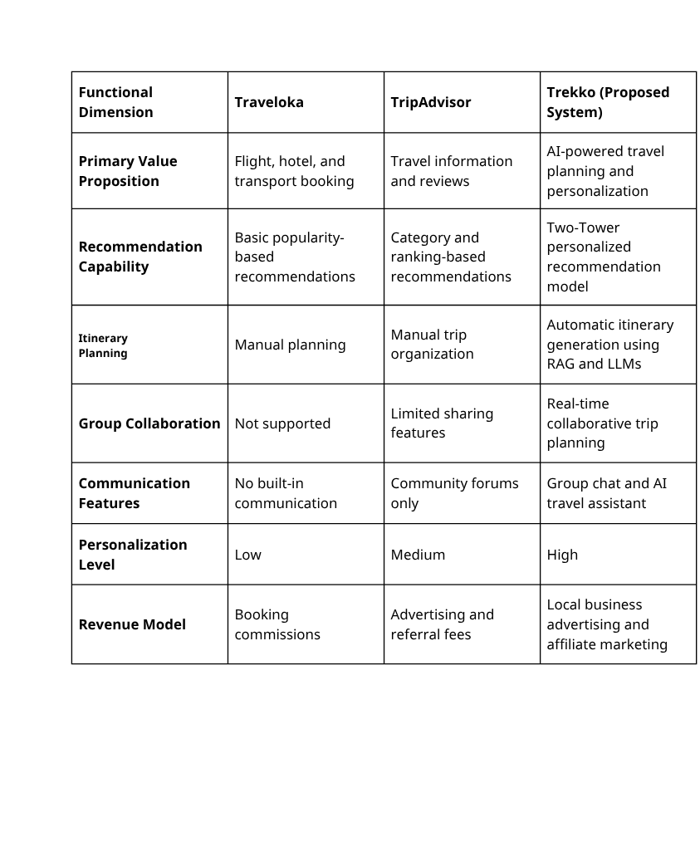
STRATEGIC MARKET ANALYSIS
PESTEL: Strong government support for digital smart tourism.
Competitor Gap:
  OTAs (Klook, Traveloka): Booking transactions only.
  Trekko: Captures users early at the planning stage.

Slide 5
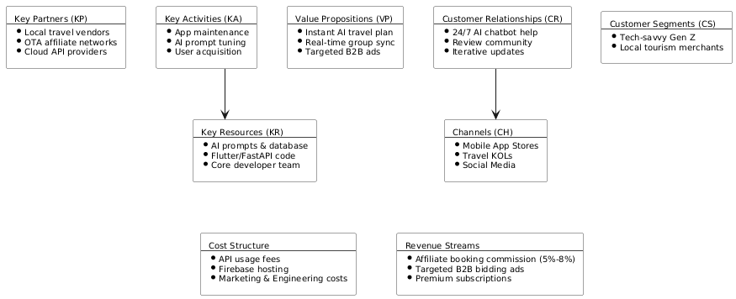
THE BUSINESS MODEL CANVAS
Value Proposition: AI-driven itinerary & real-time group collaboration.
Target Segment: Tech-savvy Gen Z & local tourism merchants.
Core Channels: App Stores, Travel KOLs.

Slide 6
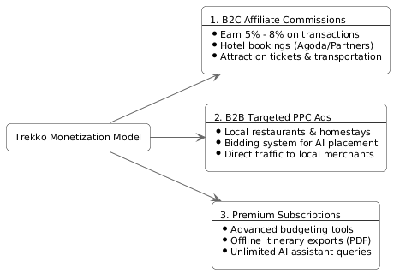
MONETIZATION & SCALABILITY
Affiliate Fees: 5%–8% commission from hotel/ticket partners.
B2B PPC Bidding: Pay-Per-Click ads for local vendors.
Freemium Model: Premium plans for offline export & advanced budgeting.

Slide 7
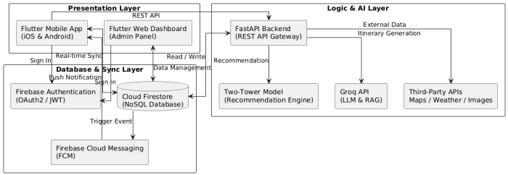
SYSTEM ARCHITECTURE
Frontend: Flutter (iOS, Android, Web Admin).
Database: Cloud Firestore NoSQL (WebSocket real-time sync).
Backend: Python FastAPI (AI coordination).

Slide 8
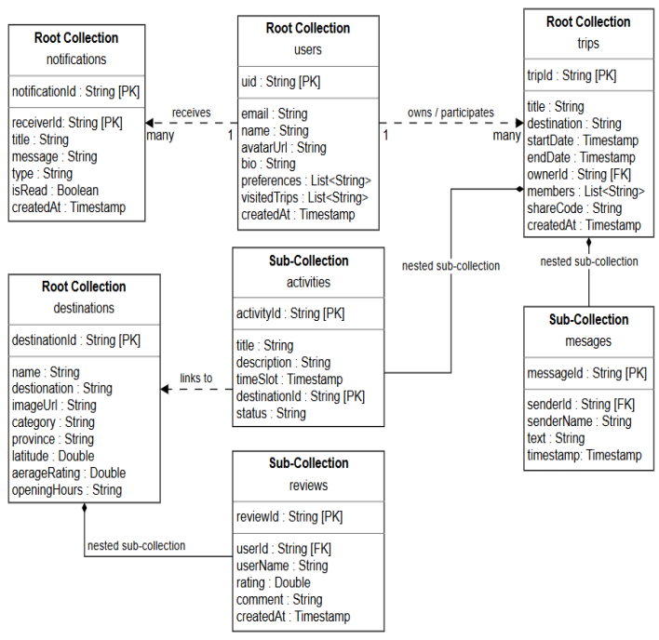
SYSTEM DATABASE & UML DESIGN
Database: Nested collections (activities, messages under trips).
Actors: Traveler (Mobile) & System Admin (Web).

Slide 9
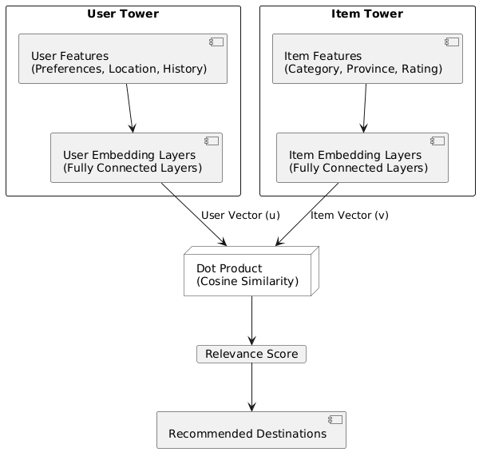
PERSONALIZATION ENGINE
User Tower:
Item Tower: Vectorizes destination features (Category, coordinate, rating, tags).
Ranking: Cosine Similarity matching score.
Cold Start: Onboarding preference survey.

Slide 10
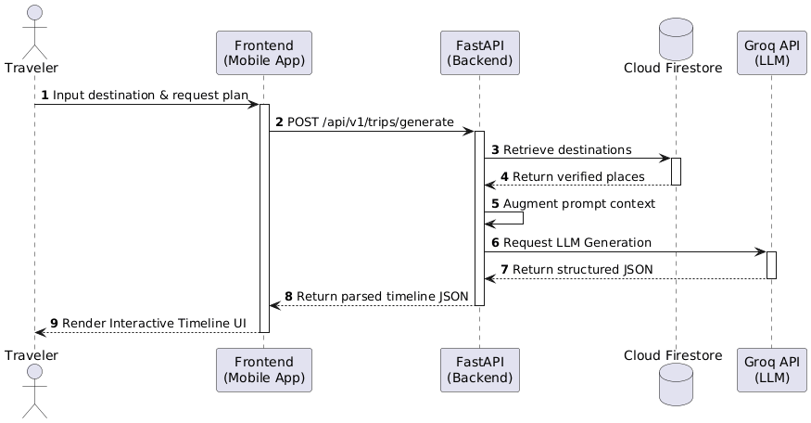
SMART PLANNING ENGINE (RAG)
Retrieve: Fetch verified local destinations from Firestore.
Augment: Inject verified places and weather into prompt context.
Generate: Groq LPU runs Llama-3.3 in under 2 seconds.

Slide 11
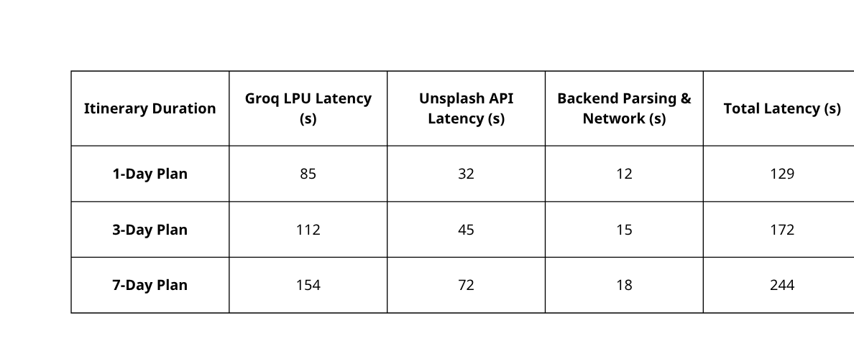
TECHNICAL PERFORMANCE
AI Generation Speed: 3-Day Plan in 1.72s (Groq LPU optimized).
WebSocket Sync Latency: 210ms (Wi-Fi) | 380ms (4G LTE).
Concurrency Control: LWW & OCC database conflict rules.

Slide 12
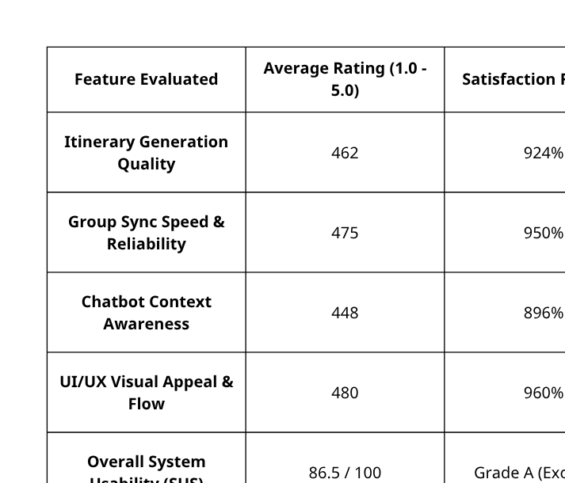
USER EVALUATION & UAT
Cohort Size: N = 10 active travelers.
Time-saving: Saves 98.75% of trip planning time (145 mins to 1.8 mins).
Usability (SUS Score): 86.5 / 100 (Grade A - Excellent).

Slide 13
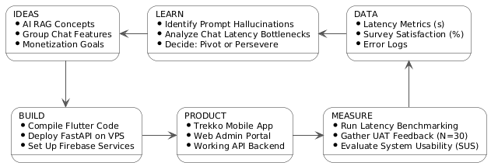
LEAN STARTUP VALIDATION
Build: Core AI planning and real-time chat modules.
Measure: Logged latency and chat memory constraints.
Learn: Implemented history context window truncation in FastAPI.

Slide 14
6-MONTH ROADMAP & FUTURE WORK
Phase 1: MVP Optimization & Closed Beta (Month 1)
  Refine cross-platform Flutter code and deploy VPS security updates.
  Run closed beta test with 50 local users to measure sync latency.
Phase 2: Public Launch & Model Tuning (Month 2)
  Launch publicly on iOS/Android stores; log user interactions.
  Optimize Two-Tower neural network weights using real interaction logs.
Phase 3: B2B Integration & Monetization (Months 3–4)
  Release local merchant dashboard for PPC (Pay-Per-Click) ad bidding.
  Activate OTA affiliate booking APIs.
Phase 4: Scaling & Open-Source LLMs (Months 5–6)
  Expand destination database to secondary tourism cities.
  Migrate to self-hosted open-source LLMs (Llama-3-8B) to cut API costs.

Slide 15
PROJECT DEMO

Slide 16
THANK YOU
Q&A SESSION

