Slide 1

MIDP Programming
Networking

Slide 2

Chapter Objectives
The CLDC Streams Model
Generic Connection Framework (GCF)
Supported Protocols
Creating a Connection
Review of HTTP
Making an HTTP Request
Building a CGI String
Design Tips
Differences between J2ME and J2SE Networking

Slide 3
The CLDC Streams Model
In MIDP, as in J2SE, IO streams are the primary mechanism available to applications to read and write streams of data.
In addition to java.io, the MIDP defines the javax.microedition.io package in contrast to java.net, which supports networking and communications for MIDP applications.
MIDP applications use the javax.microedition.io types to create and manipulate various kinds of network connections.
They then read from these connections and write to them using the types in the MIDP java.io package, which contains a subset of the classes and interfaces in the J2SE java.io package.

Slide 4
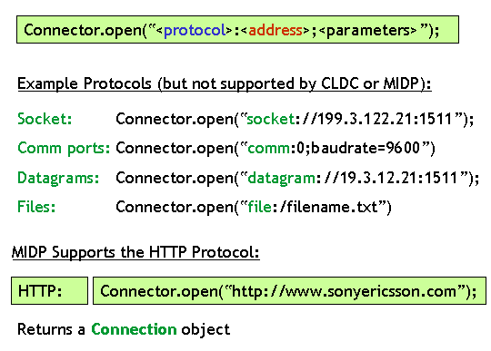
Generic Connection Framework
CLDC specifies a generic connection mechanism
  Leaves considerable flexibility to implementations
  Capable of supporting many different kinds of connections, from serial ports through wireless networking
The fundamental idea:
  Give an URL-like string to the framework
  Get back something that has input and output streams

Slide 5
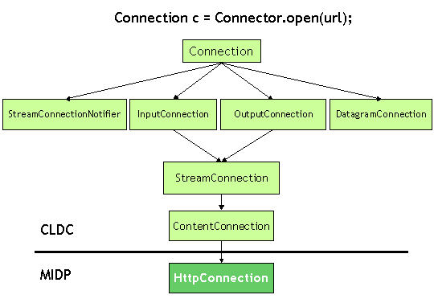
Connection and its Family
Connection represents some kind of I/O connection
It has subinterfaces that define more specific connection types

Slide 6

Making a Connection
Connector is a Connection factory
Pass a URL-style string to open(), get back some Connection implementation
MIDP says that HTTP must be supported
  Other connection types are optional
Note that HTTP does not have to run over TCP/IP

Slide 7
Connection protocol support
Connector.Open("socket://www.corej2me.com.com:55");
Connector.Open("http://www.corej2me.com");
Connector.Open("datagram://www.corej2me.com:1000");
Connector.Open("file://makefile.txt");

Slide 8
Opening a connection
public static Connection open(String name)
public static Connection open(String name, int mode)
public static Connection open(String name, int mode, boolean timeouts)

Slide 9
Opening a connection
public static DataInputStream openDataInputStream(String name)
public static DataOutputStream openDataOutputStream(String name)
public static InputStream openInputStream(String name)
public static OutputStream openOutputStream(String name)

Slide 10
Opening a connection
//Create connection
ContentConnection connection = (ContentConnection) Connector.open("http://www.corej2me.com" );
// With the connection, open a stream
InputStream iStrm = connection.openInputStream();
// ContentConnection includes a length method
int length = (int) connection.getLength();
if (length != -1) {
  byte imageData[] = new byte[length];
  // Read the data into an array
  iStrm.read(imageData);
}

Slide 11
Opening a connection
InputStream iStrm = (InputStream) Connector.openInputStream(url);
Image img = null;
ByteArrayOutputStream bStrm = new ByteArrayOutputStream();
int ch;
while ((ch = iStrm.read()) != -1) {
  bStrm.write(ch);
  // Place into image array
  byte imageData[] = bStrm.toByteArray();
  // Create the image from the byte array
  img = Image.createImage(imageData, 0, imageData.length);
}

Slide 12
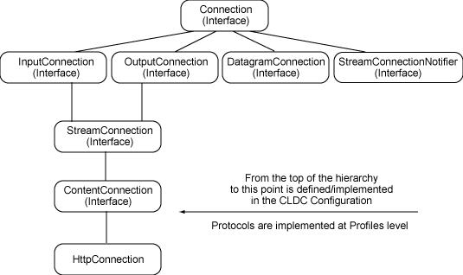
HTTP support in MIDP

Slide 13
HTTP support in MIDP
The original MIDP 1.0 specification only required that devices support the HTTP connection protocol
MIDP 2.0 spec requires support for both HTTP and HTTPS.
The APIs to work with these protocols are HttpConnection and HttpConnections, respectively

Slide 14
Request and response protocols
Both HTTP and HTTPS are request/response protocols.
A client sends a request and a server sends a response

Slide 15
Request and response protocols
The client request, sometimes called the request entity, consists of the following three sections:
Request method
Header
Body

Slide 16
Request and response protocols
The request method determines how data will be sent to a remote resource. The three methods available are:
GET: data is sent as part of the URL.
POST: any client data is sent in a separate stream, distinct from the request to establish a connection.
HEADER: requests do not send any data to a server. Instead, HEADER requests only meta information about the remote resource

Slide 17
Request and response protocols
String url = "http://www.corej2me.com?size=large";
HttpConnection http = (HttpConnection) Connector.open(url);
http.setRequestMethod(HttpConnection.GET);

Slide 18
Request and response protocols
Header fields let us pass parameters, if you will, from the client to the server.
Common fields are If-Modified-Since, Accept, and User Agent.
You set header fields as key-value pairs, using the setRequestProperty() method

Slide 19
Request and response protocols
String url = "http://www.corej2me.com\somefile.txt";
HttpConnection http = (HttpConnection) Connector.open(url);
http.setRequestMethod(HttpConnection.GET);
// Set header field as key-value pair
http.setRequestProperty("If-Modified-Since", "Mon, 12 Jan 2004 12:00:00 GMT");

Slide 20
Request and response protocols
String url = “http://www.corej2me.com”;
String tmp = "test data here";
OutputStream ostrm = null; HttpConnection http = null;
http = (HttpConnection) Connector.open(url);
http.setRequestMethod(HttpConnection.POST);
//Send client body
ostrm = http.openOutputStream();
byte bytes[] = tmp.getBytes();
for(int i = 0; i < bytes.length; i++) {
  os.write(bytes[i]);
}
os.flush();

Slide 21
Request and response protocols
After the server has received and processed the client request, it must package and send a response.
As with the client request, three sections are associated with the server response:
Status line
Header
Body

Slide 22
Request and response protocols
Status line: the server status line informs the client of the outcome of its request.
HTTP classifies the status line codes into the following broad categories:
1xx is informational
2xx is success
3xx is redirection
4xx is client error
5xx is server error

Slide 23
Request and response protocols
"HTTP/1.1 200 OK"
"HTTP/1.1 400 Bad Request"
"HTTP/1.1 500 Internal Server Error"

Slide 24
Request and response protocols
The server can send information through header fields.
Three of the most common methods for retrieving header information sent from a server
String getHeaderField(int n)
String getHeaderField(String name)
String getHeaderFieldKey(int n)

Slide 25
Request and response protocols
the response in a server header contained the content "content-type=text/plain"
Method | Return value
http.getHeaderField(0) | "text-plain"
http.getHeaderField("content-type") | "text-plain"
http.getHeaderFieldKey(0) | "content-type"

Slide 26
The HttpConnection API
Method | Description
long getDate() | Get header field date
long getExpiration() | Gets header field expiration
String getFile() | Gets filename from the URL
int getHeaderField(int n) | Gets header field value looking up by index
String getHeaderField( String name) | Gets header field value looking up by name

Slide 27
Request and response protocols
Method | Description
int getHeaderFieldInt(String name, int def) | Gets named field as an integer
String getHeaderFieldKey(int n) | Gets header field key using index
String getHost() | Gets host from the URL
String getPort() | Gets port from the URL
void setRequestMethod( String method) | Sets the request method (GET, POST or HEAD)
String getProtocol() | Gets protocol from the URL

Slide 28
Request and response protocols
Method | Description
String getQuery() | Gets the query string
String getRequestMethod() | Gets the current setting of the request method
int getResponseCode() | Gets the response code
String getURL() | Gets the entire URL
String getResponseMessage() | Gets the response message

Slide 29
Accessing a Java servlet
private void callServlet() throws IOException {
  HttpConnection http = null;
  InputStream iStrm = null;
  boolean ret = false;
  // Examples - Data is passed at the end of url for GET
  String url = "http://www.mycgiserver.com/servlet/corej2me.DateFormatServlet? format=MMMM.dd.yyyy+'-'+hh:mm+aa";
  http = (HttpConnection) Connector.open(url);
  // 1) Send request method
  http.setRequestMethod(HttpConnection.GET);
  // 2) Send header information - none
  // 3) Send body/data - data is at the end of URL
  iStrm = http.openInputStream();
  // Three steps are processed in this method call
  ret = processServerResponse(http, iStrm);
}

Slide 30
Accessing a Java servlet
private boolean processServerResponse(HttpConnection http, InputStream iStrm) {
  // 1) Get status Line
  if (http.getResponseCode() == HttpConnection.HTTP_OK) {
    // 2) Get header information - none
    // 3) Get body (data)
    int length = (int) http.getLength();
    String str;
    if (length != -1) {
      byte servletData[] = new byte[length];
      iStrm.read(servletData);
      str = new String(servletData);
    } else { // Length not available...
      ByteArrayOutputStream bStrm = new ByteArrayOutputStream();
      int ch;
      while ((ch = iStrm.read()) != -1)
        bStrm.write(ch);
      str = new String(bStrm.toByteArray());
    }
    serverMsg = str; // Save the server message
    return true;
  } return false;
}

Slide 31
Accessing a Java servlet
public class DateFormatServlet extends HttpServlet {
  public void init(ServletConfig config) throws ServletException {
  super.init(config);
  }
  public void doGet(HttpServletRequest request, HttpServletResponse response) throws ServletException, IOException {
    doPost(request, response);
  }
  public void doPost(HttpServletRequest request, HttpServletResponse response) throws ServletException, IOException {
    String format = request.getParameter("format");
    SimpleDateFormat simpleDate = new SimpleDateFormat(format); Date dt = new Date();
    PrintWriter out = response.getWriter();
    response.setContentType("text/html");
    out.println(simpleDate.format(dt));
    out.close();
  }
  public String getServletInfo() {
    return "DateFormatServlet";
  }
}

Slide 32
Review of HTTP
General data transfer protocol
Client sends request
Server sends response
Requests and responses have two parts:
  Headers (metadata)
  Content
Requests often have no content
Requests can contain parameters
  Think of the values from an HTML form

Slide 33
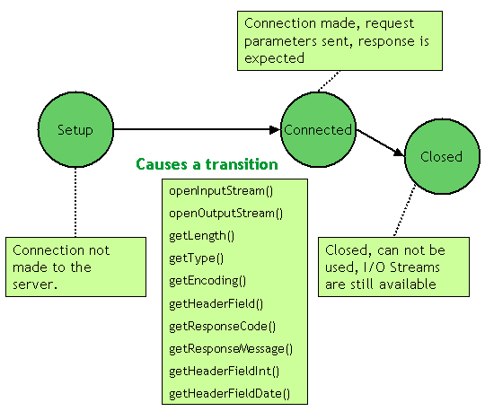
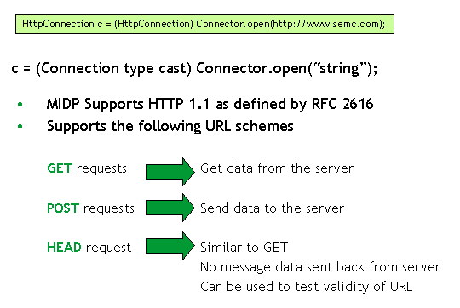
HTTP Connections
The MIDP profile supports HTTP version 1.1 connections via the HttpConnection interface. The GET, POST, and HEAD schemes of HTTP are supported.

Slide 34

Parameters
For GET, parameters are encoded and tacked on to the end of the URL
  http://www.jonathanknudsen.com/simple?user=jonathan&zip=08540
With POST, parameters are sent as the content part of the request
  The same encoding is used

Slide 35
Performing a GET
It’s amazingly simple:
    String url = "http://www.jonathanknudsen.com/simple";
    InputConnection ic = (InputConnection)Connector.open(url);
    InputStream in = ic.openInputStream();
    // Now read stuff from the InputStream.
    // Remember to clean up.
    ic.close();
Remember to catch IOExceptions

Slide 36
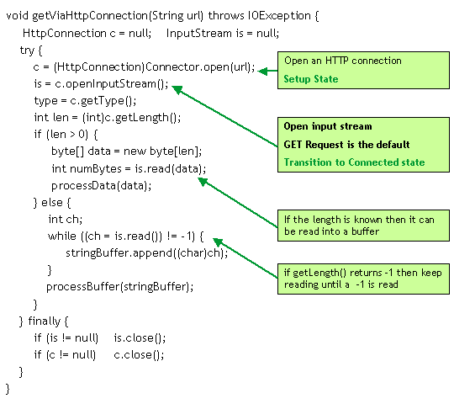
GET Example

Slide 37
POSTing a Form
It’s a little more complicated than GET
You need HttpConnection methods
Change the request method with setRequestMethod()
Tell the server the length of your parameters (“Content-Length”) with setRequestProperty()
Send the parameters in the output stream of the connection of the connection
See Jargoneer.java

Slide 38
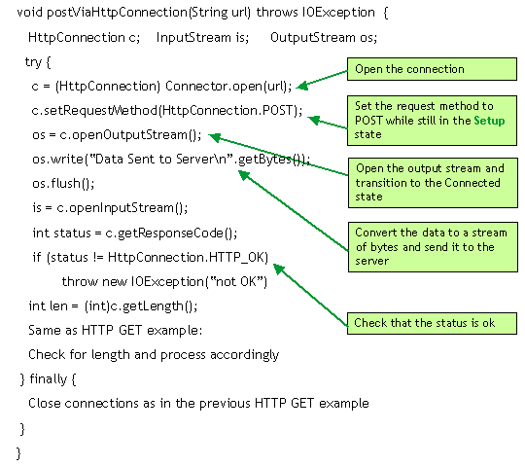
POST Example

Slide 39
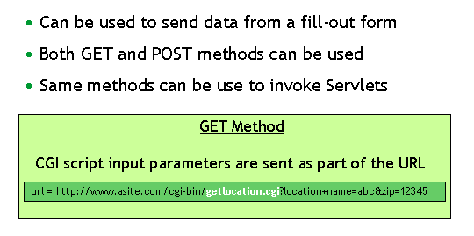
Invoking a CGI Script
Both the GET and POST methods can be used to invoke a CGI (Common Gateway Interface) scripts and supply input data

Slide 40
Design Tips
Use GET instead of POST
Don’t hard-code URLs
Network access should go in its own thread
Handle exceptions gracefully
Clean up

Slide 41
Differences between J2ME and J2SE Networking
There's no MIDP java.net package as there is in J2SE.
MIDP java.io package only supports a subset of the familiar J2SE byte- and character-oriented input and output stream classes.
The following application-level facilities are missing from the MIDP:
  RMI requires too much processing for mobile devices to support at this time.
  Jini requires RMI; therefore, it's not present.
  JavaSpaces doesn't exist in J2ME.
  CORBA middleware doesn't exist in J2ME.

