Slide 1
Cloud computing Assignment 2
Lecturer: Nguyen Ngoc Tu
Student : Phung Ngoc Tan

Slide 2
Problems
ATN is a Vietnamese company which is selling toys to teenagers in many provinces all over Vietnam. The company has the revenue over 500.000 dollars/year. Currently each shop has its own database to store transactions for that shop only. Each shop has to send the sale data to the board director monthly and the board director need lots of time to summarize the data collected from all the shops. Besides the board can’t see the stock information update in real time.

Slide 3
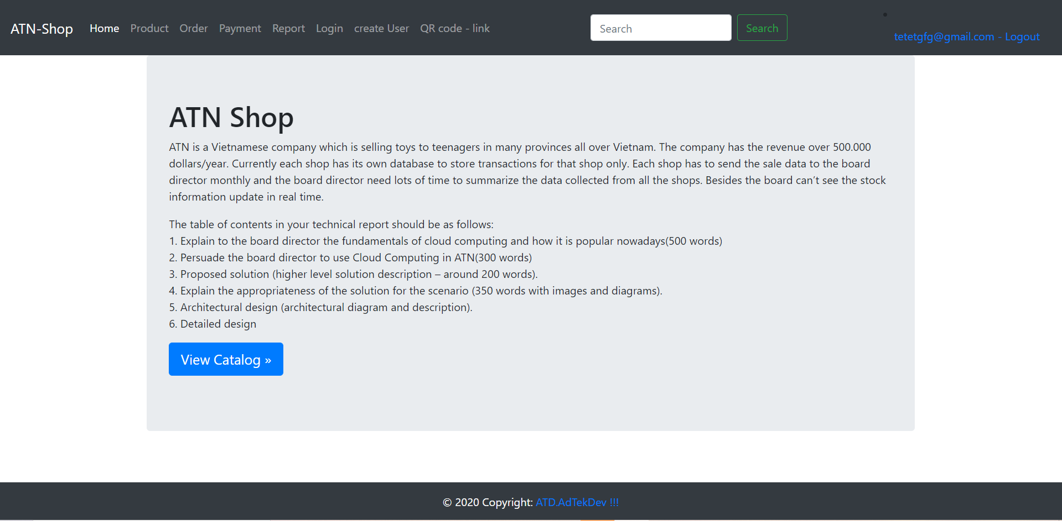
Website 1- The homepage

Slide 4
source code
<!DOCTYPE html>
<html lang="en">
<head>
<meta charset="utf-8">
<title> ATN-Shop Home page </title>
<meta name="viewport" content="width=device-width, initial-scale=1, shrink-to-fit=no">
<meta name="description" content="">
<link rel="stylesheet" href="https://cdn.jsdelivr.net/npm/bootstrap@4.5.3/dist/css/bootstrap.min.css" integrity="sha384-TX8t27EcRE3e/ihU7zmQxVncDAy5uIKz4rEkgIXeMed4M0jlfIDPvg6uqKI2xXr2" crossorigin="anonymous">
<script src="https://ajax.googleapis.com/ajax/libs/jquery/3.5.1/jquery.min.js"></script>
<script src="https://cdn.jsdelivr.net/npm/bootstrap@4.5.3/dist/js/bootstrap.bundle.min.js" integrity="sha384-ho+j7jyWK8fNQe+A12Hb8AhRq26LrZ/JpcUGGOn+Y7RsweNrtN/tE3MoK7ZeZDyx" crossorigin="anonymous"></script>
<link rel="canonical" href="https://getbootstrap.com/docs/3.4/examples/navbar-fixed-top/">
<link href="/vendors/fontawesome/css/all.css" rel="stylesheet">
<style>
footer {
position: fixed;
left: 0;
bottom: 0;
width: 100%;
background-color:#343a40;
color: white;
text-align: center;
}
</style>
</head>
<body>
<header>
<nav class="navbar navbar-expand-lg navbar-dark bg-dark">
<a class="navbar-brand" href="#">ATN-Shop</a>
<button class="navbar-toggler" type="button" data-toggle="collapse" data-target="#navbarSupportedContent" aria-controls="navbarSupportedContent" aria-expanded="false" aria-label="Toggle navigation">
<span class="navbar-toggler-icon"></span>
</button>
<div class="collapse navbar-collapse" id="navbarSupportedContent">
<ul class="navbar-nav mr-auto">
<li class="nav-item
active ">
<a class="nav-link" href="/">Home</a>
</li>
<li class="nav-item ">
<a class="nav-link" href="/product">Product</a>
</li>
<li class="nav-item ">
<a class="nav-link" href="/order">Order</a>
</li>
<li class="nav-item ">
<a class="nav-link" href="/payment">Payment</a>
</li>
<li class="nav-item ">
<a class="nav-link" href="/report">Report</a>
</li>
<li class="nav-item ">
<a class="nav-link" href="/login">Login</a>
</li>
<li class="nav-item ">
<a class="nav-link" href="/user/create">create User</a>
</li>
<li class="nav-item ">
<a class="nav-link" href="/qr">QR code - link</a>
</li>
</ul>
<form class="form-inline my-2 my-lg-0">
<input class="form-control mr-sm-2" type="search" placeholder="Search" aria-label="Search">
<button class="btn btn-outline-success my-2 my-sm-0" type="submit">Search</button>
</form>
<ul class="navbar-nav mr-auto"></ul>
<li class="nav-item">
<a class="nav-link" href="/logout"> hheirhewjkrhwek@gmail.com - Logout</a>
</li>
</ul>
</div>
</nav>
</header>
<main>
<div class="container" >
<div class="jumbotron">
<h1>ATN Shop</h1>
<p>ATN is a Vietnamese company which is selling toys to teenagers in many provinces all over Vietnam. The company has the revenue over 500.000 dollars/year. Currently each shop has its own database to store transactions for that shop only. Each shop has to send the sale data to the board director monthly and the board director need lots of time to summarize the data collected from all the shops. Besides the board can’t see the stock information update in real time.</p>
<p>The table of contents in your technical report should be as follows:
<BR>1. Explain to the board director the fundamentals of cloud computing and how it is popular nowadays(500 words)
<BR>2. Persuade the board director to use Cloud Computing in ATN(300 words)
<BR>3. Proposed solution (higher level solution description – around 200 words).
<BR>4. Explain the appropriateness of the solution for the scenario (350 words with images and diagrams).
<BR>5. Architectural design (architectural diagram and description).
<BR>6. Detailed design
</p>
<p>
<a class="btn btn-lg btn-primary" href="/product" role="button">View Catalog »</a>
</p>
</div>
</div>
</main>
<!-- Footer -->
<footer class="navbar-fixed-bottom">
<!-- Copyright -->
<div class="footer-copyright text-center py-3">© 2020 Copyright:
<a href="/"> ATD.AdTekDev !!! </a>
</div>
<!-- Copyright -->
</footer>
<!-- Footer -->
</body>
</html>

Slide 5
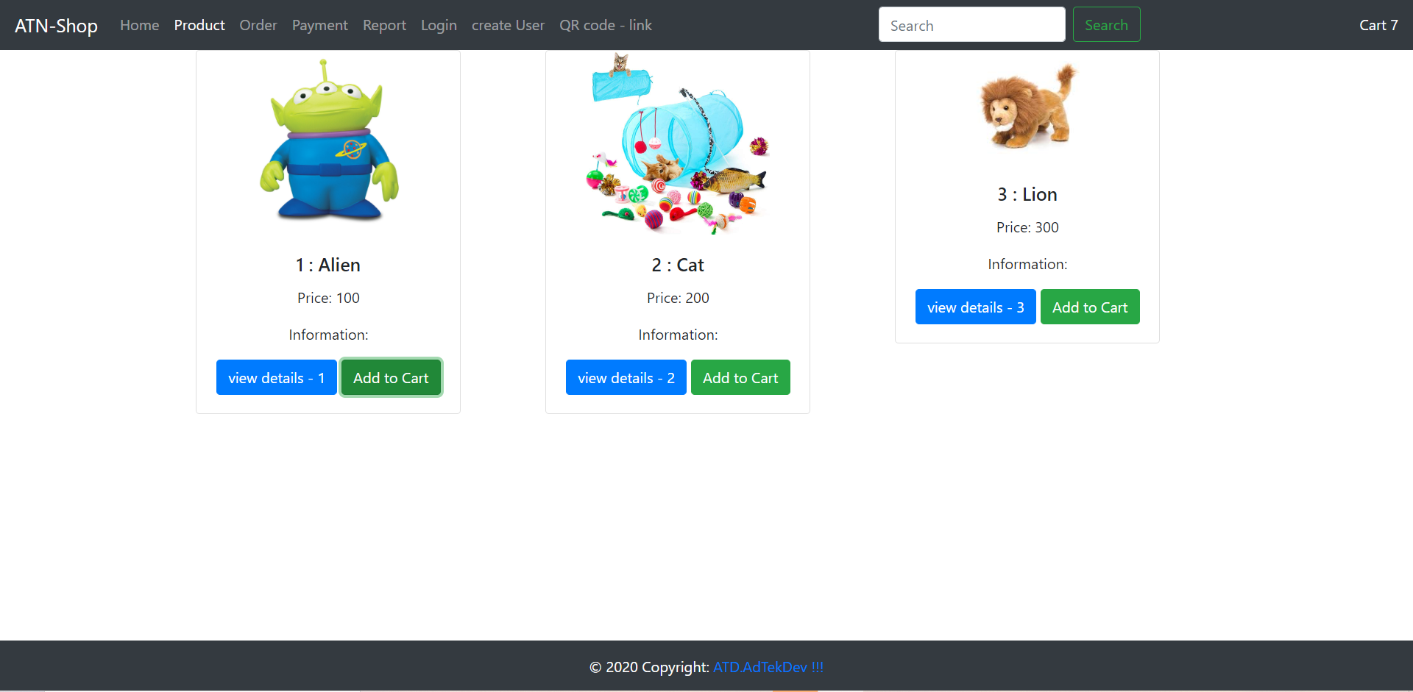
Product page

Slide 6
source code 2
<!DOCTYPE html>
<html lang="en">
<head>
<meta charset="utf-8">
<title> ATN-Shop PRODUCT page </title>
<meta name="viewport" content="width=device-width, initial-scale=1, shrink-to-fit=no">
<meta name="description" content="">
<link rel="stylesheet" href="https://cdn.jsdelivr.net/npm/bootstrap@4.5.3/dist/css/bootstrap.min.css" integrity="sha384-TX8t27EcRE3e/ihU7zmQxVncDAy5uIKz4rEkgIXeMed4M0jlfIDPvg6uqKI2xXr2" crossorigin="anonymous">
<script src="https://ajax.googleapis.com/ajax/libs/jquery/3.5.1/jquery.min.js"></script>
<script src="https://cdn.jsdelivr.net/npm/bootstrap@4.5.3/dist/js/bootstrap.bundle.min.js" integrity="sha384-ho+j7jyWK8fNQe+A12Hb8AhRq26LrZ/JpcUGGOn+Y7RsweNrtN/tE3MoK7ZeZDyx" crossorigin="anonymous"></script>
<link rel="canonical" href="https://getbootstrap.com/docs/3.4/examples/navbar-fixed-top/">
<link href="/vendors/fontawesome/css/all.css" rel="stylesheet">
<style>
footer {
position: fixed;
left: 0;
bottom: 0;
width: 100%;
background-color:#343a40;
color: white;
text-align: center;
}
</style>
</head>
<body>
<header>
<nav class="navbar navbar-expand-lg navbar-dark bg-dark">
<a class="navbar-brand" href="#">ATN-Shop</a>
<button class="navbar-toggler" type="button" data-toggle="collapse" data-target="#navbarSupportedContent" aria-controls="navbarSupportedContent" aria-expanded="false" aria-label="Toggle navigation">
<span class="navbar-toggler-icon"></span>
</button>
<div class="collapse navbar-collapse" id="navbarSupportedContent">
<ul class="navbar-nav mr-auto">
<li class="nav-item ">
<a class="nav-link" href="/">Home</a>
</li>
<li class="nav-item
active ">
<a class="nav-link" href="/product">Product</a>
</li>
<li class="nav-item ">
<a class="nav-link" href="/order">Order</a>
</li>
<li class="nav-item ">
<a class="nav-link" href="/payment">Payment</a>
</li>
<li class="nav-item ">
<a class="nav-link" href="/report">Report</a>
</li>
<li class="nav-item ">
<a class="nav-link" href="/login">Login</a>
</li>
<li class="nav-item ">
<a class="nav-link" href="/user/create">create User</a>
</li>
<li class="nav-item ">
<a class="nav-link" href="/qr">QR code - link</a>
</li>
</ul>
<form class="form-inline my-2 my-lg-0">
<input class="form-control mr-sm-2" type="search" placeholder="Search" aria-label="Search">
<button class="btn btn-outline-success my-2 my-sm-0" type="submit">Search</button>
</form>
<ul class="navbar-nav mr-auto"></ul>
</ul>
<span style="color:white;">
<i class="fas fa-shopping-cart"></i>
Cart
<span id="numberItems"></span>
</span>
</div>
</nav>
</header>
<main>
<div class="container" style="text-align: center;" >
<div class="row">
<div class="col-sm-4">
<div class="card" style="width: 18rem; ">
<div>
<img class="card-img-top center" style="max-width:200px;max-height:200px;" src="/images/1.jpg" alt="Card image cap">
</div>
<div class="card-body">
<h5 class="card-title">1 : Alien</h5>
<p class="card-text">Price: 100 </p>
<p class="card-text">Information: </p>
<a href="/product/1" class="btn btn-primary">view details - 1</a>
<button type="submit" class="btn btn-success" onclick="add_to_cart('1' , 'Alien', '100')"><i class="fas fa-shopping-cart"></i> Add to Cart</button>
</div>
</div>
</div>
<div class="col-sm-4">
<div class="card" style="width: 18rem; ">
<div>
<img class="card-img-top center" style="max-width:200px;max-height:200px;" src="/images/2.jpg" alt="Card image cap">
</div>
<div class="card-body">
<h5 class="card-title">2 : Cat</h5>
<p class="card-text">Price: 200 </p>
<p class="card-text">Information: </p>
<a href="/product/2" class="btn btn-primary">view details - 2</a>
<button type="submit" class="btn btn-success" onclick="add_to_cart('2' , 'Cat', '200')"><i class="fas fa-shopping-cart"></i> Add to Cart</button>
</div>
</div>
</div>
<div class="col-sm-4">
<div class="card" style="width: 18rem; ">
<div>
<img class="card-img-top center" style="max-width:200px;max-height:200px;" src="/images/3.jpg" alt="Card image cap">
</div>
<div class="card-body">
<h5 class="card-title">3 : Lion</h5>
<p class="card-text">Price: 300 </p>
<p class="card-text">Information: </p>
<a href="/product/3" class="btn btn-primary">view details - 3</a>
<button type="submit" class="btn btn-success" onclick="add_to_cart('3' , 'Lion', '300')"><i class="fas fa-shopping-cart"></i> Add to Cart</button>
</div>
</div>
</div>
</div>
</div>
</main>
<!-- Footer -->
<footer class="navbar-fixed-bottom">
<!-- Copyright -->
<div class="footer-copyright text-center py-3">© 2020 Copyright:
<a href="/"> ATD.AdTekDev !!! </a>
</div>
<!-- Copyright -->
</footer>
<!-- Footer -->
</body>
<script>
function add_to_cart(iditem, nameitem, price) {
$.ajax({
type: 'get',
url: '/product/add_to_cart',
success: function(data) {
var sum = 0;
for(var key in data) {
sum += data[key].qty;
}
$("#numberItems").html(sum);
},
data: {id: iditem, name: nameitem, price: price}
})
/*
console.log(iditem);
console.log(nameitem);
if (iditem in itemlist) {
itemlist[iditem].number++;
} else {
itemlist[iditem] = {
id: iditem,
name: nameitem,
number: 1,
};
}
soluong++;
alert("Bạn mới thêm món hàng: \n" + iditem + " : \n" + nameitem
+ "\n Số lượng : \n" + itemlist[iditem].number);
///
var objCart = document.getElementById("numberItems");
objCart.textContent = "" + Object.keys(itemlist).length + " , " + soluong;
*/
/*
//var cartcookie = btoa(unescape(encodeURIComponent(JSON.stringify(itemlist))));
var cartcookie = JSON.stringify(itemlist);
console.log("\n\t\t Json - ", cartcookie);
cartcookie = encodeURIComponent(cartcookie);
console.log("\n\t\t encodeURIComponent - ", cartcookie);
cartcookie = unescape(cartcookie);
console.log("\n\t\t unescape - ", cartcookie);
cartcookie = btoa(cartcookie);
console.log("\n\t\t btoa - ", cartcookie);
///
document.cookie = "cart_itemlist=" + cartcookie + ";";
*/
}
</script>
</html>

Slide 7
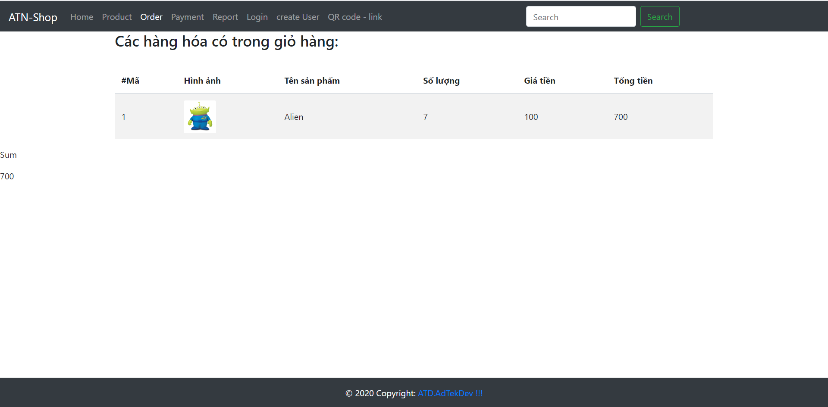
Order+payment page

Slide 8
Source code 3
<!DOCTYPE html>
<html lang="en">
<head>
<meta charset="utf-8">
<title> ATN-Shop ORDER page </title>
<meta name="viewport" content="width=device-width, initial-scale=1, shrink-to-fit=no">
<meta name="description" content="">
<link rel="stylesheet" href="https://cdn.jsdelivr.net/npm/bootstrap@4.5.3/dist/css/bootstrap.min.css" integrity="sha384-TX8t27EcRE3e/ihU7zmQxVncDAy5uIKz4rEkgIXeMed4M0jlfIDPvg6uqKI2xXr2" crossorigin="anonymous">
<script src="https://ajax.googleapis.com/ajax/libs/jquery/3.5.1/jquery.min.js"></script>
<script src="https://cdn.jsdelivr.net/npm/bootstrap@4.5.3/dist/js/bootstrap.bundle.min.js" integrity="sha384-ho+j7jyWK8fNQe+A12Hb8AhRq26LrZ/JpcUGGOn+Y7RsweNrtN/tE3MoK7ZeZDyx" crossorigin="anonymous"></script>
<link rel="canonical" href="https://getbootstrap.com/docs/3.4/examples/navbar-fixed-top/">
<link href="/vendors/fontawesome/css/all.css" rel="stylesheet">
<style>
footer {
position: fixed;
left: 0;
bottom: 0;
width: 100%;
background-color:#343a40;
color: white;
text-align: center;
}
</style>
</head>
<body>
<header>
<nav class="navbar navbar-expand-lg navbar-dark bg-dark">
<a class="navbar-brand" href="#">ATN-Shop</a>
<button class="navbar-toggler" type="button" data-toggle="collapse" data-target="#navbarSupportedContent" aria-controls="navbarSupportedContent" aria-expanded="false" aria-label="Toggle navigation">
<span class="navbar-toggler-icon"></span>
</button>
<div class="collapse navbar-collapse" id="navbarSupportedContent">
<ul class="navbar-nav mr-auto">
<li class="nav-item ">
<a class="nav-link" href="/">Home</a>
</li>
<li class="nav-item ">
<a class="nav-link" href="/product">Product</a>
</li>
<li class="nav-item
active ">
<a class="nav-link" href="/order">Order</a>
</li>
<li class="nav-item ">
<a class="nav-link" href="/payment">Payment</a>
</li>
<li class="nav-item ">
<a class="nav-link" href="/report">Report</a>
</li>
<li class="nav-item ">
<a class="nav-link" href="/login">Login</a>
</li>
<li class="nav-item ">
<a class="nav-link" href="/user/create">create User</a>
</li>
<li class="nav-item ">
<a class="nav-link" href="/qr">QR code - link</a>
</li>
</ul>
<form class="form-inline my-2 my-lg-0">
<input class="form-control mr-sm-2" type="search" placeholder="Search" aria-label="Search">
<button class="btn btn-outline-success my-2 my-sm-0" type="submit">Search</button>
</form>
<ul class="navbar-nav mr-auto"></ul>
</ul>
</div>
</nav>
</header>
<main>
<div class="container" >
<H3>Các hàng hóa có trong giỏ hàng:</H3>
<BR>
<div class="table-responsive-lg table-striped w-auto">
<table class="table table-striped table-hover">
<thead>
<tr>
<th>#Mã</th>
<th>Hình ảnh</th>
<th>Tên sản phẩm</th>
<th>Số lượng</th>
<th>Giá tiền</th>
<th>Tổng tiền</th>
</tr>
</thead>
<tbody>
<tr style="vertical-align:middle;align-items: center ;">
<td style="vertical-align:middle;align-items: center ;">1</td>
<td>
<img class="card-img-top center" style="max-width:60px;max-height:60px;" src="/images/1.jpg" alt="Card image cap">
</td>
<td style="vertical-align:middle;align-items: center ;">Alien</td>
<td style="vertical-align:middle;align-items: center ;">2</td>
<td style="vertical-align:middle;align-items: center ;">100</td>
<td style="vertical-align:middle;align-items: center ;">200</td>
</tr>
<tr style="vertical-align:middle;align-items: center ;">
<td style="vertical-align:middle;align-items: center ;">2</td>
<td>
<img class="card-img-top center" style="max-width:60px;max-height:60px;" src="/images/2.jpg" alt="Card image cap">
</td>
<td style="vertical-align:middle;align-items: center ;">Cat</td>
<td style="vertical-align:middle;align-items: center ;">1</td>
<td style="vertical-align:middle;align-items: center ;">200</td>
<td style="vertical-align:middle;align-items: center ;">200</td>
</tr>
<tr style="vertical-align:middle;align-items: center ;">
<td style="vertical-align:middle;align-items: center ;">3</td>
<td>
<img class="card-img-top center" style="max-width:60px;max-height:60px;" src="/images/3.jpg" alt="Card image cap">
</td>
<td style="vertical-align:middle;align-items: center ;">Lion</td>
<td style="vertical-align:middle;align-items: center ;">1</td>
<td style="vertical-align:middle;align-items: center ;">300</td>
<td style="vertical-align:middle;align-items: center ;">300</td>
</tr>
</tbody>
</table>
</div>
</div>
<div class="total">
<p> Sum </p>
700
</div>
</main>
<!-- Footer -->
<footer class="navbar-fixed-bottom">
<!-- Copyright -->
<div class="footer-copyright text-center py-3">© 2020 Copyright:
<a href="/"> ATD.AdTekDev !!! </a>
</div>
<!-- Copyright -->
</footer>
<!-- Footer -->
</body>
</html>

Slide 9
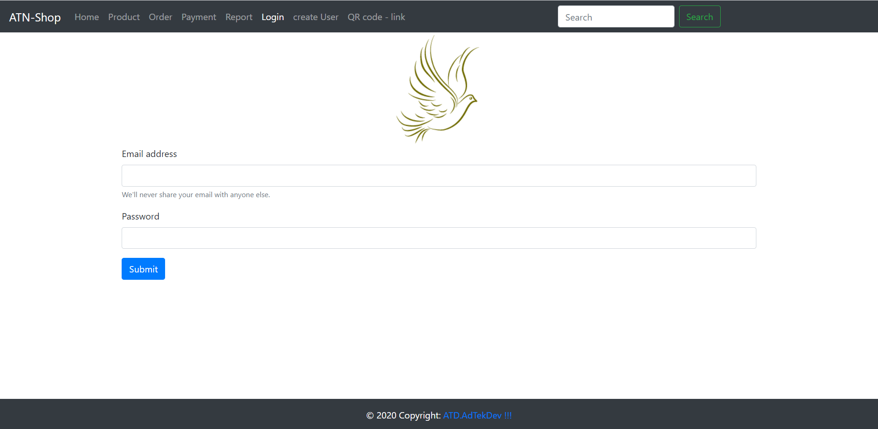
Login page

Slide 10
Source code
<!DOCTYPE html>
<html lang="en">
<head>
<meta charset="utf-8">
<title> ATN-Shop LOGIN page </title>
<meta name="viewport" content="width=device-width, initial-scale=1, shrink-to-fit=no">
<meta name="description" content="">
<link rel="stylesheet" href="https://cdn.jsdelivr.net/npm/bootstrap@4.5.3/dist/css/bootstrap.min.css" integrity="sha384-TX8t27EcRE3e/ihU7zmQxVncDAy5uIKz4rEkgIXeMed4M0jlfIDPvg6uqKI2xXr2" crossorigin="anonymous">
<script src="https://ajax.googleapis.com/ajax/libs/jquery/3.5.1/jquery.min.js"></script>
<script src="https://cdn.jsdelivr.net/npm/bootstrap@4.5.3/dist/js/bootstrap.bundle.min.js" integrity="sha384-ho+j7jyWK8fNQe+A12Hb8AhRq26LrZ/JpcUGGOn+Y7RsweNrtN/tE3MoK7ZeZDyx" crossorigin="anonymous"></script>
<link rel="canonical" href="https://getbootstrap.com/docs/3.4/examples/navbar-fixed-top/">
<link href="/vendors/fontawesome/css/all.css" rel="stylesheet">
<style>
footer {
position: fixed;
left: 0;
bottom: 0;
width: 100%;
background-color:#343a40;
color: white;
text-align: center;
}
</style>
</head>
<body>
<header>
<nav class="navbar navbar-expand-lg navbar-dark bg-dark">
<a class="navbar-brand" href="#">ATN-Shop</a>
<button class="navbar-toggler" type="button" data-toggle="collapse" data-target="#navbarSupportedContent" aria-controls="navbarSupportedContent" aria-expanded="false" aria-label="Toggle navigation">
<span class="navbar-toggler-icon"></span>
</button>
<div class="collapse navbar-collapse" id="navbarSupportedContent">
<ul class="navbar-nav mr-auto">
<li class="nav-item ">
<a class="nav-link" href="/">Home</a>
</li>
<li class="nav-item ">
<a class="nav-link" href="/product">Product</a>
</li>
<li class="nav-item ">
<a class="nav-link" href="/order">Order</a>
</li>
<li class="nav-item ">
<a class="nav-link" href="/payment">Payment</a>
</li>
<li class="nav-item ">
<a class="nav-link" href="/report">Report</a>
</li>
<li class="nav-item
active ">
<a class="nav-link" href="/login">Login</a>
</li>
<li class="nav-item ">
<a class="nav-link" href="/user/create">create User</a>
</li>
<li class="nav-item ">
<a class="nav-link" href="/qr">QR code - link</a>
</li>
</ul>
<form class="form-inline my-2 my-lg-0">
<input class="form-control mr-sm-2" type="search" placeholder="Search" aria-label="Search">
<button class="btn btn-outline-success my-2 my-sm-0" type="submit">Search</button>
</form>
<ul class="navbar-nav mr-auto"></ul>
</ul>
</div>
</nav>
</header>
<main>
<div class="container" >
<div style="text-align: center;" >
<img src="/images/bird.png" />
<audio controls autoplay loop hidden="true">
<source src="/audio/clsmusic.mp3" type="audio/mpeg">
</audio>
</div>
<form action="" method="GET">
<div class="form-group">
<label for="username">Email address</label>
<input type="email" class="form-control" id="username" name="username" aria-describedby="emailHelp">
<small id="emailHelp" class="form-text text-muted">We'll never share your email with anyone else.</small>
</div>
<div class="form-group">
<label for="password">Password</label>
<input type="password" class="form-control" id="password" name="password">
</div>
<button type="submit" class="btn btn-primary">Submit</button>
</form>
</div>
</main>
<!-- Footer -->
<footer class="navbar-fixed-bottom">
<!-- Copyright -->
<div class="footer-copyright text-center py-3">© 2020 Copyright:
<a href="/"> ATD.AdTekDev !!! </a>
</div>
<!-- Copyright -->
</footer>
<!-- Footer -->
</body>
</html>

Slide 11
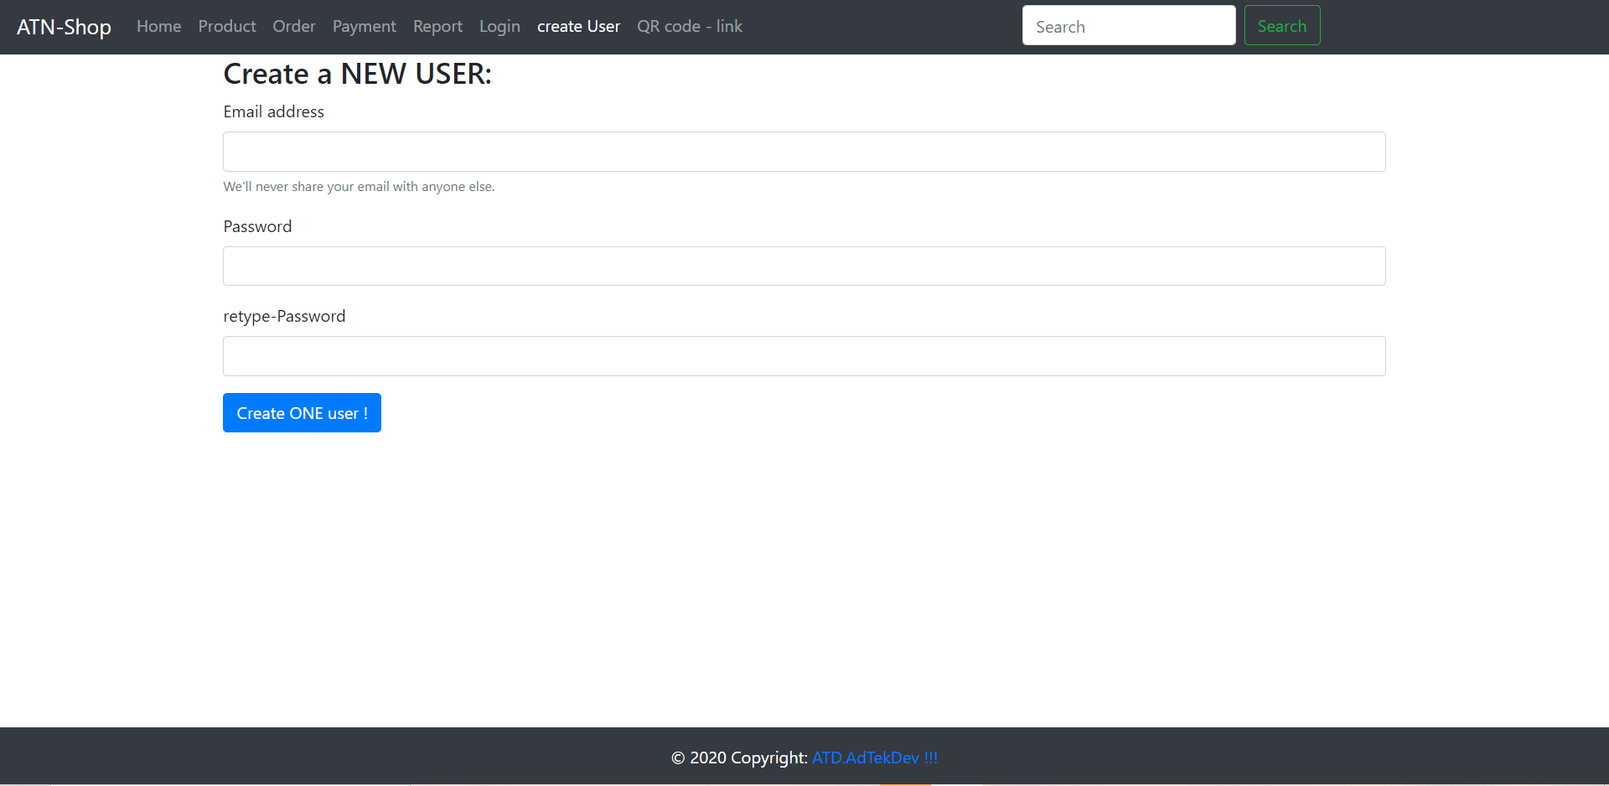
Create use page

Slide 12
Source code
<!DOCTYPE html>
<html lang="en">
<head>
<meta charset="utf-8">
<title> ATN-Shop create USER page </title>
<meta name="viewport" content="width=device-width, initial-scale=1, shrink-to-fit=no">
<meta name="description" content="">
<link rel="stylesheet" href="https://cdn.jsdelivr.net/npm/bootstrap@4.5.3/dist/css/bootstrap.min.css" integrity="sha384-TX8t27EcRE3e/ihU7zmQxVncDAy5uIKz4rEkgIXeMed4M0jlfIDPvg6uqKI2xXr2" crossorigin="anonymous">
<script src="https://ajax.googleapis.com/ajax/libs/jquery/3.5.1/jquery.min.js"></script>
<script src="https://cdn.jsdelivr.net/npm/bootstrap@4.5.3/dist/js/bootstrap.bundle.min.js" integrity="sha384-ho+j7jyWK8fNQe+A12Hb8AhRq26LrZ/JpcUGGOn+Y7RsweNrtN/tE3MoK7ZeZDyx" crossorigin="anonymous"></script>
<link rel="canonical" href="https://getbootstrap.com/docs/3.4/examples/navbar-fixed-top/">
<link href="/vendors/fontawesome/css/all.css" rel="stylesheet">
<style>
footer {
position: fixed;
left: 0;
bottom: 0;
width: 100%;
background-color:#343a40;
color: white;
text-align: center;
}
</style>
</head>
<body>
<header>
<nav class="navbar navbar-expand-lg navbar-dark bg-dark">
<a class="navbar-brand" href="#">ATN-Shop</a>
<button class="navbar-toggler" type="button" data-toggle="collapse" data-target="#navbarSupportedContent" aria-controls="navbarSupportedContent" aria-expanded="false" aria-label="Toggle navigation">
<span class="navbar-toggler-icon"></span>
</button>
<div class="collapse navbar-collapse" id="navbarSupportedContent">
<ul class="navbar-nav mr-auto">
<li class="nav-item ">
<a class="nav-link" href="/">Home</a>
</li>
<li class="nav-item ">
<a class="nav-link" href="/product">Product</a>
</li>
<li class="nav-item ">
<a class="nav-link" href="/order">Order</a>
</li>
<li class="nav-item ">
<a class="nav-link" href="/payment">Payment</a>
</li>
<li class="nav-item ">
<a class="nav-link" href="/report">Report</a>
</li>
<li class="nav-item ">
<a class="nav-link" href="/login">Login</a>
</li>
<li class="nav-item
active ">
<a class="nav-link" href="/user/create">create User</a>
</li>
<li class="nav-item ">
<a class="nav-link" href="/qr">QR code - link</a>
</li>
</ul>
<form class="form-inline my-2 my-lg-0">
<input class="form-control mr-sm-2" type="search" placeholder="Search" aria-label="Search">
<button class="btn btn-outline-success my-2 my-sm-0" type="submit">Search</button>
</form>
<ul class="navbar-nav mr-auto"></ul>
</ul>
</div>
</nav>
</header>
<main>
<div class="container" >
<div style="text-align: center;" >
<audio controls autoplay loop hidden="true">
<source src="/audio/clsmusic.mp3" type="audio/mpeg">
</audio>
</div>
<H3> Create a NEW USER: </H3>
<form action="/user/create" method="GET">
<div class="form-group">
<label for="username">Email address</label>
<input type="email" class="form-control" id="username" name="username" aria-describedby="emailHelp">
<small id="emailHelp" class="form-text text-muted">We'll never share your email with anyone else.</small>
</div>
<div class="form-group">
<label for="password">Password</label>
<input type="password" class="form-control" id="password" name="password">
</div>
<div class="form-group">
<label for="repassword">retype-Password</label>
<input type="password" class="form-control" id="repassword" name="repassword">
</div>
<button type="submit" class="btn btn-primary">Create ONE user !</button>
</form>
</div>
</main>
<notify>
<div class="container" >
</div>
</notify>
<!-- Footer -->
<footer class="navbar-fixed-bottom">
<!-- Copyright -->
<div class="footer-copyright text-center py-3">© 2020 Copyright:
<a href="/"> ATD.AdTekDev !!! </a>
</div>
<!-- Copyright -->
</footer>
<!-- Footer -->
</body>
</html>

Slide 13
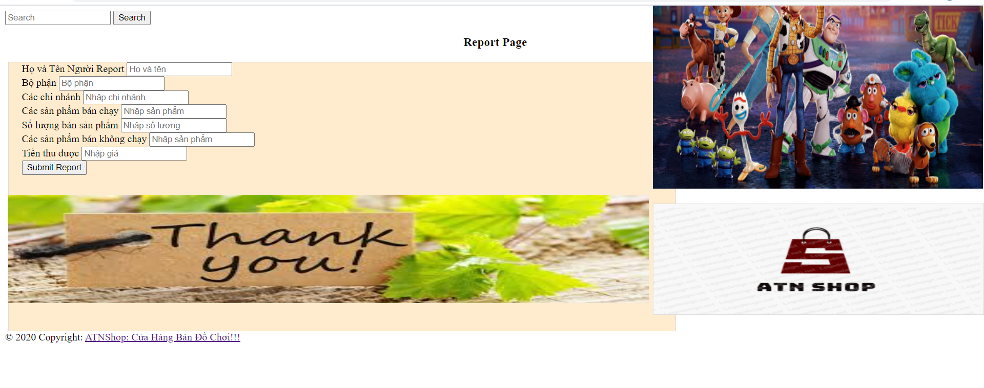
Report page

Slide 14
Source code
!DOCTYPE html>
<html lang="en">
<head>
</ul>
<form class="form-inline my-2 my-lg-0">
<input class="form-control mr-sm-2" type="search" placeholder="Search" aria-label="Search">
<button class="btn btn-outline-success my-2 my-sm-0" type="submit">Search</button>
</form>
<ul class="navbar-nav mr-auto"></ul>
</ul>
</div>
</nav>
</header>
<main>
<h3 style="text-align: center;margin-left: 10px;margin-top: 10px;">Report Page</h3>
<form action="" method="GET" style="background-color: blanchedalmond;padding-bottom:20px;padding-right:20px;padding-left:20px;width: 1000px;height: 400px;border: 1px solid gainsboro;margin-top: 20px;margin-left: 5px;">
<div class="form-row">
<div class="form-group col-md-6">
<label for="inputEmail4">Họ và Tên Người Report</label>
<input placeholder="Họ và tên" class="form-control" id="inputEmail4" type="text" name="fullname">
</div>
<div class="form-group col-md-6">
<label for="bophan">Bộ phận</label>
<input placeholder="Bộ phận" type="text" name="bophan" class="form-control">
</div>
</div>
<div class="form-group">
<label for="inputAddress">Các chi nhánh</label>
<input placeholder="Nhập chi nhánh" type="text" name="chinhanh" class="form-control">
</div>
<div class="form-group">
<label for="inputAddress2">Các sản phẩm bán chạy</label>
<input placeholder="Nhập sản phẩm" name="sanphambanchay" class="form-control" id="inputAddress2">
</div>
<div class="form-row">
<div class="form-group col-md-4">
<label for="inputCity">Số lượng bán sản phẩm</label>
<input placeholder="Nhập số lượng" type="number" name="soluong" class="form-control">
</div>
<div class="form-group col-md-6">
<label for="inputState">Các sản phẩm bán không chạy</label>
<input placeholder="Nhập sản phẩm" type="text" name="sanphambankhongchay" class="form-control">
</div>
<div class="form-group col-md-2">
<label for="inputZip">Tiền thu được</label>
<input placeholder="Nhập giá" type="number" name="total" class="form-control">
</div>
</div>
<button type='submit'><a style="text-decoration: none;" name="all">Submit Report</a></button>
<img style="height: 400px;;width: 515px;margin-left: 985px;margin-top: -378px;" src="https://lh3.googleusercontent.com/proxy/CDiAR0EqN6F23s6DuXFVuZGqHa4Og75siQEPWW3BcFqa_POUCBTRmI6hRbKA9oEdtezmgQukwTBL7qg3ybawQUoZlZjLUQWQiWjkkiPfVz6ZIEPloBwK5Q" alt="photo">
<img style="margin-top: 5px;margin-left: -21px;width: 1000px;height: 170px;" src="https://anhdep123.com/wp-content/uploads/2020/05/%E1%BA%A3nh-c%E1%BA%A3m-%C6%A1n.jpg" alt="photo">
<img style="border: 1px solid gainsboro;margin-top: -200px;margin-left: 985px;height: 173px;width: 515px;" src="https://scontent.xx.fbcdn.net/v/t1.15752-9/122217012_263628948410275_7530321273644394189_n.png?_nc_cat=107&ccb=2&_nc_sid=ae9488&_nc_ohc=NCxFqDm3N5QAX_IaVv0&_nc_ad=z-m&_nc_cid=0&_nc_ht=scontent.xx&oh=4090d4b2d50b8a472640dd85bae1685b&oe=5FB9AB1F" alt="photo">
</div>
</form>
</main>
<!-- Footer -->
<footer class="navbar-fixed-bottom">
<!-- Copyright -->
<div class="footer-copyright text-center py-3">© 2020 Copyright:
<a href="/"> ATNShop: Cửa Hàng Bán Đồ Chơi!!! </a>
</div>
<!-- Copyright -->
</footer>
<!-- Footer -->
</body>
</html>

Slide 15
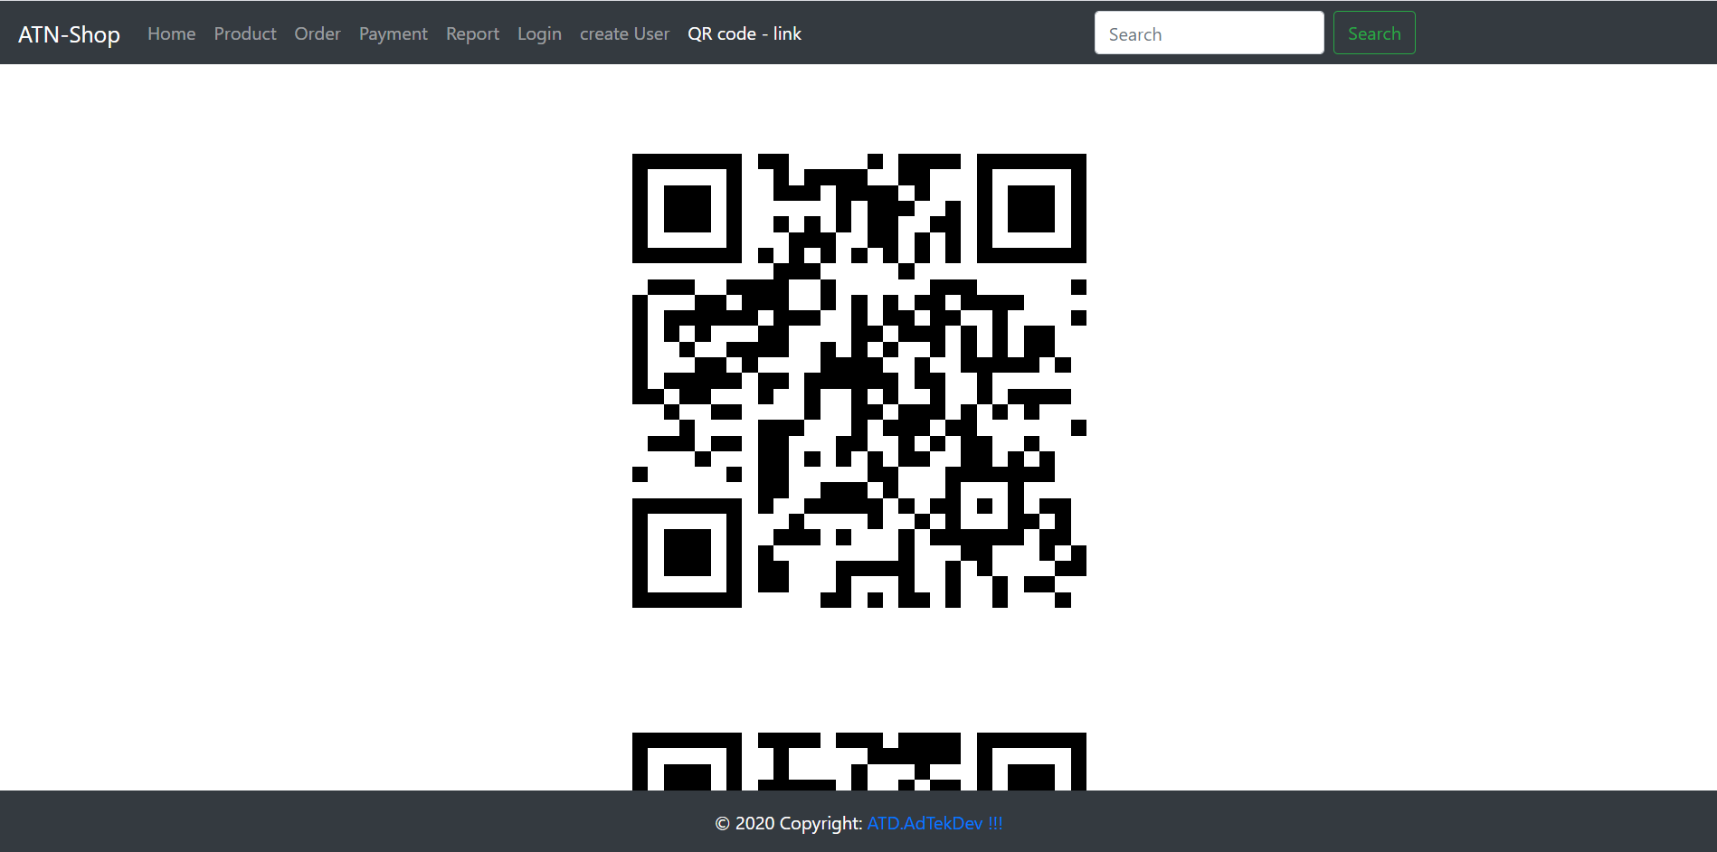
QR page

Slide 16
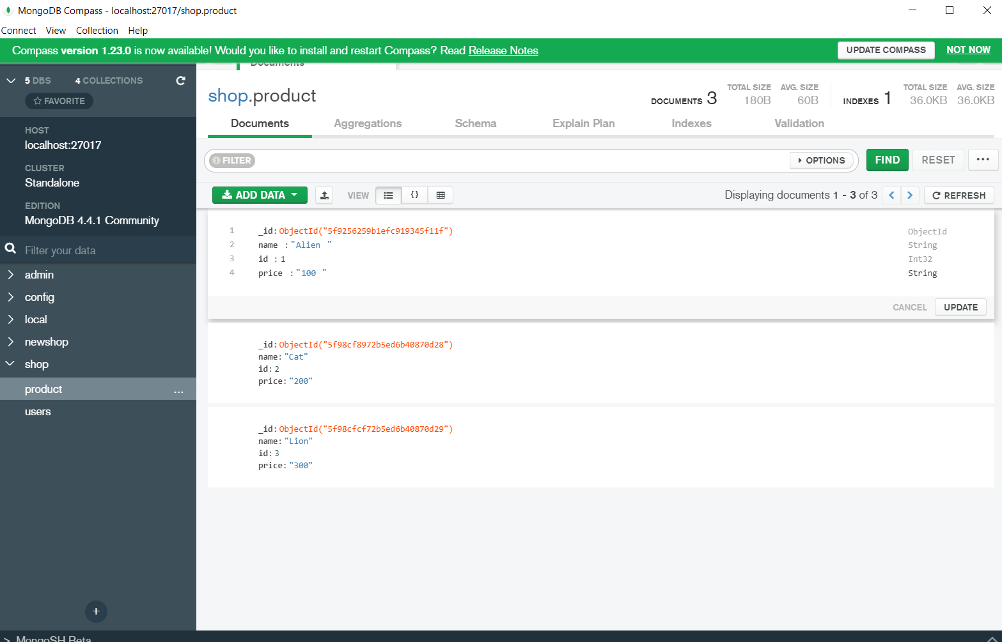
Database Mongo DB

Slide 17
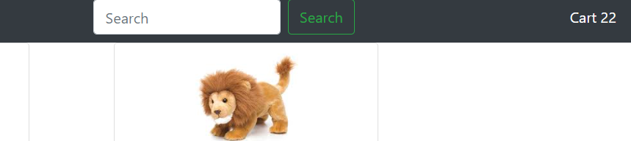
Demo
From the front page i can visit the product page by tap to the product bar
Everytine you click add to cart, the cart will update and they number values will be shown

Slide 18
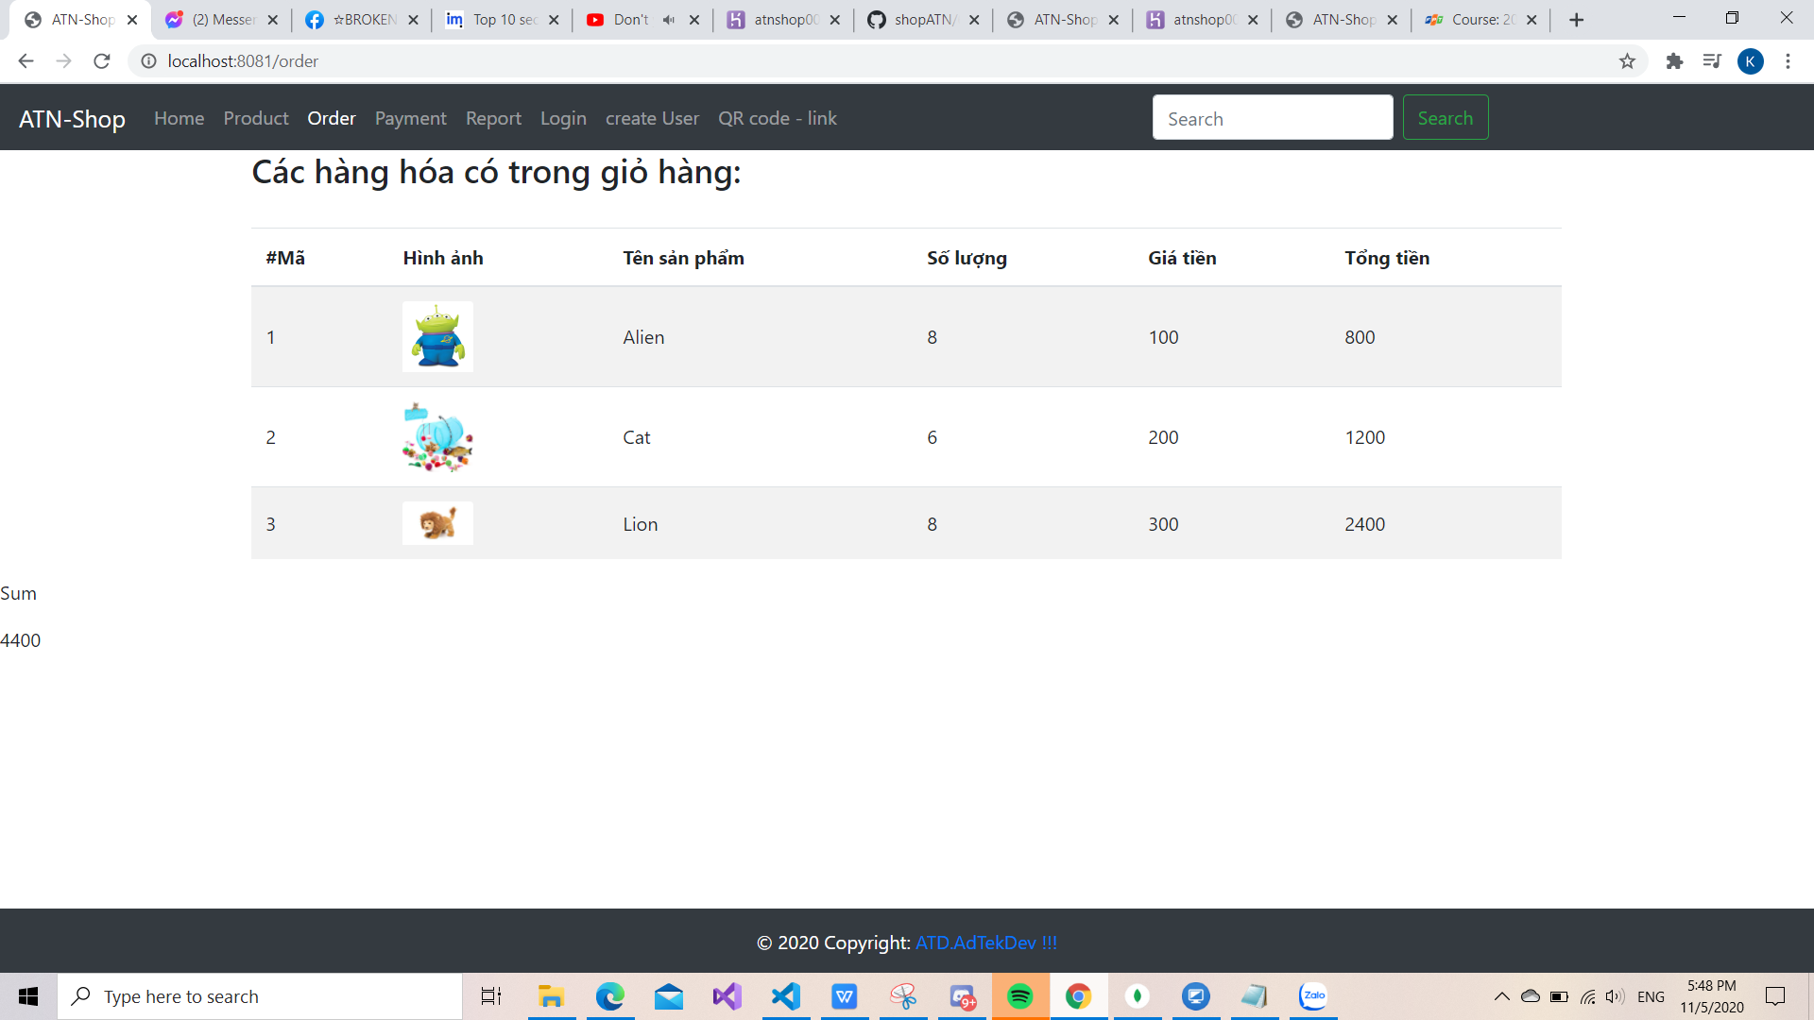
Demo
The money of each item and the total bill can be calcualted by using a reduce func
<p> Sum </p>
<%=Object.keys(itemlist).reduce((acc, curr) => acc + Number.parseInt(itemlist[curr].total),0)%>
</div>

Slide 19
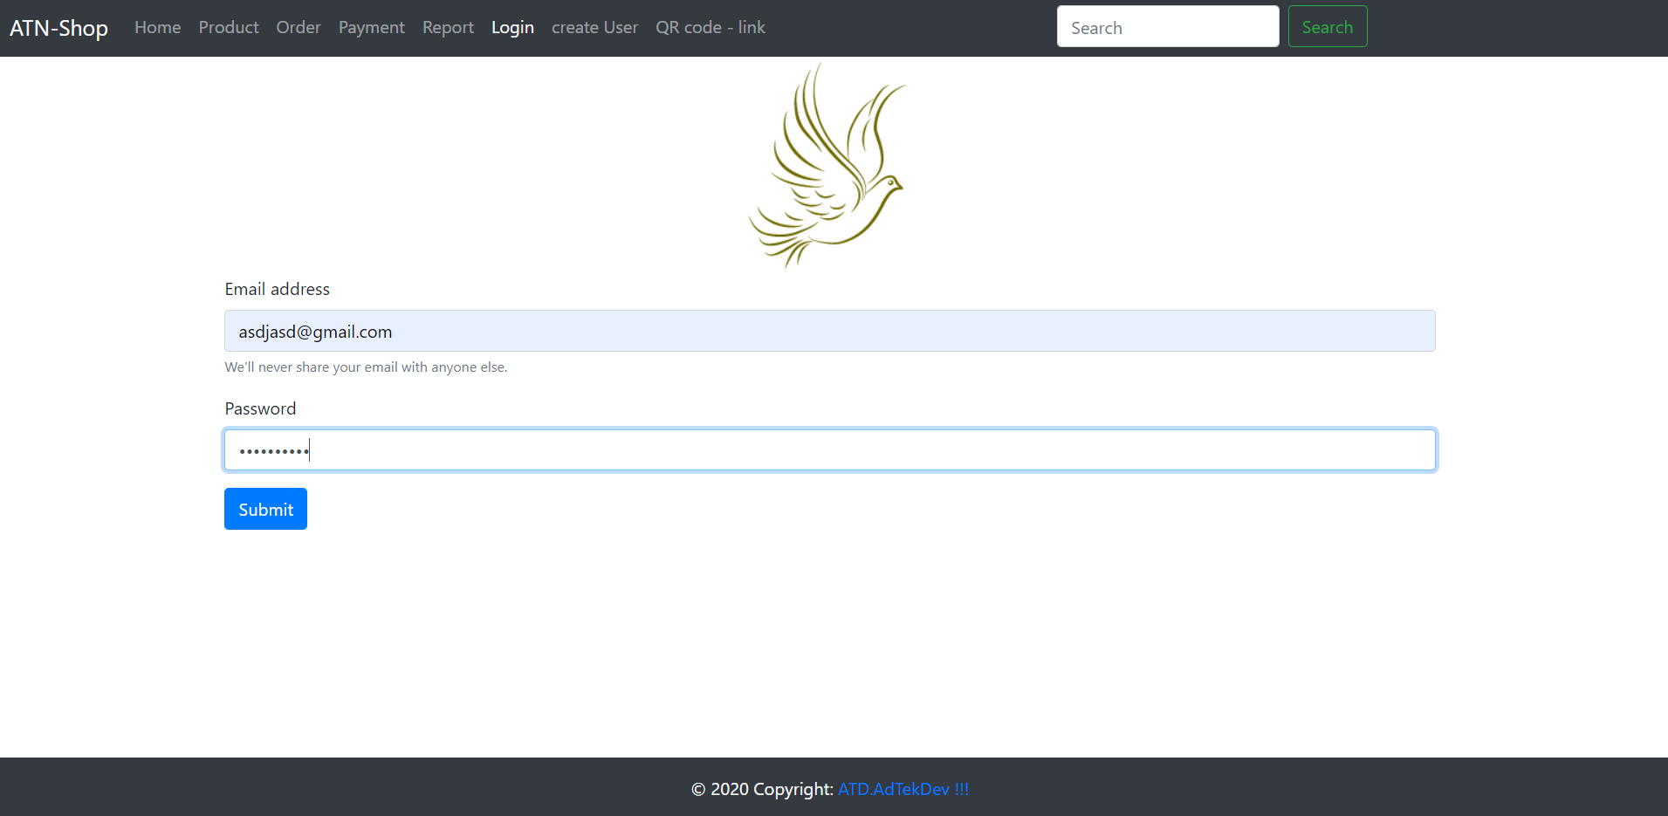
the login page demo
the login page can be demo if you enter the correct format
If you forgot the @, it wont let you into

Slide 20
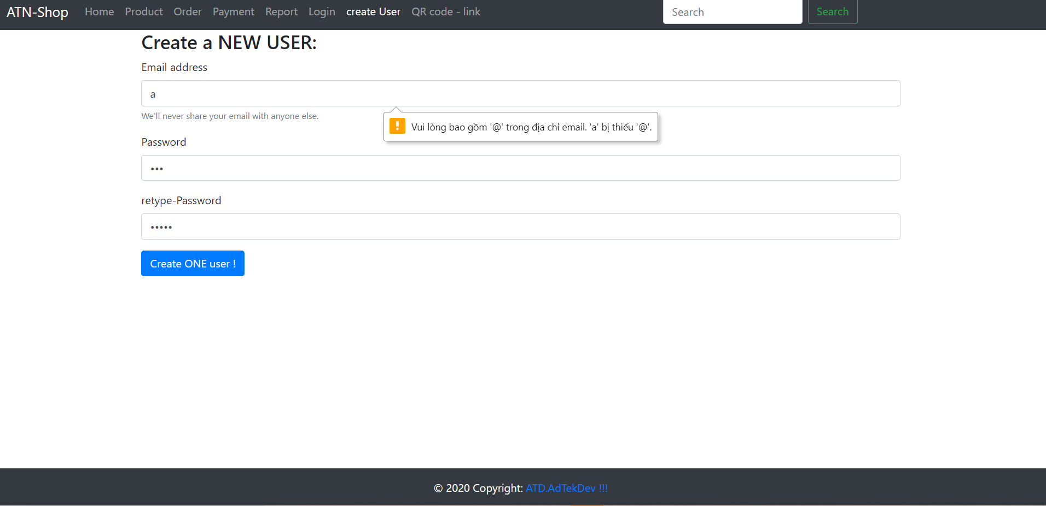
Demo create user
Same with log in , it only accpet the one with the @, the picture next by show ifu dont have the right format

Slide 21
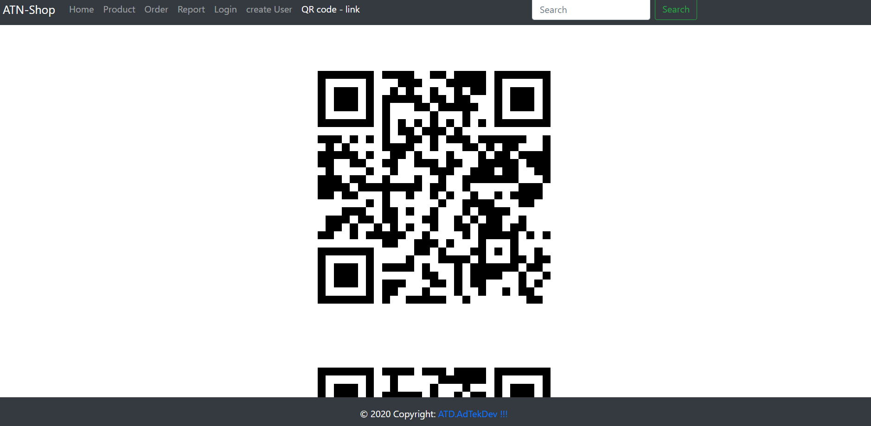
Throughout QR code you can get to my site

Slide 22
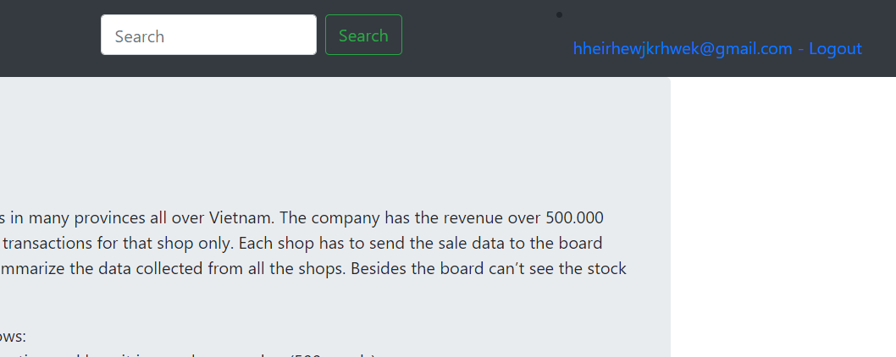
Click to log out it will archive to the front page and log out from this account

Slide 23
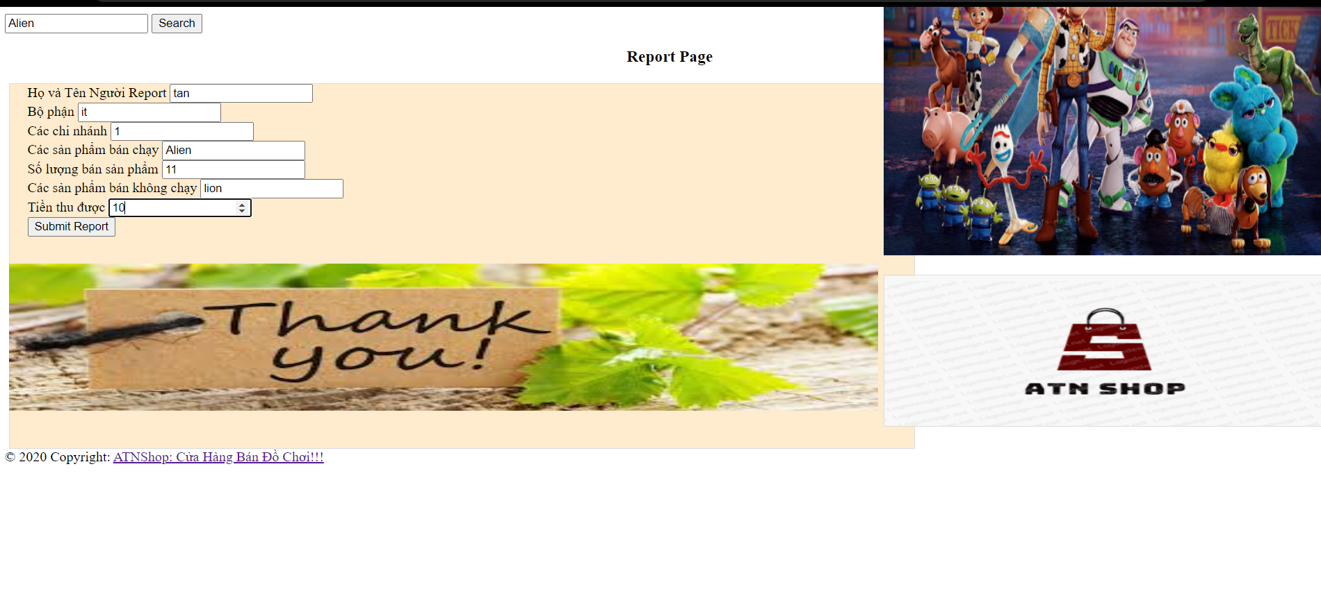
Report page demo, click to the footer inorder to return to the front page

Slide 24
Heroku link
https://atnshop00001.herokuapp.com/

Slide 25
Github link
https://github.com/phungngoctan11/shopATN

