Slide 1



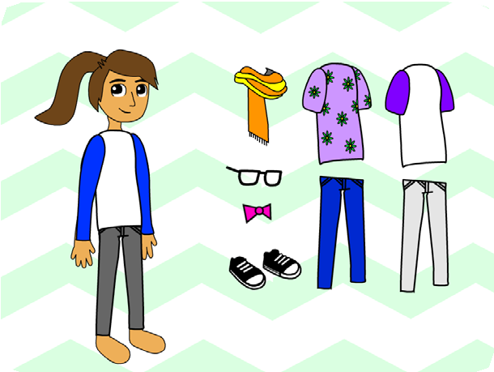
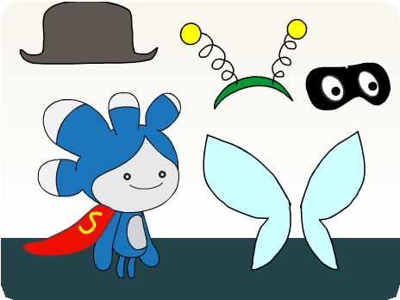
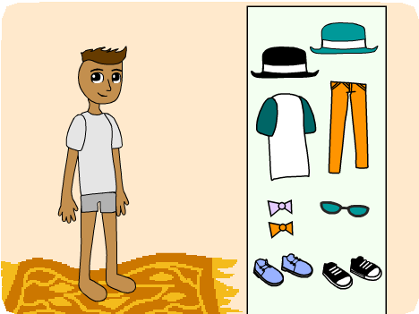
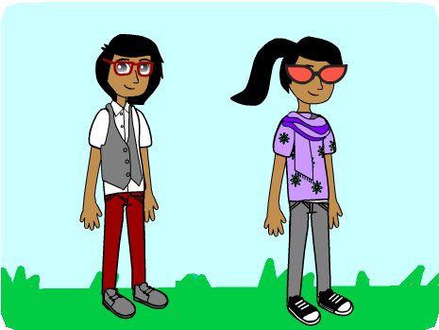
FASHION GAME / EDUCATOR GUIDE
FASHION GAME / EDUCATOR GUIDE
EDUCATOR GUIDE
Fashion Game
With this guide, you can plan and lead a one-hour workshop using Scratch.
Participants will gain experience with coding as they design a fashion game.
Workshop Overview
Here’s a suggested agenda for a one-hour workshop:
First, gather as a group to introduce the theme and spark ideas.
IMAGINE
10 minutes
Next, help participants as they create their fashion games, working at their own pace.
CREATE
40 minutes
At the end of the session, gather together to share and reflect.
SHARE
10 minutes
1
SCRATCH EDUCATOR GUIDE • scratch.mit.edu/go
2

Slide 2
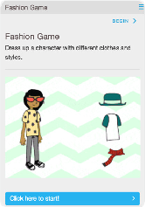
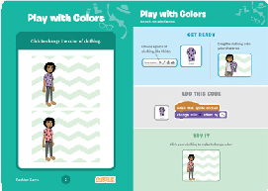
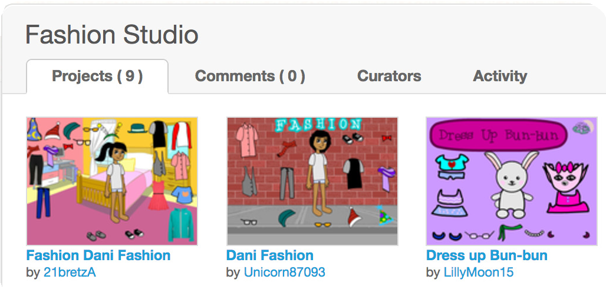
FASHION GAME / EDUCATOR GUIDE
FASHION GAME / EDUCATOR GUIDE
Get Ready for the Workshop
Use this checklist to prepare for the workshop.
Imagine
IMAGINE
Begin by gathering the participants to introduce the theme and spark ideas for projects.
Preview the Tutorial
The Fashion Game tutorial shows participants how to create their own projects. Preview the tutorial before your workshop and try the first few steps:
scratch.mit.edu/fashion
Warm-up Activity: Draw a Hat
Give the participants a minute or two to sketch an imaginary hat with paper and pen. It could be a fashion statement, silly party hat, or a useful invention. When would you wear it? Have the participants show their hats to their neighbors.
Print the Activity Cards
Print a few sets of Fashion Game cards to have available for participants during the workshop. scratch.mit.edu/fashion/cards
Provide Ideas and Inspiration
Show some example Fashion Game projects to spark ideas. You can find some in the Fashion Studio on the Scratch website.
Make sure participants have Scratch accounts
Participants can sign up for their own Scratch accounts at scratch.mit.edu, or you can set up student accounts if you have a Teacher Account. To request a Teacher Account, go to: scratch.mit.edu/educators
Set up computers or laptops
Arrange computers so that participants can work individually or in pairs.
Set up a computer with projector or large monitor
You can use a projector to show examples and demonstrate how to get started.
View the studio at: scratch.mit.edu/studios/1424746
3
SCRATCH EDUCATOR GUIDE • scratch.mit.edu/go
4

Slide 3
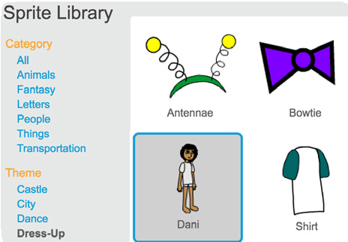


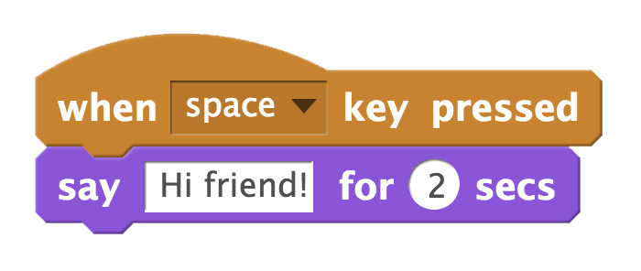
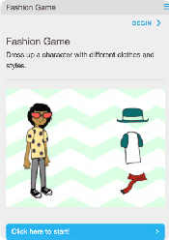
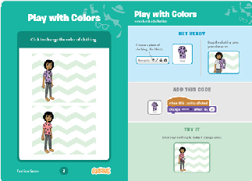
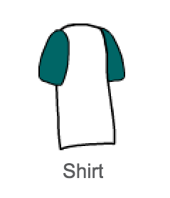
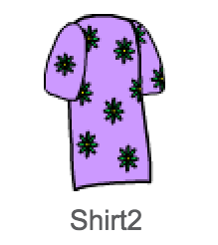

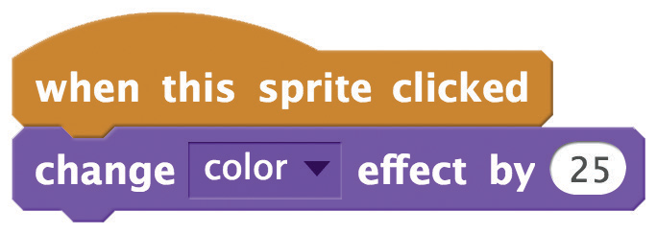
FASHION GAME / EDUCATOR GUIDE
FASHION GAME / EDUCATOR GUIDE
Demonstrate the First Steps
Create
IMAGINE
CREATE
Demonstrate the first few steps of the tutorial so participants can see how to get started.
Support participants as they design projects with a set of clothes to dress up a character.
In Scratch, click Create.
Choose Dani from the Sprite Library:
Start with Prompts
Ask participants questions to get started
What colors do you want the clothes to be?
What clothing item will you add first?
Provide Resources
Offer options for getting started
Tell Dani to say something:
Add an item of clothing:
Some participants may want to follow the online tutorial: scratch.mit.edu/fashion
Others may want to explore using the activity cards: scratch.mit.edu/fashion/cards
Make the clothing change colors when you click it:
Suggest Ideas for Starting
Pick Dani or another character
Say something
Pick an item of clothing
Change the clothing’s style
Add more clothes
Choose a backdrop
5
SCRATCH EDUCATOR GUIDE • scratch.mit.edu/go
6

Slide 4
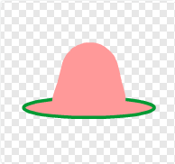
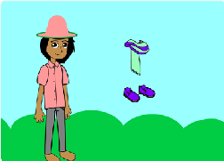
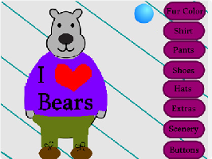
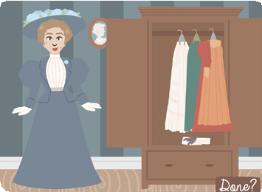
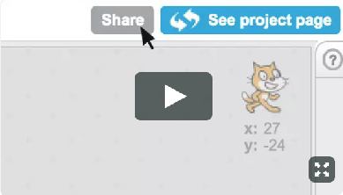
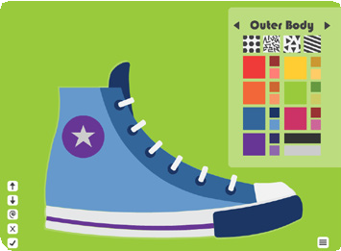
FASHION GAME / EDUCATOR GUIDE
FASHION GAME / EDUCATOR GUIDE
Share
CREATE
SHARE
More Things to Try
Have a virtual fashion show. Ask participants to share their fashion games with each other.
Make the clothes glide
into place.
Reset position of the clothes when you press the green flag.
Draw your own character or clothes.
Ask questions they can discuss:
What do you like best about the project you made?
What was the hardest part?
Support Personalization
If you had more time, what would you add or change?
Encourage participants to customize their projects based on their own personal style and interests. Every project will be different!
What’s Next?
Participants can use these ideas and concepts to create a variety of projects. Here are two variations on the fashion game project you could suggest:
What kind of character do you want to dress up? What is their style?
Historical Fashion
Research the fashion of a particular time and place in history and make a dress-up game based on that style. To find sample projects, search on Scratch for “historical fashion”.
Prepare to Share
To add instructions and credits to a project, click the button: “See project page”.
Design a Shoe
Instead of making a game based on an entire outfit, zoom in and make a game that lets you design a shoe, hat, necklace, t-shirt, or nail art.
This video shows how to share a project on the Scratch website: vimeo.com/llk/share
Scratch is a project of the Lifelong Kindergarten Group at the MIT Media Lab.
7
SCRATCH EDUCATOR GUIDE • scratch.mit.edu/go
8

