Slide 1


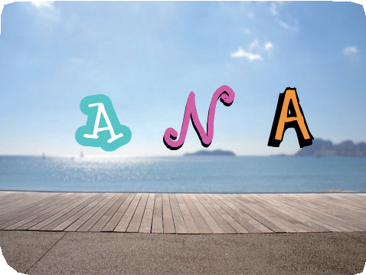


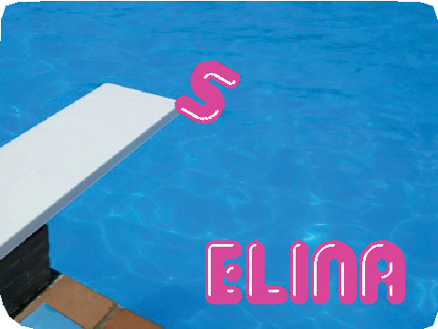

Animate Your Name Cards
Animate Your Name 1
Animate the letters of your name, initials, or favorite word.
scratch.mit.edu/name

Slide 2
Animate Your Name Cards
Animate Your Name 2
Try these cards in any order:
Color Clicker Spin
Play a Sound Dancing Letter Change Size Press a Key Glide Around
scratch.mit.edu/name

Slide 3




Color Clicker
Make a letter change color when you click it.
Animate Your Name
1

Slide 4


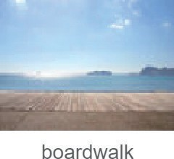


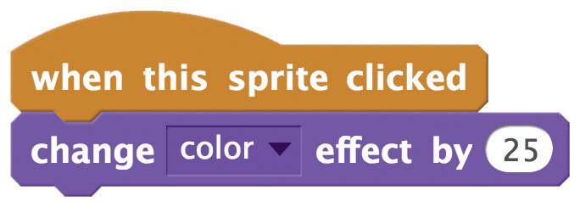

Color Clicker
scratch.mit.edu/name
GET READY
Choose a backdrop.
Choose a letter from the Letters category.
ADD THIS CODE
Try different numbers.
TRY IT
Click your letter.

Slide 5




Spin
Make a letter turn when you click it.
Animate Your Name
2

Slide 6


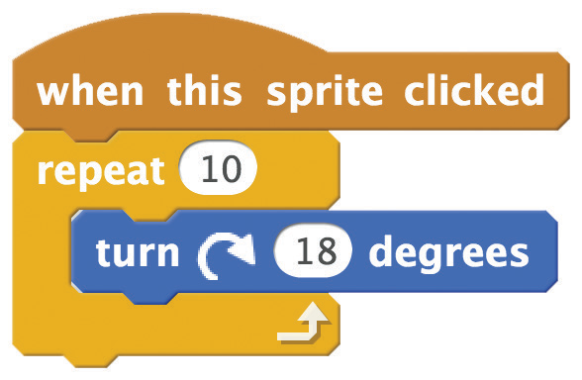


Spin
scratch.mit.edu/name
GET READY
Choose a letter from the Letters category.
ADD THIS CODE
Try different numbers.
TRY IT
Click your letter.
TIP
Click this block to reset the sprite’s direction.

Slide 7


Play a Sound
Click a letter to play a sound.
Animate Your Name
3

Slide 8






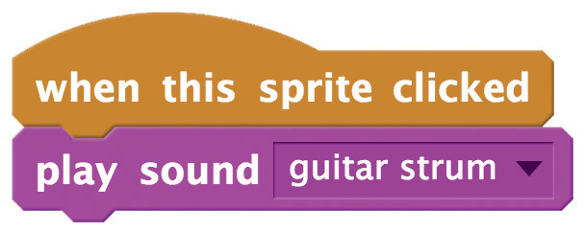
Play a Sound
scratch.mit.edu/name
GET READY
Choose a letter from the Letters category.
Choose a backdrop.
Click the
tab.
Choose a sound.
ADD THIS CODE
Click the tab.
TRY IT
Click your letter.

Slide 9
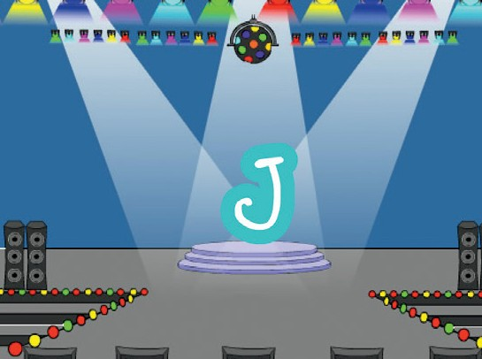
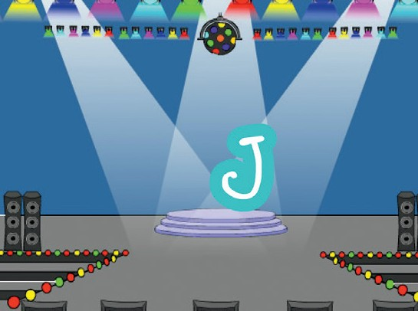

Dancing Letter
Make a letter move to the beat.
Animate Your Name
4

Slide 10



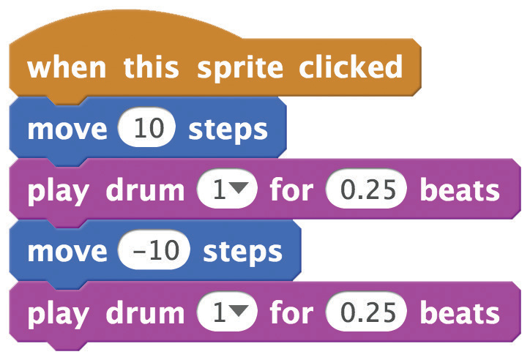
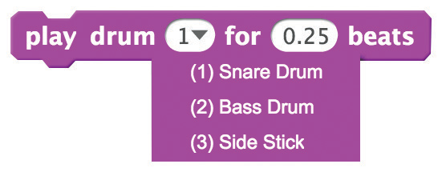
Dancing Letter
scratch.mit.edu/name
GET READY
Choose a letter from the Letters category.
Choose a backdrop.
ADD THIS CODE
Type a positive number
to move forward.
Type a negative number to move back.
TIP
You can choose any drum from the menu.

Slide 11
Change Size
Make a letter get bigger and then smaller.
Animate Your Name
5

Slide 12



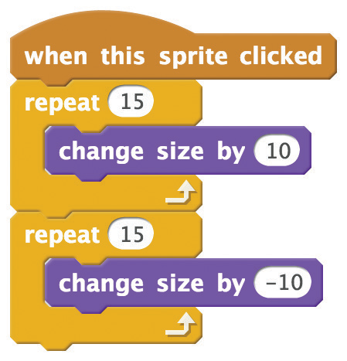

Change Size
scratch.mit.edu/name
GET READY
Choose a letter from the Letters category.
ADD THIS CODE
Type a positive number to get bigger.
Type a negative number
to get smaller.
TRY IT
Click your letter.
TIP
Click this block to reset the size.

Slide 13
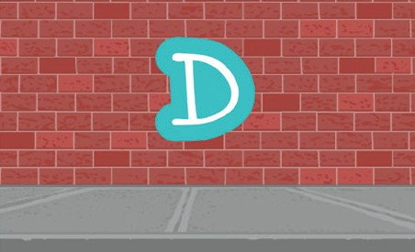
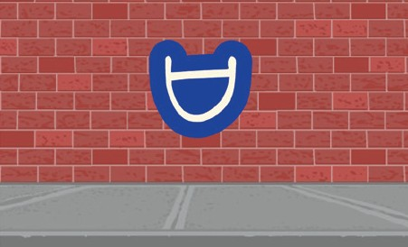
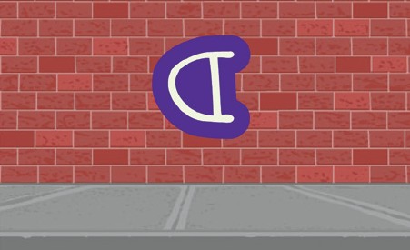

Press a Key
Press a key to make your letter change.
Animate Your Name
6

Slide 14

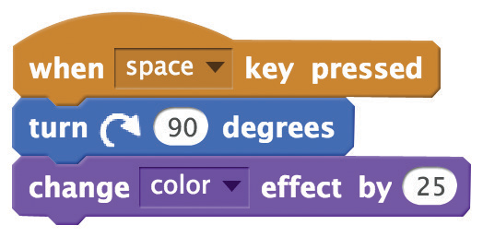
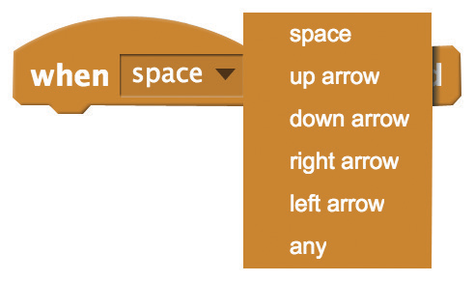
Press a Key
scratch.mit.edu/name
GET READY
Choose a letter from the Letters category.
Choose a backdrop.
ADD THIS CODE
Try different numbers.
TRY IT
Press the space key.
TIP
You can choose a different key from the menu. Then press that key!

Slide 15



Glide Around
Make a letter glide smoothly
from place to place.
Animate Your Name
7

Slide 16

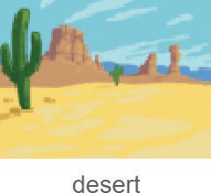

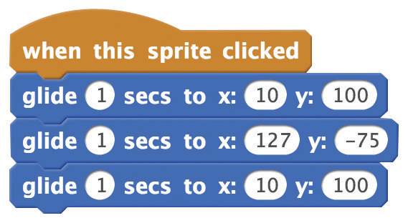
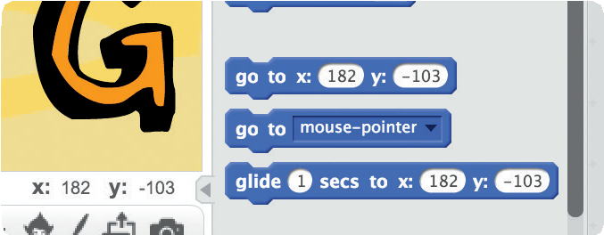
Glide Around
scratch.mit.edu/name
GET READY
Choose a letter from the Letters category.
Choose a backdrop.
ADD THIS CODE
Try different numbers.
TRY IT
Click your letter to start.
TIP
Drag your sprite to where you want it and
then add a glide block to your script.
When you drag a sprite,
its x and y position will update in the Blocks palette.

