Slide 1



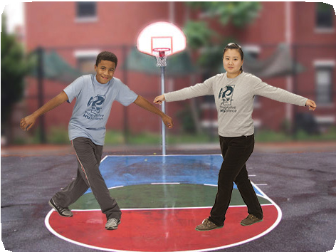
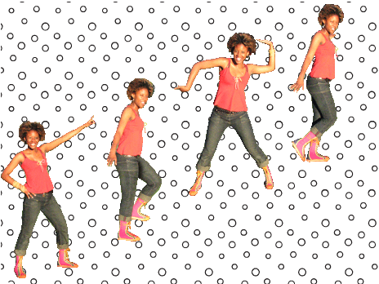
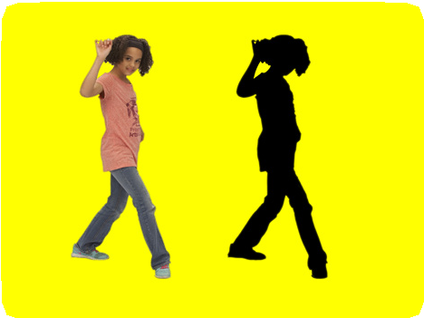
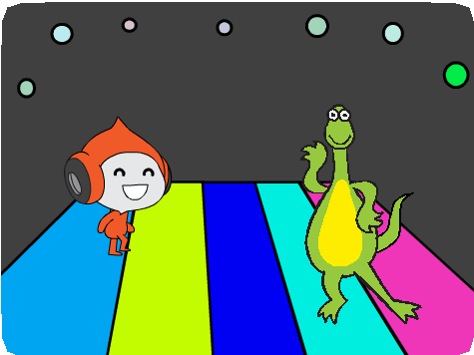
LET’S DANCE / EDUCATOR GUIDE
LET’S DANCE / EDUCATOR GUIDE
EDUCATOR GUIDE
Let’s Dance
Workshop Overview
Here’s a suggested agenda for a one-hour workshop:
With this guide, you can plan and lead a one-hour workshop using Scratch.
Participants will create an animated dance scene, combining music and dance moves.
First, gather as a group to introduce the theme and spark ideas.
IMAGINE
10 minutes
Next, help participants as they create dance projects, working at their own pace.
CREATE
40 minutes
At the end of the session, gather together to share and reflect.
SHARE
10 minutes
1
SCRATCH EDUCATOR GUIDE • scratch.mit.edu/go
2

Slide 2
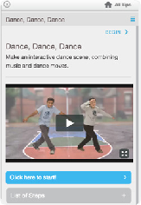
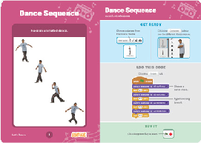
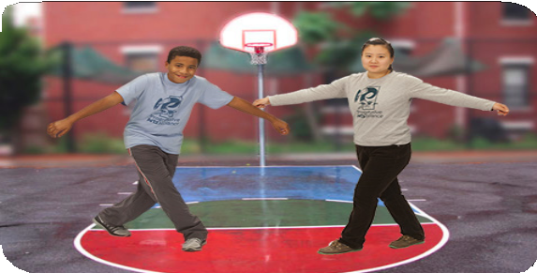
LET’S DANCE / EDUCATOR GUIDE
LET’S DANCE / EDUCATOR GUIDE
Get Ready for the Workshop
Imagine
IMAGINE
Use this checklist to prepare for the workshop.
Begin by gathering the participants to introduce the theme and spark ideas for projects.
Preview the Tutorial
The Let’s Dance tutorial shows participants how to create their own projects. Preview the tutorial before your workshop and try the first few steps:
scratch.mit.edu/dance
Warm-up Activity: Share a Dance Move
Put on music with a beat, and bring the group together in a circle. Do a dance move while you say your first name to the beat of the music. Then ask the group to copy what you did. Go around the circle taking turns, with each person saying their name and doing a move for others to repeat.
Print the Activity Cards
Print a few sets of Let’s Dance cards to have available for participants during the workshop. scratch.mit.edu/dance/cards
Spark Ideas and Inspiration
Show the introductory video for the Let’s Dance tutorial. The video shows a variety of projects for ideas and inspiration.
Make sure participants have Scratch accounts
Participants can sign up for their own Scratch accounts at scratch.mit.edu, or you can set up student accounts if you have a Teacher Account. To request a Teacher Account, go to: scratch.mit.edu/educators
Set up a studio for project sharing on Scratch
Set up a studio so participants will be able to add their projects. Go to your My Stuff page, then click the + New Studio button. Type in a name for the studio (such as ‘Our Dance Projects’).
Check sound on computers or laptops
Check to make sure that the sound output is working on the computers or laptops.
View at scratch.mit.edu/dance or vimeo.com/llk/dance
3
SCRATCH EDUCATOR GUIDE • scratch.mit.edu/go
4

Slide 3

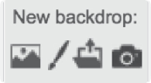
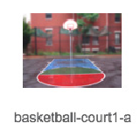

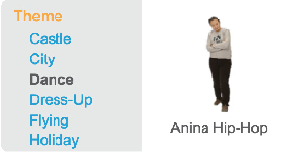

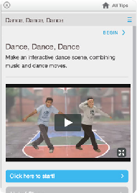
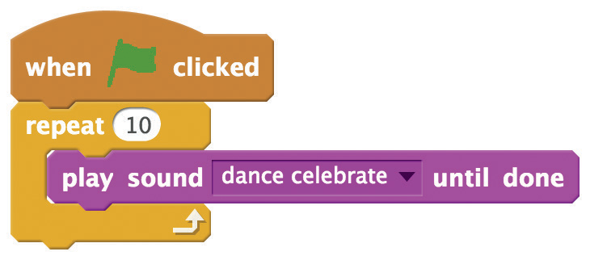
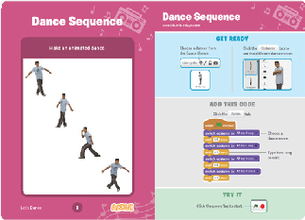
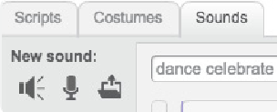
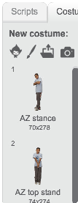
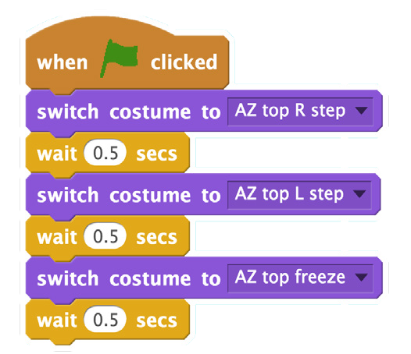
LET’S DANCE / EDUCATOR GUIDE
LET’S DANCE / EDUCATOR GUIDE
Demonstrate the First Steps
Create
Support participants as they make dance projects, on their own or in pairs.
IMAGINE
CREATE
Demonstrate the first few steps of the tutorial so participants can see how to get started.
Go to Scratch to create a new project. Choose a backdrop.
Add a dancer from the Sprite library.
Start with Prompts
Ask participants questions to get started
Which dancer will you choose?
Where will they dance?
Provide Resources
Offer options for getting started
Add music from the Sound library.
Code a dance sequence.
Some participants may want to follow the online tutorial: scratch.mit.edu/dance
Others may want to explore using the activity cards: scratch.mit.edu/dance/cards
Suggest Ideas for Starting
Choose a backdrop
Add a dancer
Add music
Choose dance moves by switching costumes
Code a dance sequence
5
SCRATCH EDUCATOR GUIDE • scratch.mit.edu/go
6

Slide 4
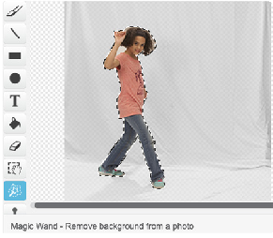

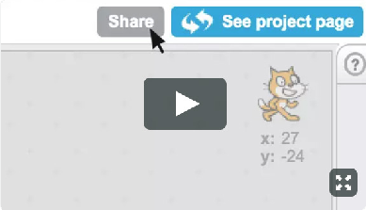
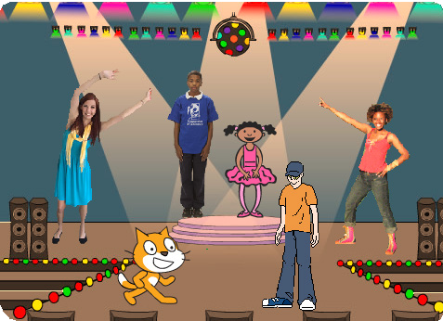
LET’S DANCE / EDUCATOR GUIDE
LET’S DANCE / EDUCATOR GUIDE
Share
Help the participants add their projects to a shared studio in Scratch. Give them a link to the studio. Then they can click ‘Add Projects’ at the bottom of the page.
CREATE
SHARE
More Things to Try
Add a repeat loop
Adjust the timing to sync the dance with the music
Add more dancers
Change backdrops
Add colors and effects
Ask for volunteers to show their project to the group. Everyone can dance along!
Add Your Own Dance Moves
If you have time, here’s a way to personalize your project:
Find a solid color wall that is well-lit
Take photos of yourself doing different dance moves
Import the photos as costumes into Scratch
Use the magic wand to remove the background, see http://bit.ly/scratchmagicwand
What’s Next?
Participants can use the ideas from this workshop to create a variety of dance projects. Here are a couple of different approaches:
Where Will you Dance?
Take a photograph of a park or other favorite place, import it into Scratch and use it as a backdrop for a dance animation.
Prepare to Share
To add instructions and credits to a project, click the button: “See project page”.
Pass It On: Dance Together
Give each person 5 minutes to start a dance project. Then, have them switch to the next computer and add a dancer.
Keep switching, adding a dancer to each. Then let participants return to see (and finish) the project they originally started.
This video shows how to share a project on the Scratch website: vimeo.com/llk/share
Scratch is a project of the Lifelong Kindergarten Group at the MIT Media Lab.
7
SCRATCH EDUCATOR GUIDE • scratch.mit.edu/go
8

