Slide 1



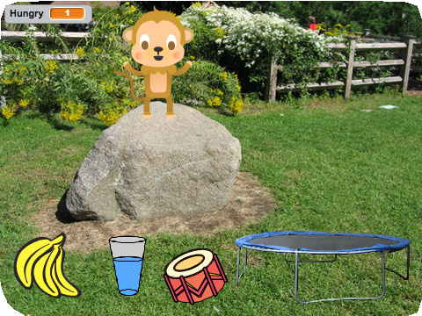
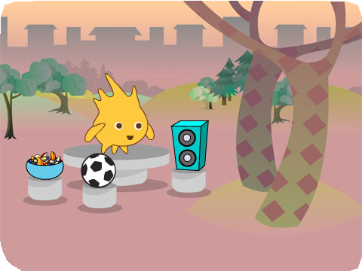
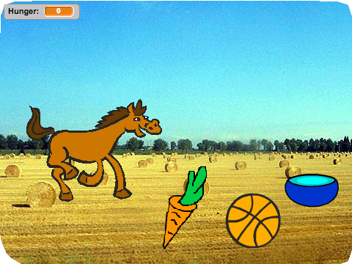
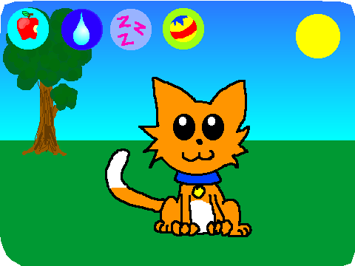
VIRTUAL PET / EDUCATOR GUIDE
VIRTUAL PET / EDUCATOR GUIDE
EDUCATOR GUIDE
Virtual Pet
Workshop Overview
Here’s a suggested agenda for a one-hour workshop:
With this guide, you can plan and lead a one-hour workshop using Scratch.
Participants will create an interactive pet that can eat, drink, and play!
First, gather as a group to introduce the theme and spark ideas.
IMAGINE
10 minutes
Next, help participants as they create interactive pets, working at their own pace.
CREATE
40 minutes
At the end of the session, gather together to share and reflect.
SHARE
10 minutes
session.
1
SCRATCH EDUCATOR GUIDE • scratch.mit.edu/go
2

Slide 2
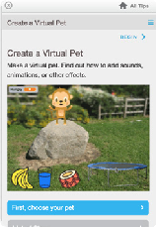
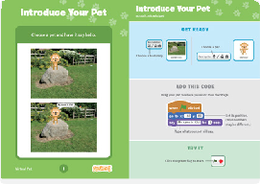
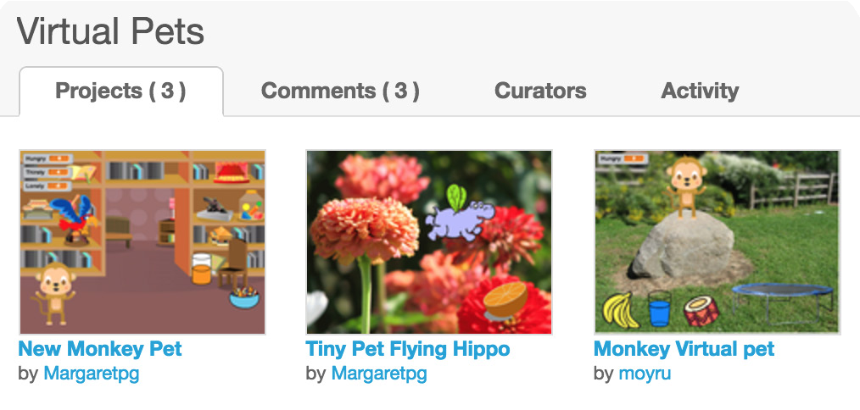
VIRTUAL PET / EDUCATOR GUIDE
VIRTUAL PET / EDUCATOR GUIDE
Get Ready for the Workshop
Imagine
IMAGINE
Use this checklist to prepare for the workshop.
Begin by gathering the participants to introduce the theme and spark ideas for projects.
Preview the Tutorial
The Virtual Pet tutorial shows participants how to create their own projects. Preview the tutorial before your workshop and try the first few steps:
scratch.mit.edu/pet
Warm-Up Activity: Broadcast Game
To see how messages work in Scratch, play the Broadcast Game. Give each participant a piece of paper with one of the “when I receive” scripts on it (from bit.ly/ScratchBroadcastGame ).
Choose one person as the leader. The leader reads aloud one broadcast message at a time (e.g.,“Exercise” or “Time to Dance”). Participants wait until they receive the message printed on their
Print the Activity Cards
Print a few sets of Virtual Pet cards to have available for participants during the workshop. scratch.mit.edu/pet/cards
Provide Ideas and Inspiration
Print Scratch blocks for warm-up activity
Print and cut a script for each participant: bit.ly/ScratchBroadcastGame
To spark ideas, show a couple of examples of virtual pet projects from the Virtual Pets Studio on the Scratch website.
Make sure participants have Scratch accounts
Print and cut a script for each participant:
scratch.mit.edu, or you can set up student accounts if you have a Teacher Account. To request a Teacher Account, go to: scratch.mit.edu/educators
Set up computers or laptops
Arrange computers so that participants can work individually or in pairs.
View the studio at scratch.mit.edu/studios/1275856/
Set up a computer with projector or large monitor
3
SCRATCH EDUCATOR GUIDE • scratch.mit.edu/go
4

Slide 3




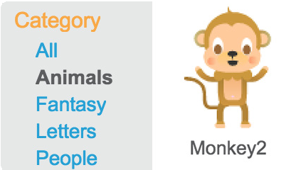
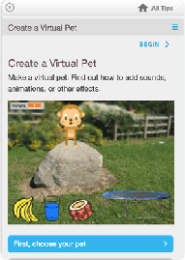
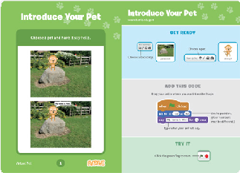



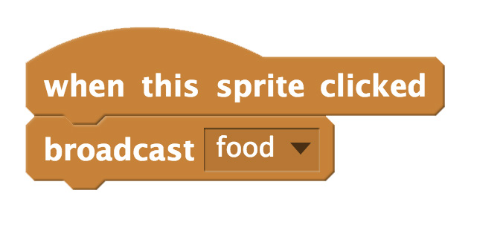
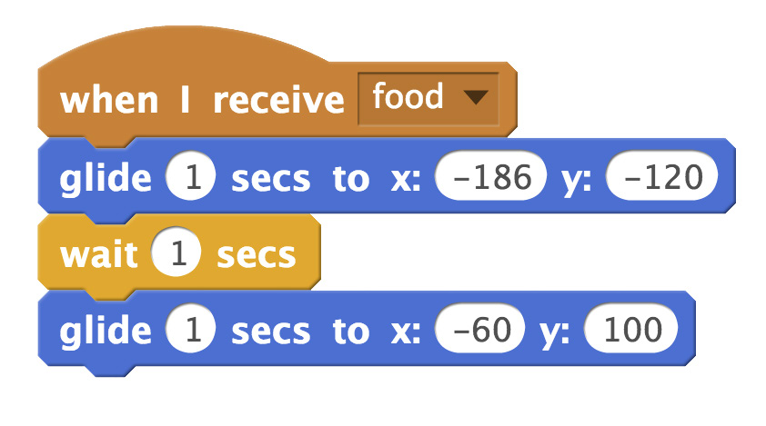
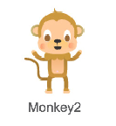
VIRTUAL PET / EDUCATOR GUIDE
VIRTUAL PET / EDUCATOR GUIDE
Demonstrate the First Steps
Create
Support participants as they make interactive pets, on their own or in pairs.
IMAGINE
CREATE
Demonstrate the first few steps of the tutorial so participants can see how to get started.
In Scratch, choose a new sprite as your pet.
Choose a backdrop.
Start with Prompts
Ask participants questions to get started:
What’s your pet’s name? What does it like to eat?
Where is your pet going to live?
Provide Resources
Offer options for getting started
Add a food sprite. Broadcast a new message and name it food.
Some participants may want to follow the online tutorial: scratch.mit.edu/pet
Others may want to explore using the activity cards: scratch.mit.edu/pet/cards
Make your pet glide to the food when it receives the message.
Suggest Ideas for Starting
Choose a pet and have it say hello
Choose a backdrop
Add a food sprite.
Make your pet glide to the food when you click on the food.
5
SCRATCH EDUCATOR GUIDE • scratch.mit.edu/go
6

Slide 4
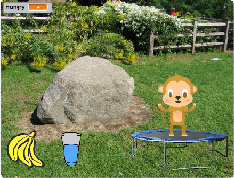
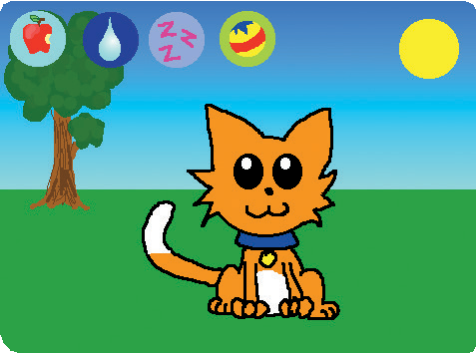
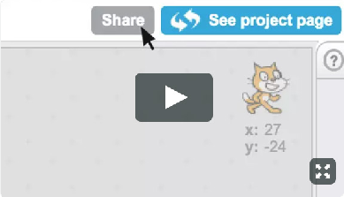
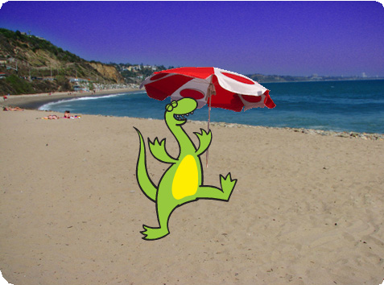
VIRTUAL PET / EDUCATOR GUIDE
VIRTUAL PET / EDUCATOR GUIDE
Share
Have a virtual pet show. Ask participants to visit and interact with two or three virtual pet projects.
CREATE
SHARE
More Things to Try
Animate your pet
Add other activities for your pet to do, such as drink water, jump on trampoline, or play drums
Have your pet say what it likes
Make your pet hungry over time
Ask questions to discuss:
What ideas did you get for your own pet?
What would you like to try next?
Encourage Personalization and Customization
Encourage participants to enhance and customize their projects to reflect their own style:
What kind of pet would you like? How would you take care of it?
Is your pet shy? Noisy? How does it like to play?
What’s Next?
Participants can use the ideas and concepts from this workshop to create a wide variety of projects. Here are a couple of variations on the virtual pet project you could suggest.
Prepare to Share
Adopt a Pet
Find a pet project in the Virtual Pet Studio: scratch.mit.edu/studios/1275856/
Click See Inside and then Remix. Change the pet’s looks, what it eats, or how it plays!
To add instructions and credits to a project, click the button: “See project page”.
This video shows how to share a project on the Scratch website: vimeo.com/llk/share
Creature Creator
Create your own dinosaur, extraterrestrial creature, or fantasy creature. Add sounds and animations.
Scratch is a project of the Lifelong Kindergarten Group at the MIT Media Lab.
7
SCRATCH EDUCATOR GUIDE • scratch.mit.edu/go
8

