Slide 1



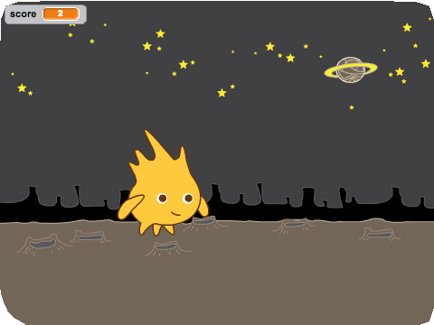
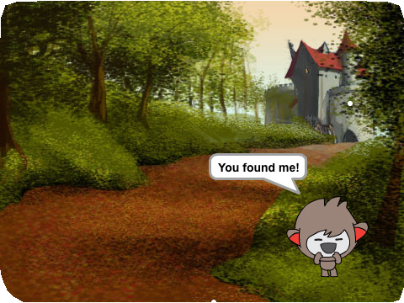
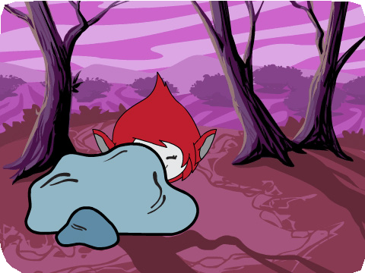
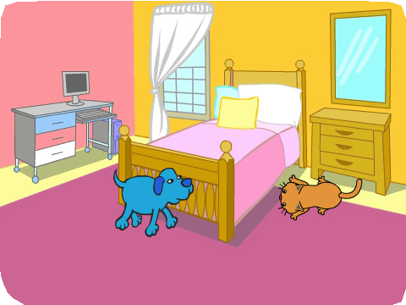
HIDE AND SEEK / EDUCATOR GUIDE
HIDE AND SEEK / EDUCATOR GUIDE
EDUCATOR GUIDE
Hide and Seek
Workshop Overview
Here’s a suggested agenda for a one-hour workshop:
With this guide, you can plan and lead a one-hour workshop using Scratch.
Participants will make a hide-and-seek game with characters that appear and disappear.
First, gather as a group to introduce the theme and spark ideas.
IMAGINE
10 minutes
Next, help participants as they make hide-and-seek games, working at their own pace.
CREATE
40 minutes
At the end of the session, gather together to share and reflect.
SHARE
10 minutes
1
SCRATCH EDUCATOR GUIDE • scratch.mit.edu/go
2

Slide 2
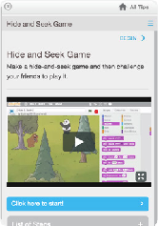
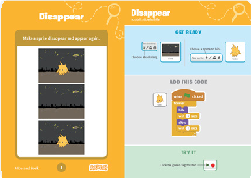
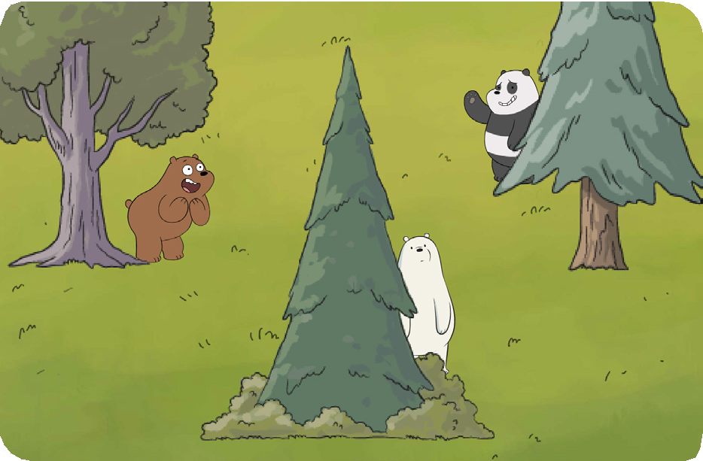
HIDE AND SEEK / EDUCATOR GUIDE
HIDE AND SEEK / EDUCATOR GUIDE
Get Ready for the Workshop
Imagine
IMAGINE
Use this checklist to prepare for the workshop.
Begin by gathering the participants to introduce the theme and spark ideas for projects.
Preview the Tutorial
The Hide and Seek tutorial shows participants how to create their own projects. Preview the tutorial before your workshop and try the first few steps:
scratch.mit.edu/hide
Warm-up Activity: Guessing Game
Arrange for participants to play a guessing game. Give each pair of participants three paper cups and have them choose a small object to hide. In each pair, one person hides the object under one of the cups and moves them around. The first person guesses which cup has the object underneath. Then switch.
Print the Activity Cards
Print a few sets of Hide and Seek cards to have available for participants during the workshop. scratch.mit.edu/hide/cards
Provide Ideas and Inspiration
Show the introductory video for the Hide and Seek tutorial. The video shows a variety of projects for ideas and inspiration.
Gather materials for the warm-up activity:
For each pair, gather 3 paper cups and a small object to hide.
Make sure participants have Scratch accounts
Participants can sign up for their own Scratch accounts at scratch.mit.edu, or you can set up student accounts if you have a Teacher Account. To request a Teacher Account, go to: scratch.mit.edu/educators
Set up computers or laptops
Arrange computers so that participants can work individually or in pairs.
View at scratch.mit.edu/hide or vimeo.com/llk/hide
Set up a computer with projector or large monitor
3
SCRATCH EDUCATOR GUIDE • scratch.mit.edu/go
4

Slide 3

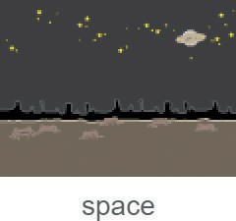




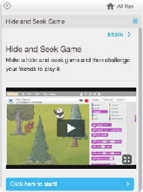
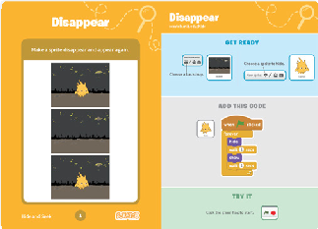
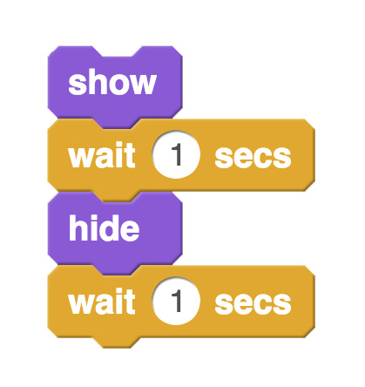
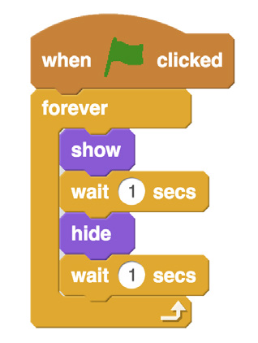
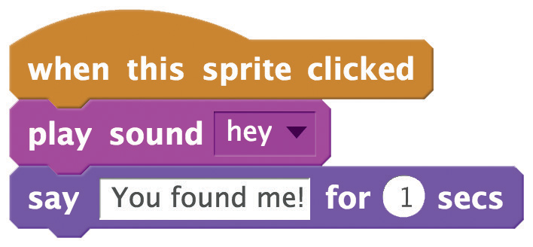

HIDE AND SEEK / EDUCATOR GUIDE
HIDE AND SEEK / EDUCATOR GUIDE
Demonstrate the First Steps
Create
Support participants as they create
hide-and-seek games, on their own or in pairs.
IMAGINE
CREATE
Demonstrate the first few steps of the tutorial so participants can see how to get started.
Go to Scratch to create a new project. Choose a backdrop.
Choose a sprite to hide.
Start with Prompts
Ask participants questions to get started
Which character do you want in your game?
What do you want to happen when that character is clicked?
Provide Resources
Offer options for getting started
Make your sprite hide and show.
Make it keep going.
Some participants may want to follow the online tutorial: scratch.mit.edu/hide
Others may want to explore using the activity cards: scratch.mit.edu/hide/cards
Make your sprite respond when clicked.
Suggest Ideas for Starting
Choose a bear or other sprite
Make it hide and show
Make it do something when clicked
Play with the timing
5
SCRATCH EDUCATOR GUIDE • scratch.mit.edu/go
6

Slide 4

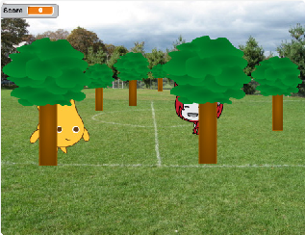
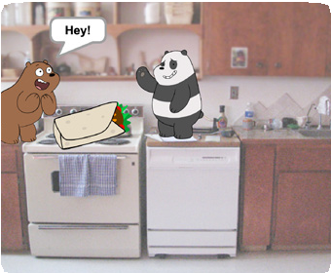
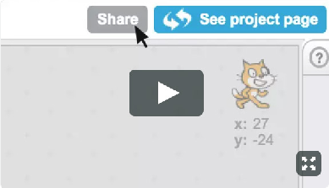
HIDE AND SEEK / EDUCATOR GUIDE
HIDE AND SEEK / EDUCATOR GUIDE
Share
CREATE
SHARE
More Things to Try
Have participants gather in small groups and take turns playing each other’s games.
Move around
Score points
Make hiding places
Add more characters
Ask them to think about these questions:
What did you like best about the games you tried?
Did you get some ideas for your own game? What would you like to try next?
Many Paths, Many Styles
Different participants will approach projects in different ways. Celebrate this diversity, and allow them to go at their own pace and follow their own paths.
What’s Next?
Here are a couple variations on the hide-and-seek project you can suggest.
Prepare to Share
Neighborhood Hide-and-Seek
Make a game featuring a place you know. Import a photograph of your room, school, or neighborhood. Create a new sprite from a drawing or photo to find in that place.
To add instructions and credits to a project, click the button: “See project page”.
This video shows how to share a project on the Scratch website: vimeo.com/llk/share
Invent a Variation:
Another way to get started is to remix a project, such as from the Hide-and-Seek Studio: scratch.mit.edu/studios/1614974/. When participants see a project they like, they can click the See Inside button and then the Remix button. Then, make changes to customize the game. Remember to add credits on the Project Page.
Scratch is a project of the Lifelong Kindergarten Group at the MIT Media Lab.
7
SCRATCH EDUCATOR GUIDE • scratch.mit.edu/go
8

