Slide 1




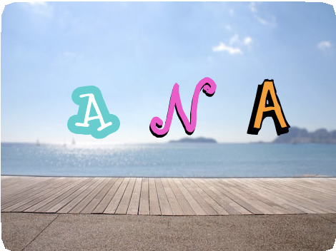
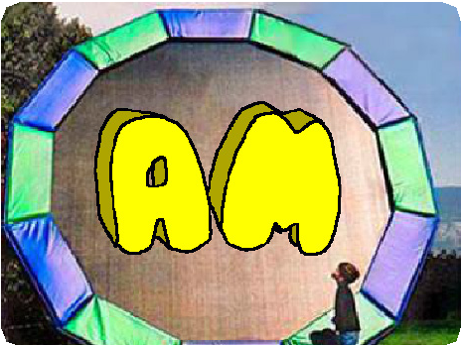

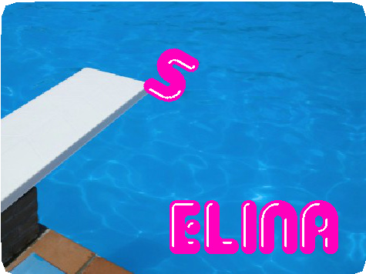
ANIMATE YOUR NAME / EDUCATOR GUIDE
ANIMATE YOUR NAME / EDUCATOR GUIDE
EDUCATOR GUIDE
Animate Your Name
Workshop Overview
Here’s a suggested agenda for a one-hour workshop:
With this guide, you can plan and lead a one-hour workshop using Scratch.
Participants will gain experience with coding as they animate the letters in their name.
First, gather as a group to introduce the theme and spark ideas.
IMAGINE
10 minutes
Next, help participants as they animate their names, working at their own pace.
CREATE
40 minutes
At the end of the session, gather together to share and reflect.
SHARE
10 minutes
1
SCRATCH EDUCATOR GUIDE • scratch.mit.edu/go
2

Slide 2
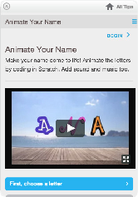
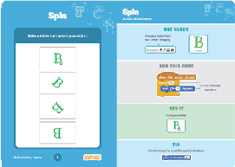
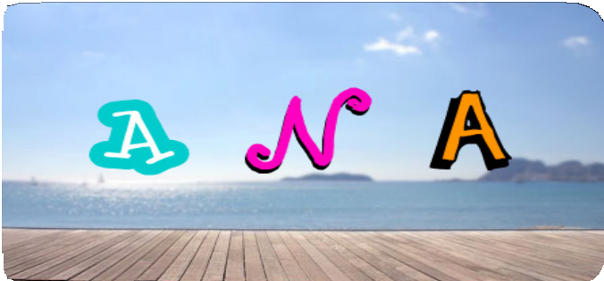
ANIMATE YOUR NAME / EDUCATOR GUIDE
ANIMATE YOUR NAME / EDUCATOR GUIDE
Get Ready for the Workshop
Imagine
IMAGINE
Use this checklist to prepare for the workshop.
Begin by gathering the participants to introduce the theme and spark ideas for projects.
Preview the Tutorial
The Animate Your Name tutorial shows participants how to create their own projects. Preview the tutorial before your workshop and try the first few steps:
scratch.mit.edu/name
Warm-up Activity: Letter Shapes
Gather the group in a circle. Ask each participant to say their name, and then have everyone in the group act out the shape of the first letter.
Print the Activity Cards
Print a few sets of Animate Your Name cards to have available for participants during the workshop. scratch.mit.edu/name/cards
Provide Ideas and Inspiration
Show the introductory video for the Animate Your Name tutorial. The video shows a variety of projects for ideas and inspiration.
Make sure participants have Scratch accounts
Participants can sign up for their own Scratch accounts at scratch.mit.edu, or you can set up student accounts if you have a Teacher Account. To request a Teacher Account, go to: scratch.mit.edu/educators
Set up computers or laptops
Arrange computers so that participants can work individually or in pairs.
Set up a computer with projector or large monitor
You can use a projector to show examples and demonstrate how to get started.
View at scratch.mit.edu/name or vimeo.com/llk/name
3
SCRATCH EDUCATOR GUIDE • scratch.mit.edu/go
4

Slide 3

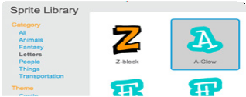


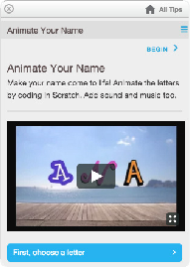
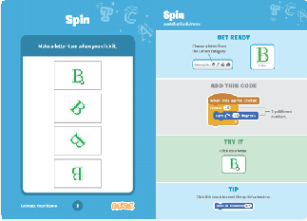
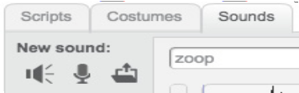
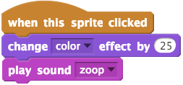
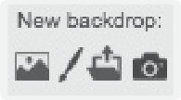
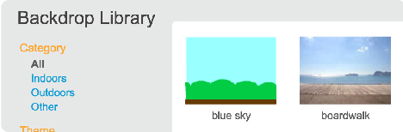
ANIMATE YOUR NAME / EDUCATOR GUIDE
ANIMATE YOUR NAME / EDUCATOR GUIDE
Demonstrate the First Steps
Create
Support participants as they create interactive name projects.
IMAGINE
CREATE
Demonstrate the first few steps of the tutorial so participants can see how to get started.
In Scratch, click Create.
Choose a letter from the Sprite Library:
Start with Prompts
Ask participants questions to get started
Do you want to animate your name, initials, or username?
Which letter do you want to start with?
Provide Resources
Offer options for getting started
Make it do something:
Add a sound:
Some participants may want to follow the online tutorial: scratch.mit.edu/name
Others may want to explore using the activity cards: scratch.mit.edu/name/cards
Choose a new backdrop:
Suggest Ideas for Starting
Choose a letter
Make it change color
Add a sound
Add a backdrop
5
5
SCRATCH EDUCATOR GUIDE • scratch.mit.edu/go
6

Slide 4

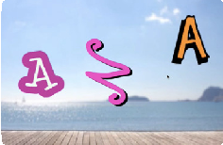
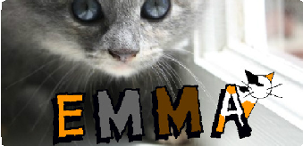
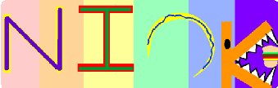

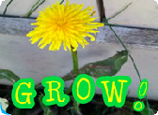

ANIMATE YOUR NAME / EDUCATOR GUIDE
ANIMATE YOUR NAME / EDUCATOR GUIDE
Share
Have participants share their project with their neighbors.
CREATE
SHARE
More Things to Try
Draw a letter
Make it spin
Make it glide
Change size
Add more letters and motion!
Ask questions they can discuss:
What do you like best about the project you made?
What was the hardest part?
Support collaboration
If you had more time, what would you add or change?
When someone gets stuck, connect them to another participant who can help.
See a cool idea? Ask the creator to share with others.
What’s Next?
Participants can use the ideas and concepts from this workshop to create a wide variety of projects. Here are a few variations on the animated name project you could suggest.
Encourage experimenting
Help participants feel comfortable trying different combinations of blocks and seeing what happens.
Other Names
Animate the name of a favorite character from a
book or movie. Or, animate the letters of the name of your school or town.
Start with an Image
Have participants bring in a picture (or find a picture on the web) and animate a word that goes with the picture.
Acrostics
Make an interactive acrostic (a poem
in which the first letters of each line spell out a word reading down).
To understand their thought process, you can ask questions:
What are you working on now?
What are you thinking of trying next?
Scratch is a project of the Lifelong Kindergarten Group at the MIT Media Lab.
7
SCRATCH EDUCATOR GUIDE • scratch.mit.edu/go
8

