Slide 1




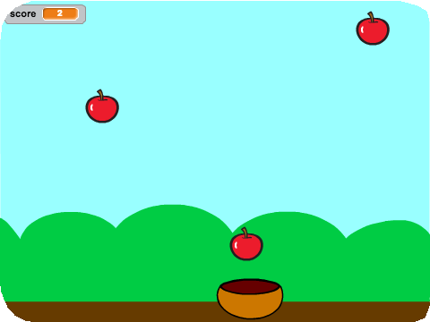
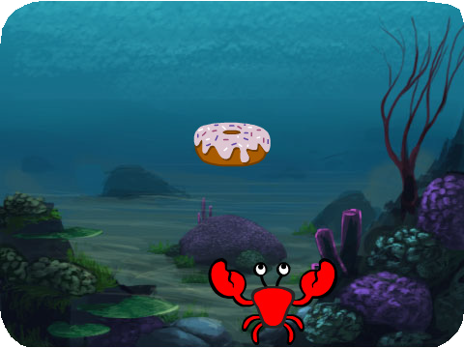

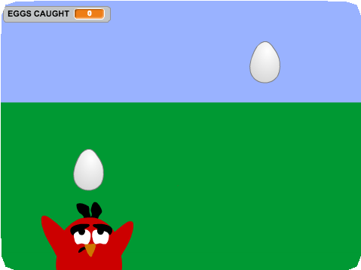


CATCH GAME / EDUCATOR GUIDE
CATCH GAME / EDUCATOR GUIDE
EDUCATOR GUIDE
Catch Game
With this guide, you can plan and lead a one- hour workshop using Scratch. Participants will make a game where they catch things falling from the sky.
Workshop Overview
Here’s a suggested agenda for a one-hour workshop:
First, gather as a group to introduce the theme and spark ideas.
IMAGINE
10 minutes
Next, help participants as they make catch games, working at their own pace.
CREATE
40 minutes
At the end of the session, gather together to share and reflect.
SHARE
10 minutes
1
SCRATCH EDUCATOR GUIDE •
scratch.mit.edu/ideas
2

Slide 2

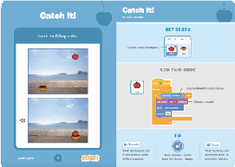
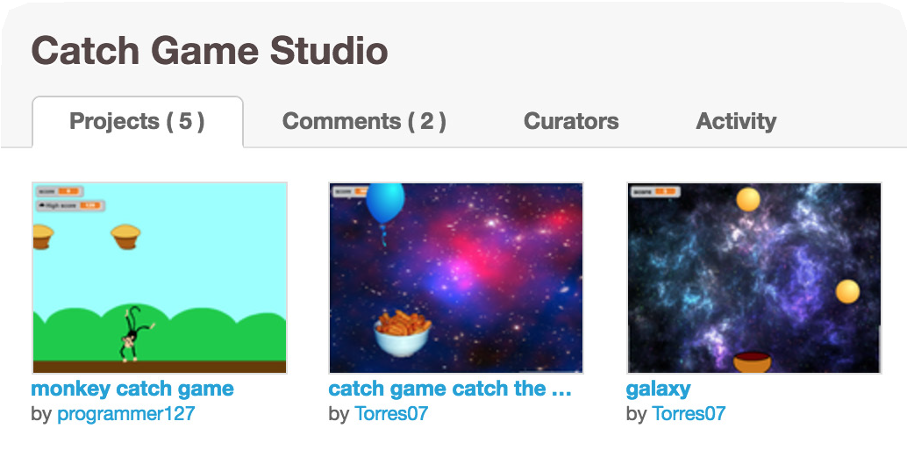
Imagine
CATCH GAME / EDUCATOR GUIDE
CATCH GAME / EDUCATOR GUIDE
Get Ready for the Workshop
Use this checklist to prepare for the workshop.
IMAGINE
Begin by gathering the participants to introduce the theme and spark ideas for projects.
Preview the Tutorial
The Catch Game tutorial shows participants how to create their own projects. Preview the tutorial before your workshop and try the first few steps: scratch.mit.edu/ideas
Print the Activity Cards
Print a few sets of Catch Game cards
to have available for participants during the workshop. scratch.mit.edu/ideas
Make sure participants have Scratch accounts
Participants can sign up for their own Scratch accounts at scratch.mit.edu, or you can set up student accounts if you have a Teacher Account. To request a Teacher Account, go to: scratch.mit.edu/educators
Set up computers or laptops
Arrange computers so that participants can work individually or in pairs.
Set up a computer with projector or large monitor
You can use a projector to show examples and demonstrate how to get started.
Warm-up Activity: Make a wish!
Gather the participants in a circle. Ask, “What do you wish could fall from the sky?” and give an example, such as a favorite food or flower. Then, toss a ball of yarn to someone. The person who catches the ball shares what they would like to fall from the sky. Then they toss the ball to someone, until each person has shared what they imagine.
Provide Ideas and Inspiration
To spark ideas, show a couple of examples of catch games from the Catch Game Studio on the Scratch website.
View the studio at scratch.mit.edu/studios/3553067/
3
SCRATCH EDUCATOR GUIDE •
scratch.mit.edu/ideas
4

Slide 3







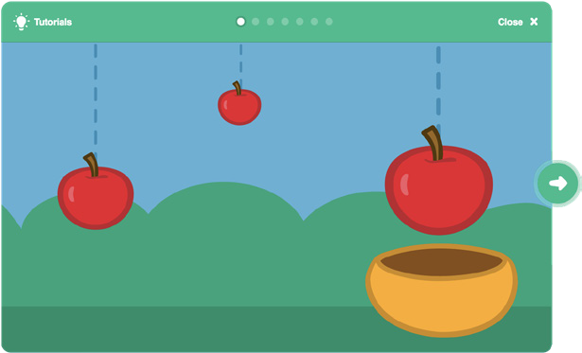
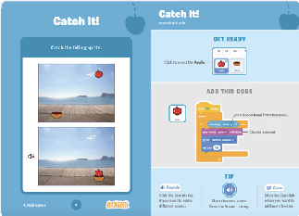
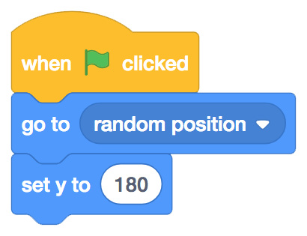
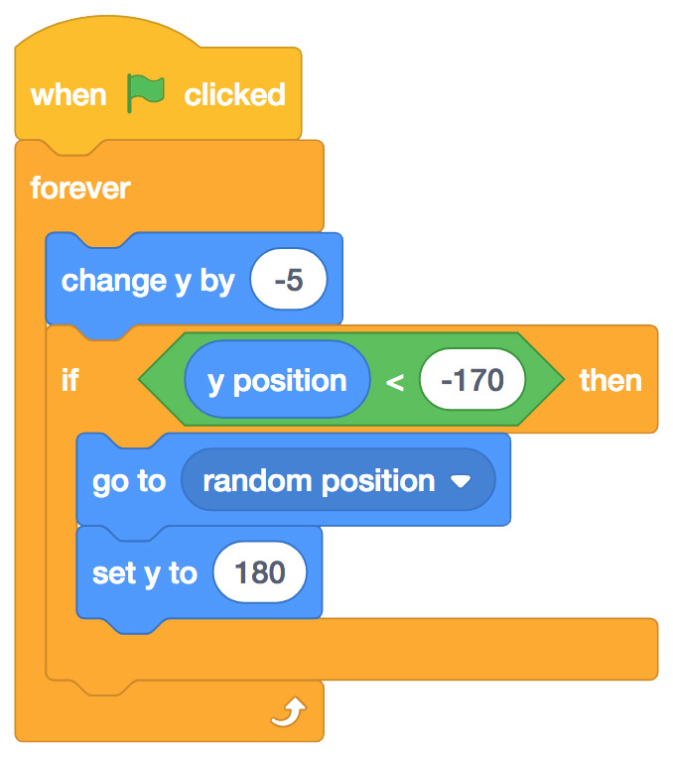
Create
CATCH GAME / EDUCATOR GUIDE
CATCH GAME / EDUCATOR GUIDE
Demonstrate the First Steps
IMAGINE
CREATE
Demonstrate the first few steps of the tutorial so participants can see how to get started.
Support participants as they create catch games. Suggest working in pairs.
In Scratch, choose a new sprite to fall.
Start with Prompts
Ask participants questions to get started
What would you like to catch? How will you catch it?
Which backdrop would you like to choose for your game?
Choose an object to fall.
Choose a backdrop.
Apple
Provide Resources
Offer options for getting started
Choose abackdrop.
Boardwalk
Make your sprite start from a random spot at the top.
Then, make it fall down repeatedly.
Some participants may want to follow the online tutorial: scratch.mit.edu/catch
Others may want to explore using the activity cards: scratch.mit.edu/ideas
Suggest Ideas for Starting
Choose a backdrop
Choose or draw an object to fall
Make it fall down repeatedly from the top.
Select a catcher and make it move with arrow keys.
5
SCRATCH EDUCATOR GUIDE •
scratch.mit.edu/ideas
6

Slide 4


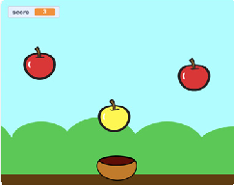
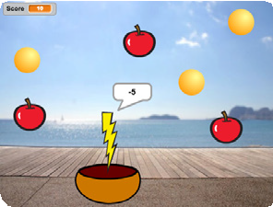

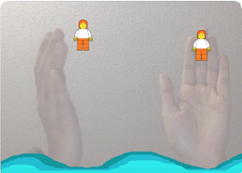

Share
CATCH GAME / EDUCATOR GUIDE
CATCH GAME / EDUCATOR GUIDE
CREATE
SHARE
More Things to Try
Make a script to catch the falling sprite
Add a point when it’s caught
Add sounds
Use the duplicate tool to make more falling sprites
Add a bonus sprite that scores extra points
Encourage Tinkering
Encourage participants to feel comfortable trying combinations of blocks and seeing what happens.
Suggest participants look inside other catch games to see the code.
If they find code they like, they can drag the scripts or sprites into the backpack to reuse in their own project.
Have participants share their projects with their neighbors.
Ask questions that encourage reflection:
What do you like best about your game?
If you had more time, what would you add or change?
What’s Next?
The Catch Game projects provide an introduction to creating interactive games in Scratch. Here are a few ways that participants can build on the concepts they learned from this project.
Add a Level
Encourage participants to experiment with how they might add a level to their game.
Video Sensing
If the computers have a web camera attached or built-in, participants can make a game that they interact with by moving their body. To start, play with the project: Save the Mini-Figs scratch.mit.edu/projects/10123832. Then, open and remix to customize the sprites and scripts.
Scratch is a project of the Lifelong Kindergarten Group at the MIT Media Lab.
Prepare to Share
Suggest adding instructions so others know how to play the project, such as which keys to press.
To add instructions and credits to a project, click the button: “See project page”.
Give your project a title, add instructions and credits, then click Share.
7
SCRATCH EDUCATOR GUIDE •
scratch.mit.edu/ideas
8

