Slide 1


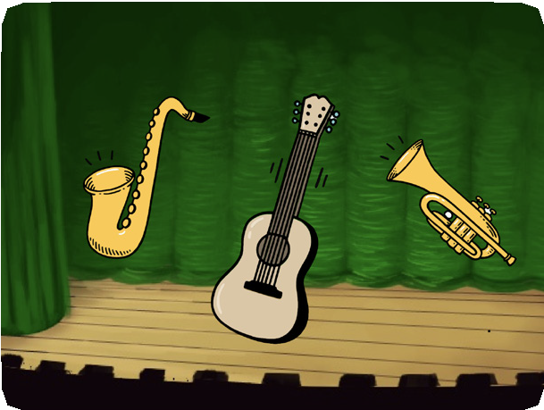
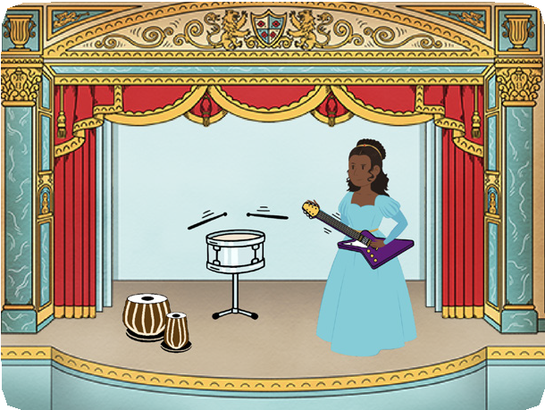
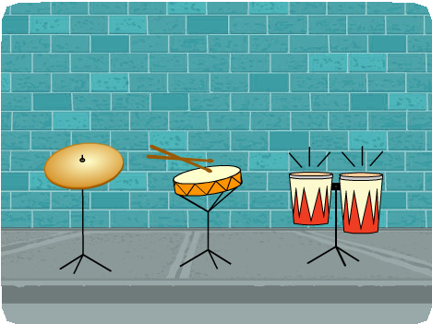
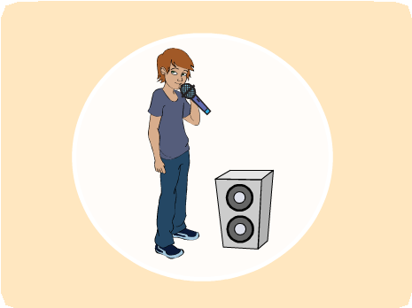


MAKE MUSIC / EDUCATOR GUIDE
MAKE MUSIC / EDUCATOR GUIDE
EDUCATOR GUIDE
Make Music
With this guide, you can plan and lead a one-hour workshop using Scratch.
Participants will choose instruments,
add sounds, and press keys to play music.
Workshop Overview
Here’s a suggested agenda for a one-hour workshop:
First, gather as a group to introduce the theme and spark ideas.
IMAGINE
10 minutes
Next, help participants as they create musical projects, working at their own pace.
CREATE
40 minutes
At the end of the session, gather together to share and reflect.
SHARE
10 minutes
1
SCRATCH EDUCATOR GUIDE •
scratch.mit.edu/ideas
2

Slide 2

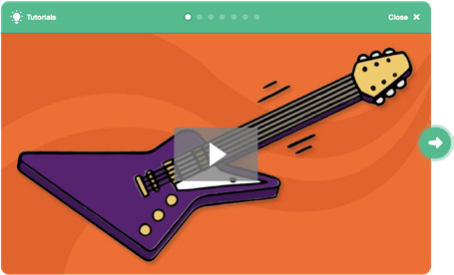
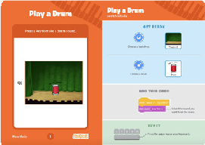
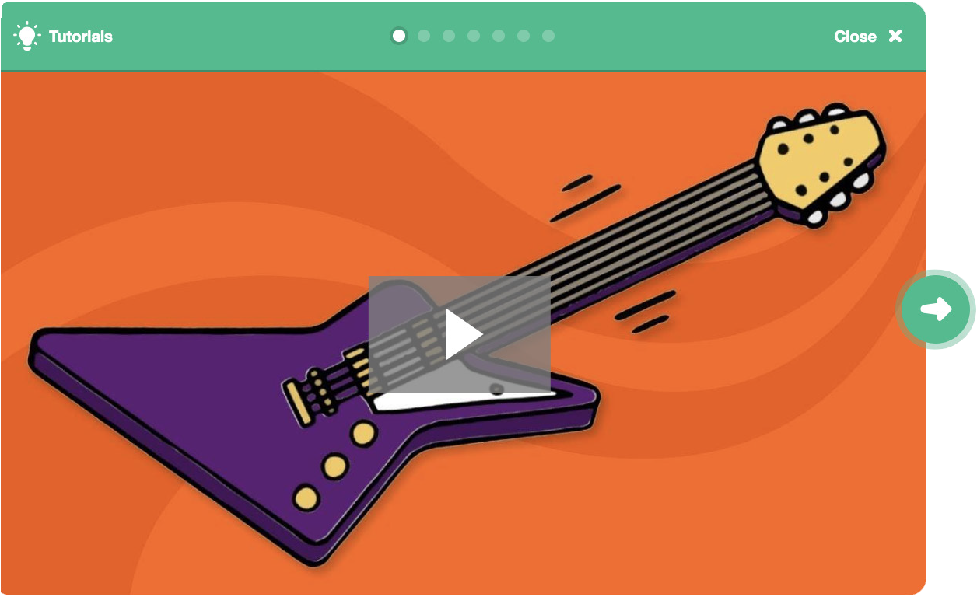
Imagine
MAKE MUSIC / EDUCATOR GUIDE
MAKE MUSIC / EDUCATOR GUIDE
Get Ready for the Workshop
Use this checklist to prepare for the workshop.
IMAGINE
Begin by gathering the participants to introduce the theme and spark ideas for projects.
Preview the Tutorial
The Make Music tutorial shows participants how to create their own projects. Preview the tutorial before your workshop and try the first few steps: scratch.mit.edu/tutorials
Print the Activity Cards
Print a few sets of Make Music cards to have available for participants during the workshop.
scratch.mit.edu/ideas
Make sure participants have Scratch accounts Check sound on computers or laptops
Check to make sure that the sound output is working on the
computers or laptops. You may want to make headphones available (including headphone splitters to allow participants to listen together).
Check microphone if recording sounds (optional)
For the optional step of recording sounds, see if the computers have a microphone (sound input) turned on or added.
Tip: To record sounds in Scratch, participants will need to check “Allow” to give Scratch access to the microphone.
Warm-up Activity: Repeat a Rhythm
Gather the group in a circle and get ready to make music.
Take turns tapping or clapping a short rhythm, then have the group repeat it back.
Provide Ideas and Inspiration
Show the introductory video for the Make Music tutorial. The video shows a variety of projects for ideas and inspiration.
View at scratch.mit.edu/music or vimeo.com/llk/music
3
SCRATCH EDUCATOR GUIDE •
scratch.mit.edu/ideas
4

Slide 3



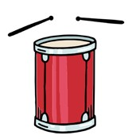


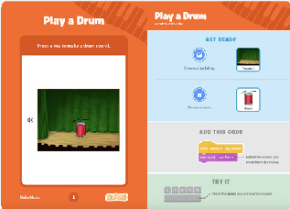
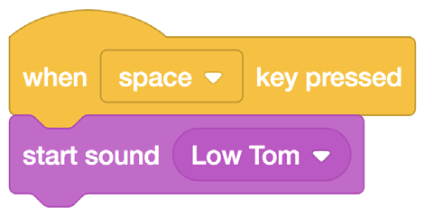
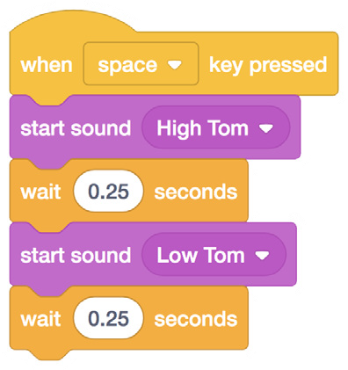


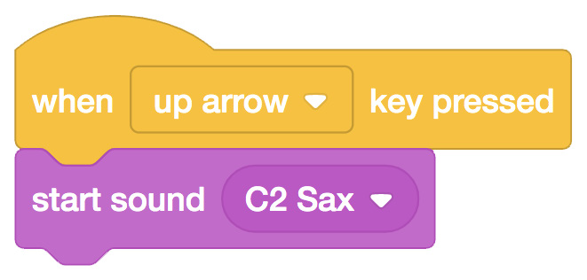

Create
MAKE MUSIC / EDUCATOR GUIDE
MAKE MUSIC / EDUCATOR GUIDE
Demonstrate the First Steps
IMAGINE
CREATE
Demonstrate the first few steps of the tutorial so participants can see how to get started.
Support participants as they create musical projects, on their own or in pairs.
In Scratch, choose a new sprite and select a drum from the Music theme.
Start with Prompts
Ask participants questions to get started
Which instruments or sounds do you want to try first?
What kind of rhythms or musical patterns can you make?
Choose a drum.
Drum
Provide Resources
Offer options for getting started
Make the drum play a sound when you press a key:
Make it play a rhythm:
Select the sound you want from the menu.
Some participants may want to follow the online tutorial: scratch.mit.edu/music
Others may want to explore using the activity cards: scratch.mit.edu/ideas
Choose another instrument from the music theme and make it play a note.
Suggest Ideas for Starting
Choose a drum or other instrument
Press a key to play a sound
Create a rhythm
Try changing the rhythm
Saxophone
5
SCRATCH EDUCATOR GUIDE •
scratch.mit.edu/ideas
6

Slide 4


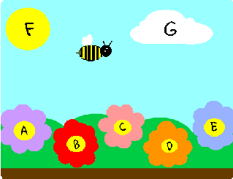
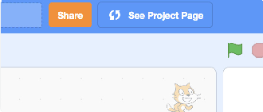
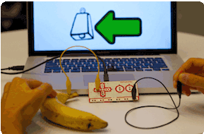

Share
MAKE MUSIC / EDUCATOR GUIDE
MAKE MUSIC / EDUCATOR GUIDE
CREATE
SHARE
More Things to Try
Have participants walk around the room to see and listen to each others’ musical projects on their computers or laptops.
Add musical instruments
Play with musical patterns
Play a random note or sound
Add animation
Use beatbox sounds in a loop
Record short sounds to play
Keep going! Expanding and enhancing projects
Check in with participants as they work and offer support to take their projects further.
Suggest that participants experiment with new instruments and ways of adding sound to their projects.
Get inspired by someone else’s project: What have they tried? What variations might you try?
Reflect as a group:
What do you like best about the project you made or heard?”
What else might you like to add?
What’s Next?
Scratch + Makey Makey
If you have access to Makey Makey boards (makeymakey.com),
you can connect a Scratch project to the physical world. Participants can interact with their musical projects using coins, clay, cardboard, and more.
To learn how to use Makey Makey with Scratch, see scratch.mit.edu/makeydrum or scratch.mit.edu/makeypiano
Prepare to Share
Suggest adding instructions so others know how to play the project, such as which keys to press.
To add instructions and credits to a project, click the button: “See project page”.
Give your project a title, add instructions and credits, then click Share.
Scratch is a project of the Lifelong Kindergarten Group at the MIT Media Lab.
7
SCRATCH EDUCATOR GUIDE •
scratch.mit.edu/ideas
8

