Slide 1


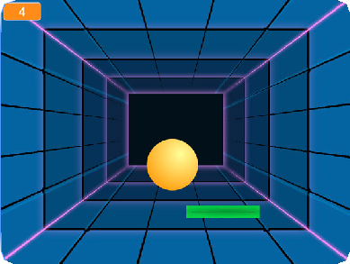
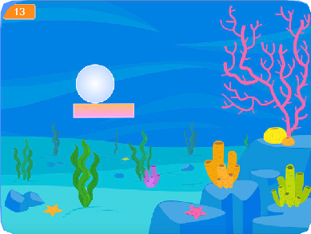
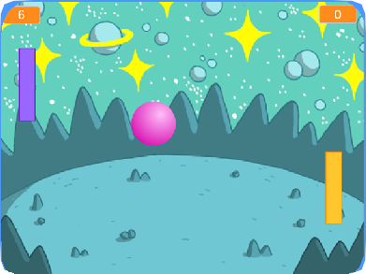
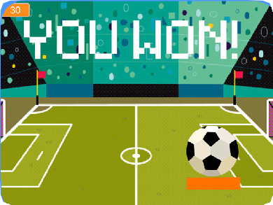


PONG GAME / EDUCATOR GUIDE
PONG GAME / EDUCATOR GUIDE
EDUCATOR GUIDE
Pong Game
With this guide, you can plan and lead a one- hour workshop using Scratch. Participants will gain experience with coding as they design a bouncing ball game.
Workshop Overview
Here’s a suggested agenda for a one-hour workshop:
First, gather as a group to introduce the theme and spark ideas.
IMAGINE
10 minutes
Next, help participants as they make games, working at their own pace.
CREATE
40 minutes
At the end of the session, gather together to share and reflect.
SHARE
10 minutes
1
SCRATCH EDUCATOR GUIDE •
scratch.mit.edu/ideas
2

Slide 2

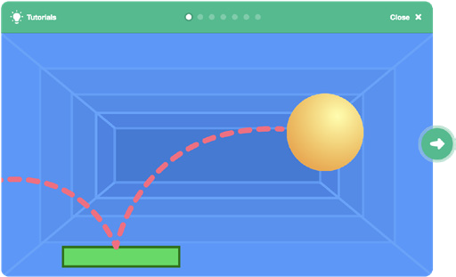
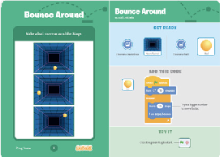
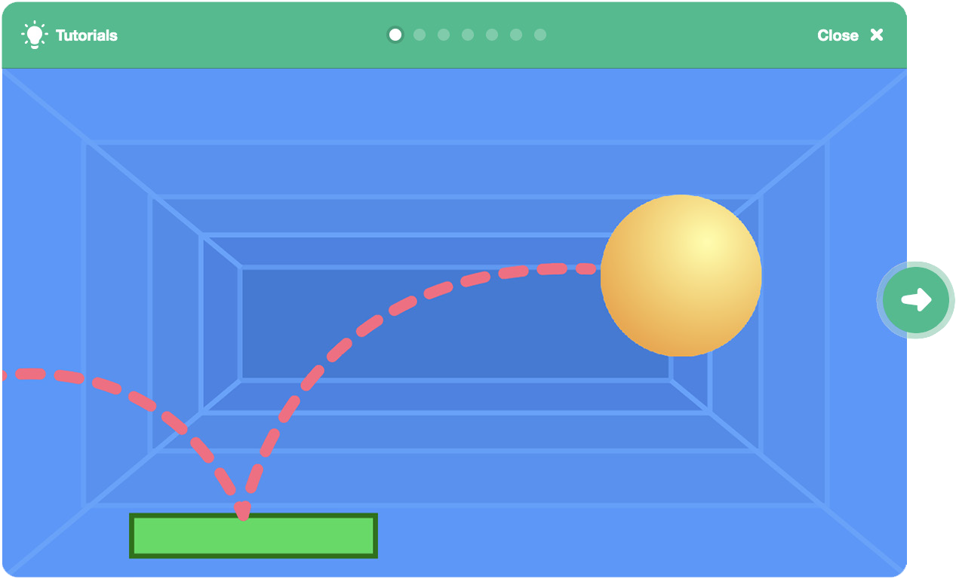
Imagine
PONG GAME / EDUCATOR GUIDE
PONG GAME / EDUCATOR GUIDE
Get Ready for the Workshop
Use this checklist to prepare for the workshop.
IMAGINE
Begin by gathering the participants to introduce the theme and spark ideas for projects.
Preview the Tutorial
The Pong Game tutorial shows participants how to create their own projects. Preview the tutorial before your workshop and try the first few steps: scratch.mit.edu/pong
Print the Activity Cards
Print a few sets of Pong Game cards to have available for participants during the workshop. scratch.mit.edu/ideas
Make sure participants have Scratch accounts
Participants can sign up for their own Scratch accounts at scratch.mit.edu, or you can set up student accounts if you have a Teacher Account. To request a Teacher Account, go to: scratch.mit.edu/educators
Set up computers or laptops
Arrange computers so that participants can work individually or in pairs.
Set up a computer with projector or large monitor
You can use a projector to show examples and demonstrate how to get started.
Provide Ideas and Inspiration
Show the introductory video for the Pong Game tutorial. The video shows pong games with a variety of themes, including everything from soccer to a magic potion-themed Pong game.
View at scratch.mit.edu/pong
Warm-up Activity: Bouncing Ideas
To get participants thinking about a theme for their game, take turns calling out a theme, such as pizza pong or flower pong and brainstorming ideas for the type of images they could use to represent the theme.
3
SCRATCH EDUCATOR GUIDE •
scratch.mit.edu/ideas
4

Slide 3




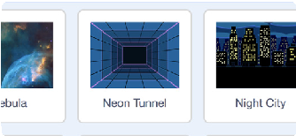



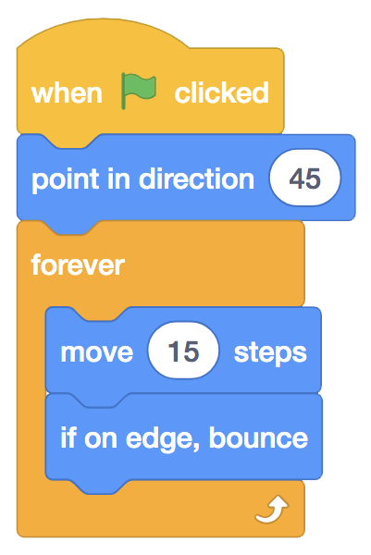

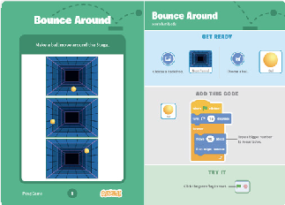


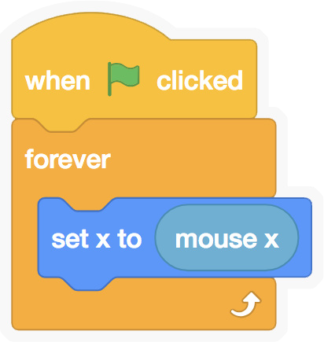


Create
PONG GAME / EDUCATOR GUIDE
PONG GAME / EDUCATOR GUIDE
Demonstrate the First Steps
IMAGINE
CREATE
Demonstrate the first few steps of the tutorial so participants can see how to get started.
Support participants as they create pong games, on their own or in pairs.
Go to the Scratch website. Click Create. Choose a new backdrop:
Start with Prompts
Ask participants questions to get started
What background do you want for your game?
What color or type of ball?
Neon Tunnel
Choose a ball sprite and make it bounce around:
Provide Resources
Offer options for getting started
Ball
Some particpants may want to follow the online tutorial: scratch.mit.edu/pong
Others may want to use the printed activity cards: scratch.mit.edu/ideas
Add a paddle sprite and control it with the mouse:
Suggest Ideas for Starting
Choose a backdrop
Choose or draw a ball sprite and make it bounce around
Add a paddle sprite that you can control
Make the ball bounce off the paddle
Paddle
5
SCRATCH EDUCATOR GUIDE •
scratch.mit.edu/ideas
6

Slide 4


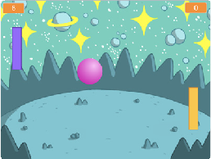
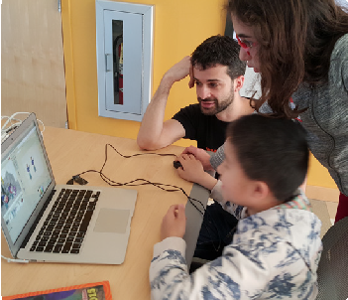
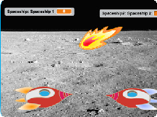
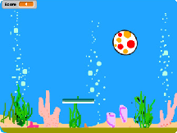
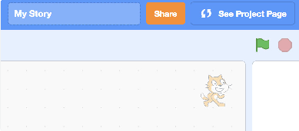
Share
PONG GAME / EDUCATOR GUIDE
PONG GAME / EDUCATOR GUIDE
CREATE
SHARE
More Things to Try
Have particpants share their projects with others in the room.
Add sounds and color effects
Keep score by adding a variable
Add a way to win or lose the game
Change the backdrop when you reach a certain number of points
Duplicate the ball for an added challenge
Ask questions to encourage reflection:
What did you notice about the games you tried?
What ideas might you add to your game?
Offer strategies for problem solving
Talk out what you’re working on with someone
Try out small bits of code at a time to figure out what’s happening at each step
Look closely at the blocks on the tutorial or activity cards to see if they are the same or different from the blocks you’re using
Look at the code for other pong games on the Scratch site
What’s Next?
Here are a couple of other directions you could suggest:
Two-Player Game
For a more advanced project, try making a two-player game. To make a new version of your own project, click File > Save as a Copy.
Remix a Game
A different way to make a pong game is to remix someone else’s project, adding images and ideas. Find a project to remix in the Pong Game Studio: scratch.mit.edu/studios/644508/
Click ‘See inside’, then click the ‘Remix’ button.
Prepare to Share
To add instructions and credits to a project, click the button: “See project page”.
Then click the Share button if you want the project visible to others online.
Scratch is a project of the Lifelong Kindergarten Group at the MIT Media Lab.
7
SCRATCH EDUCATOR GUIDE •
scratch.mit.edu/ideas
8

