Slide 1


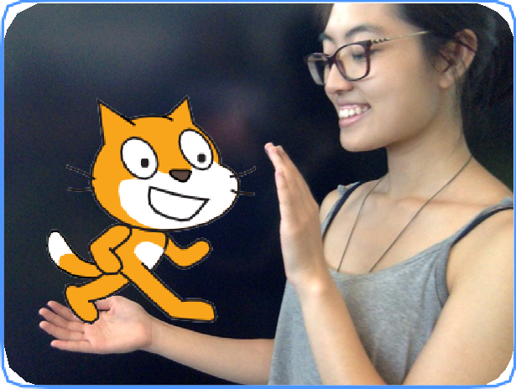
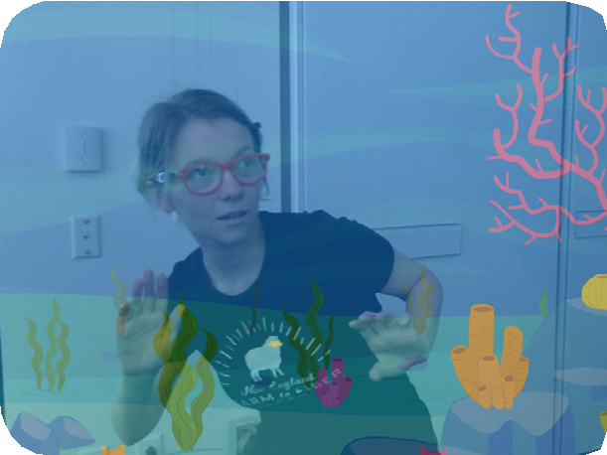

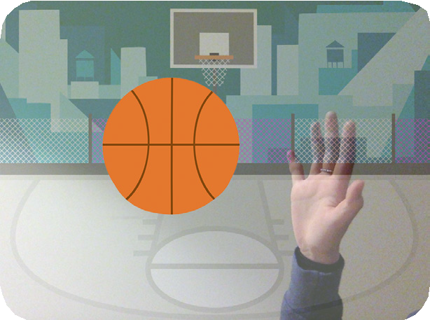




VIDEO SENSING / EDUCATOR GUIDE
VIDEO SENSING / EDUCATOR GUIDE
EDUCATOR GUIDE
Video Sensing
With this guide, you can plan and lead a one- hour workshop using Scratch. Participants will gain experience with coding as they create interactive projects using Video Sensing.
Workshop Overview
Here’s a suggested agenda for a one-hour workshop:
First, gather as a group to introduce the theme and spark ideas.
IMAGINE
10 minutes
Next, help participants as they make interactive projects, working at their own pace.
CREATE
40 minutes
At the end of the session, gather together to share and reflect.
SHARE
10 minutes
1
SCRATCH EDUCATOR GUIDE •
scratch.mit.edu/ideas
2

Slide 2

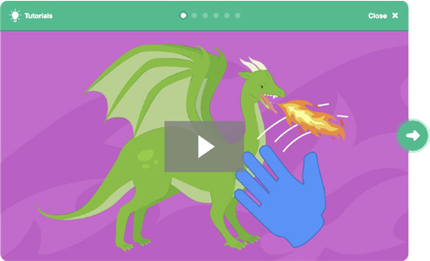
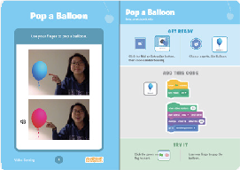
Imagine
VIDEO SENSING / EDUCATOR GUIDE
VIDEO SENSING / EDUCATOR GUIDE
Get Ready for the Workshop
Use this checklist to prepare for the workshop.
IMAGINE
Begin by gathering the participants to introduce the theme and spark ideas for projects.
Preview the Tutorial
The Video Sensing tutorial shows participants how to create their own projects. Preview the tutorial before your workshop and try the first few steps: scratch.mit.edu/tutorials
Make sure your computers have built-in cameras
Video Sensing uses your computer’s built-in camera. Make sure that participants are using computers with built-in cameras.
Print the Activity Cards
Print a few sets of Video Sensing cards to have available for participants during the workshop.
scratch.mit.edu/ideas
Make sure participants have Scratch accounts
Participants can sign up for their own Scratch accounts at scratch.mit.edu, or you can set up student accounts if you have a Teacher Account. To request a Teacher Account, go to: scratch.mit.edu/educators
Set up a computer with projector or large monitor
You can use a projector to show examples and demonstrate how to get started.
Warm-up Activity: Invisible Energy Ball
Gather the group in a circle. Together you must pass an invisible energy ball around the circle, acting out the action of passing or throwing the ball. The challenge is, it is always changing shape, size, texture and even temperature.
Model this activity by passing the ball to the first participant. Say your name, then describe the ball. “I’m Alex and I’m passing you a huge energy ball that is slippery like a fish!”
The next person then acts out how they would catch that huge, slippery energy ball, introduces themself and describes the energy ball they’re passing to the next person. Encourage participants to transform the ball as much as possible with each turn.
Provide Ideas and Inspiration
To spark ideas, watch the Video Sensing tutorial video. The video shows a variety of projects to spark ideas and inspiration.
View the scratch.mit.edu/ideas
3
SCRATCH EDUCATOR GUIDE •
scratch.mit.edu/ideas
4

Slide 3



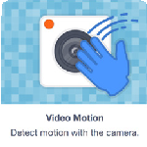

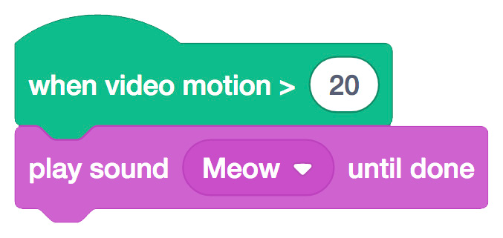
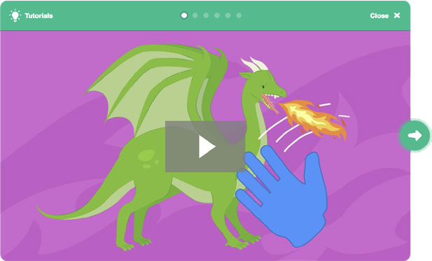
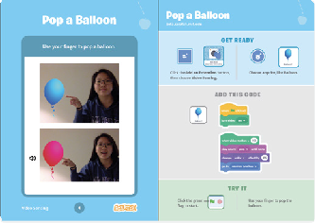





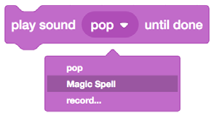
Create
VIDEO SENSING / EDUCATOR GUIDE
VIDEO SENSING / EDUCATOR GUIDE
Demonstrate the First Steps
IMAGINE
CREATE
Demonstrate the first few steps of the tutorial so participants can see how to get started.
Support participants as they create interactive Scratch projects.
Start a new project in Scratch, then add the Video Sensing blocks.
Start with Prompts
Ask participants questions to get started
Click the Add an Extension button (on the bottom of the screen).
Choose Video Sensing to add the video blocks.
Which character or object do you want to interact with?
What do you want it to do when you interact with it?
Provide Resources
Offer options for getting started
Pet the cat:
This block senses motion on a sprite.
Type a larger number to make it less sensitive to movement.
Cat
Move your hand to pet the cat.
Some participants may want to follow the online tutorial: scratch.mit.edu/tutorials
Others may want to explore using the activity cards: scratch.mit.edu/ideas
Follow these steps to choose different sprites and sounds:
Suggest Ideas for Starting
5
Add the Video Sensing blocks using the Add an Extension button.
Choose a sprite to interact with.
Decide how you want it to react.
Choose a sprite.
Choose a sound.
Select your sound.
5
SCRATCH EDUCATOR GUIDE •
scratch.mit.edu/ideas
6

Slide 4


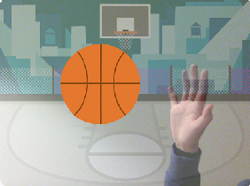





Share
VIDEO SENSING / EDUCATOR GUIDE
VIDEO SENSING / EDUCATOR GUIDE
CREATE
SHARE
More Things to Try
Try adding a second character or object to interact with.
If you’re not sure what to do, pick a card and try something new.
You can create a game, an interactive story, or a virtual pet.
Have participants share their project with their neighbors.
Ask questions they can discuss:
What do you like best about the project you made?
What was the hardest part?
Support collaboration
When someone gets stuck, connect them to another participant who can help.
See a cool idea? Ask the creator to share with others.
If you had more time, what would you add or change?
What’s Next?
Participants can use the ideas and concepts from this workshop to create a wide variety of projects. Encourage them to continue developing their projects into games, stories, or interactive art using the resources listed below.
Encourage experimenting
The Video Sensing activity cards can be done in any order, with a range of different character and object sprites.
Encourage students to try new things:
Create a Story
Choose characters, add conversation, and bring your story to life.
Chase Game
Make a game where you chase a character to score points.
Animate a Character
Bring characters to life with animation.
What are different ways your project can react?
Can you create a project that two (or more) people can play?
Find these projects in the Tutorials library: scratch.mit.edu/ideas
Created by the Scratch Team
7
SCRATCH EDUCATOR GUIDE •
scratch.mit.edu/ideas
8

