Slide 1



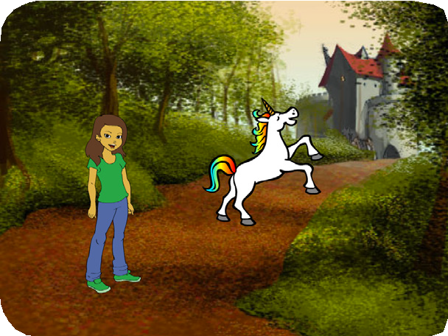
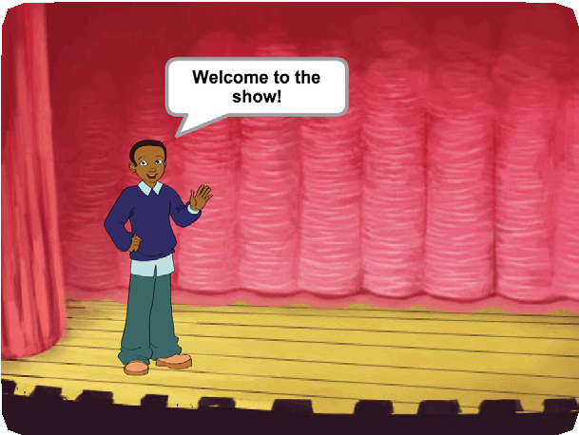
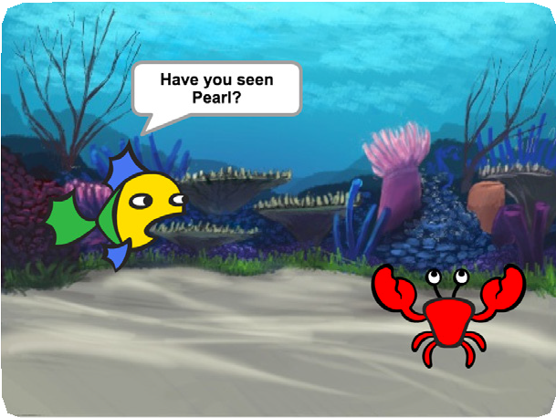
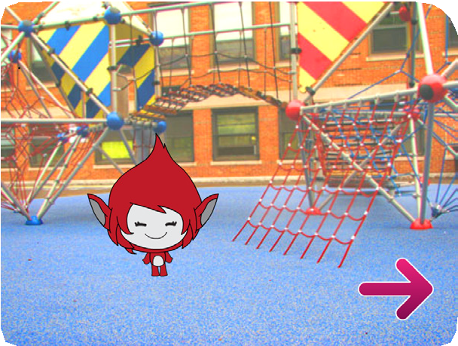
CREATE A STORY / EDUCATOR GUIDE
CREATE A STORY / EDUCATOR GUIDE
EDUCATOR GUIDE
Create a Story
With this guide, you can plan and lead a one-hour workshop using Scratch.
Participants will create a story with settings, characters, and dialogue.
Workshop Overview
Here’s a suggested agenda for a one-hour workshop:
First, gather as a group to introduce the theme and spark ideas.
IMAGINE
10 minutes
Next, help participants as they create story projects, working at their own pace.
CREATE
40 minutes
At the end of the session, gather together to share and reflect.
SHARE
10 minutes
1
SCRATCH EDUCATOR GUIDE • scratch.mit.edu/go
2

Slide 2
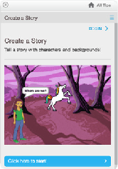
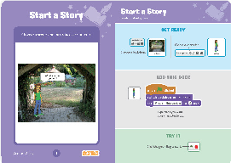
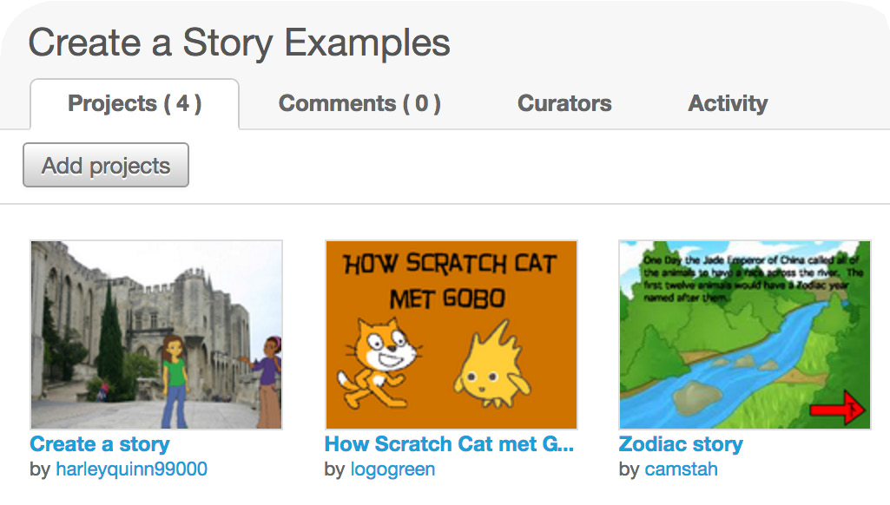
CREATE A STORY / EDUCATOR GUIDE
CREATE A STORY / EDUCATOR GUIDE
Get Ready for the Workshop
Use this checklist to prepare for the workshop.
Imagine
IMAGINE
Begin by gathering the participants to introduce the theme and spark ideas for projects.
Preview the Tutorial
The Create a Story tutorial shows participants how to create their own projects. Preview the tutorial before your workshop and try the first few steps:
scratch.mit.edu/story
Warm-up Activity: Draw a Hat
Give each participant a piece of paper. Ask them to think of a favorite character (for example, from a book, movie, or their imagination). Then, ask them to imagine a new scene. Where could their character go? Who would they meet there? What would they say? Suggest that they write or draw the scene from their story.
Ask them to share their scene with someone else in the group.
Print the Activity Cards
Print a few sets of Create a Story cards to have available for participants during the workshop. scratch.mit.edu/story/cards
Provide Ideas and Inspiration
Show some example Story projects to spark ideas. You can find some in the Create a Story examples Studio on the Scratch website.
Make sure participants have Scratch accounts
Participants can sign up for their own Scratch accounts at scratch.mit.edu, or you can set up student accounts if you have a Teacher Account. To request a Teacher Account, go to: scratch.mit.edu/educators
Set up a studio for project sharing on Scratch
Set up a studio so participants will be able to add their projects. Go to your My Stuff page, then click the + New Studio button. Type in a name for the studio (such as ‘Our Fashion Projects’).
Set up computers or laptops
Arrange computers so that participants can work individually or in pairs.
View the studio at: scratch.mit.edu/studios/3757922
3
SCRATCH EDUCATOR GUIDE • scratch.mit.edu/go
4

Slide 3

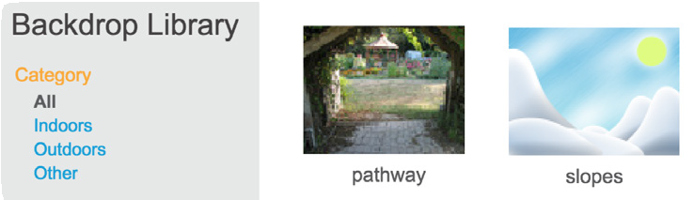


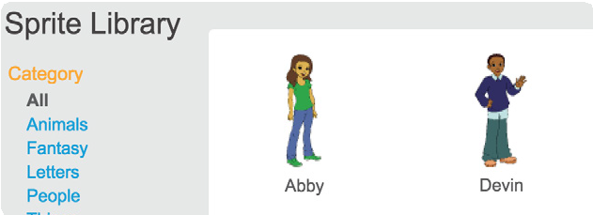
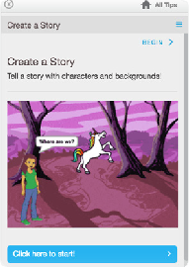
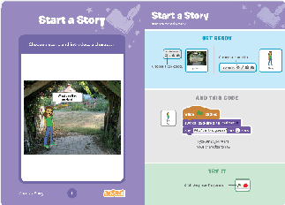
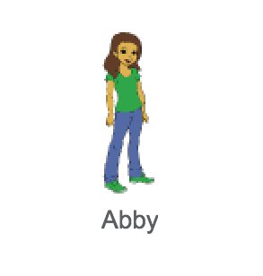
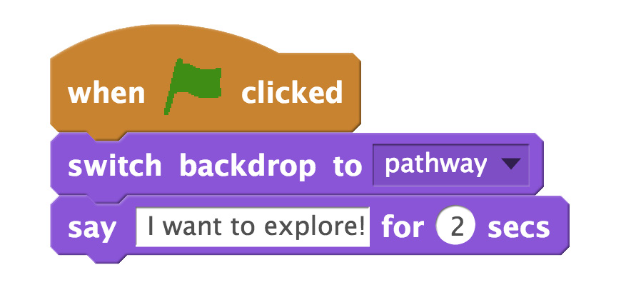
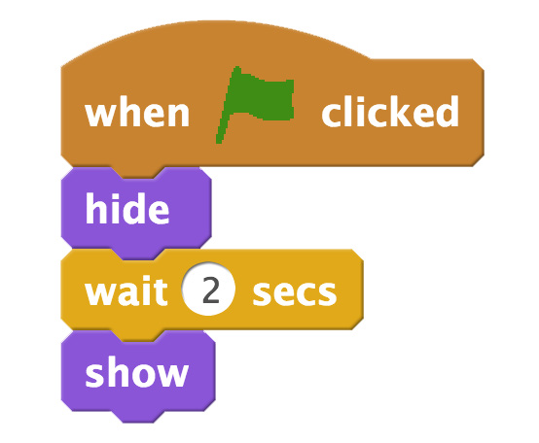


CREATE A STORY / EDUCATOR GUIDE
CREATE A STORY / EDUCATOR GUIDE
Demonstrate the First Steps
Create
Support participants as they create Story projects, on their own or in pairs.
IMAGINE
CREATE
Demonstrate the first few steps of the tutorial so participants can see how to get started.
In Scratch, click Create.
Choose a setting from the Backdrop library:
Start with Prompts
Ask participants questions to get started
Where will your story take place?
What will happen first?
Choose a character from the Sprite library:
Provide Resources
Offer options for getting started
Start your story:
Some participants may want to follow the online tutorial: scratch.mit.edu/story
Others may want to explore using the activity cards: scratch.mit.edu/story/cards
Choose a new character and make it appear:
Suggest Ideas for Starting
Choose a backdrop.
Choose a character.
Make a character say something
Make a character hide and show.
5
SCRATCH EDUCATOR GUIDE • scratch.mit.edu/go
6

Slide 4
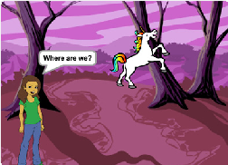


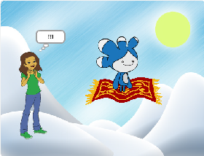
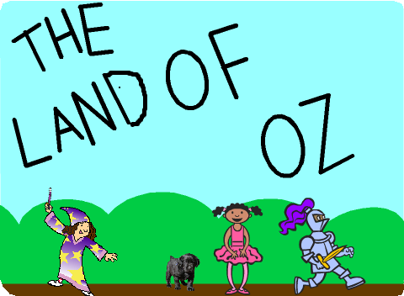
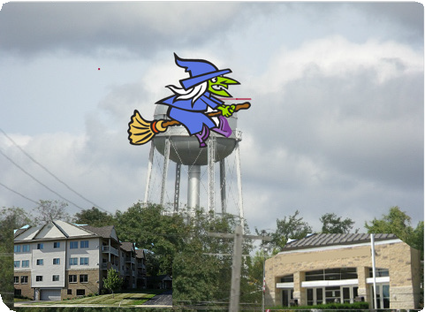
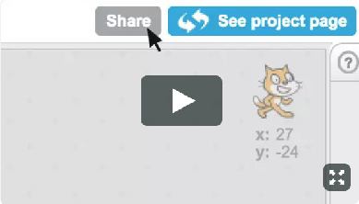
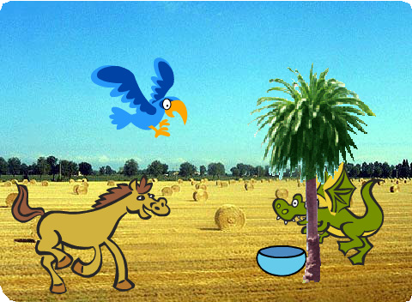
CREATE A STORY / EDUCATOR GUIDE
CREATE A STORY / EDUCATOR GUIDE
Share
Help the participants add their projects to a shared studio in Scratch. Give them a link to the studio. Then they can click ‘Add Projects’ at the bottom of the page.
CREATE
SHARE
More Things to Try
Switch backdrops.
Make your characters have a conversation.
Move your characters.
Change something when you click on it.
Ask for volunteers to show their project to the group.
Support Tinkering
What’s Next?
Participants can use these ideas and concepts to create a variety of projects. Here are some variations on the story project you could suggest:
Scratch is designed to support creating by experimenting and tinkering. So, your participants may want to start their stories without planning beforehand. As they create, one idea can spark another.
Celebrate their sparks of creativity and the unexpected turns their stories may take.
Retell a story
Start with a story you know and make it in Scratch. Imagine a new ending or a different setting.
Prepare to Share
Neighbourhood story
Take photos of your classroom, school, or neighborhood and use them as backdrops in your story.
To add instructions and credits to a project, click the button: “See project page”.
Round-robin story
Give everyone 5 minutes to start a story. Then, have them switch to the next computer to add to the story. Repeat.
This video shows how to share a project on the Scratch website: vimeo.com/llk/share
Scratch is a project of the Lifelong Kindergarten Group at the MIT Media Lab.
7
SCRATCH EDUCATOR GUIDE • scratch.mit.edu/go
8

