Slide 1




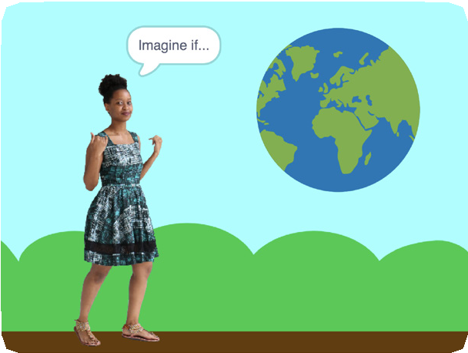
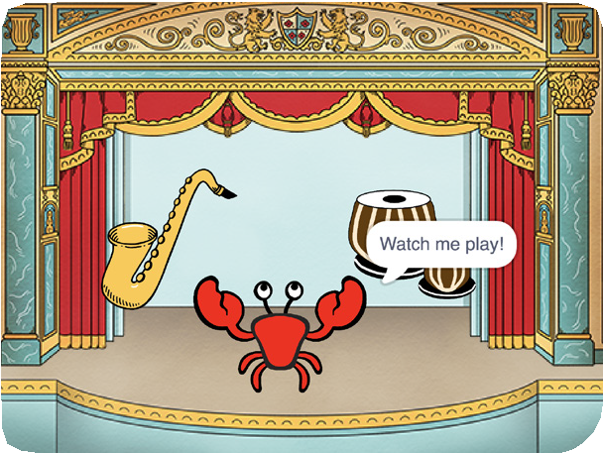
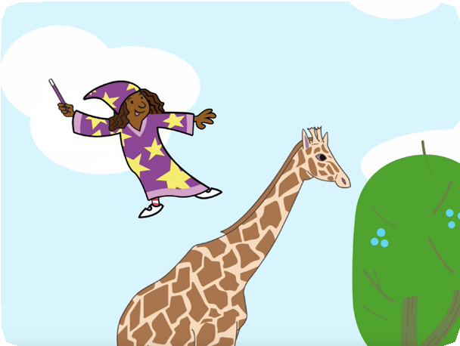
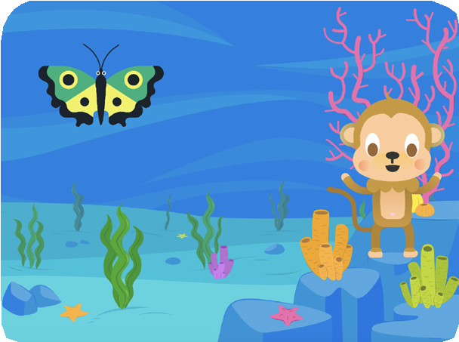


IMAGINE A WORLD / EDUCATOR GUIDE
IMAGINE A WORLD / EDUCATOR GUIDE
EDUCATOR GUIDE
Imagine a World
With this guide, you can plan and lead a one- hour workshop using Scratch. Participants
will gain experience with coding as they create projects based on the theme Imagine a World.
Workshop Overview
Here’s a suggested agenda for a one-hour workshop:
First, gather as a group to introduce the theme and spark ideas.
IMAGINE
10 minutes
Next, help participants as they create projects, working at their own pace.
CREATE
40 minutes
At the end of the session, gather together to share and reflect.
SHARE
10 minutes
1
SCRATCH EDUCATOR GUIDE •
scratch.mit.edu/ideas
2

Slide 2

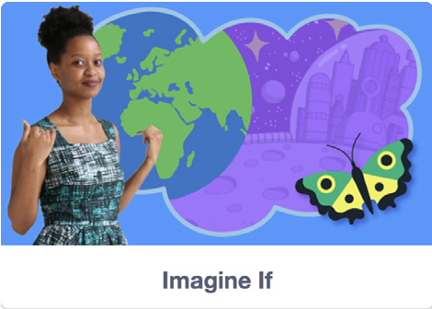
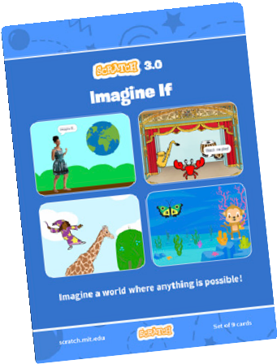
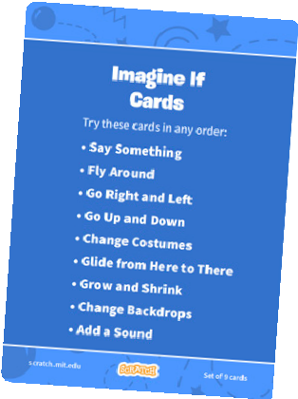
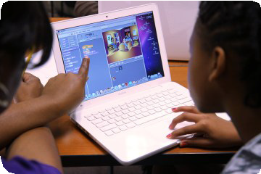
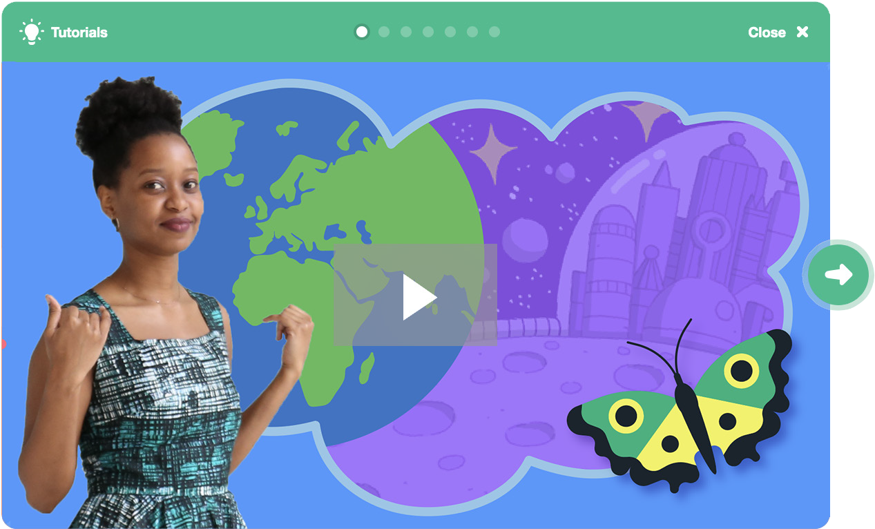
Imagine
IMAGINE A WORLD / EDUCATOR GUIDE
IMAGINE A WORLD / EDUCATOR GUIDE
Get Ready for the Workshop
Use this checklist to prepare for the workshop.
IMAGINE
Begin by gathering the participants to introduce the theme and spark ideas for projects.
Preview the Tutorial
The Imagine a World tutorial shows participants how to create their own projects. Preview the tutorial by opening Scratch, clicking Create, then Tutorials. Choose the Imagine a World tutorial from the library. scratch.mit.edu/imagine
Warm-up Activity: Imagine a world...
Gather the group in a circle. Start with the prompt “Imagine a world where…” and have each participant share their name and one thing they imagine in their world.
Imagine a World
This activity can be playful, or it can be more focused on social or environmental issues. Set the tone by starting off the activity. For example, “My name is Maya and I imagine a world where everyone can fly,” or, “My name is Devon and I imagine a world where no one goes hungry.”
Imagine a World Coding Cards
If you have access to a printer, print the Imagin a World cards for students to use. Download the PDF at: scratch.mit.edu/ideas
Provide Ideas and Inspiration
Participants can create a wide range of projects with the Imagine a World tutorial. To spark ideas, watch the Imagine a World video together.
Set up your workspace
Creating with Scratch is collaborative. Arrange your space so participants can work in groups or pairs.
If you have a projector or large monitor, use it to view the Imagine a World video together, show examples and demonstrate how to get started.
scratch.mit.edu/imagine
3
SCRATCH EDUCATOR GUIDE •
scratch.mit.edu/ideas
4

Slide 3


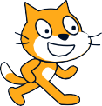

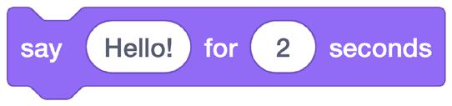


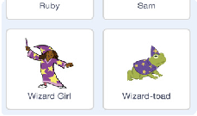
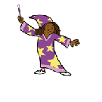

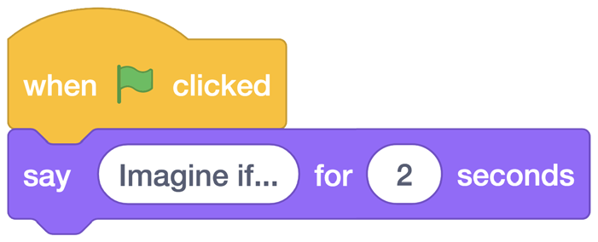
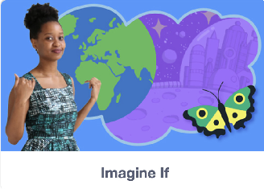
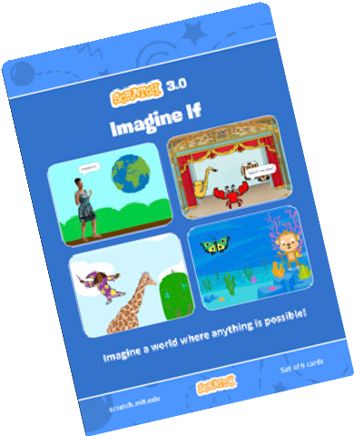
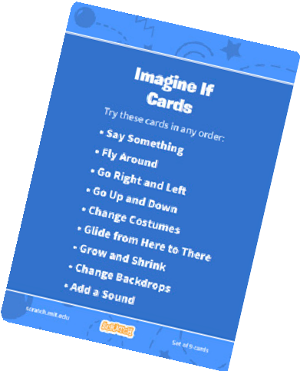

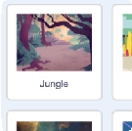
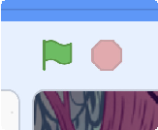
Create
IMAGINE A WORLD / EDUCATOR GUIDE
IMAGINE A WORLD / EDUCATOR GUIDE
Demonstrate the First Steps
IMAGINE
CREATE
Demonstrate the first few steps of the tutorial so participants can see how to get started.
Support participants as they create projects based on their ideas.
In Scratch, click Create.
Drag out a say block, and click it to make the cat say hello!
Start with Prompts
Ask participants questions to get started
What does your ideal world look like?
What could you do to help make our world a little better?
Have participants choose their own sprite.
Who or what inhabits your world?
Is it full of people, animals, or creatures?
Wizard Girl
Now make it say something.
Provide Resources
Offer options for getting started
Start with an Event block.
This tells your code when to run.
Type what you want your sprite to say.
Next, choose a backdrop.
Click the green flag to start.
Imagine a World
Click the green flag to run your code.
Some participants may want to follow the online tutorial: scratch.mit.edu/imagine
Others may want to explore using the activity cards: scratch.mit.edu/ideas
5
SCRATCH EDUCATOR GUIDE •
scratch.mit.edu/ideas
6

Slide 4


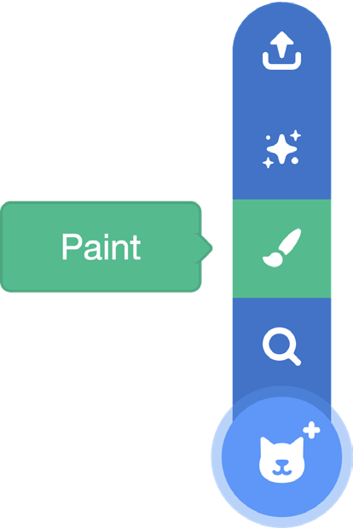


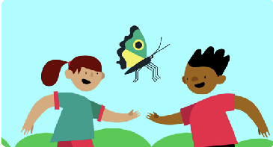
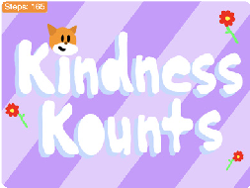

Share
IMAGINE A WORLD / EDUCATOR GUIDE
IMAGINE A WORLD / EDUCATOR GUIDE
CREATE
SHARE
Have participants share their project with their neighbors.
More Things to Try
It’s your world. To draw your own images, click the Add a Sprite button, then choose Paint.
Ask questions they can discuss:
What do you like best about the project you made?
What was the hardest part?
You can also upload a photo
If you had more time, what would you add or change?
What’s Next?
Participants can use the ideas and concepts from this workshop to create a wide variety of projects. Here are a few project ideas you could suggest:
Support collaboration
When someone gets stuck, connect them to another participant who can help.
See a cool idea? Ask the creator to share with others.
Encourage experimenting
Help participants feel comfortable experimenting with blocks. Encourage them to try different combinations and edit inputs.
Games for Change
Make a game with a positive outcome. The goal of your game could be something like cleaning up a local park, or spreading kindness.
How-to Guides
Create an animated tutorial or guide that shows something you know how to do. Design it for someone you know or to share with your community.
What happens when you add a repeat loop?
What happens if you type a larger or smaller number?
7
SCRATCH EDUCATOR GUIDE •
scratch.mit.edu/ideas
8

