Slide 1


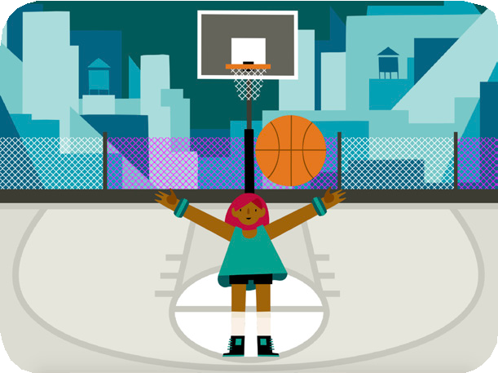
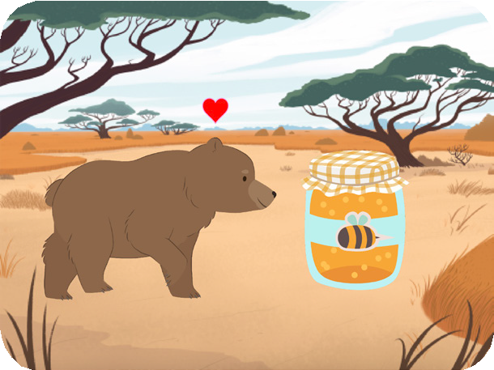
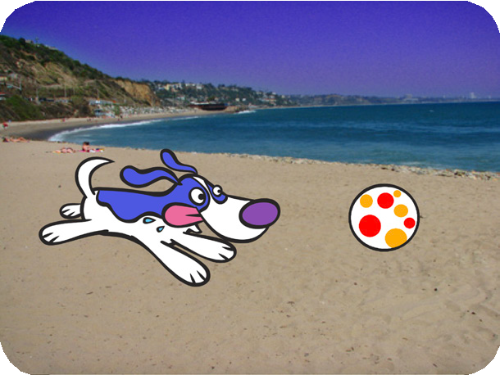



ANIMATE A CHARACTER / EDUCATOR GUIDE
ANIMATE A CHARACTER / EDUCATOR GUIDE
EDUCATOR GUIDE
Animate a Character
With this guide, you can plan and lead a one- hour workshop using Scratch. Participants will gain experience with coding as they bring characters to life with animation.
Workshop Overview
Here’s a suggested agenda for a one-hour workshop:
First, gather as a group to introduce the theme and spark ideas.
IMAGINE
10 minutes
Next, help participants as they animate characters, working at their own pace.
CREATE
40 minutes
SHARE
10 minutes
At the end of the session, gath- er together to share and reflect.
1
SCRATCH EDUCATOR GUIDE •
scratch.mit.edu/ideas
2

Slide 2

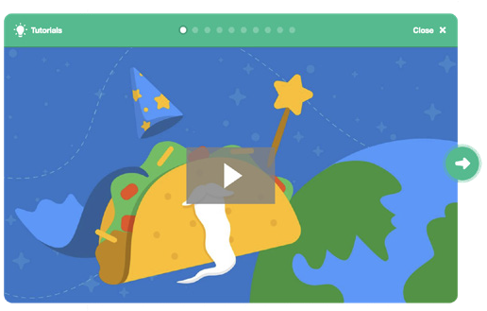
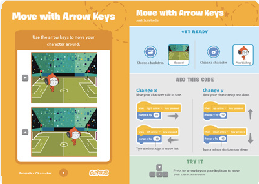
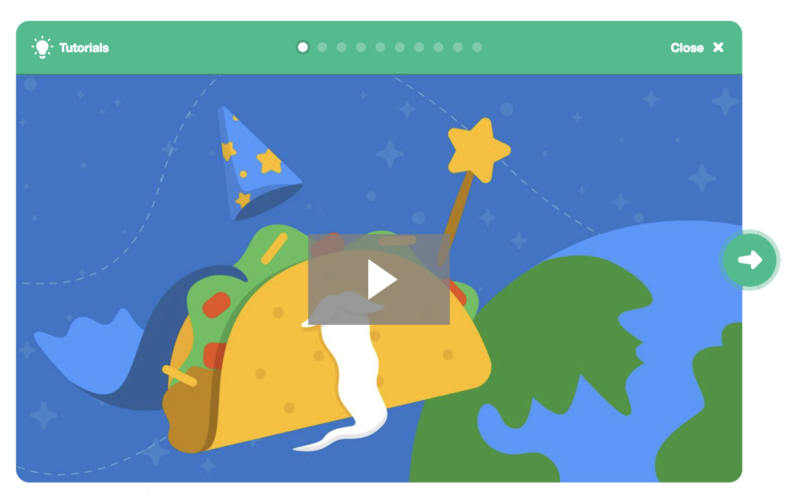
ANIMATE A CHARACTER / EDUCATOR GUIDE
ANIMATE A CHARACTER / EDUCATOR GUIDE
Get Ready for the Workshop
Use this checklist to prepare for the workshop.
Imagine
IMAGINE
Begin by gathering the participants to introduce the theme and spark ideas for projects.
Preview the Tutorial
The Animate a Character tutorial shows participants how to create their own projects. Preview the tutorial before your workshop and try the first few steps: scratch.mit.edu/tutorials
Warm-up Activity: Favorite Characters
Gather the group in a circle. Ask each participant to say their name, then share a favorite character from a book, movie, or TV show, and one or two of their favorite things about that character.
Print the Activity Cards
Print a few sets of Animate a Character cards to have available for participants during the workshop. scratch.mit.edu/ideas
Provide Ideas and Inspiration
To spark ideas, watch the Animate a Character video at the start of the tutorial. The video shows a variety of projects to spark ideas and inspiration.
Make sure participants have Scratch accounts
Participants can sign up for their own Scratch accounts at scratch.mit.edu, or you can set up student accounts if you have a Teacher Account. To request a Teacher Account, go to: scratch.mit.edu/educators
Set up computers or laptops
Arrange computers so that participants can work individually or in pairs.
Set up a computer with projector or large monitor
You can use a projector to show examples and demonstrate how to get started.
View the scratch.mit.edu/ideas
3
SCRATCH EDUCATOR GUIDE •
scratch.mit.edu/ideas
4

Slide 3



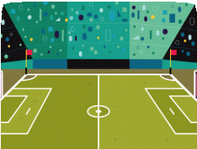



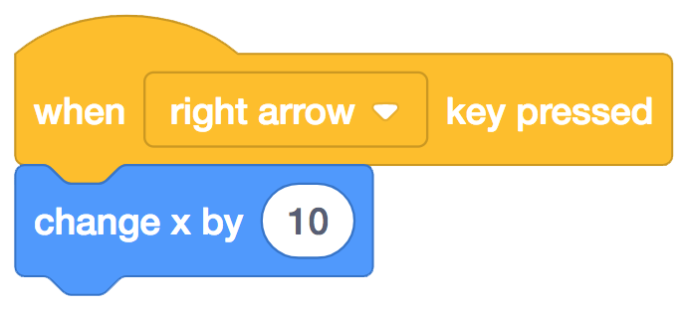
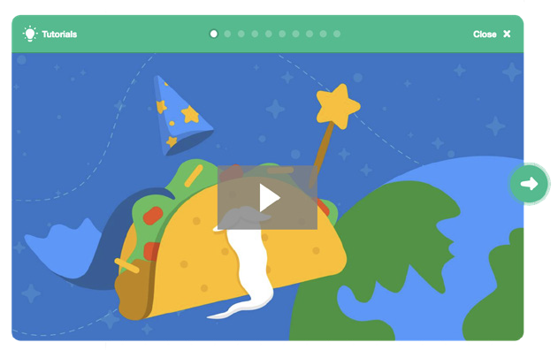
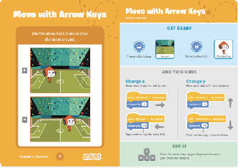
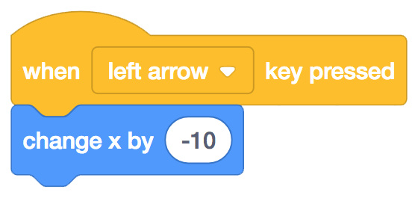


ANIMATE A CHARACTER / EDUCATOR GUIDE
ANIMATE A CHARACTER / EDUCATOR GUIDE
Demonstrate the First Steps
Create
Support participants as they create animated Scratch projects.
IMAGINE
CREATE
Demonstrate the first few steps of the tutorial so participants can see how to get started.
Choose a backdrop.
Choose a character to animate.
Start with Prompts
Ask participants questions to get started
Which character would you like to animate?
What do you want your character to do?
Soccer 2
Pico Walking
Make your sprite move right and left with arrow keys:
Provide Resources
Offer options for getting started
Choose right arrow
from the menu.
Choose left
Type a minus sign to move
Press the left arrow and right arrow keys on your keyboard to move.
Some participants may want to follow the online tutorial: scratch.mit.edu/animate
Others may want to explore using the activity cards: scratch.mit.edu/ideas
Helpful Hint: Understanding x y coordinates will help participants
figure out how to move sprites around the stage.
Suggest Ideas for Starting
y is the position on the Stage from top to bottom.
x is the position on the Stage from right to left.
Choose a character to animate.
Animate your character: make it jump, fly, glide or talk!
Choose a backdrop.
5
5
SCRATCH EDUCATOR GUIDE •
scratch.mit.edu/ideas
6

Slide 4


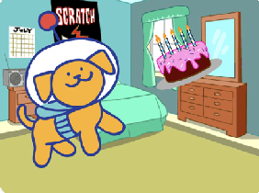





ANIMATE A CHARACTER / EDUCATOR GUIDE
ANIMATE A CHARACTER / EDUCATOR GUIDE
Share
Have participants share their project with their neighbors.
CREATE
SHARE
More Things to Try
Try combining more than one kind of animation.
If you’re not sure what to do, pick a card and try something new.
Add a second character or object to animate.
Ask questions they can discuss:
What do you like best about the project you made?
What was the hardest part?
Support collaboration
If you had more time, what would you add or change?
When someone gets stuck, connect them to another participant who can help.
See a cool idea? Ask the creator to share with others.
What’s Next?
Participants can use the ideas and concepts from this workshop to create a wide variety of projects. Encourage them to continue developing their projects into games, stories or interactive art with the resources listed below.
Encourage experimenting
The Animate a Character activity can be done in any order, with a range of different character and object sprites.
Create a Story
Choose characters, add conversation, and bring your story to life.
Chase Game
Make a game where you chase a character to score points.
Video Sensing
Interact with characters and objects in Scratch with video sensing.
Encourage students to try new things:
What will your character do next?
How can you make your animation interactive?
Find these projects in the Tutorials library: scratch.mit.edu/ideas
Scratch is a project of the Lifelong Kindergarten Group at the MIT Media Lab.
7
SCRATCH EDUCATOR GUIDE •
scratch.mit.edu/ideas
8

