Slide 1


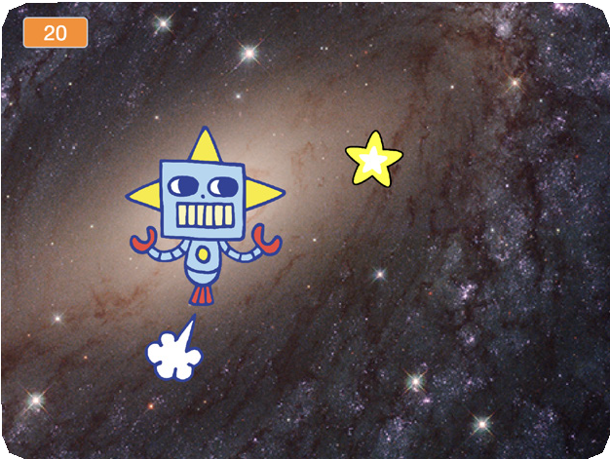
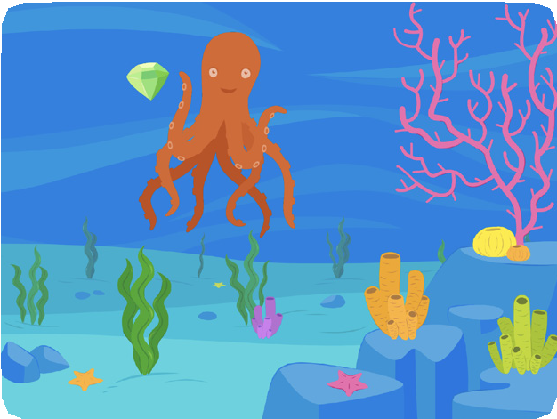
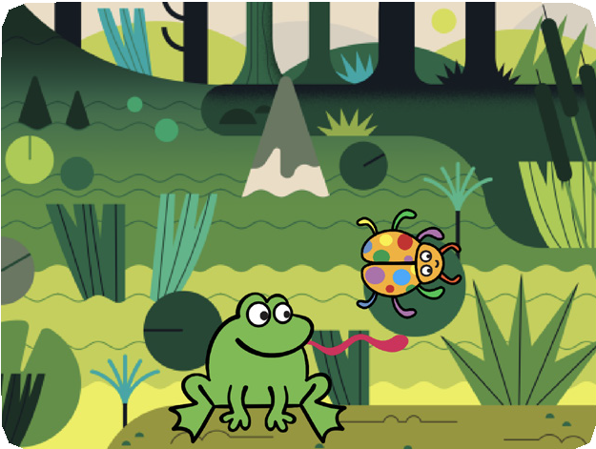
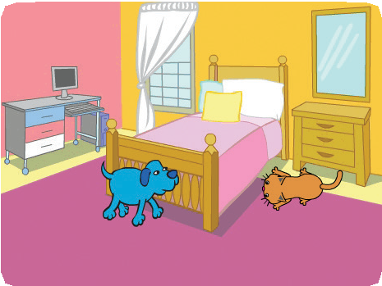


CHASE GAME / EDUCATOR GUIDE
CHASE GAME / EDUCATOR GUIDE
EDUCATOR GUIDE
Make a Chase Game
With this guide, you can plan and lead a one- hour workshop using Scratch. Participants will make a game that includes a variable to keep score.
Workshop Overview
Here’s a suggested agenda for a one-hour workshop:
First, gather as a group to introduce the theme and spark ideas.
IMAGINE
10 minutes
Next, help participants as they make chase games, working at their own pace.
CREATE
40 minutes
At the end of the session, gather together to share and reflect.
SHARE
10 minutes
1
SCRATCH EDUCATOR GUIDE •
scratch.mit.edu/ideas
2

Slide 2

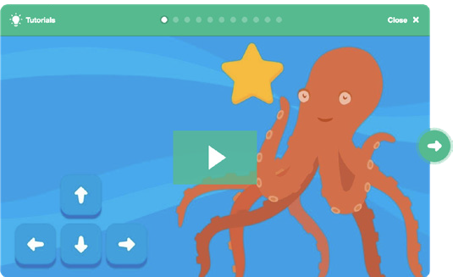
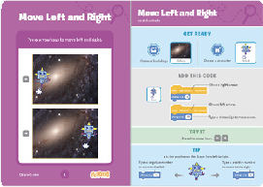
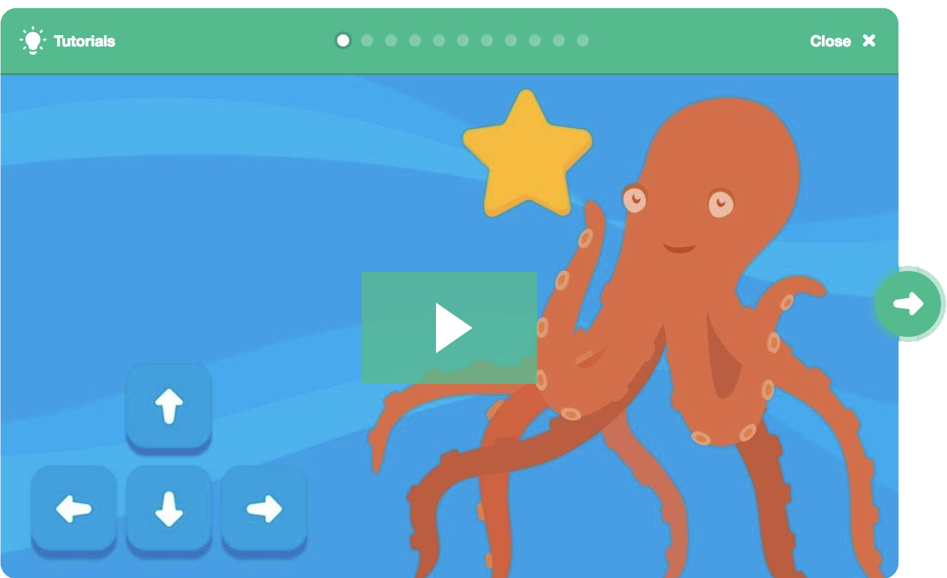
Imagine
CHASE GAME / EDUCATOR GUIDE
CHASE GAME / EDUCATOR GUIDE
Get Ready for the Workshop
Use this checklist to prepare for the workshop.
IMAGINE
Begin by gathering the participants to introduce the theme and spark ideas for projects.
Preview the Tutorial
The Make a Chase Game tutorial shows participants how to create their own projects. Preview the tutorial before your workshop and try the first few steps.
Warm-up Activity: Imaginary Chase
Gather the participants in a circle. Start by giving an example of one thing chasing another, such as “The dog is chasing the dinosaur.” The next person adds on, such as, “The dinosaur
is chasing a donut.” The following person adds on by saying, “The donut is chasing a duck.” or whatever creature or object they choose. Continue until each person has added on to this imaginary game of chase.
Print the Activity Cards
Print a few sets of Chase Game cards to have available for participants during the workshop. You can download the cards at: scratch.mit.edu/ideas
Make sure participants have Scratch accounts
Participants can sign up for their own Scratch accounts at scratch.mit.edu, or you can set up student accounts if you have a Teacher Account. To request a Teacher Account, go to: scratch.mit.edu/educators
Set up computers or laptops
Arrange computers so that participants can work individually or in pairs.
Set up a computer with projector or large monitor
You can use a projector to show examples and demonstrate how to get started.
Provide Ideas and Inspiration
To spark ideas, watch the Make a Chase Game video at the start of the tutorial.
View the video at scratch.mit.edu/chase
3
SCRATCH EDUCATOR GUIDE •
scratch.mit.edu/ideas
4

Slide 3



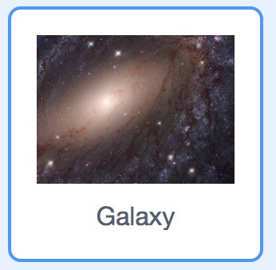

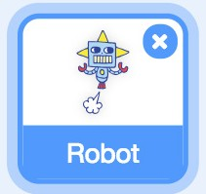

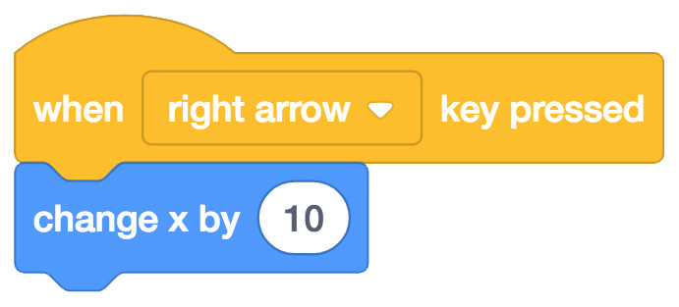
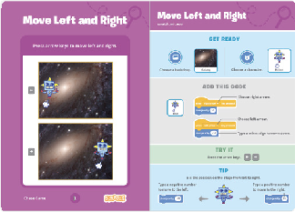
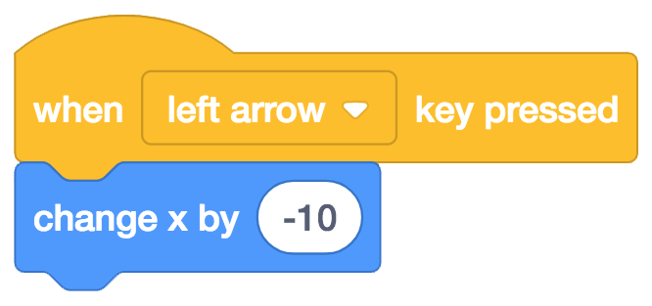





Create
CHASE GAME / EDUCATOR GUIDE
CHASE GAME / EDUCATOR GUIDE
Demonstrate the First Steps
IMAGINE
CREATE
Demonstrate the first few steps of the tutorial so participants can see how to get started.
Support participants as they create catch games. Suggest working in pairs.
Choose a backdrop.
_{C}In_{ho}S_{o}c_{s}r_{e}at_{a}ch_{s},_{p}c_{r}h_{it}o_{e}o_{, l}s_{ik}e_{e}a_{R}n_{o}e_{b}w_{ot}s.prite.
Start with Prompts
Ask participants questions to get started
Which backdrop would you like to choose for your game?
Who do you want as the main character in your game? What will it chase?
Make your sprite move right and left with arrow keys.
Choose right arrow from the menu.
Choose left arrow from the
Type a minus sign to move
Press the left arrow and right arrow
keys on your keyboard to move.
Provide Resources
Offer options for getting started
Some participants may want to follow the online tutorial: scratch.mit.edu/chase
Others may want to explore using the printed cards: scratch.mit.edu/ideas
Discuss next steps they can try, such as coding the sprite to move up and down and adding a sprite to chase.
Suggest Ideas for Starting
Choose a backdrop
Choose or draw a main character
Make it move with arrow keys.
Select an object to chase.
Star
5
SCRATCH EDUCATOR GUIDE •
scratch.mit.edu/ideas
6

Slide 4


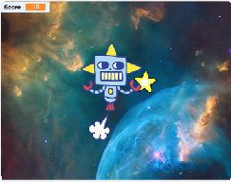
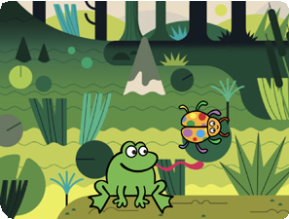
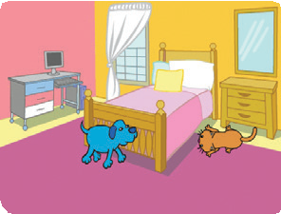
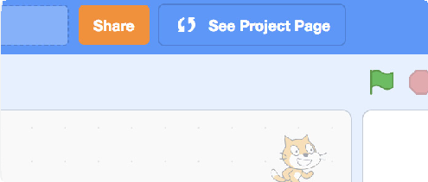

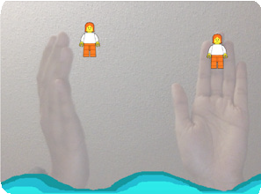
Share
CHASE GAME / EDUCATOR GUIDE
CHASE GAME / EDUCATOR GUIDE
CREATE
SHARE
More Things to Try
Code the star or other sprite to chase
Add a variable to keep score
Add sounds
Add a level
Show a message when reaching the new level
Have participants share their projects with their neighbors.
Ask questions that encourage reflection:
What do you like best about your game?
If you had more time, what would you add or change?
Encourage Tinkering
Encourage participants to feel comfortable trying combinations of blocks and seeing what happens.
Suggest participants look inside other chase games to see the code.
If they find code they like, they can drag the scripts or sprites into the backpack to reuse in their own project.
What’s Next?
Chase Game projects provide an introduction to creating interactive games in Scratch. Here are a few ways that learners can build on the concepts they learned from this project.
Add Obstacles
For a more complex game, add obstacles to avoid. Subtract points when you hit the obstacles.
Make a Two-Player Game
For an extra challenge, make a version of the game that allows two players to play.
Video Sensing
If the computers have a web camera attached or built-in, learners can make a game that they interact by moving their bodies. See the Video Sensing tutorial and educator guide for support.
Created by the Scratch Team
Prepare to Share
To add instructions and credits to a project, click the “See project page” button.
7
SCRATCH EDUCATOR GUIDE •
scratch.mit.edu/ideas
8

