Slide 1




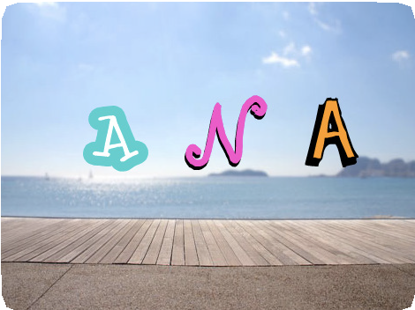
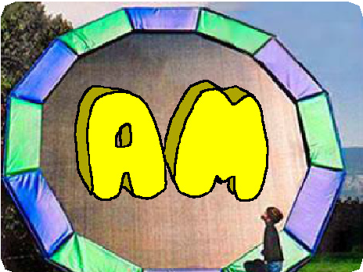

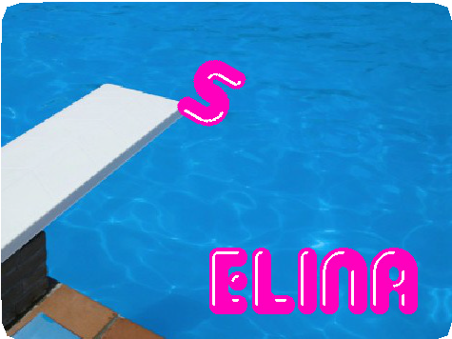


ANIMATE YOUR NAME / EDUCATOR GUIDE
ANIMATE YOUR NAME / EDUCATOR GUIDE
EDUCATOR GUIDE
Animate a Name
With this guide, you can plan and lead a one- hour workshop using Scratch. Participants will gain experience with coding as they animate the letters in a word or name.
Workshop Overview
Here’s a suggested agenda for a one-hour workshop:
First, gather as a group to introduce the theme and spark ideas.
IMAGINE
10 minutes
Next, help participants as they animate their names, working at their own pace.
CREATE
40 minutes
At the end of the session, gather together to share and reflect.
SHARE
10 minutes
1
SCRATCH EDUCATOR GUIDE •
scratch.mit.edu/ideas
2

Slide 2

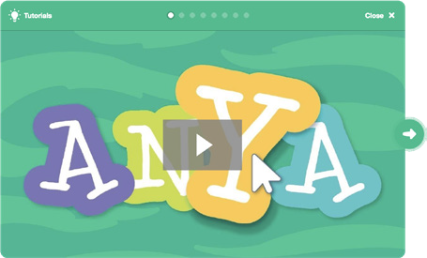
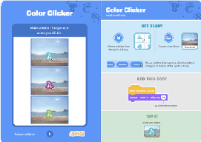
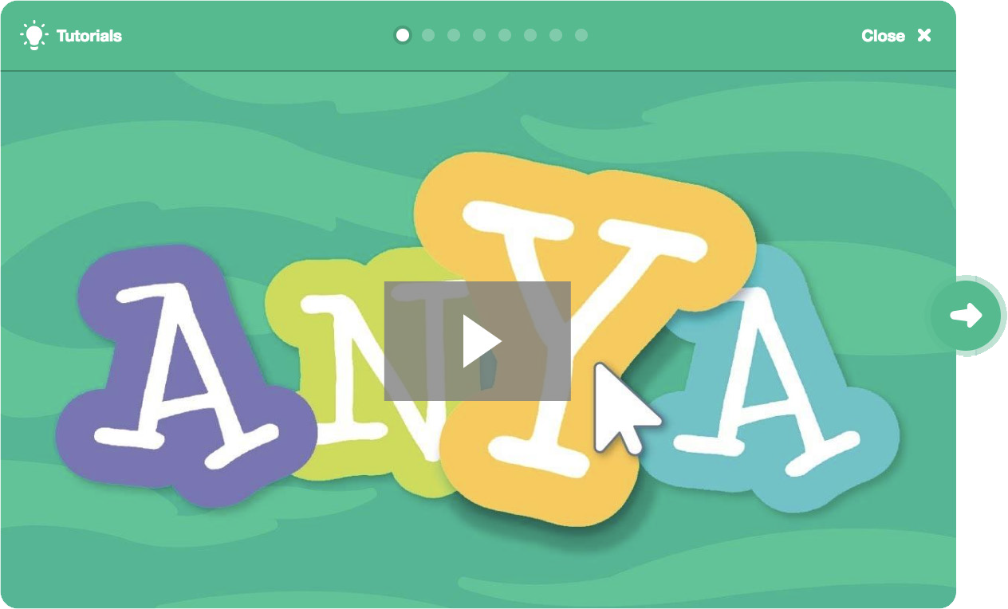
Imagine
ANIMATE YOUR NAME / EDUCATOR GUIDE
ANIMATE YOUR NAME / EDUCATOR GUIDE
Get Ready for the Workshop
Use this checklist to prepare for the workshop.
IMAGINE
Begin by gathering the participants to introduce the theme and spark ideas for projects.
Preview the Tutorial
The Animate Your Name tutorial shows participants how to create their own projects. Preview the tutorial before your workshop and try the first few steps: scratch.mit.edu/name
Print the Activity Cards
Print a few sets of Animate Your Name cards to have available for participants during the workshop. scratch.mit.edu/ideas
Make sure participants have Scratch accounts
Participants can sign up for their own Scratch accounts at scratch.mit.edu, or you can set up student accounts if you have a Teacher Account. To request a Teacher Account, go to: scratch.mit.edu/educators
Set up computers or laptops
Arrange computers so that participants can work individually or in pairs.
Set up a computer with projector or large monitor
You can use a projector to show examples and demonstrate how to get started.
Warm-up Activity: Letter Shapes
Gather the group in a circle. Ask each participant to say their name, and then have everyone in the group act out the shape of the first letter.
Provide Ideas and Inspiration
Show the introductory video for the Animate Your Name tutorial. The video shows a variety of projects for ideas and inspiration.
View at scratch.mit.edu/name
3
SCRATCH EDUCATOR GUIDE •
scratch.mit.edu/ideas
4

Slide 3




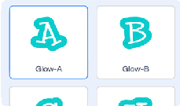

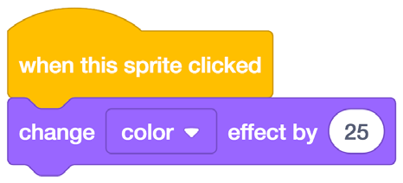

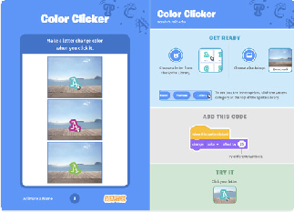

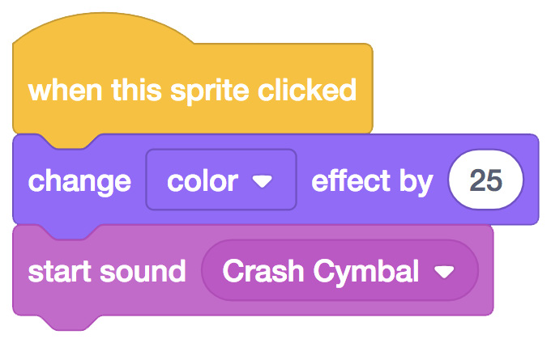


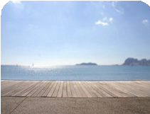

Create
ANIMATE YOUR NAME / EDUCATOR GUIDE
ANIMATE YOUR NAME / EDUCATOR GUIDE
Demonstrate the First Steps
IMAGINE
CREATE
Demonstrate the first few steps of the tutorial so participants can see how to get started.
Support participants as they create interactive name projects.
In Scratch, click Create.
Choose a letter from the Sprite Library:
Start with Prompts
Ask participants questions to get started
Do you want to animate your name, initials, or username?
Which letter do you want to start with?
Glow-A
Make it do something:
Provide Resources
Offer options for getting started
Try different numbers.
Add a sound:
Click the Sounds tab.
Some participants may want to follow the online tutorial: scratch.mit.edu/name
Others may want to explore using the activity cards: scratch.mit.edu/ideas
Choose your sound from the menu.
Choose a new backdrop:
Suggest Ideas for Starting
Choose a letter
Make it change color
Add a sound
Add a backdrop
Boardwalk
5
SCRATCH EDUCATOR GUIDE •
scratch.mit.edu/ideas
6

Slide 4



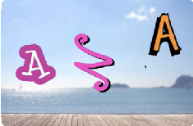
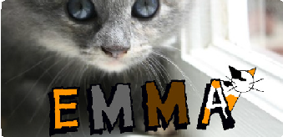
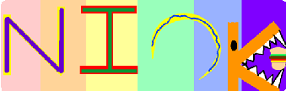

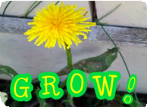

Share
ANIMATE YOUR NAME / EDUCATOR GUIDE
ANIMATE YOUR NAME / EDUCATOR GUIDE
CREATE
SHARE
More Things to Try
Have participants share their project with their neighbors.
Draw a letter
Make it spin
Make it glide
Change size
Add more letters and motion!
Ask questions they can discuss:
What do you like best about the project you made?
What was the hardest part?
Support collaboration
When someone gets stuck, connect them to another participant who can help.
See a cool idea? Ask the creator to share with others.
If you had more time, what would you add or change?
What’s Next?
Participants can use the ideas and concepts from this workshop to create a wide variety of projects. Here are a few variations on the animated name project you could suggest.
Encourage experimenting
Help participants feel comfortable trying different combinations of blocks and seeing what happens.
To understand their thought process, you can ask questions:
Other Names
Animate the name of a favorite character from a book or movie. Or,
animate the letters of the name of your school or town.
Start with an Image
Have participants bring in a picture (or find a picture on the web) and animate a word that goes with the picture.
Acrostics
Make an interactive acrostic (a poem
in which the first letters of each line spell out a word reading down).
What are you working on now?
What are you thinking of trying next?
Scratch is a project of the Lifelong Kindergarten Group at the MIT Media Lab.
7
SCRATCH EDUCATOR GUIDE •
scratch.mit.edu/ideas
8

