Slide 1



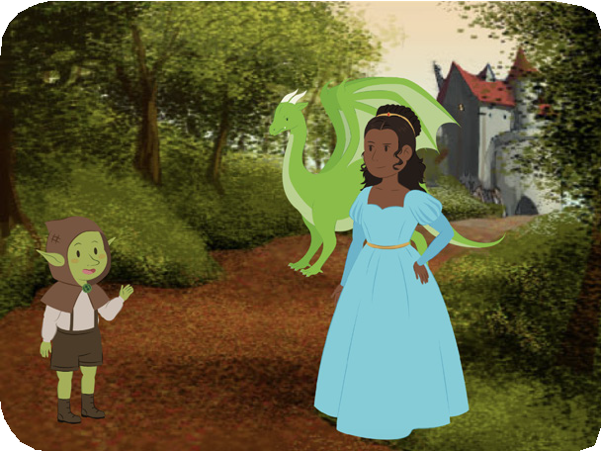
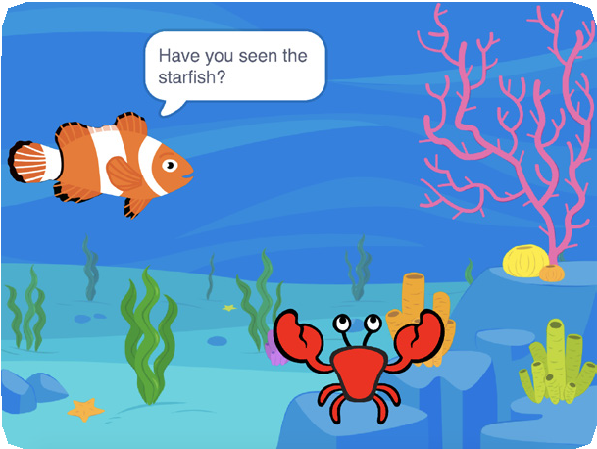
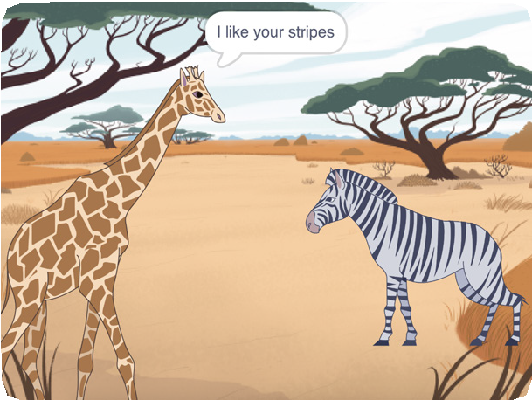
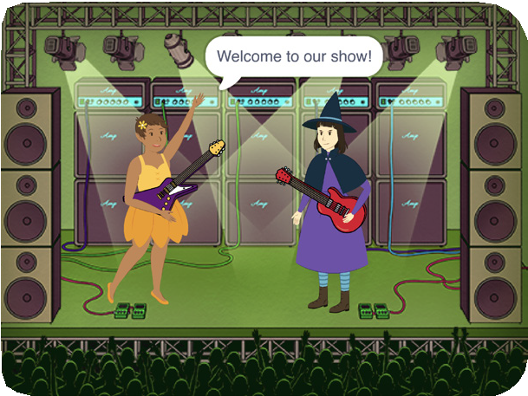


CREATE A STORY / EDUCATOR GUIDE
CREATE A STORY / EDUCATOR GUIDE
EDUCATOR GUIDE
Create a Story
With this guide, you can plan and lead a one- hour workshop using Scratch. Participants will create a story with settings, characters, and dialogue.
Workshop Overview
Here’s a suggested agenda for a one-hour workshop:
First, gather as a group to introduce the theme and spark ideas.
IMAGINE
10 minutes
Next, help participants as they create story projects, working at their own pace.
CREATE
40 minutes
At the end of the session, gather together to share and reflect.
SHARE
10 minutes
1
SCRATCH EDUCATOR GUIDE •
scratch.mit.edu/ideas
2

Slide 2

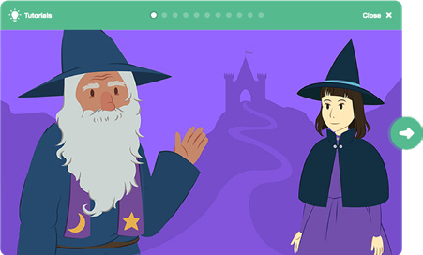
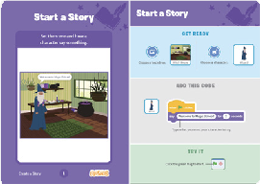
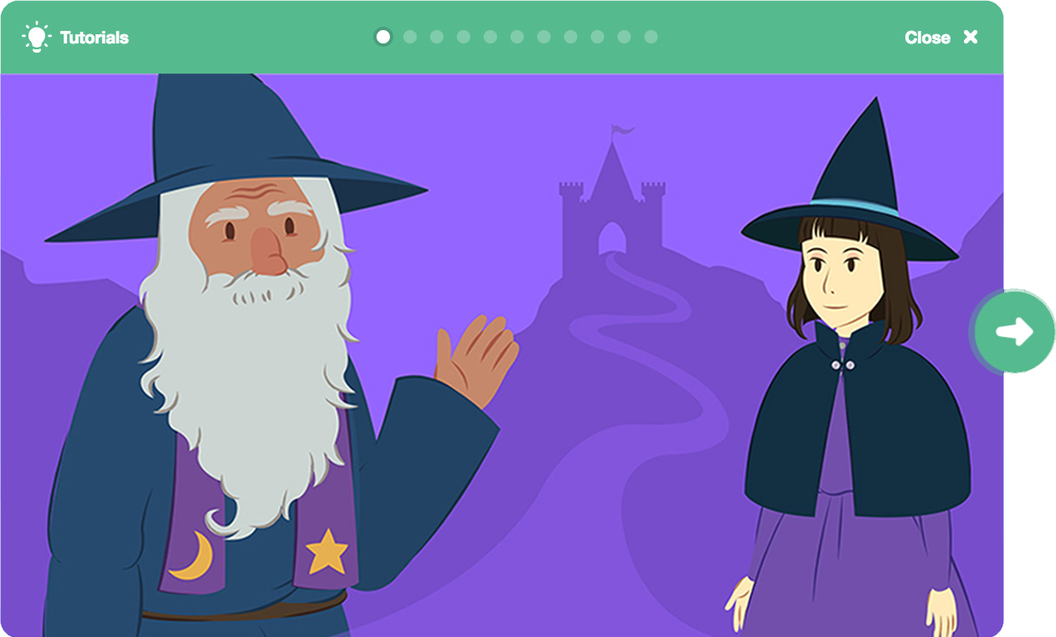
Imagine
CREATE A STORY / EDUCATOR GUIDE
CREATE A STORY / EDUCATOR GUIDE
Get Ready for the Workshop
Use this checklist to prepare for the workshop.
IMAGINE
Begin by gathering the participants to introduce the theme and spark ideas for projects.
Preview the Tutorial
The Create a Story tutorial shows participants how to create their own projects. Preview the tutorial before your workshop and try the first few steps: scratch.mit.edu/story
Print the Coding Cards
Print a few sets of Create a Story cards to have available for participants during the workshop. You can download from this page: scratch.mit.edu/ideas
Make sure participants have Scratch accounts
Participants can sign up for their own Scratch accounts at scratch.mit.edu, or you can set up student accounts if you have a Teacher Account. To request a Teacher Account, go to: scratch.mit.edu/educators
Set up a studio for project sharing on Scratch
Set up a studio so participants will be able to add their projects. Go to your My Stuff page, then click the +New Studio button. Type in a name for the studio.
Set up computers or laptops
Arrange computers so that participants can work individually or in pairs.
Warm-up Activity: Story Starters in a Bag
Have participants make up a brief story by giving them a bag with three objects in it, and asking them to include all of the items in the story. In each bag, you could include small objects, pictures of animals or characters, and/or words (people, places, or things).
Divide participants into groups of two or three, and have each pick a bag. Give them a few minutes to come up with a quick story.
Provide Ideas and Inspiration
You can show the Create a Story tutorial video to show participants how they can start making stories in Scratch.
View the video at: scratch.mit.edu/story
3
SCRATCH EDUCATOR GUIDE •
scratch.mit.edu/ideas
4

Slide 3



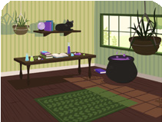

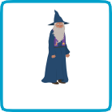

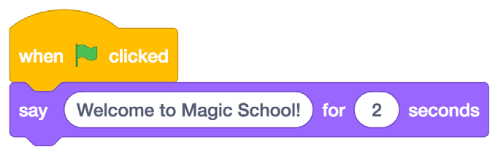

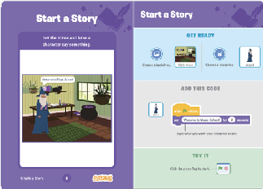
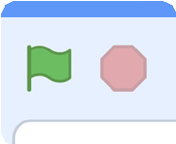
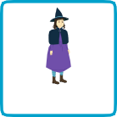

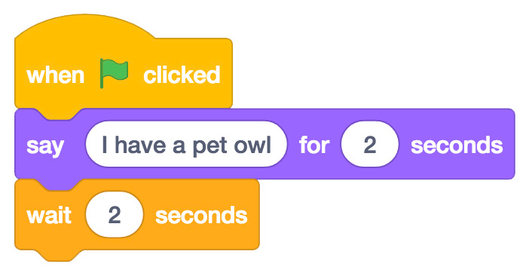
Create
CREATE A STORY / EDUCATOR GUIDE
CREATE A STORY / EDUCATOR GUIDE
Demonstrate the First Steps
IMAGINE
CREATE
Demonstrate the first few steps of the tutorial so participants can see how to get started.
Support participants as they create Story projects, on their own or in pairs.
In Scratch, click Create. Choose a backdrop.
Choose any character (in Scratch called a sprite).
Start with Prompts
Ask participants questions to get started
Where will your story take place?
What will happen first?
Witch House
Code your character to say something.
Wizard
Provide Resources
Offer options for getting started
Type what you want your character to say.
Click the green flag to start.
Add another character.
Some participants may want to follow the online tutorial: scratch.mit.edu/story
Others may want to explore using the coding cards: scratch.mit.edu/ideas
Witch
Add code to the new character.
Suggest Ideas for Starting
Use this block to have the second character
wait before they say
something.
Choose a backdrop.
Choose a character.
Make a character say something
Make a character hide and show.
5
SCRATCH EDUCATOR GUIDE •
scratch.mit.edu/ideas
6

Slide 4


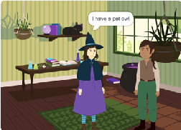
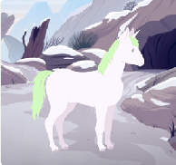
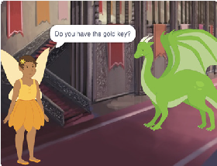
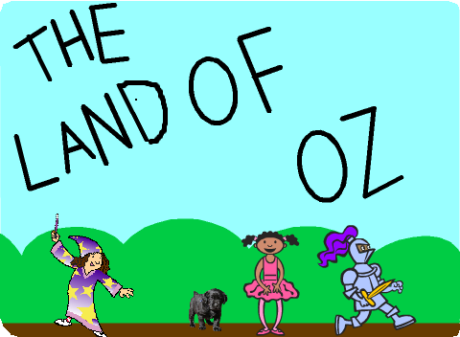
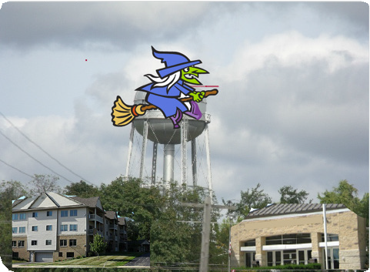
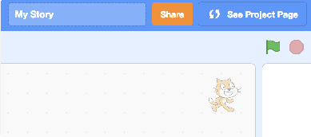
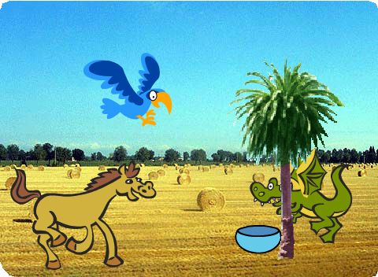
Share
CREATE A STORY / EDUCATOR GUIDE
CREATE A STORY / EDUCATOR GUIDE
CREATE
SHARE
More Things to Try
Help the participants add their projects to a shared studio in Scratch. Give them a link to the studio. Then they can click ‘Add Projects’ at the bottom of the page.
Switch backdrops.
Make your characters have a conversation.
Move your characters.
Change something when you click on it.
Ask for volunteers to show their project to the group.
Support Tinkering
What’s Next?
Participants can use these ideas and concepts to create a variety of projects. Here are some variations on the story project you could suggest:
Scratch is designed to support creating by experimenting and tinkering. So, your participants may want to start their stories without planning beforehand. As they create, one idea can spark another.
Celebrate their sparks of creativity and the unexpected turns their stories may take.
Retell a story
Start with a story you know and make it in Scratch. Imagine a new ending or a different setting.
Prepare to Share
Neighbourhood story
Take photos of your classroom, school, or neighborhood and use them as backdrops in your story.
To add instructions and credits to a project, click the button: “See project page”.
Round-robin story
Give everyone 5 minutes to start a story. Then, have them switch to the next computer to add to the story. Repeat.
Then click the Share button if you want the project visible to others online.
Scratch is a project of the Lifelong Kindergarten Group at the MIT Media Lab.
7
SCRATCH EDUCATOR GUIDE •
scratch.mit.edu/ideas
8

