Slide 1
Introduction to Machine Learning
PhD(d) Eng. Gabriel Pirlogeanu

Slide 2
Overview
What is Machine Learning?
Data & Feature Engineering
Supervised ML
Various Methods
Hard Cases

Slide 3
Nature & Processes
Natural systems consist of processes that evolve continuously over time.
Patterns to be studied
Past observations and experiences => predictions of future states based on prior knowledge
Question:
Isn’t this what statistics does?

Slide 4
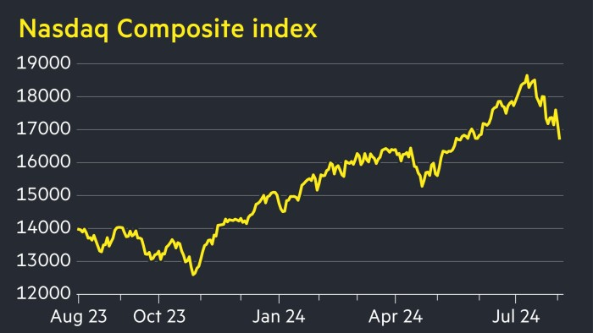
Nature & Processes

Slide 5
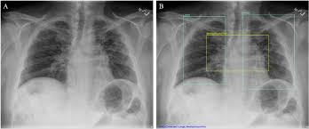
Nature & Processes

Slide 6
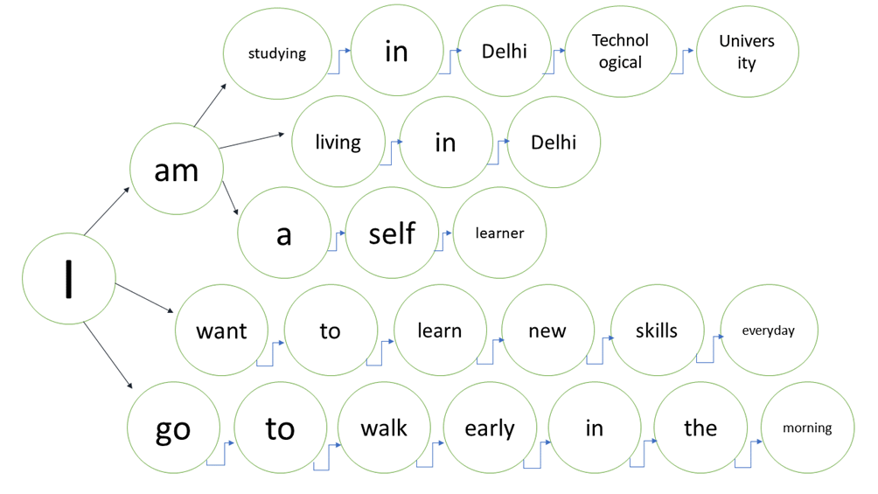
Nature & Processes

Slide 7
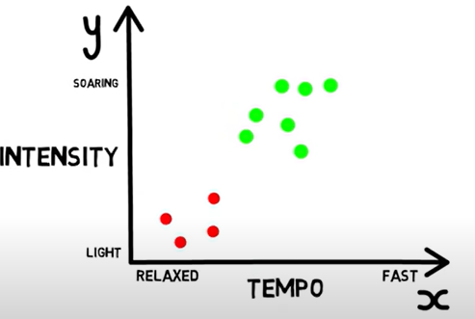

Study Case: Music Preferences
Can we predict if somebody will like a song based on previous songs he liked? Why do we like songs? Because of: tempo, intensity, genre, etc.

Slide 8
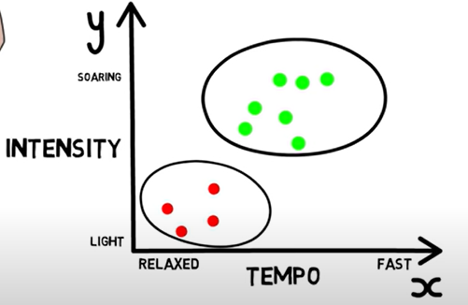
Study Case: Music Preferences
Can we predict if somebody will like a song based on previous songs he liked? Why do we like songs? Because of: tempo, intensity, genre, etc.

Slide 9
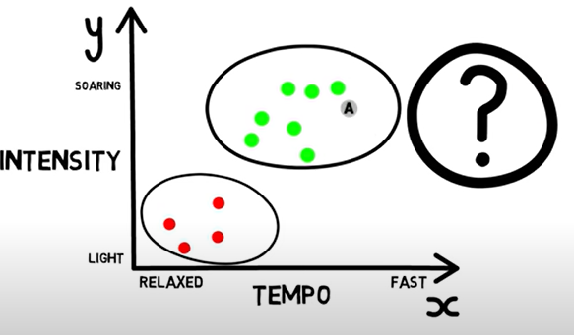
Study Case: Music Preferences
Can we predict if somebody will like a song based on previous songs he liked? Why do we like songs? Because of: tempo, intensity, genre, etc.

Slide 10
Study Case: Music Preferences
Can we predict if somebody will like a song based on previous songs he liked? Why do we like songs? Because of: tempo, intensity, genre, etc.
EASY

Slide 11
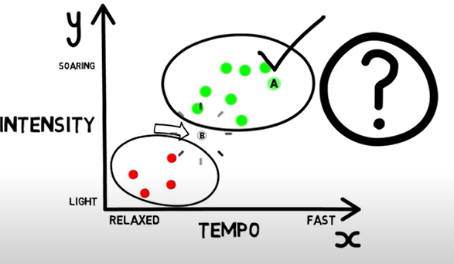
Study Case: Music Preferences
Can we predict if somebody will like a song based on previous songs he liked? Why do we like songs? Because of: tempo, intensity, genre, etc.

Slide 12
Study Case: Music Preferences
Can we predict if somebody will like a song based on previous songs he liked? Why do we like songs? Because of: tempo, intensity, genre, etc.
HARD

Slide 13
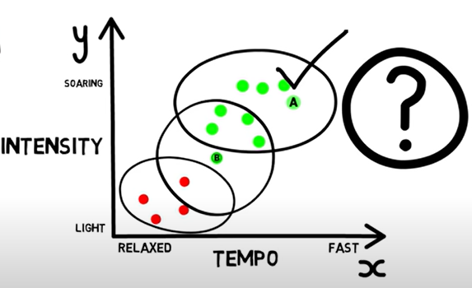
Study Case: Music Preferences
Can we predict if somebody will like a song based on previous songs he liked? Why do we like songs? Because of: tempo, intensity, genre, etc.

Slide 14
Study Case: Music Preferences
Can we predict if somebody will like a song based on previous songs he liked? Why do we like songs? Because of: tempo, intensity, genre, etc.
K-Nearest Neighbours

Slide 15
Study Case: Music Preferences
Can we predict if somebody will like a song based on previous songs he liked? Why do we like songs? Because of: tempo, intensity, genre, etc.
Classes/Labels
K-Nearest Neighbours

Slide 16
Study Case: Music Preferences
Can we predict if somebody will like a song based on previous songs he liked? Why do we like songs? Because of: tempo, intensity, genre, etc.
Classes/Labels
K-Nearest Neighbours

Slide 17
Study Case: Music Preferences
Can we predict if somebody will like a song based on previous songs he liked? Why do we like songs? Because of: tempo, intensity, genre, etc.
Classes/Labels
Features/Attributes
K-Nearest Neighbors

Slide 18
AI or ML or Fancy Statistics?
Machine Learning starts making sense in problems where it’s hard to draw a clear decision boundary or can’t model the relationship between input data and output data.

Slide 19
AI or ML or Fancy Statistics?
Machine Learning starts making sense in problems where it’s hard to draw a clear decision boundary or can’t model the relationship between in data and output data.
Systems than can automate processes.
Imply more than an algorithm.
It needs an interface, ports, etc.
Can be as simple as rule-based and complex as ChatGPT
Artificial Intelligence

Slide 20
AI or ML or Fancy Statistics?
Machine Learning starts making sense in problems where it’s hard to draw a clear decision boundary or can’t model the relationship between in data and output data.
Predictive algorithms
Learn patterns from data
Artificial Intelligence
Machine Learning

Slide 21
AI or ML or Fancy Statistics?
Machine Learning starts making sense in problems where it’s hard to draw a clear decision boundary or can’t model the relationship between in data and output data.
Artificial Intelligence
Learn complex data patterns through Multi-Layered Networks
Non-linear problems
Machine Learning
Deep Learning

Slide 22
AI or ML or Fancy Statistics?
Machine Learning starts making sense in problems where it’s hard to draw a clear decision boundary or can’t model the relationship between in data and output data.
Basis of many ML algorithms
Regressions, Probability, Decision Trees
Can’t handle complex data patterns
Artificial Intelligence
Machine Learning
Statistics
Deep Learning

Slide 23
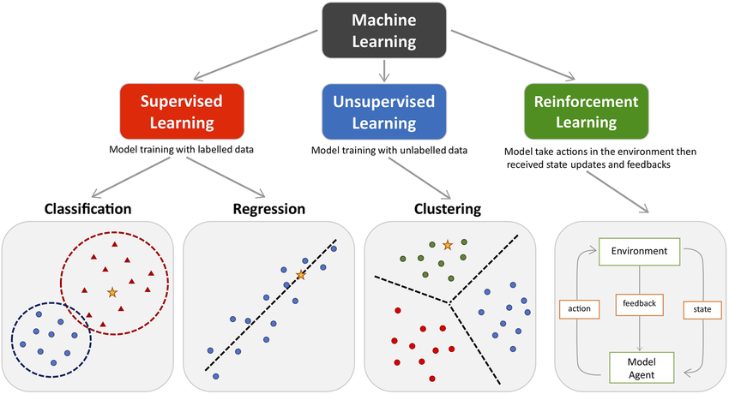
Problems in Machine Learning

Slide 24
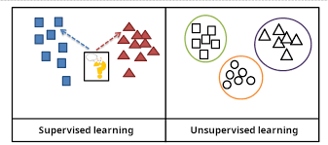
Supervised vs Unsupervised Learning

Slide 25
Data Processing: Features & Labels
“garbage in, garbage out”

Slide 26
Features
Describe data.
Represent attributes, properties, variable responsible for taking decisions.

Slide 27
Features
Describe data.
Represent attributes, properties, variable responsible for taking decisions.
Feature Types

Slide 28
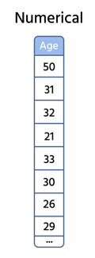
Features
Describe data.
Represent attributes, properties, variable responsible for taking decisions.
Feature Types
Numerical

Slide 29
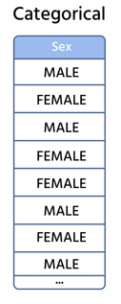
Features
Describe data.
Represent attributes, properties, variable responsible for taking decisions.
Feature Types
Numerical
Categorical

Slide 30
Features
Describe data.
Represent attributes, properties, variable responsible for taking decisions.
Feature Types
Numerical
Categorical
Boolean (True/False)
Categories (Cities, Names, Colors, etc.)

Slide 31
Problem with features

Slide 32
Problem with features
It’s hard to manually collect these features/descriptions of data

Slide 33
Problem with features
It’s hard to manually collect these features/descriptions of data
Expert knowledge might be needed for measurements

Slide 34
Problem with features
It’s hard to manually collect these features/descriptions of data
Expert knowledge might be needed for measurements
There are often missing values

Slide 35
Problem with features
It’s hard to manually collect these features/descriptions of data
Expert knowledge might be needed for measurements
There are often missing values
Outliers

Slide 36
Problem with features
It’s hard to manually collect these features/descriptions of data
Expert knowledge might be needed for measurements
There are often missing values
Outliers
Redundant Features

Slide 37
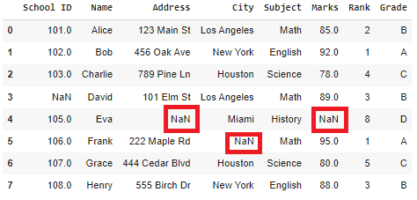
Problem with features

Slide 38
Feature Engineering

Slide 39
Feature Engineering
Extract features automatically
Collect them through sensors
Extract different values from complicate data like images (RGB channels, hues, pixel values, etc.) or from audio (spectrograms, mel cepstral coefficients, etc.)
Use Neural Networks

Slide 40
Feature Engineering
Extract features automatically
Collect them through sensors
Extract different values from complicate data like images (RGB channels, hues, pixel values, etc.) or from audio (spectrograms, mel cepstral coefficients, etc.)
Use Neural Networks
Scale Feature Values to similar data ranges (e.g. [0,1])

Slide 41
Feature Engineering
Extract features automatically
Collect them through sensors
Extract different values from complicate data like images (RGB channels, hues, pixel values, etc.) or from audio (spectrograms, mel cepstral coefficients, etc.)
Use Neural Networks
Scale Feature Values to similar data ranges (e.g. [0,1])
Encode features
We can’t work with strings
Convert categorical features => numerical features

Slide 42
Feature Engineering – Missing Data
Some properties may have not been collected, due to errors - N/A values

Slide 43
Feature Engineering – Missing Data
Some properties may have not been collected, due to errors - N/A values
Solutions:
Drop samples that contain missing data => reduces dataset size..
Should be done if <=5% of dataset size is missing for that particular feature
Fill them with values:
Numerical feats: min, max, mean, median
Categorical feats: “UNK”, most frequent value

Slide 44
Feature Engineering – Dimensionality Reduction
Some data may have hundreds of features:
Medical data tends to have many variables in order to make a prediction
Images: a 250 x 250 pixel image has 62k pixels!
Problems:
Some features might not be useful for the specific problem
It greatly increases memory, computation complexity, training time!

Slide 45
Feature Engineering – Dimensionality Reduction
Some data may have hundreds of features:
Medical data tends to have many variables in order to make a prediction
Images: a 250 x 250 pixel image has 62k pixels!
Problems:
Some features might not be useful for the specific problem
It greatly increases memory, computation complexity, training time!
Solution:
Principal Component Analysis (PCA)
Reduces the number of features, while keeping the most important traits!
Reduces computation complexity & can even improve results!

Slide 46
Labels
What the models tries to LEARN based on data FEATURES.
Targets, classes.

Slide 47
Labels
What the models tries to LEARN based on data FEATURES.
Targets, classes.
Label types based on TASK
REGRESSION: numerical values
CLASSIFICATION: classes/categories

Slide 48
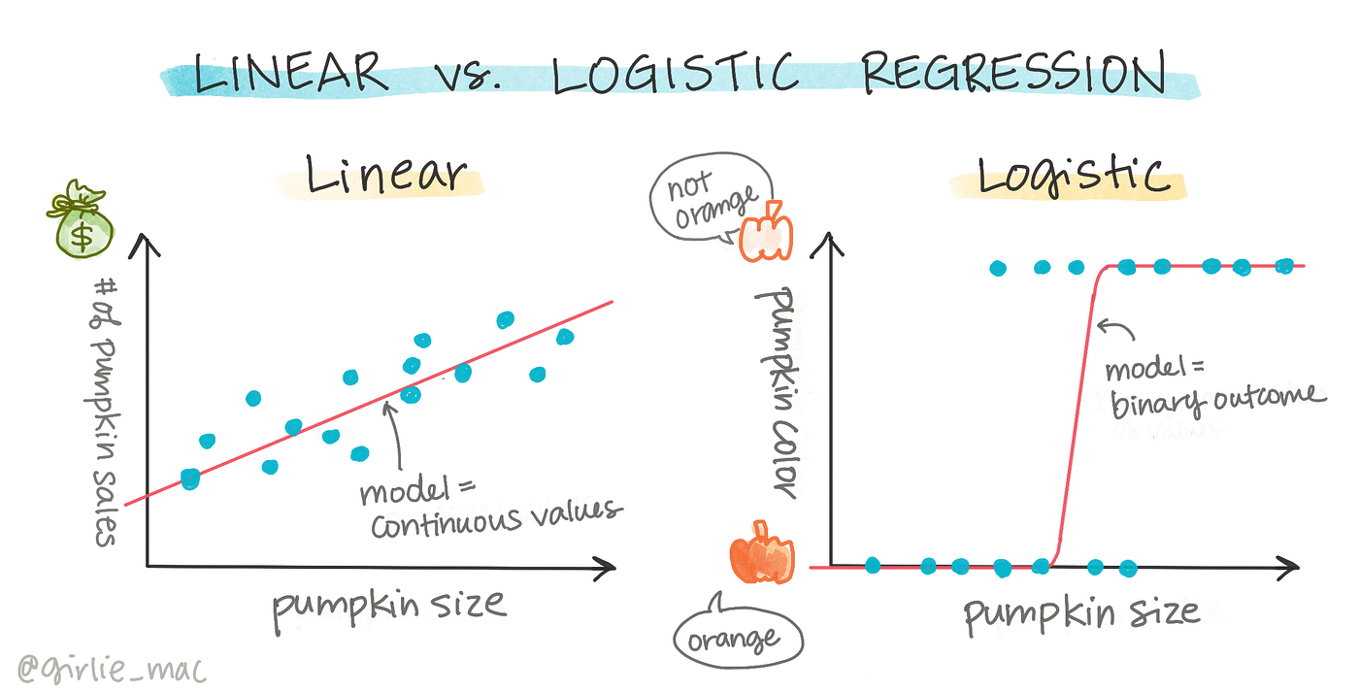


Regression Task
Very common problem in Statistics
Fitting data to a curve.
$$y∈R$$
$$y∈[0,1]$$

Slide 49
Classification
Attribute a class/label to data
Several types
Binary Classification: only 2 possible classes (e.g.: dead/alive, healthy/sick, dog/cat); only one prediction per sample.
Multi-class Classification: >2 possible classes; only one prediction per sample.
Multi-label Classification: >=2 possible classes; more than one predictions per sample.

Slide 50
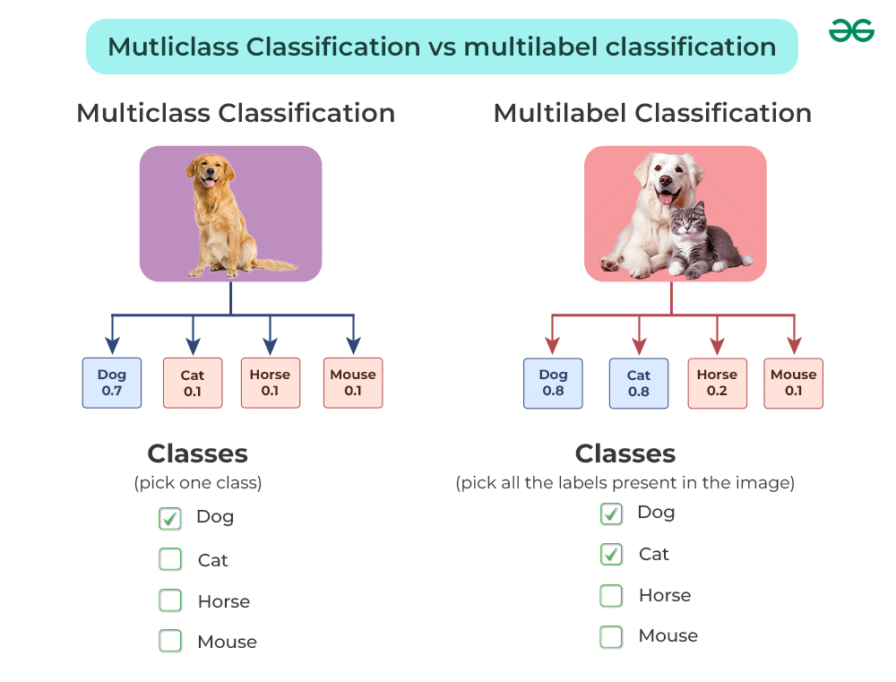

Slide 51
Classification: Encoding
It is normal to encode the labels in the numerical space
Solutions:
Simply attribute a number to each class. For N labels, we will have classes with number in the range [0,N].
One-Hot Encoding

Slide 52
Classification: Encoding
It is normal to encode the labels in the numerical space
Solutions:
Simply attribute a number to each class. For N labels, we will have classes with number in the range [0,N].
One-Hot Encoding
Multi-Class Classification:
Multi-Label Classification
Car:
[1 0 0 0]
[0 1 0 0]
[0 0 1 0]
[ 0 0 0 1]
Car:
[1 0 0 0]
[0 1 0 0]
[0 0 1 0]
[ 0 0 0 1]
Dog:
Dog:
TRAIN
TRAIN
Bike:
Bike:
Table:
Table:
Prediction: [ 0 0 1 0]
Prediction: [ 1 0 1 0]

Slide 53
Classification: Encoding
Why encode?
Predictions can be sparse/discrete
E.g.: Reference: [ 0 1 0 0 0 ] - Prediction: [ 0 1 0 1 0 ]
Predictions can be probabilities
E.g.: Reference: [ 0 1 0 0 0 ] - Prediction: [ 0.1 0.75 0.2 0.3 0.51]
choose the max? choose classes with probabilities above a threshold?

Slide 54
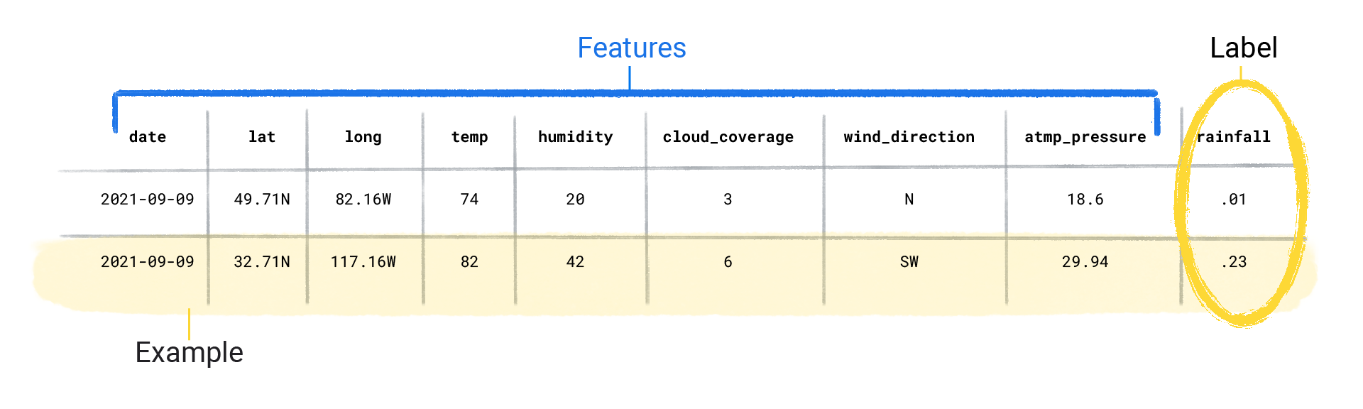
Conclusions: Features & Labels

Slide 55
RECAP
What does Machine Learning try to solve?
Problems where it’s hard to draw clear decision boundaries.
Tries to model functions/transformations, where we don’t have an explicit mathematical formulation.
Features
Categorical
Numerical
Feature Engineering: Drop/Fill missing values, Scale/Normalize, PCA
Labels
Numerical Values (Regression)
Classes (Classification)

Slide 56
Supervised Learning

Slide 57
Supervised Learning
We have looked different data components and data processing techniques.
But how can we use them in order to make predictions?
We FIT a model based on prior observations.
We EVALUATE the model on new/future observations.
Types of models:
Non-parametric
Parametric

Slide 58
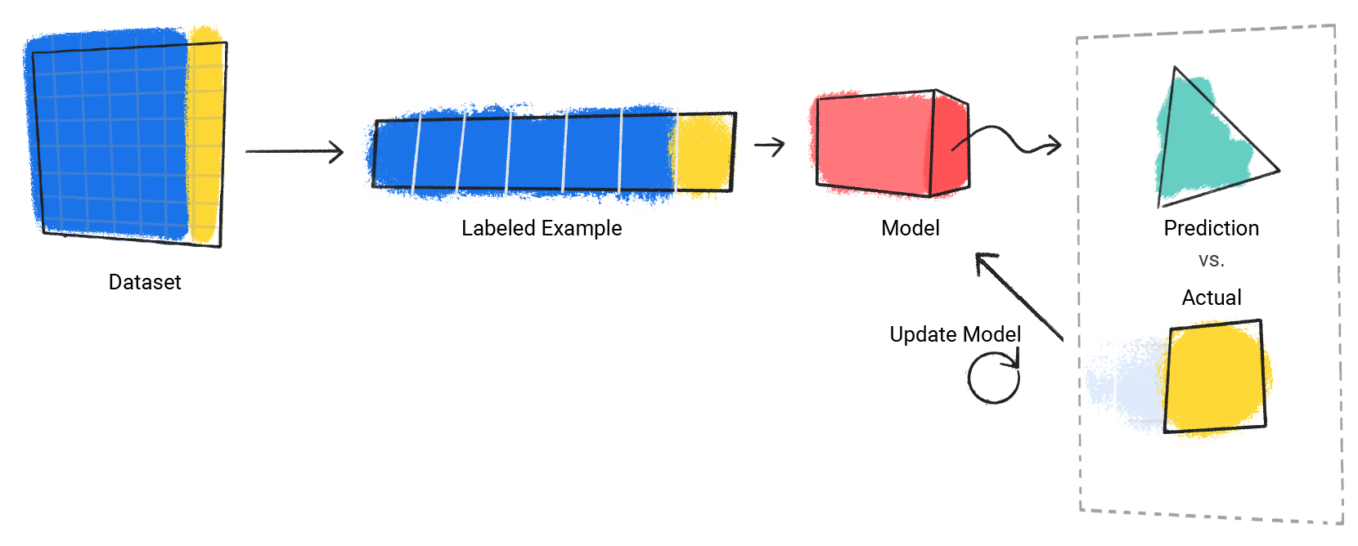
Supervised Learning

Slide 59
Supervised Learning: Training
Model: an algorithm that can make predictions based on prior observations.
Training data: prior observations/experiences, used to teach a model.
Training/Fitting a model: teaching a model to recognize patterns in the data by adjusting it’s internal parameters.
Test data: data on which we evaluate a model; it should NEVER be seen in the training stage!

Slide 60
Supervised Learning: Training
Start with a model
Example: Linear regression, decision tree, neural network
Initially, the model doesn’t know the relationship between features and labels
Feed the model data
Input: Features (like size of a house, number of bedrooms)
Output: Labels (actual house price)
Model makes predictions
At first, predictions are usually far from correct
Calculate error
Compare predicted output to actual labels
Error = difference between predicted and actual
Adjust parameters
The model tweaks its internal settings to reduce error
Repeat this process many times (iterations) until predictions improve

Slide 61
Supervised Learning: Generalization
Well, a model can’t simply copy-cat values from a dataset, learn them “by heart”. It needs to understand complex relationships between data points.
If perfectly fitting the train set happens => won’t generalize to new data. (OVERFITTING)
If not learning enough patterns happen => won’t be able to predict on neither the train or test set. (UNDERFITTING)
We need a TRADE-OFF.

Slide 62
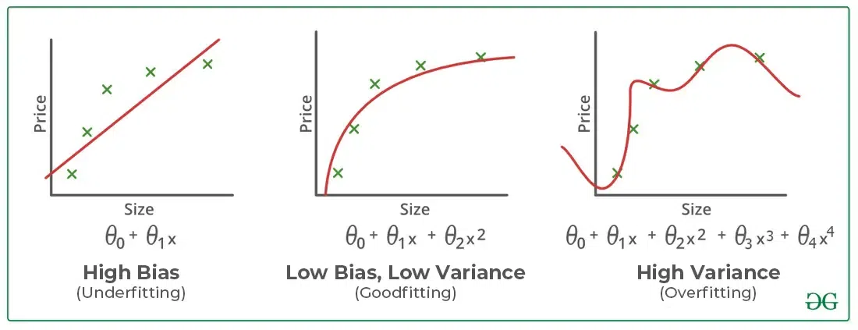
Supervised Learning: Underfitting, Overfitting

Slide 63
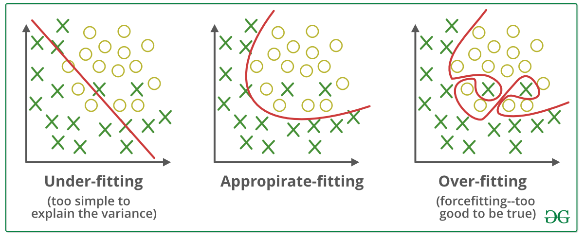
Supervised Learning: Underfitting, Overfitting

Slide 64
Supervised Learning: Bias-Variance Trade-off
If a model is perfectly fit to train data
High Variance and Low Bias
Won’t generalize
If a model is bad on the train data
High Bias and Low Variance
Didn’t learn enough
The “magic” lies in finding the sweet spot
Do not sacrifice generability, but also can’t have perfect results
In order to not aim blindly => use a validation set

Slide 65
Supervised Learning: validation set
Besides train & test, if we have any problem where we need to tune hyper-parameters, we ALSO need a validation set!
NEVER report results on the train set.
NEVER tune hyper-parameters on the test set.
The test set should be completely held-out from the training stage of a model/hyper-parameter tuning.
Usual splits:
70-20-10 for train-val-test split %
60-20-20 for train-val-test split %

Slide 66
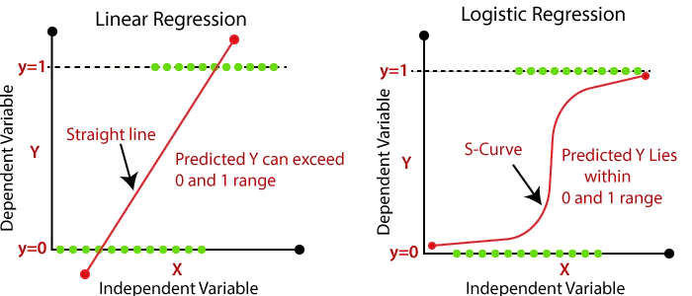
Supervised Learning: Metrics
But what results do we actually report? How do we measure the quality of a model.
We either minimize an error or maximize accuracy. (or precision/recall/f1-score/etc.)
Which line fits data better?

Slide 67
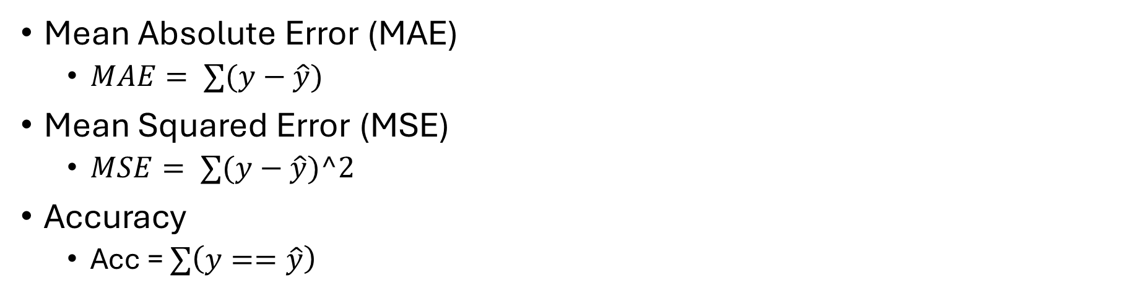
Supervised Learning: Metrics
Mean Absolute Error (MAE)
$MAE= ∑(y−\hat{y})$
Mean Squared Error (MSE)
$MSE= ∑(y−\hat{y})^2$
Accuracy
Acc = $∑\left(y==\hat{y}\right)$

Slide 68
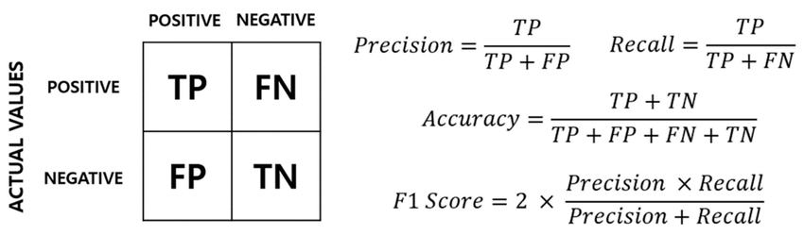
Supervised Learning: Metrics
Mean Absolute Error (MAE)
$MAE= ∑(y−\hat{y})$
Mean Squared Error (MSE)
$MSE= ∑(y−\hat{y})^2$
Accuracy
Acc = $∑\left(y==\hat{y}\right)$

Slide 69
Supervised Learning: Goal
Train a model and minimize the validation error as much as possible, however:
Also check train error, so there are no strange cases where there are big diffs between the two of them
Usually train_error < val_error ~ test_error. (RULE OF THUMB)
MAE train: a) 9.3 b) 0.6 c) 0.3
MAE val : 7.8 0.7 4.2

Slide 70
Supervised Learning: Challenges
Domain Shits/Out-of-Distribution:
Data has different distribution between training, validation and test.
Class Imbalances:
Some classes have many more samples than other classes.
Solutions: upsampling, downsampling, class-weights
E.g. 990 alive samples & 10 dead samples. If we predict all 1000 samples as alive, we would have a 99% accuracy. However, F1-score would be much less, being a more appropriate metric.

Slide 71
Supervised Learning: Methods
Regression
Linear
Logistic
Polynomial
Etc.
Classification:
K-nearest Neighbors (KNN)
Support Vector Machines (SVMs)
Decision Trees
Random Forest
Neural Networks
Etc.

Slide 72
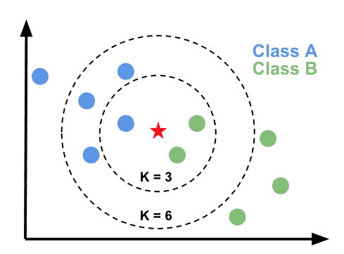
Supervised Learning: K-nearest neighbors
Simple algorithm, predicts the class that has the K nearest samples to the test sample.
Hyperparameters: K (no. of neighbors).

Slide 73
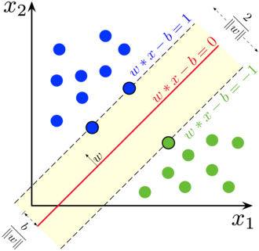
Supervised Learning: Support Vector Machines
Slightly more complex
Parameters to tune: c and gamma

Slide 74
Conclusions
We need to split data in train-val-test.
We need to check constantly for overfitting/underfitting
Train set – prior observations
Val set – hyper-parameter tuning
Test set – final evaluation
Metrics : MAE, MSE, ACC, PRECISION, RECALL, F1-score
Methods : KNN & SVM

Slide 75
Supervised Learning - Perceptron

Slide 76
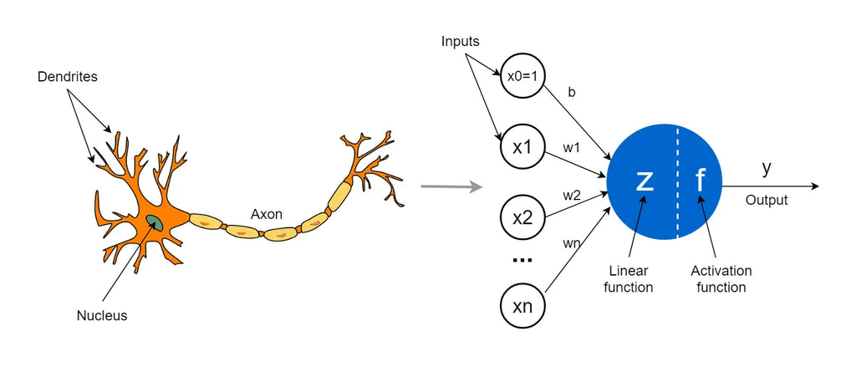
Biological Neuron Inspiration
Captures non-linearity in data better than classical approaches
Inspired by biological neuron – a neuron can be viewed like a logical gate => BINARY CLASSIFICATION

Slide 77
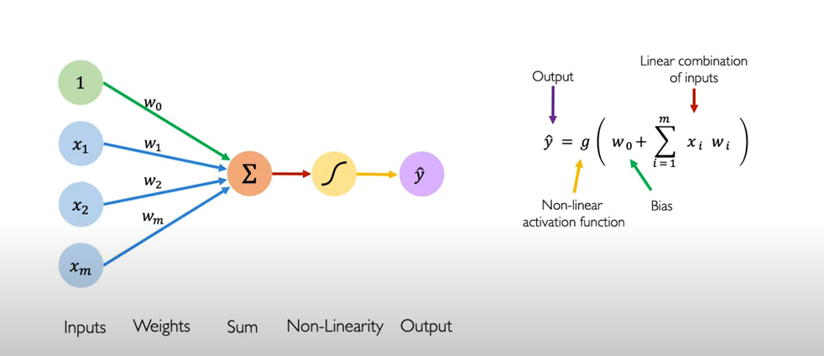
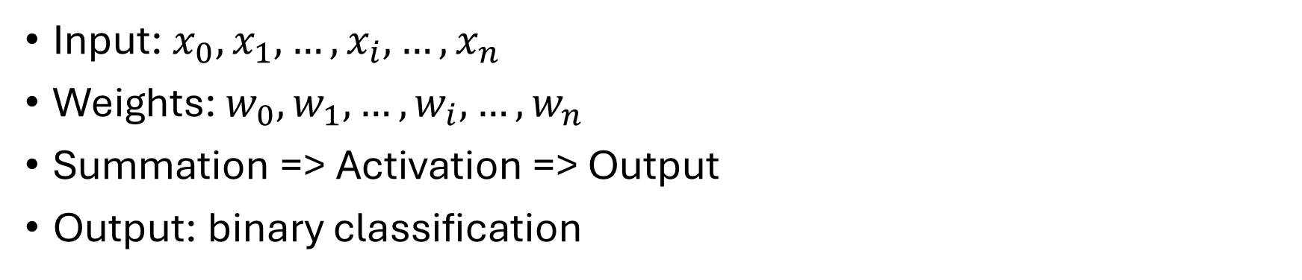
Perceptron
Input: $x_{0},x_{1},…,x_{i},…, x_{n}$
Weights: $w_{0},w_{1},…,w_{i},…, w_{n}$
Summation => Activation => Output
Output: binary classification

Slide 78
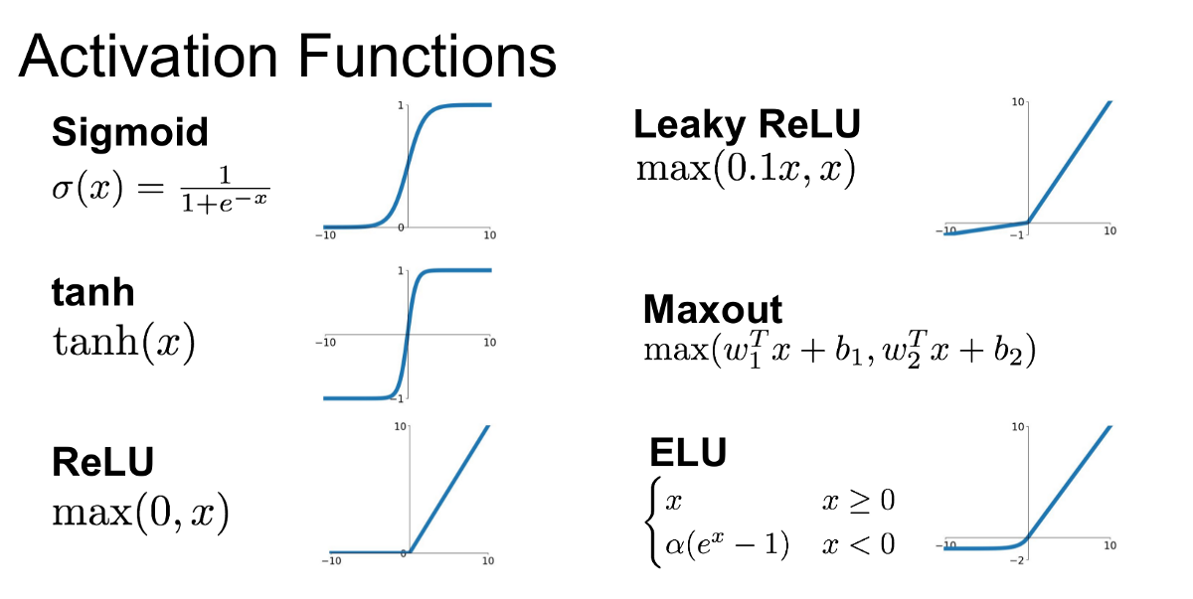
Activation function
Decides which neurons get activated/excited and which have no impact.
Introduces non-linearity; Why is ReLU non-linear?

Slide 79
Activation function
Decides which neurons get activated/excited and which have no impact.
Introduces non-linearity; Why is ReLU non-linear?
ReLU – non-linear because F(ax) == aF(x)

Slide 80
Activation function
Decides which neurons get activated/excited and which have no impact.
Introduces non-linearity; Why is ReLU non-linear?
ReLU – non-linear because F(ax) == aF(x)
NEED TO BE DIFFERENTIABLE!!

Slide 81

Perceptron – But how do we train it?
By updating the weights $w$ – BACKPROPAGATION
Stochastic Gradient Descent (SGD) – update weights after each sample.

Slide 82

Perceptron – But how do we train it?
By updating the weights $w$ – BACKPROPAGATION
Stochastic Gradient Descent (SGD) – update weights after each sample.
Given a reference $y$ and a prediction $\hat{y}$
We compute a cost/loss function (e.g. MSE)
$L=∑{\left(y−\hat{y}\right)}^{2}$

Slide 83
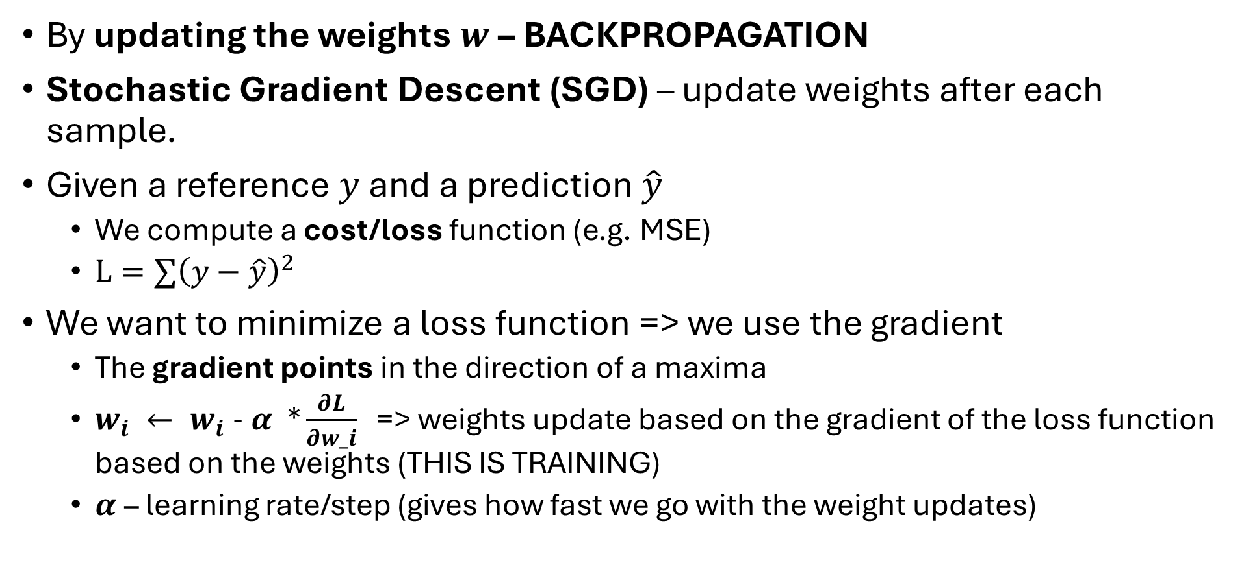
Perceptron – But how do we train it?
By updating the weights $w$ – BACKPROPAGATION
Stochastic Gradient Descent (SGD) – update weights after each sample.
Given a reference $y$ and a prediction $\hat{y}$
We compute a cost/loss function (e.g. MSE)
$L=∑{\left(y−\hat{y}\right)}^{2}$
We want to minimize a loss function => we use the gradient
The gradient points in the direction of a maxima
$w_{i} ← w_{i} - α *\frac{∂L}{∂w_i}$ => weights update based on the gradient of the loss function based on the weights (THIS IS TRAINING)
$α$– learning rate/step (gives how fast we go with the weight updates)

Slide 84
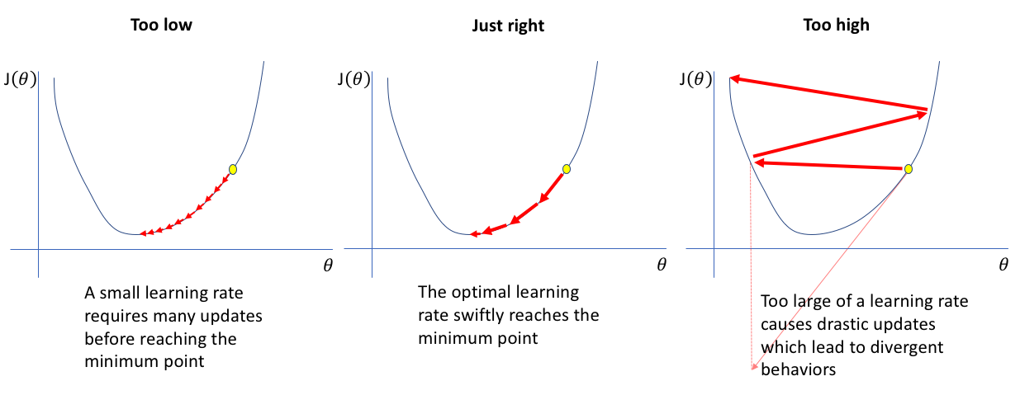
Backpropagation – Learning Rate

Slide 85
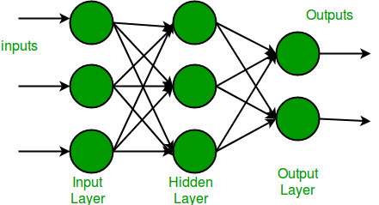
Perceptron Limitations
Only for linearly separable data
Solution:
Multi-Layer Perceptron (MLP)
Can capture non-linearity
Easy to scale for more complex data

Slide 86
Multi-Layer Perceptron – Fully Connected Network
Input Layer: similar to the perceptron (e.g. pixels)

Slide 87
Multi-Layer Perceptron – Fully Connected Network
Input Layer: similar to the perceptron (e.g. pixels)
Hidden Layers:
1 or more layers with multiple neurons that each have a connection to each neuron in the previous layer and the neurons in next layer.
Connections represent the WEIGHTS
Each neuron has an activation.

Slide 88
Multi-Layer Perceptron – Fully Connected Network
Input Layer: similar to the perceptron (e.g. pixels)
Hidden Layers:
1 or more layers with multiple neurons that each have a connection to each neuron in the previous layer and the neurons in next layer.
Connections represent the WEIGHTS
Each neuron has an activation.
Output Layer:
A decision layer characterized by an activation function fit for different tasks: Sigmoid – Regression, Softmax – Classification.

Slide 89
Multi-Layer Perceptron – Fully Connected Network
Input Layer: similar to the perceptron (e.g. pixels)
Hidden Layers:
1 or more layers with multiple neurons that each have a connection to each neuron in the previous layer and the neurons in next layer.
Connections represent the WEIGHTS
Each neuron has an activation.
Output Layer:
A decision layer characterized by an activation function fit for different tasks: Sigmoid – Regression, Softmax – Classification.
Training:
Backpropagation: update weights in the network
Minimize loss function with an algorithm: Stochastic Gradient Descent.

Slide 90
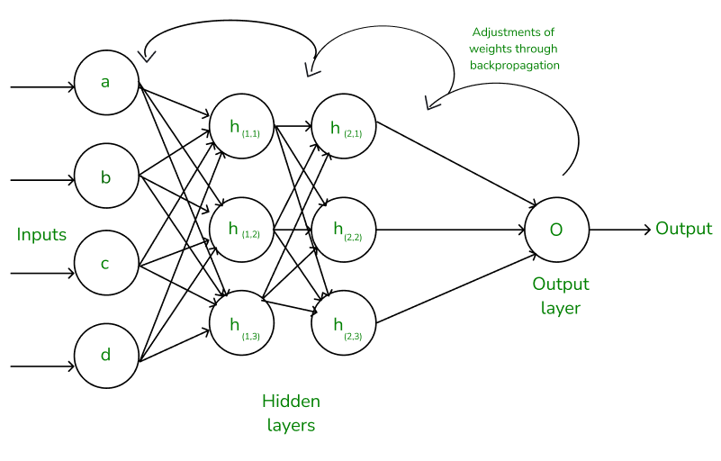
MLP - Backpropagation

Slide 91


Output Activation Functions
Softmax (classification)
Sum of probabilities for all classes is equal to 1. (e.g. [ 0.1 0.25 0.65] )
Sigmoid (regression)
Values in range [0,1]

Slide 92

Loss Functions
MAE
MSE
Categorical Cross-Entropy

Slide 93
Perceptron vs MLP
Always use MLP
The Perceptron is just the foundation of the MLP (the building block)
We train an MLP through backpropagation.
 | Perceptron | MLP
Layers | Single | Multiple
Non-linear problems | ❌ | ✅
Learning | Simple | Complex (Backprop)

Slide 94
MLP: Hyper-Parameters
Activation function: ReLU, leaky ReLU, tanh, etc.
Hidden Layer sizes: (128), (128,64), etc. => usually in decreasing size
Output activation: softmax, sigmoid (depending on the problem)
Loss function: mae, mse, categorical cross-entropy (most common for classification)
Minimization algorithm (Optimizer): Stochastic Gradient Descent, Adam
Learning Rate

Slide 95
MLP - challenges
Vanishing / Exploding Gradients → Gradients shrink or blow up during backpropagation, slowing learning

Slide 96
MLP - challenges
Vanishing / Exploding Gradients → Gradients shrink or blow up during backpropagation, slowing learning
Overfitting → Model memorizes training data, poor generalization to new data

Slide 97
MLP - challenges
Vanishing / Exploding Gradients → Gradients shrink or blow up during backpropagation, slowing learning
Overfitting → Model memorizes training data, poor generalization to new data
High Computational Cost → Training deep networks is resource-intensive

Slide 98
MLP - challenges
Vanishing / Exploding Gradients → Gradients shrink or blow up during backpropagation, slowing learning
Overfitting → Model memorizes training data, poor generalization to new data
High Computational Cost → Training deep networks is resource-intensive
Hyperparameter Sensitivity → Learning rate, hidden layers, neurons, batch size → critical choices

Slide 99
MLP - challenges
Vanishing / Exploding Gradients → Gradients shrink or blow up during backpropagation, slowing learning
Overfitting → Model memorizes training data, poor generalization to new data
High Computational Cost → Training deep networks is resource-intensive
Hyperparameter Sensitivity → Learning rate, hidden layers, neurons, batch size → critical choices
Local Minima & Saddle Points → Optimization may get stuck in non-optimal solutions

Slide 100
MLP - challenges
Vanishing / Exploding Gradients → Gradients shrink or blow up during backpropagation, slowing learning
Overfitting → Model memorizes training data, poor generalization to new data
High Computational Cost → Training deep networks is resource-intensive
Hyperparameter Sensitivity → Learning rate, hidden layers, neurons, batch size → critical choices
Local Minima & Saddle Points → Optimization may get stuck in non-optimal solutions
Large Data Requirement → Needs a lot of diverse data to perform well

Slide 101
MLP – techniques to reduce problems
Dropout
Randomly drop at each training step neurons, so we reduce overfitting.
Batch Normalization
Add layer regularization
Add more data/data augmentations
Increase/Decrease network size depending on data complexity compared to model complexity
Try new optimizers/tune learning rate.

Slide 102
Lab exercises

