Slide 1

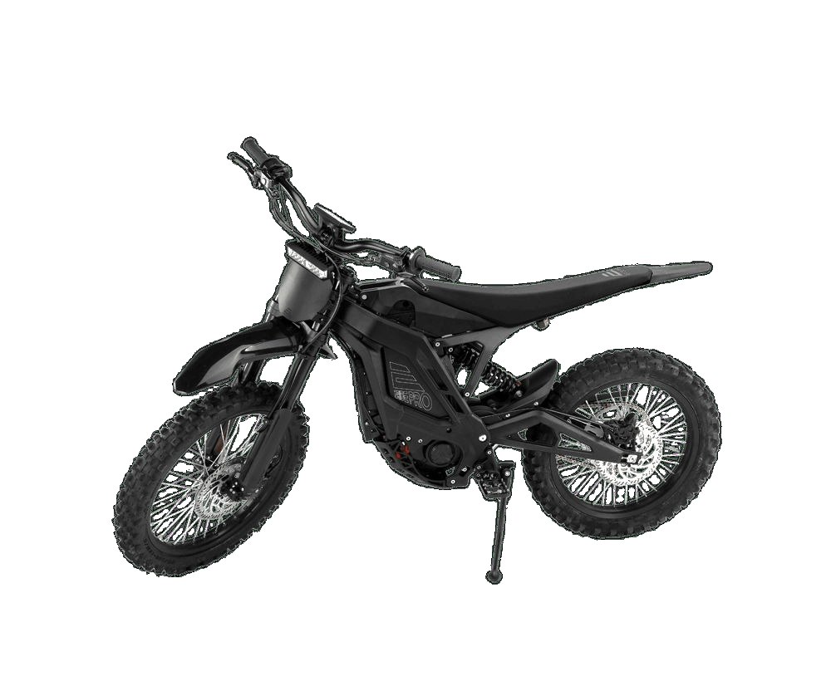

SR SERIES // OFF-ROAD PLATFORM
01 / 04
SR
OFF ROAD
POWER MEETS PRECISION.
Built for the wild — instant electric response, refined control and no compromise.
75
KM/H
8
KW
80–120
KM
TOP SPEED
PEAK POWER
RANGE*
78 KG // PRIVATE PROPERTY + OFF-ROAD TRAILS

Slide 2
02
TECH SPECS MATRIX
02 / 04
PERFORMANCE // MEASURED
A concentrated electric platform engineered around acceleration, range and responsive terrain control.
01
M
02
03
04
75
8.0
80–120
72V / 40AH
03.0
KM/H TOP SPEED
KW PEAK
KM RANGE*
SAMSUNG LITHIUM
VERIFIED MAXIMUM
ELECTRIC DRIVE
TERRAIN DEPENDENT
REPLACEABLE PACK
SECONDS
↯
05
06
07
08
0–50 KM/H
KG
2 H
19 / 18
78
REGEN
INSTANT ELECTRIC RESPONSE
20–90% CHARGE
IN FRONT / REAR
KG WEIGHT
BRAKING
CHARGE WINDOW
OFF-ROAD STANCE
PLATFORM MASS
ENERGY RECOVERY
* Range varies with terrain, rider weight and riding style.

Slide 3
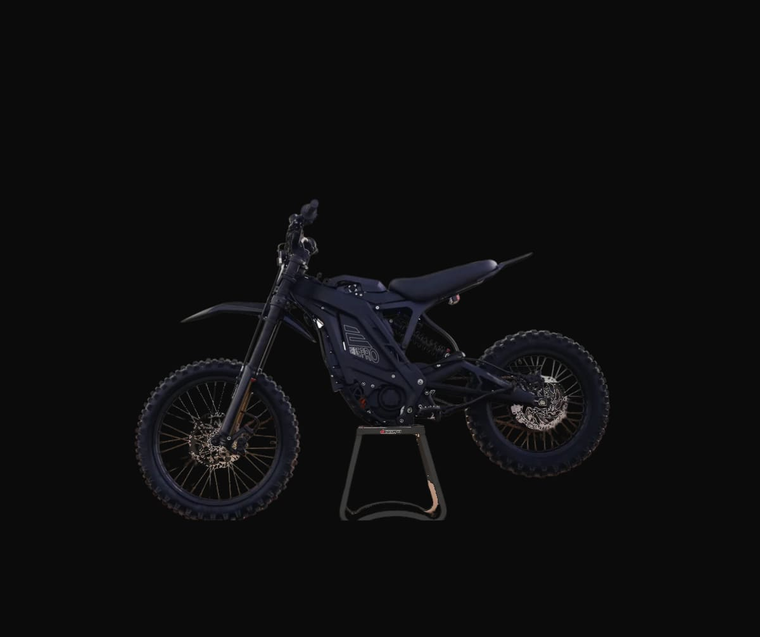
03
AERODYNAMICS / DESIGN CONCEPT
03 / 04
FORM // FOLLOWS CONTROL
A purposeful off-road silhouette shaped around rider connection, responsive handling and serious terrain capability.
01
01
BALANCED ERGONOMICS
Keeps the rider connected and in control.
03
02
RUGGED FRAME
02
Purpose-built for demanding off-road use.
03
FAST ACE SUSPENSION
Adjustable sport setup for changing terrain.
04
19 / 18 IN STANCE
Dedicated front and rear off-road format.
04
DIRT TRAILS // OPEN TERRAIN // TECHNICAL CLIMBS
CONTROL-LED DESIGN // NO UNVERIFIED AERO CLAIMS

Slide 4
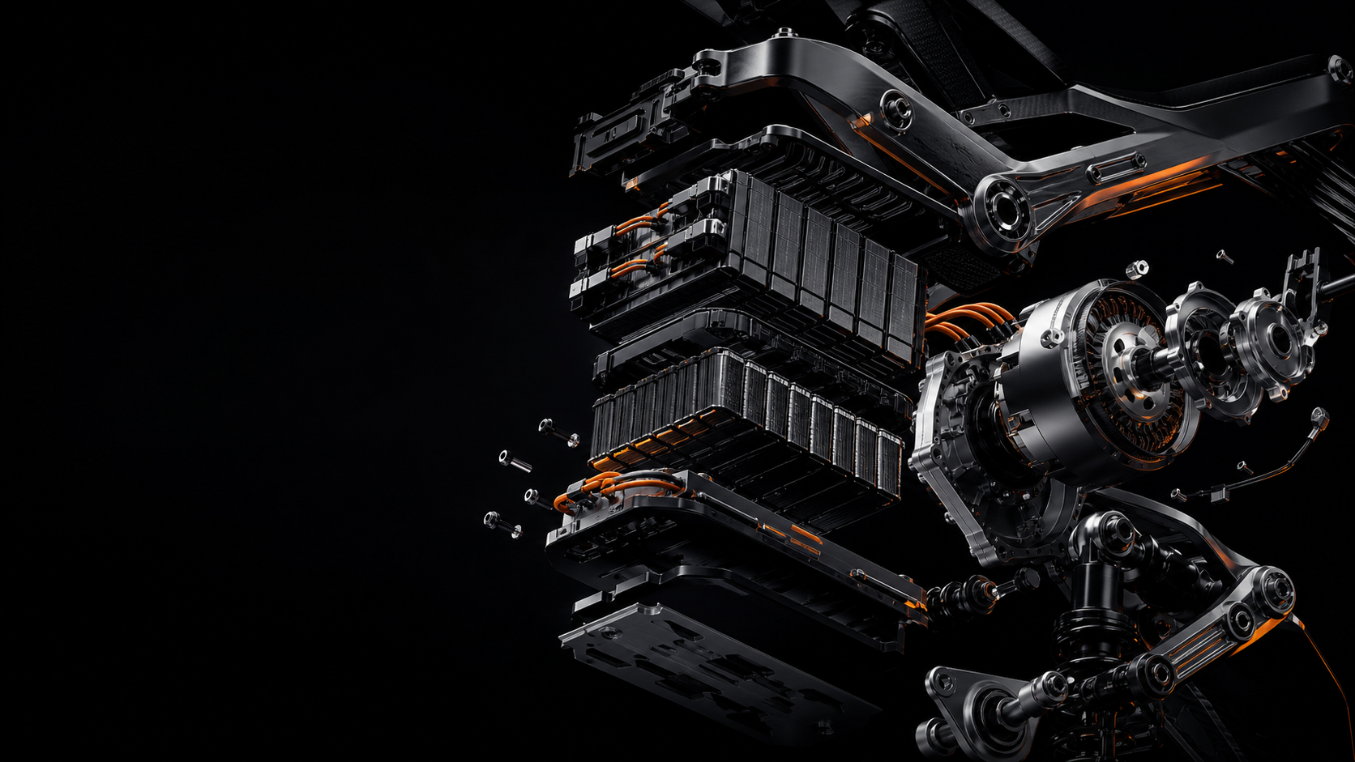
04
INSIDE THE MACHINE
04 / 04
INSIDE // THE MACHINE
CONCEPTUAL SYSTEM VISUAL // VERIFIED DATA AT LEFT
Four integrated systems translate stored energy into sustained, controllable performance.
01
ENERGY
72V / 40AH
Samsung replaceable lithium battery
02
DRIVE
8 KW PEAK
Powertrain designed for sustained output
03
CONTROL
FAST ACE
Adjustable suspension + balanced ergonomics
04
RECOVERY
REGEN
Regenerative braking architecture
INSTANT RESPONSE. SUSTAINED OUTPUT. TERRAIN-READY CONTROL.

