Slide 1
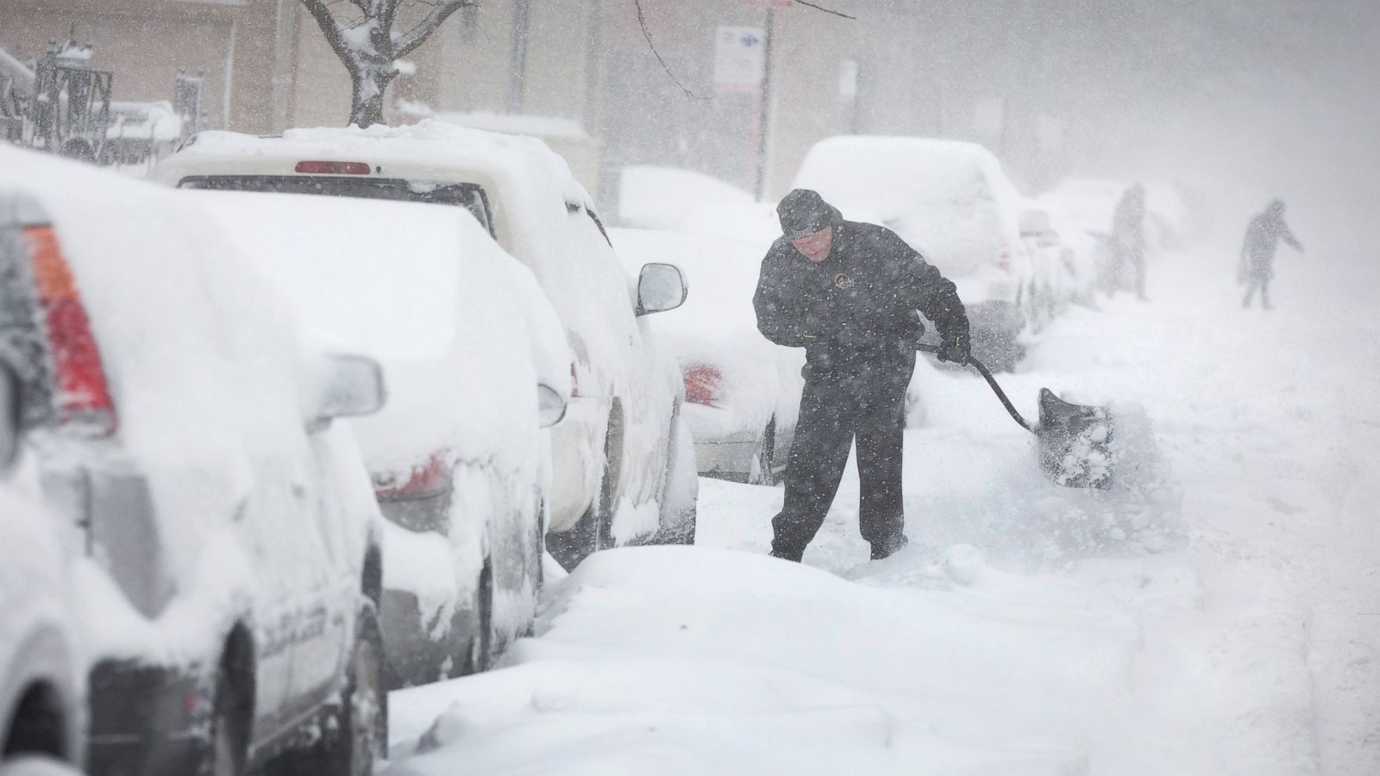
SNOW BLIZZARD
Patrik Schneider

Slide 2
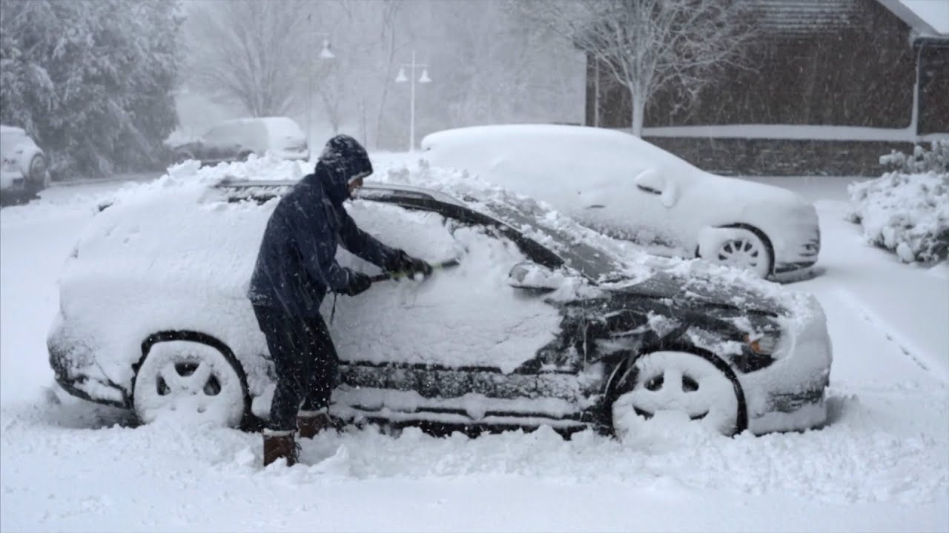
Definition
Strong winds
Reduced Visibility
Duration
Notes:
Winds: can reach up to 35mph or 56 kmh
Visibility: less than 0.25 miles or 400 meters
Duration: minimum of 3 hours

Slide 3
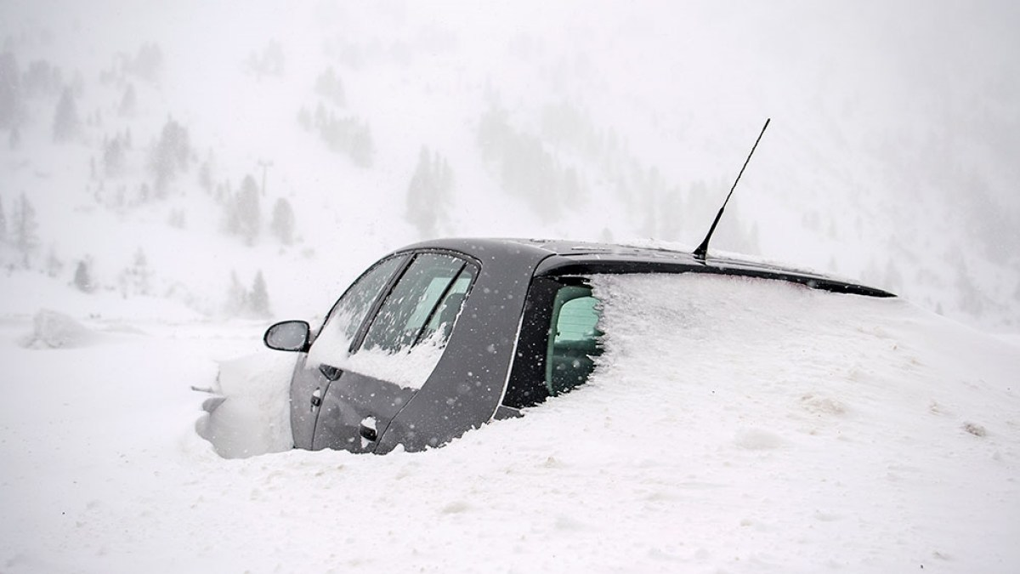
Causes of Blizzards
Cold air
Moisture
Lift
Notes:
Cold air: Blizzards need very cold air (-0°C)
Moisture: They require moisture to form clouds and precipitation
Lift: warm air rising over cold air helps create clouds and snow

Slide 4
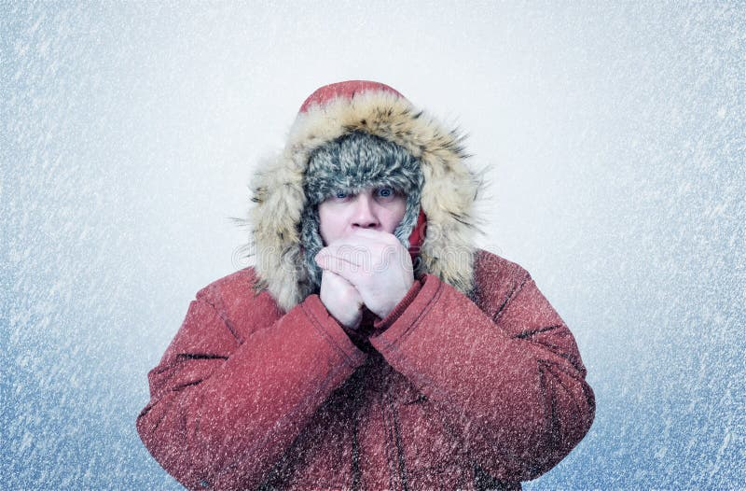

Slide 5

Effects of Blizzards
Low visibility
Snowdrifts
Cold Temperatures
Notes:
Low visibility: Heavy snow and strong winds make it hard to see, which is dangerous for driving and walking
Snowdrifts: Win can pile snow into large heaps, blocking roads and paths
Cold Temperatures: Strong winds can make it even colder, increasing the risk of frostbite and hypothermia

Slide 6
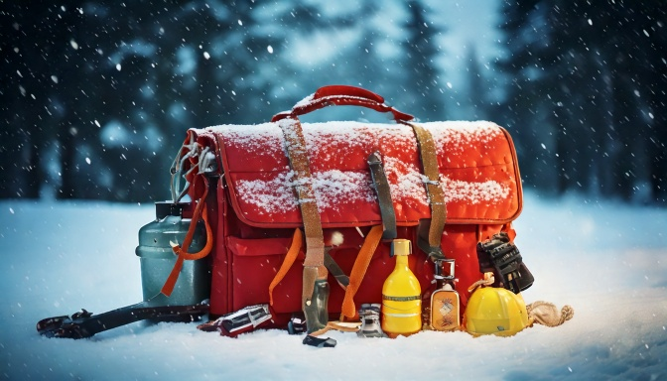
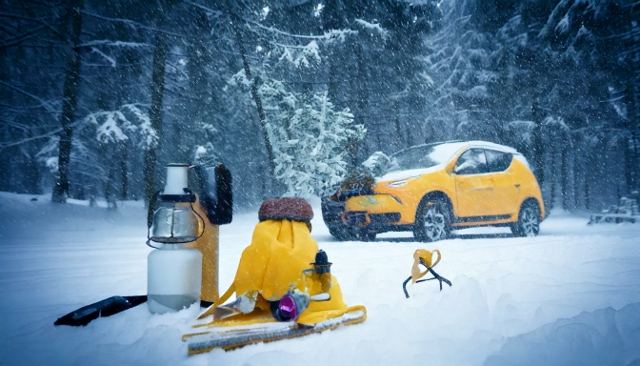
Safety tips
Stay indoors
Emergency Kit
Stay informed
Notes:
Stay indoors: It is safest to reamin inside during a blizzard
Emergency Kit: Keep food, water, and warm clothing in case the power goes out
Stay informed: Listen to weather updates and warnings

Slide 7
Thank you for your attention!!

Slide 8
sources
https://youtu.be/BpBtRmTmbqQ
https://chatgpt.com/
https://en.wikipedia.org/wiki/Blizzard

