Slide 1
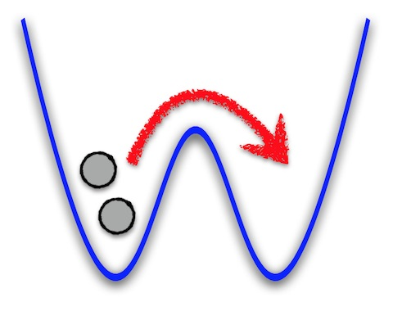
Exact dynamics of two ultra-cold bosons in a one-dimensional double-well potential
Jacek Dobrzyniecki¹, Tomasz Sowiński²
1. Faculty of Mathematics and Natural Sciences, Cardinal Stefan Wyszyński University in Warsaw
2. Institute of Physics, Polish Academy of Sciences
J. Dobrzyniecki, T. Sowinski: „Exact dynamics
of two ultra-cold bosons
confined in a one-dimensional double-well potential”,
EPJ D 70, 83 (2016).

Slide 2
Abstract
The dynamics of two ultra-cold bosons confined in a one-dimensional double-well potential is studied.
We compare an exact dynamics
governed by a full two-body Hamiltonian
with the dynamics obtained in a two-mode model approximation.
We show that for sufficiently large interactions
the two-mode model breaks down and higher
single-particle states have to be taken into account
to describe dynamical properties of the system correctly.

Slide 3
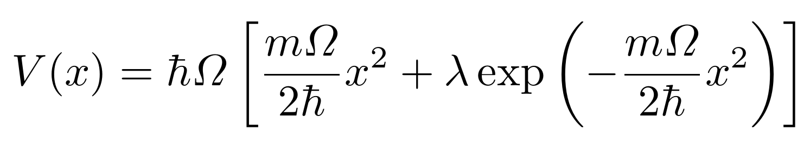
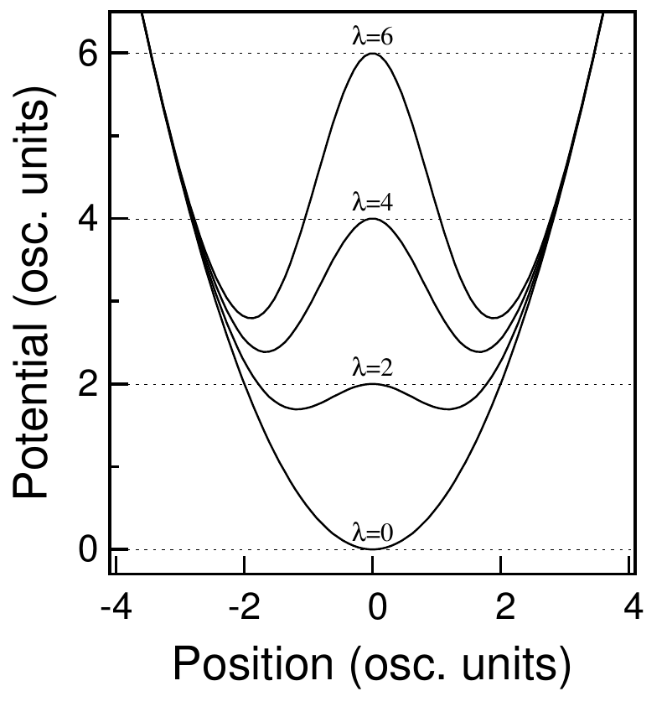
We consider dynamical properties of two ultra-cold bosons in a double-well potential:
Double-well potential
λ – dimensionless parameter controlling the height of the potential barrier

Slide 4
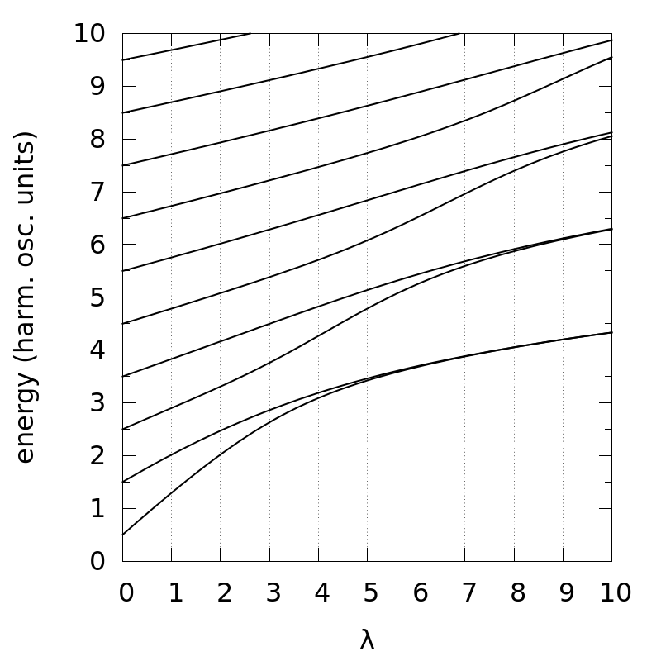
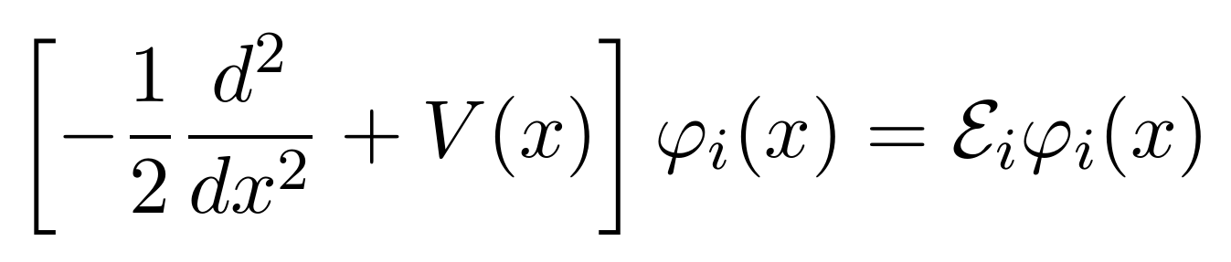

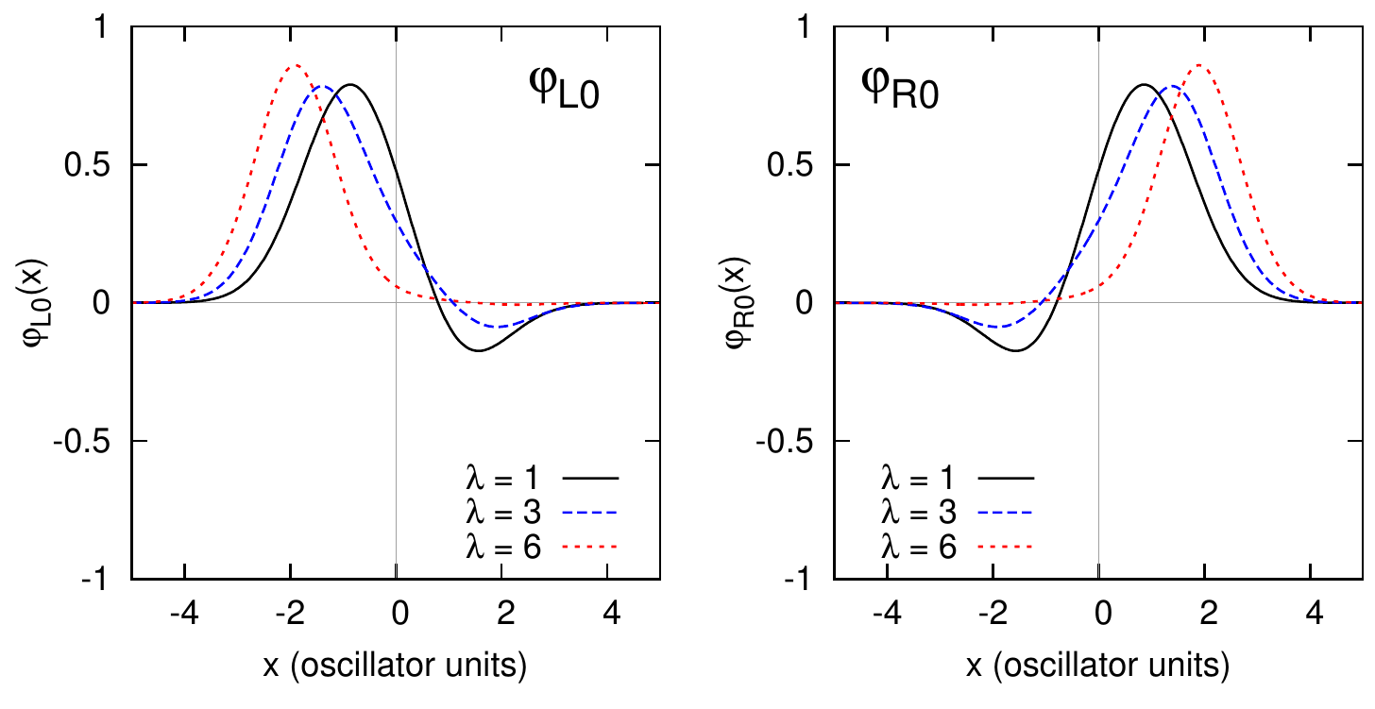
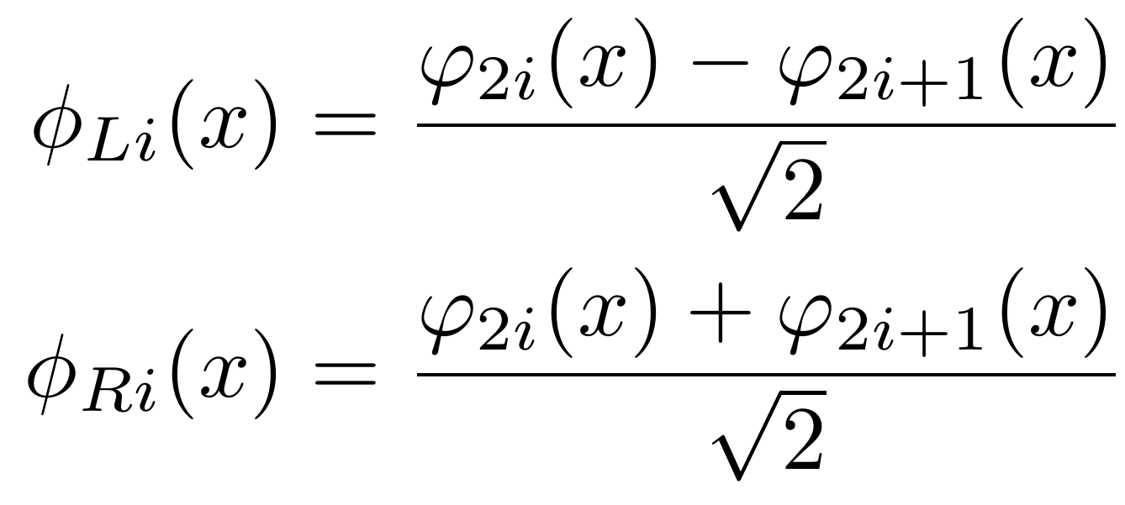
Single-particle basis
Dimensionless Schrödinger equation:
The resulting one-particle eigenenergies , depending on well depth λ, are shown:
We introduce the „left-right” basis, in which individual wavefunctions have density profiles localized in the left (L) or the right (R) well:
The lowest-energy „left-right” basis wavefunctions are shown below:

Slide 5
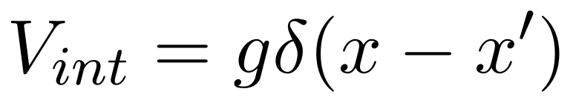
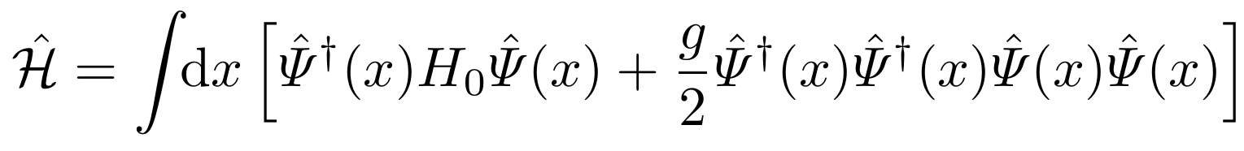
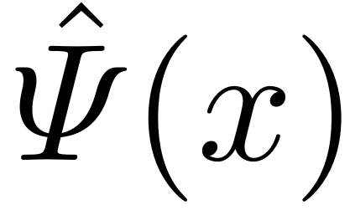
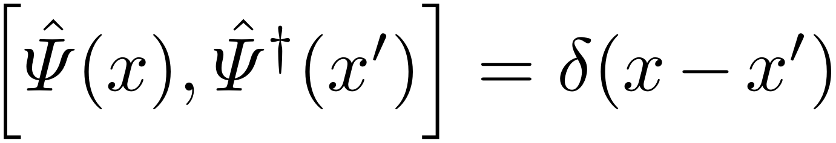
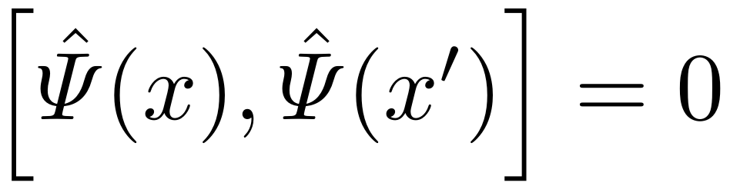
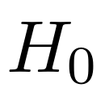
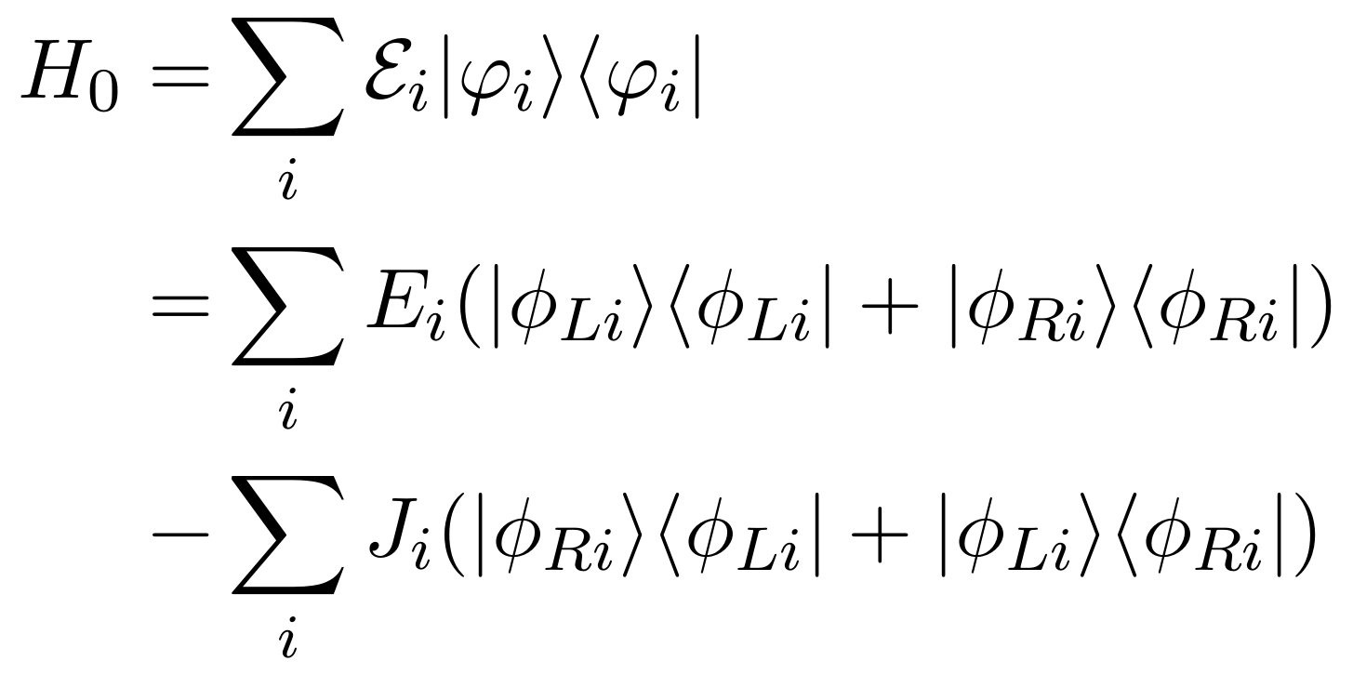
Two-particle Hamiltonian
We assume a short-range pointlike interparticle interaction potential:
x, x' – boson positions; g – interaction strength
The two-body Hamiltonian can be written in the second-quantized form:
– field operator annihilating a particle in position x. Obeys bosonic commutation relations:
– single-particle Hamiltonian, which has diagonal and off-diagonal elements when expressed in the „left-right” basis:

Slide 6
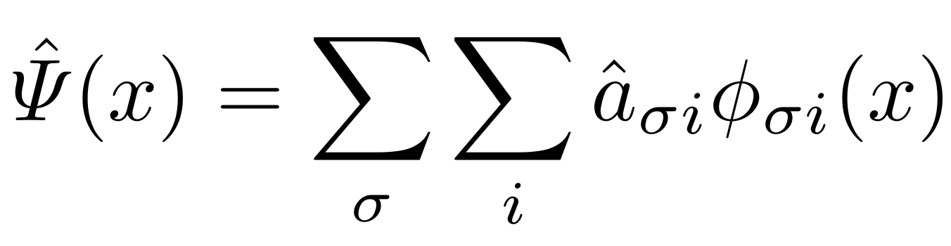
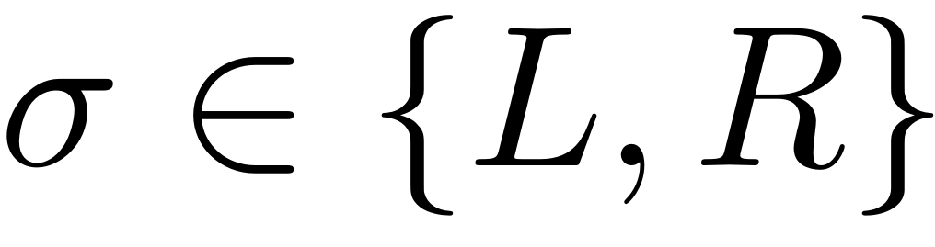
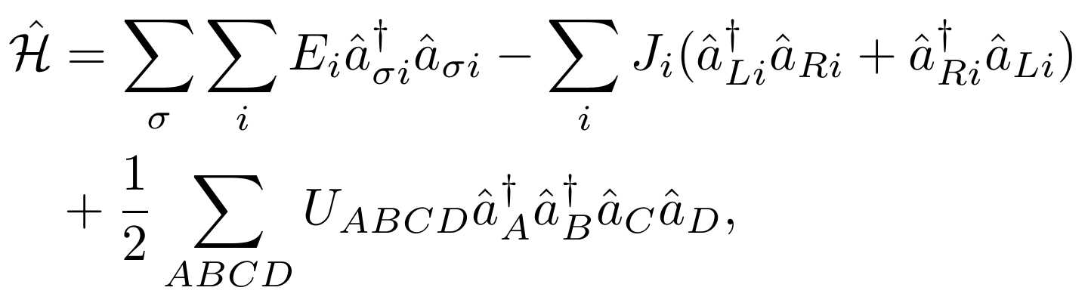
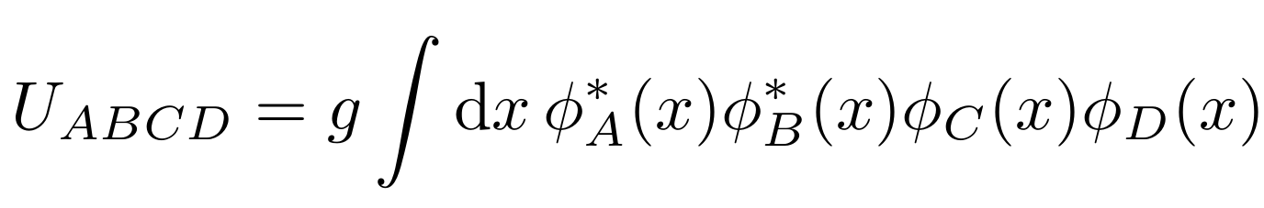
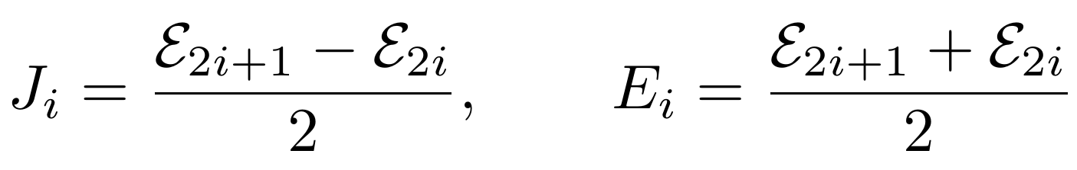
Two-boson Hamiltonian in the single-particle basis
We decompose the field operator in the single-particle „left-right” basis:
The resulting form of the Hamiltonian:
where:
A, B, C, D: special indices that represent index pairs (σ,i).
σ denotes the well (L,R);
i= 0,1,2,… is the excitation index
E_{i}, J_{i}: the diagonal and off-diagonal elements of the single-particle Hamiltonian in the „left-right” basis
J_{i} are called the tunneling amplitudes

Slide 7
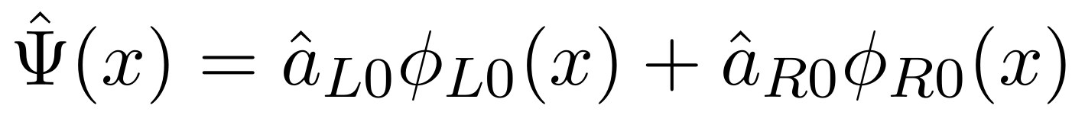
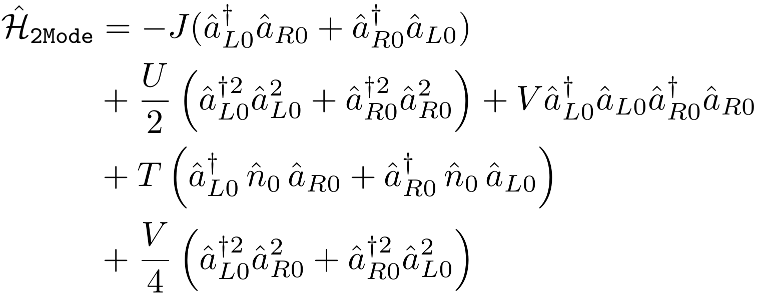
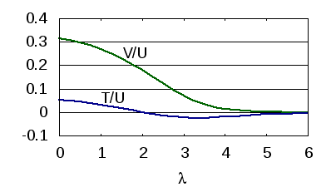
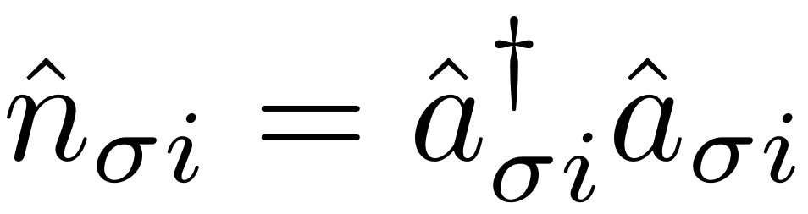
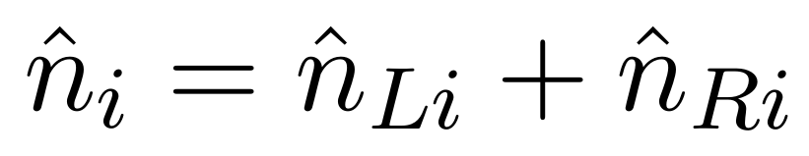
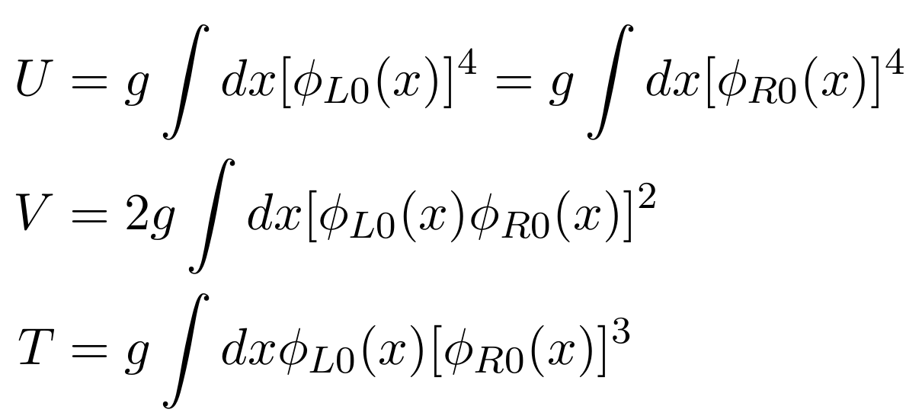
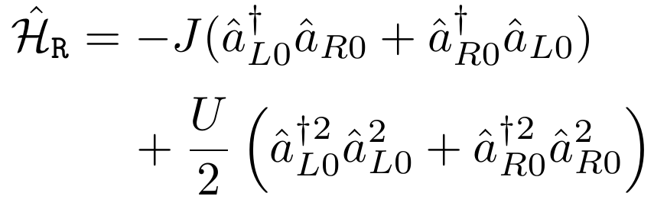
Two-mode models
Two-mode models resulting from the approximation where only the lowest two states are taken into account in the one-particle basis. This is equivalent to limiting the „left-right” basis to the lowest-energy state for either well:
The two-mode Hamiltonian:
Further approximation – neglect V and T. This is valid in the deep well limit,
as V and T are small compared to U:
Here J = J₀, and the interaction parameters are:
Then we get the Bose-Hubbard-like Hamiltonian:
The dynamics is dependent only on the U/J ratio

Slide 8
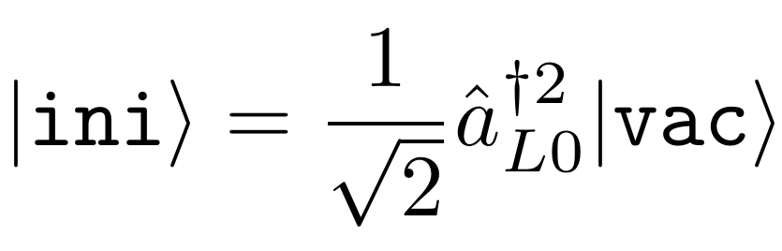
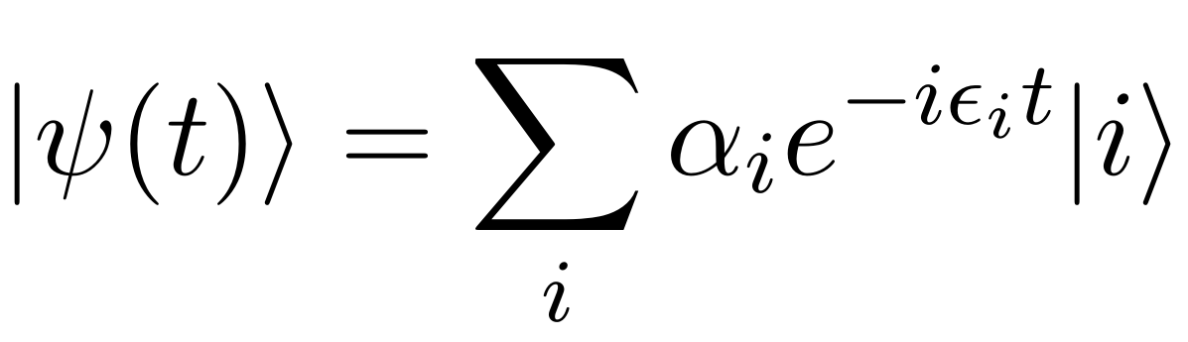
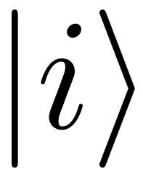
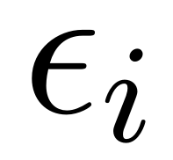
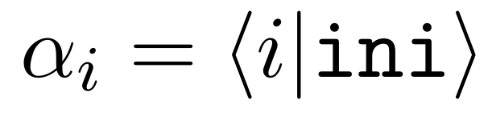
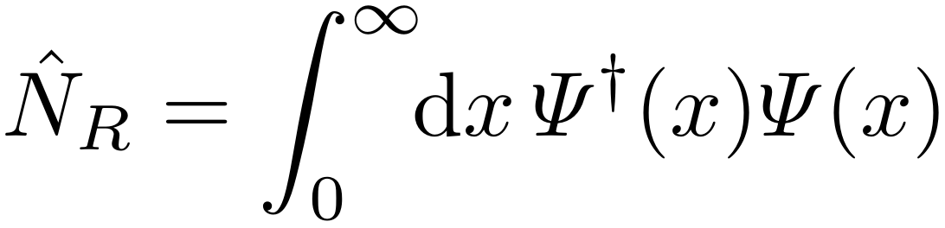
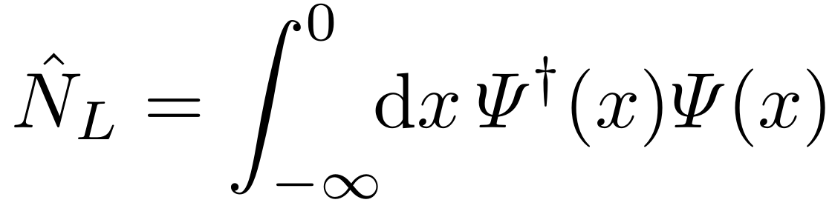
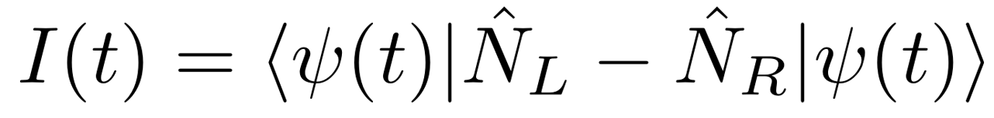
The initial state and its evolution
Initial state: two bosons located in the left well:
Time evolution of the state is obtained straightforwardly:
where are the eigenstates of the two-particle Hamiltonian, are their corresponding eigenenergies, and
Properties of the state of the system
can be characterized through well populations.
Right well population:
Left well population:
Population imbalance:

Slide 9
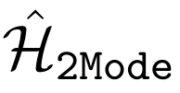

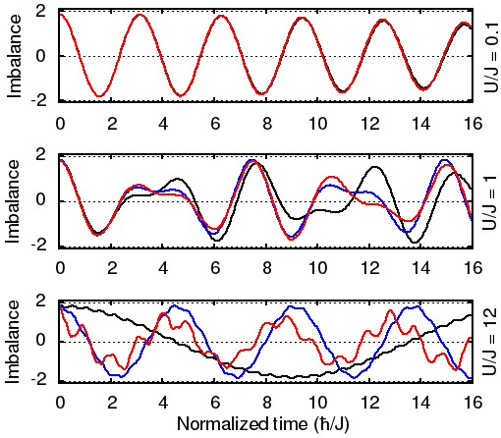
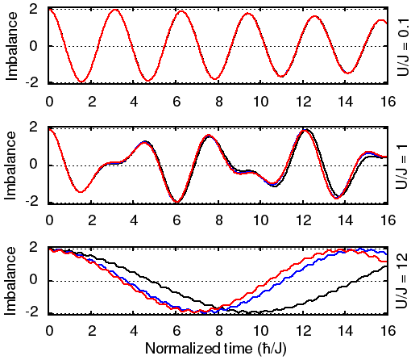
Evolution of the population imbalance I(t)
Full model
Shallow wells (λ = 3)
Deep wells (λ = 5)
The model fails for shallow wells and strong interactions.
However, the model at first glance seems to
reproduce the exact dynamics properly

Slide 10
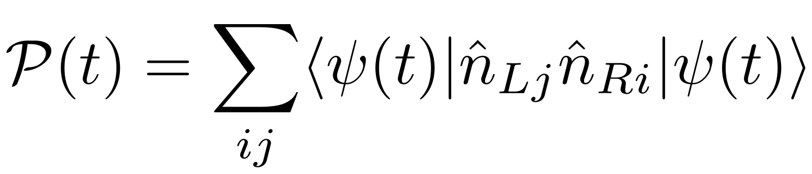
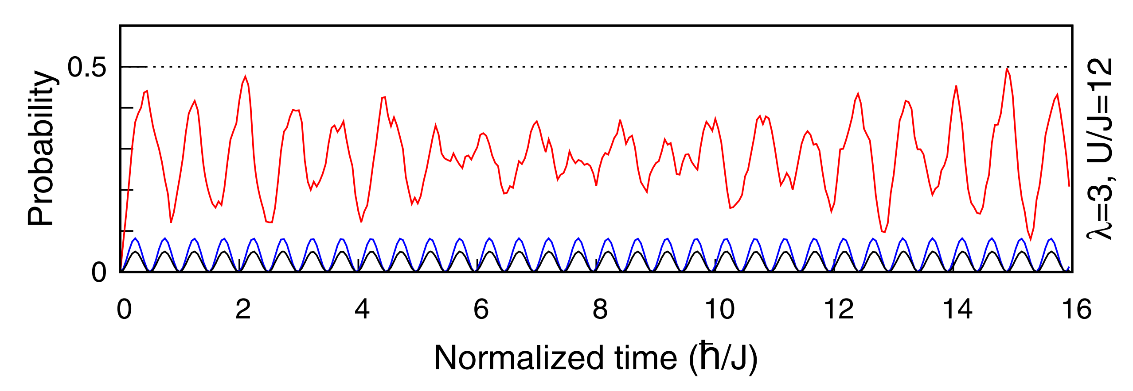
The interparticle correlations
The inaccuracy of the two-mode model becomes evident when interparticle correlations are considered.
Evolution of the probability of finding two bosons in opposite wells:
Two-mode models ignore tunneling via excited states, giving false results.

