Slide 1


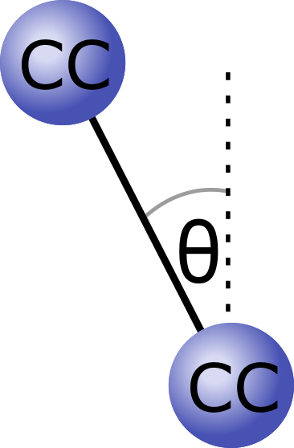
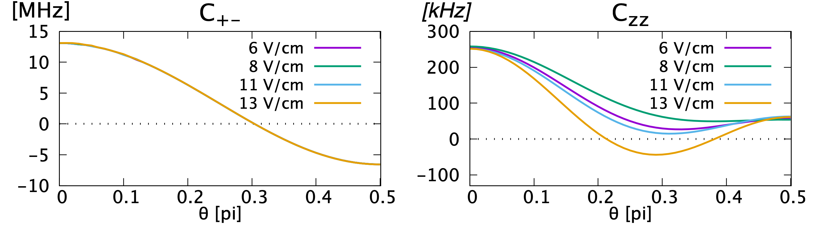
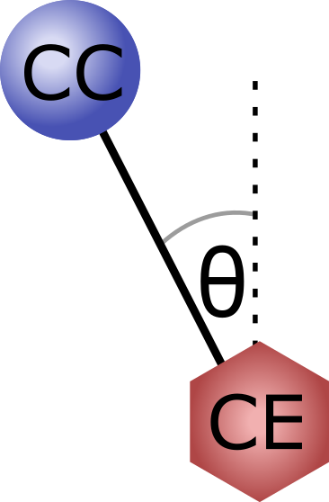
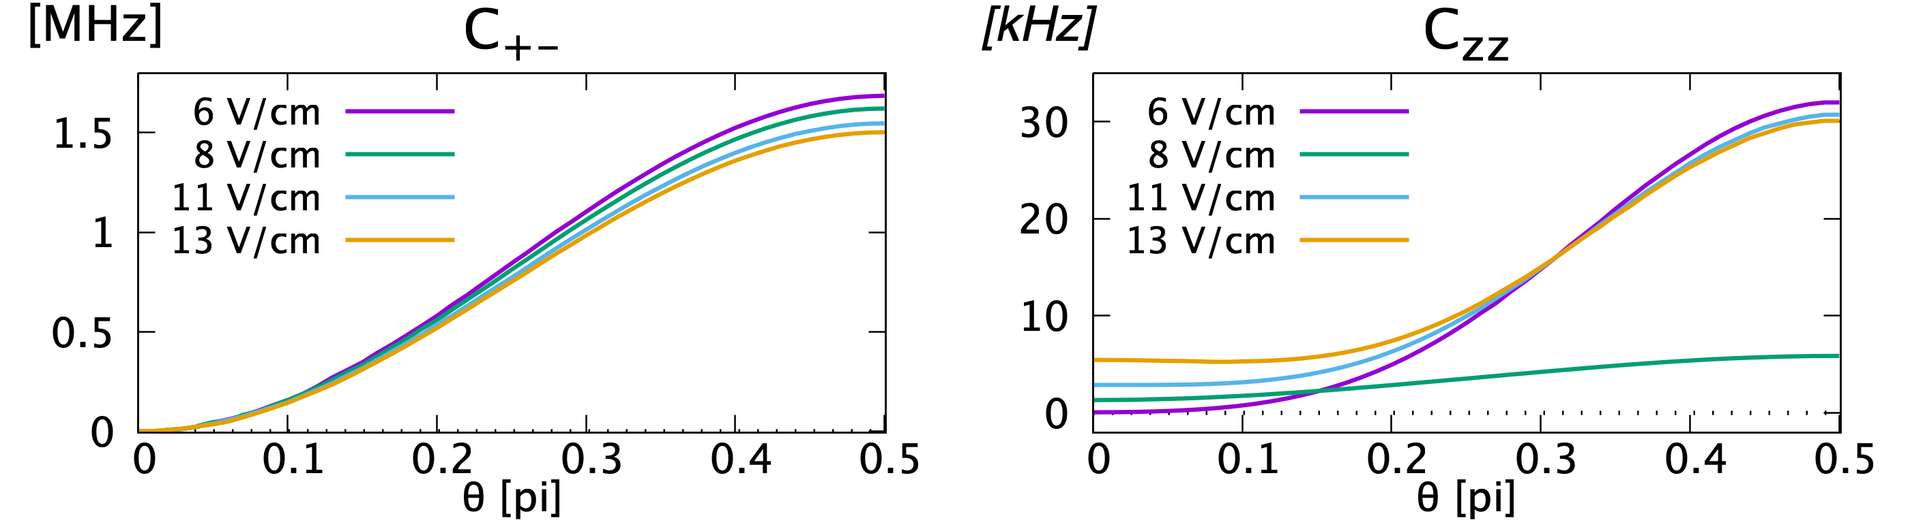
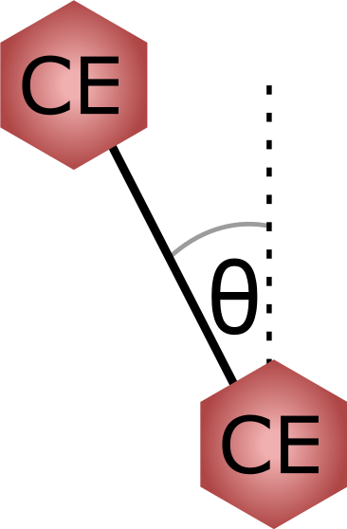
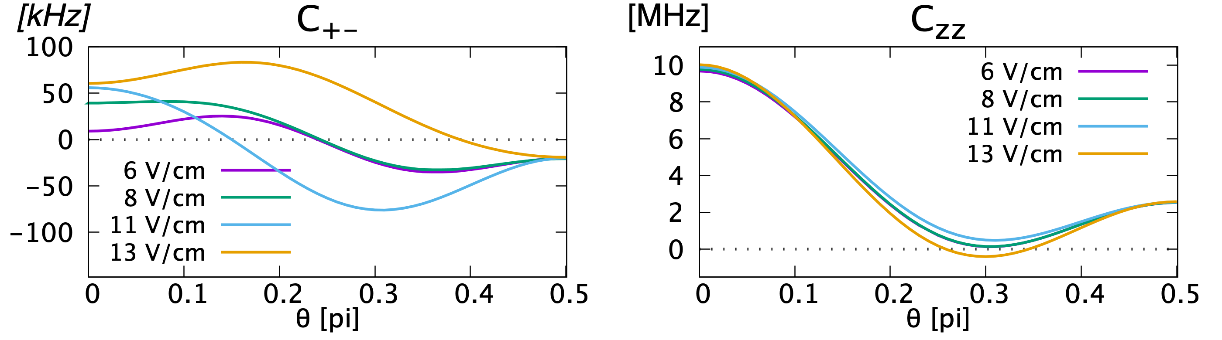
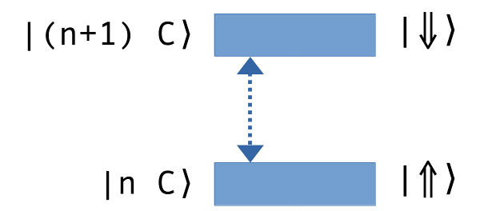
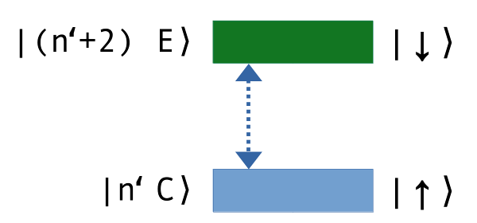
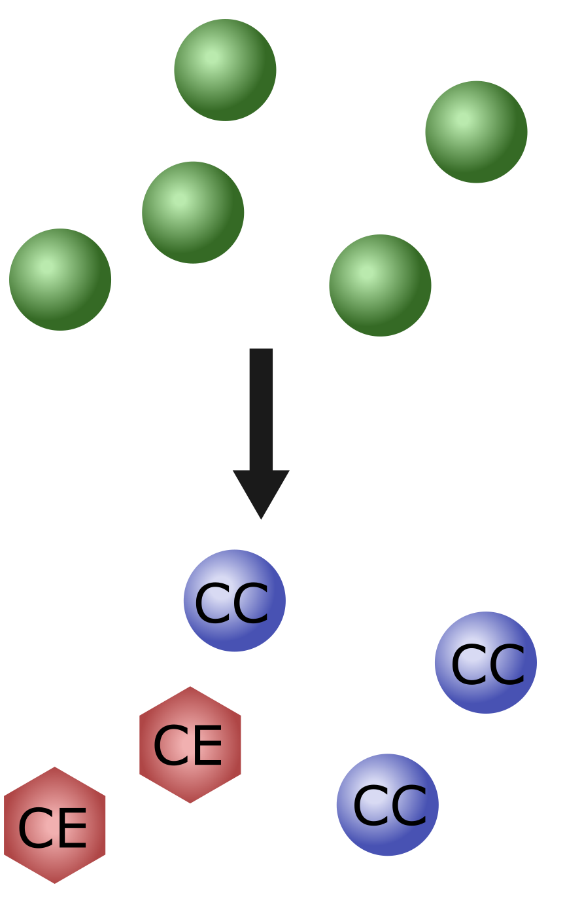
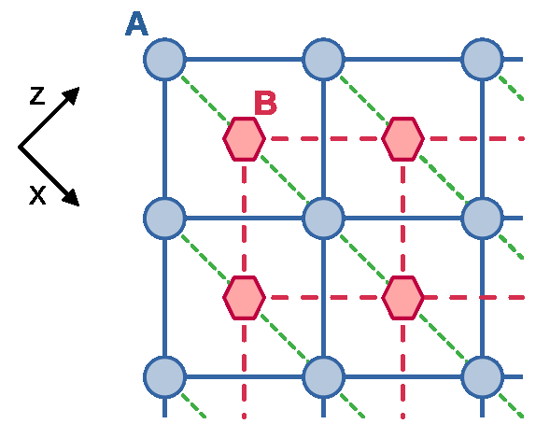
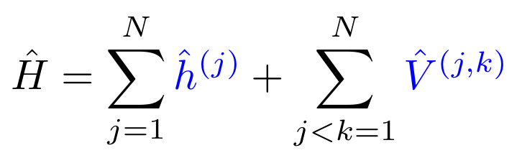
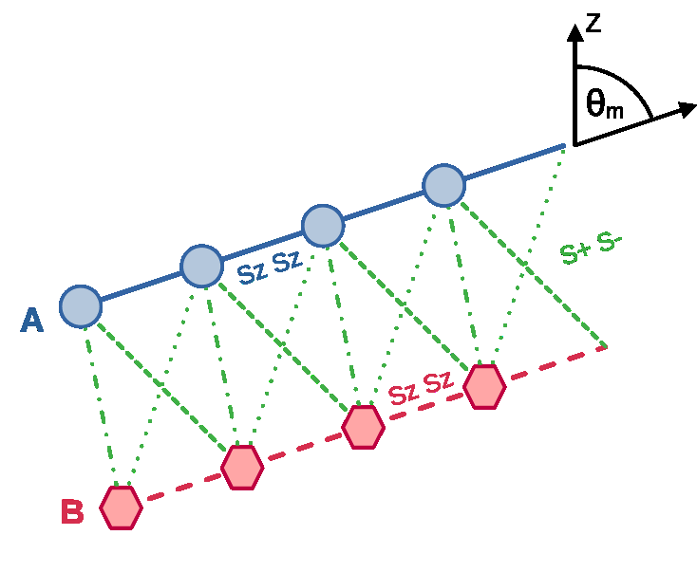
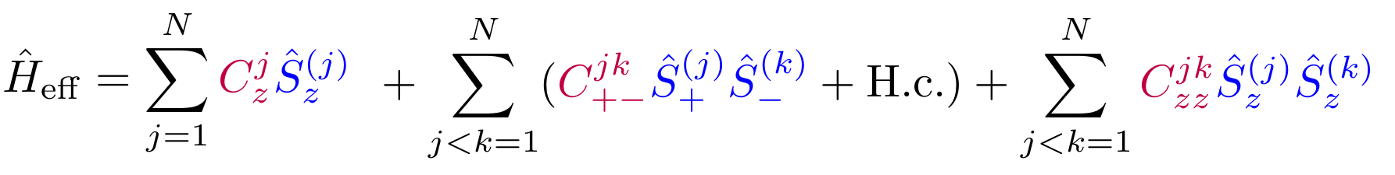

Tunable two-species spin models
with Rydberg atoms in circular and elliptical states
Jacek Dobrzyniecki, Paula Heim and Michał Tomza
▶ jacek.dobrzyniecki@oist.jp
Abstract
We propose a scheme for creating quantum simulators with Rydberg atoms in long-lived circular and elliptical states.
By exciting different subspaces of atomic levels, the atoms can be used to simulate two distinct effective spin species.
The spin-spin interaction strength, both intra- and inter-species, can be controlled within a wide range of values.
This setup can be used to simulate two-species spin models, or, lattice models with two sublattices.
Atoms in circular & elliptical Rydberg states
Effective spin interactions – example
Rydberg atoms: high quantum number n
  Strong and tunable dipole-dipole interactions; well suited for constructing quantum simulators of interacting particle systems
Circular atomic states: with the maximal magnetic quantum number
|mℓ| = ℓ = n-1
...and elliptical states: nearly-maximal magnetic quantum number
|mℓ| = n-2
  These states have long radiative lifetimes — useful for simulations involving large particle numbers or long times
  Atoms in these states can be positioned precisely by optical tweezers
Using circular & elliptical states to simulate spin models:
  Two circular states |n C⟩, |(n+1) C⟩ — mapped to spin states |⇑⟩, |⇓⟩
  Dipole-dipole interactions — mapped to spin-spin interactions
  The transition |n C⟩ ↔ |(n+1) C⟩ is dipole-allowed, which lets us obtain effective “spin exchange” interactions
  Similarly, a pair “circular state + elliptical state” can be mapped to a pair of spin states
  The different choices of atomic levels result in two different “spin species”, with different spin interaction properties
CC spins: strong exchange, weak longitudinal;
CE spins: weak exchange, strong longitudinal
You can tune the interactions via electric field
Interactions can vanish at certain “magic angles”
Example systems
Emulating lattice systems of hardcore bosons:
  Atoms = individual sites
  Internal levels = filling state (site free / occupied)
  Spin exchange = hopping of bosons between sites
  Two “species” = two distinct sublattices
“Species CC”
“Species CE”
Two-species spin model simulation
Dual square lattice
  By exploiting magic angles, we can ensure the inter-lattice hopping (green) only occurs along one direction
  A two-species spin model can be simulated by a system of atoms excited into the “CC” and “CE” level subspaces
  Interactions between spins can be tuned: (individually) by adjusting distance/angle between any atom pair, and (globally) via electric field
Two coupled Ising chains
  Magic angle θm ensures that hopping within each chain disappears, and hopping is only allowed between chains
How to obtain the effective spin Hamiltonian Heff (below):
  limit the atom Hamiltonian H to just our “spin” subspaces
  calculate the effective interaction for each atom pair; include contributions from first- and higher-order dipolar interactions
  remove terms corresponding to off-resonant processes
Effective magnetic field
Exchange interaction
Longitudinal interaction
Read more at: Phys. Rev. Research 7, 013321
Note on funding by Japan’s “National Institutes for Quantum Science and Technology”:
A part of this work was performed for the Council for Science, Technology and Innovation (CSTI) Cross-ministerial Strategic Innovation Promotion Program (SIP), “Promoting the application of advanced quantum technology platforms to social issues” (Funding agency: QST).

