Slide 1



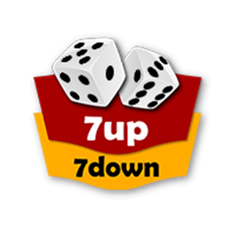
PYTHON PROGRAMMING MINI-PROJECT A GAME OF 7 UP AND 7 DOWN
16010520108 – Anilesh Duraphe
16010520110 – Archit Yadav
16010520126 – Nish Salia

Slide 2
PROBLEM DEFINITION
PROBLEM :
Now people are getting bored easily by playing the same games again and again. So they are finding new games and ways to keep themselves entertained. A game is needed which can be played between a group of friends. It should be a fun game which can be played by people of any age group, also easy to play.
SOLUTION :
Creating a fun game system using GUI (Graphical user interface) which will roll two dices and ask the user for their choice between 7 up or 7 down, then it will add the numbers on the dice and give an appropriate output on whether the user won or lost. It will also keep the score of the user.

Slide 3
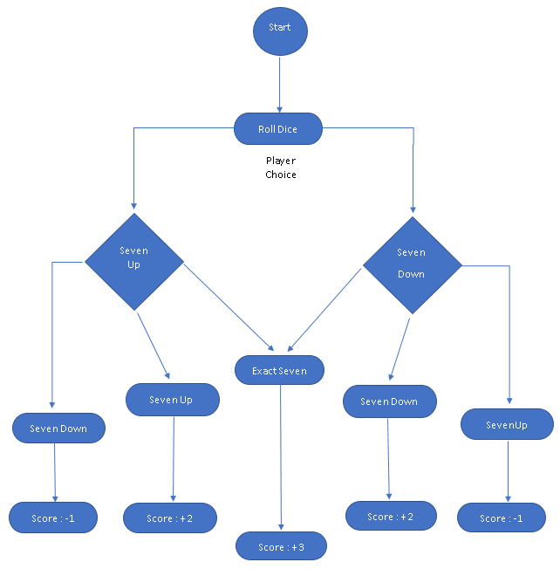
FLOW CHART

Slide 4
PACKAGES USED
1. Tkinter
Tkinter is a python module that is used to create GUI applications.
It is preinstalled along with python and therefore no separate installation is required.
It is the main package on which our project is based on.
Its Button widget is used to fetch the choice of the player.
The background option is used to add colour.
The label widget is used to display the output.
2. Random
The main use of this package is to provide random numbers.
The random module arbitrarily selects numbers from the given set of numbers (from 1-6) and provides it to the dice which then
displays it as output.
3. tkinter.messagebox
Tkinter Messagebox is a module in python which provides a different set of dialogues that are used to display message boxes,
showing errors or warnings, widgets to select files or change colours which is a pop-up box with a relevant message.
It is used to take feedback from the player.
The text message is displayed as an option in the form of a menu at the top.

Slide 5
Functionalities
The game is made on a GUI package named as tkinter, so first tkinter is imported.
Then we also import random module for the random selection of numbers.
After that the text.message module is imported for the feedback.
Then we provide the game with a window by initialising and giving the window a specific size also adding a title to it.
The Label for the dice is defined next, adding to it is the size and position.
A frame is created for the rules and other details related to the game.
Then a “Score” variable is initialised and a function is defined for counting the points.
A function is defined for rolling the dice and showing the result as per the opted choice.
Buttons are created, positioned and respective commands are given to them.
At the end menu and function is made for taking the feedback from the player

Slide 6
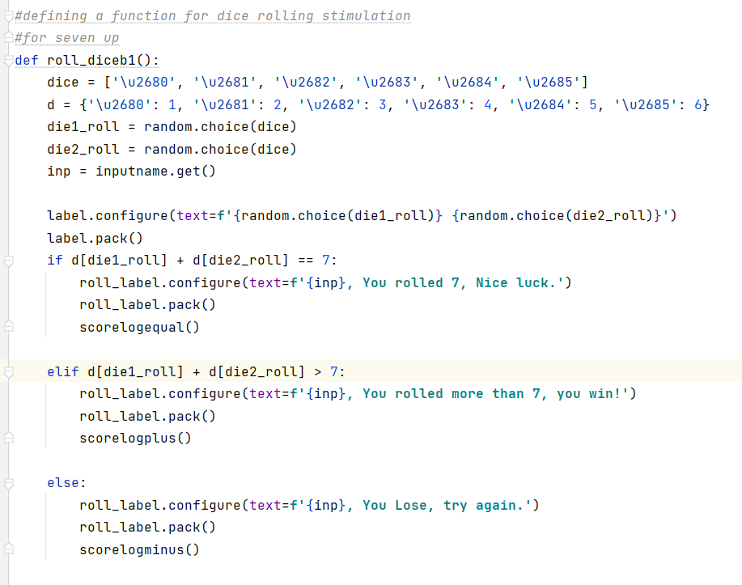
Functionalities
Dice rolling
We need 2 functions 7 up and 7 down.
Assigning ASCII characters for the dice.
Giving them random values using random module.
Create 2 dice for display.
Adding the result of the roll.
Showing the result as per the outcome.
Updating the score.

Slide 7
DIFFICULTIES FACED
Experienced a lot of keyword error.
Functions were not defined properly.
Order of the function going wrong.
Adjustment of the appropriate window size.
Adjusting the buttons to put it in the right place.
Text not getting printed.
Learning new features of Tkinter.
Initializing the score label.
Making the numbers on the output of the dice which are used for calculations.
Indentation errors.
Initializing the dice rolling simulation.
In defining the score label, and continuing the score count from the previous number.

Slide 8
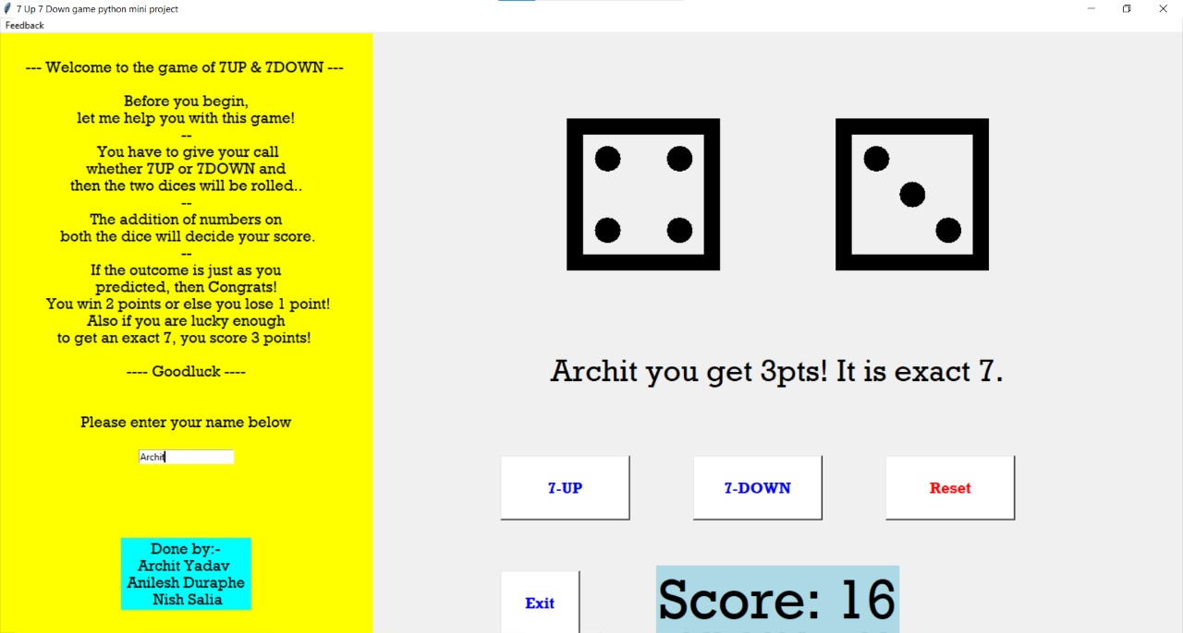
OUTPUT WINDOW

Slide 9
FUTURE SCOPE
Using this concept we can create a betting game in which players use virtual coins to place bets and win. It will be a multiplayer game and can be played with friends and family.
Adding an online multiplayer mode so friends can play and perform the assigned tasks on losing.
Adding some more features like adding sound, a different win or lose animation.

Slide 10
REFERENCES
https://youtube.com/playlist?list=PLu0W_9lII9ajLcqRcj4PoEihkukF_OTzA
https://www.bing.com/videos/search?q=GUI+in+python&&view=detail&mid=74AE7B3A4C530D3E7D1574AE7B3A4C530D3E7D15&&FORM=VRDGAR&ru=%2Fvideos%2Fsearch%3Fq%3DGUI%2Bin%2Bpython%26FORM%3DHDRSC3
https://www.bing.com/videos/search?q=GUI+in+python&&view=detail&mid=DA027F279717AF48DE46DA027F279717AF48DE46&&FORM=VRDGAR&ru=%2Fvideos%2Fsearch%3Fq%3DGUI%2Bin%2Bpython%26FORM%3DHDRSC3

Slide 11
CONCLUSION
Thus, we learned to use Tkinter package and its various widget features
which helped in making this game for our Miniproject.
Also we got to learn about random module and its use for fetching random
numbers while rolling the dice.

Slide 12

print(“Thank You!”)

