Slide 1
Introductions
Dan’s Competitive Card Games
Team Members
Dan

Slide 2

Project Overview/Explanation/Business Case
This high-powered poker and blackjack site, built in .NET/Blazor, will offer a rich, multi-lobby experience with tables ready for players. Each table hosts six players and a virtual dealer, with game logic and card handling managed server-side to ensure smooth, fair gameplay. Players earn virtual currency as they play, unlocking exclusive in-game items like custom card backs and profile decorations, enhancing both competition and personalization in a social, interactive setting.
Notes:
This site is more than just a gaming platform; it’s designed to provide a rich, multi-lobby experience where players interact in real time. I specifically went this route because for my senior project I wanted to challenge myself in developing an interactive and engaging multiplayer environment where players can join from any web browser and compete against each other in real time.
Each table hosts multiple players, with server-side handling ensuring fair gameplay and smooth interactions.
The concept of a “business case” here is centered on user engagement: players earn virtual currency through games, unlocking exclusive in-game items that enhance personalization and competition.
Focus on Multiplayer Challenges: Real-time multiplayer is the biggest hurdle here. Creating a seamless experience that can support multiple players interacting simultaneously requires careful synchronization of data.
SQL for Game State Management: SQL’s role in maintaining game state is crucial—especially for reliability. If the website crashes or a player’s session ends unexpectedly, SQL helps preserve each player's progress, the game’s current status, and each player’s position at the table.

Slide 3
The Tech Stack
1. Frontend: Blazor (Interactive UI for web-based gaming)
2. Backend: ASP.NET Core (Handles game logic, authentication, and matchmaking)
3. Real-Time Communication: SignalR (Enables multiplayer interactions, live updates, and chat features)
4. Database: SQL Server (Stores user accounts, game states, coin balances, customizations, etc.)
5. Authentication: ASP.NET Identity (Manages user logins and account security)
Notes:
Blazor: Supports dynamic content updates and responsive gameplay.
SignalR: Enables real-time updates for each player, creating an authentic multiplayer feel.
SQL: Used to track game state, player progress, and lobby status. This integration is essential for preserving the game state, ensuring continuity even in case of unexpected events.
Challenges with Tech Integration: Integrating these technologies is no small task. Each component must work in harmony to provide smooth, real-time gameplay.

Slide 4
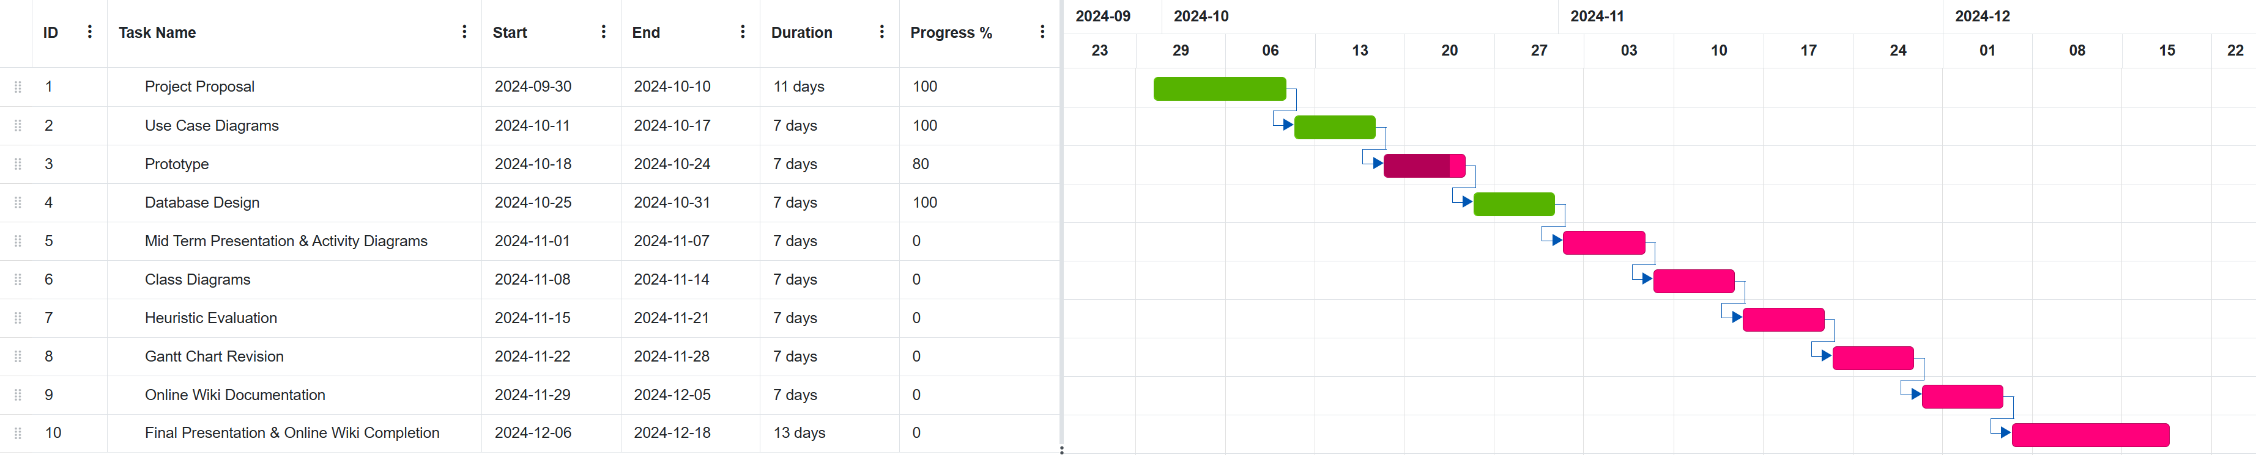
Gantt Chart (10 Weeks - 1st Quarter)

Slide 5
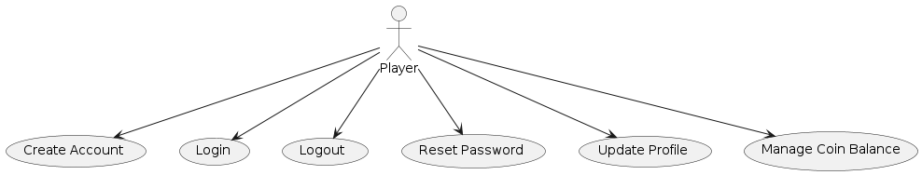
Use Case Diagrams
Account Management

Slide 6
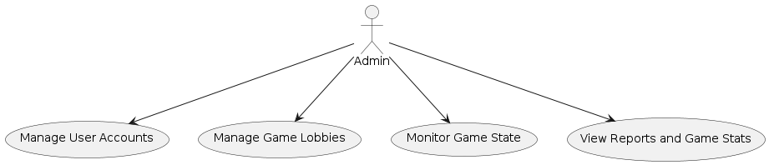
Use Case Diagrams
Admin Management

Slide 7
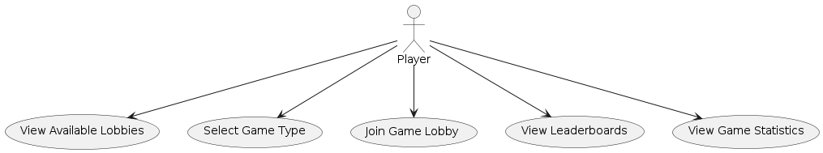
Use Case Diagrams
Game Lobby and Selection

Slide 8
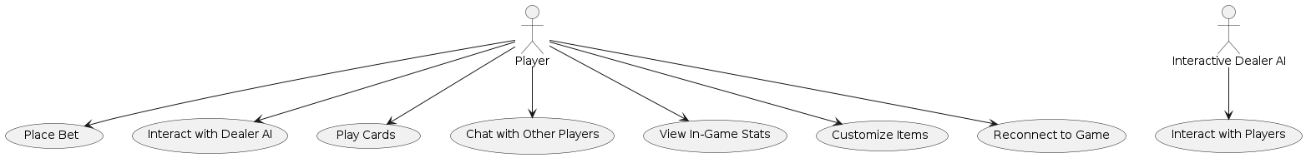
Use Case Diagrams
In-Game Activities

Slide 9
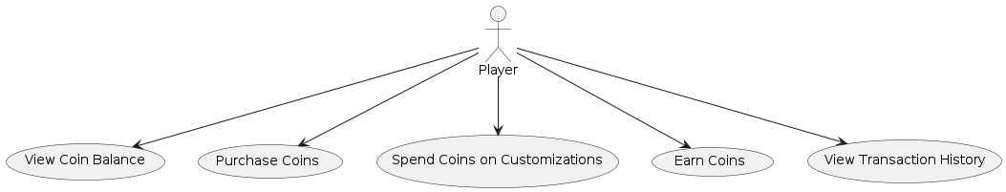
Use Case Diagrams
Virtual Currency System

Slide 10
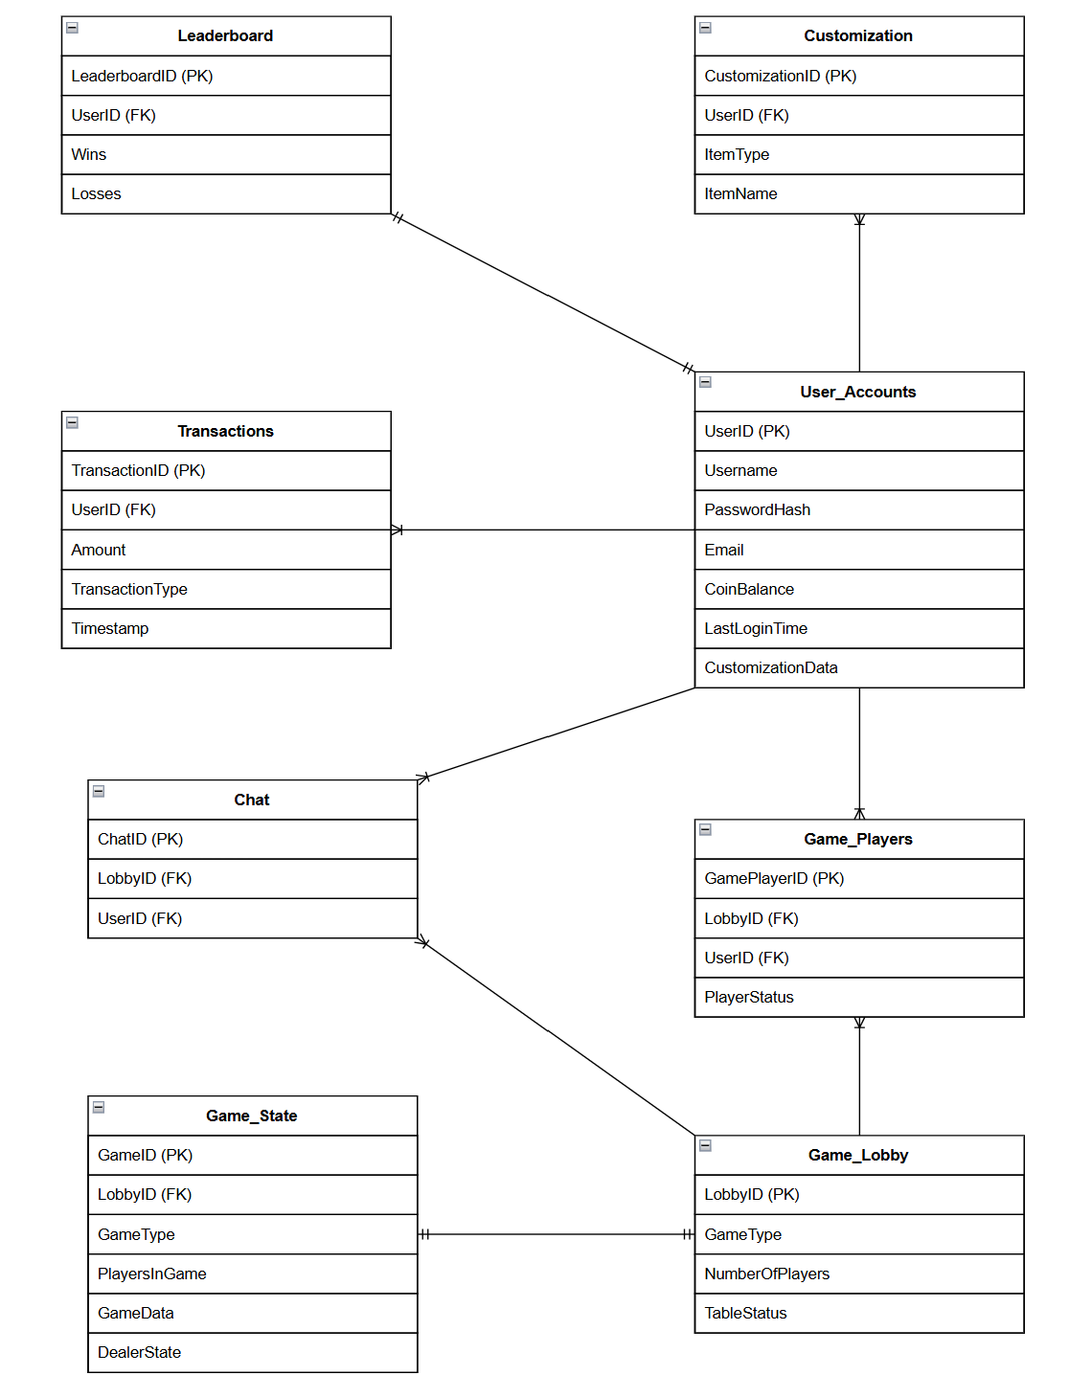
Entity Relationship Diagram

Slide 11
Wireframe/Prototype
DEMO

