Slide 1
Orphan Finder
Team: Past the Wall
Reliability-aware target prediction: from natural products to drug repurposing to antimicrobial resistance
James K. Martin II, PhD · Rowan-Virtua School of Osteopathic Medicine
Built with Claude
Notes:
I'm James Martin, and this is Orphan Finder. About half of all approved drugs come from natural products, from plants, microbes, and fungi. But most of these molecules are stuck: we can see they do something, yet we don't know which protein they act on, and without the target you can't build a drug. We call those orphan molecules. Orphan Finder gives them a target.

Slide 2
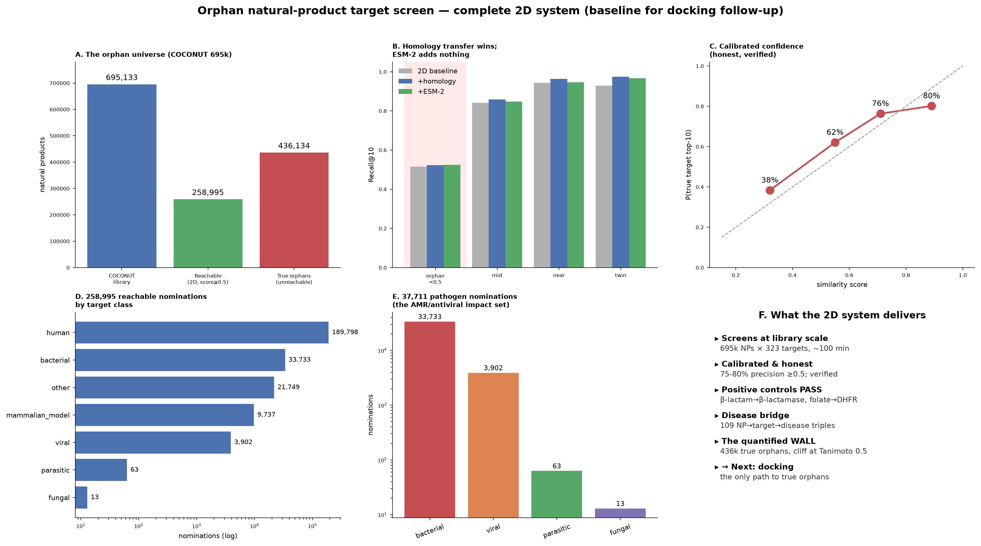
THE PROBLEM WE MEASURED
Similarity prediction has a failure boundary. We measured it.
63%
of 695,133 natural products have no close analog among known binders.
For these, similarity transfer provably cannot work. There is nothing to compare to.
Notes:
Why don't we already know? It comes down to how prediction normally works: guilt by association. If a new molecule looks like a drug we understand, we assume it hits the same protein. Chemists score that resemblance from zero to one, one means near-identical twins, zero means nothing in common. But that shortcut fails for the molecules that matter most. Orphans, by definition, look like nothing we've seen. We measured exactly where it breaks: below a similarity of one half, prediction collapses. Across 695,000 natural products, sixty-three percent live past that cliff. We call it the analog wall. So here's our idea: Orphan Finder always knows which side of the wall it's on. With a close relative, it uses the shortcut. Past the wall, it switches to physics, folding the molecule's 3D shape into the protein's pocket to see if it truly fits.

Slide 3
BUILT ON CLAUDE SCIENCE
One prompt drives the whole engine
Orchestrate
Model + dock
Return ranked leads
Pulls COCONUT, ChEMBL, and the Broad repurposing library into one screening set.
Runs ESM-2 embeddings and dispatches docking to GPUs on Modal, scoring every pose.
Fingerprints 695,000 compounds and returns structure-checked target hypotheses.
Notes:
That whole system runs on Claude Science. From one instruction, it pulls together the world's natural-product libraries, reads each protein's structure, sends the hard past-the-wall cases to physics-based docking on GPUs, and ranks the results. You point it at a molecule, and it returns the proteins it most likely targets, with an honest confidence for each. A months-long lab hunt becomes a single run.

Slide 4
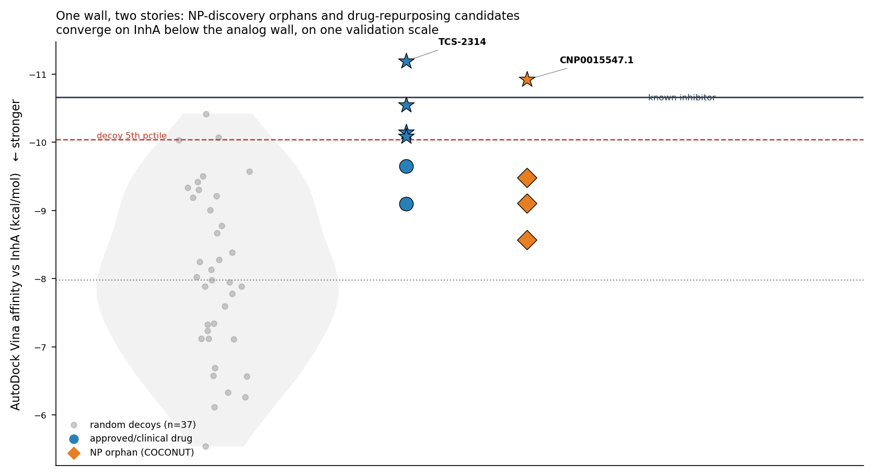
THE HEADLINE RESULT
An orphan natural product and a repurposing-library compound converge on the same TB target
Two molecules that share no chemical skeleton (Tanimoto 0.28) both land on M. tuberculosis InhA through one shared validation standard. Both grip the catalytic Tyr158, both beat a matched decoy set, and an independent structure predictor confirms the poses.
Notes:
So when Orphan Finder goes past the wall, does it land on real targets? Here's the result that convinced me. Take two molecules. One orphan natural product, and one compound from a drug-repurposing library, made for a different purpose. On that similarity score they sit at zero point two eight, far below the wall. They are chemical strangers, sharing no common skeleton. And yet both fold into the same pocket of the same bacterial enzyme, InhA, the enzyme the tuberculosis drug isoniazid was built to shut down. Both grip the same catalytic residue, both beat a field of decoy controls, and a separate structure method confirms it. Two chemical strangers, pointed at the same target, found by one rule. That's the tool working.

Slide 5
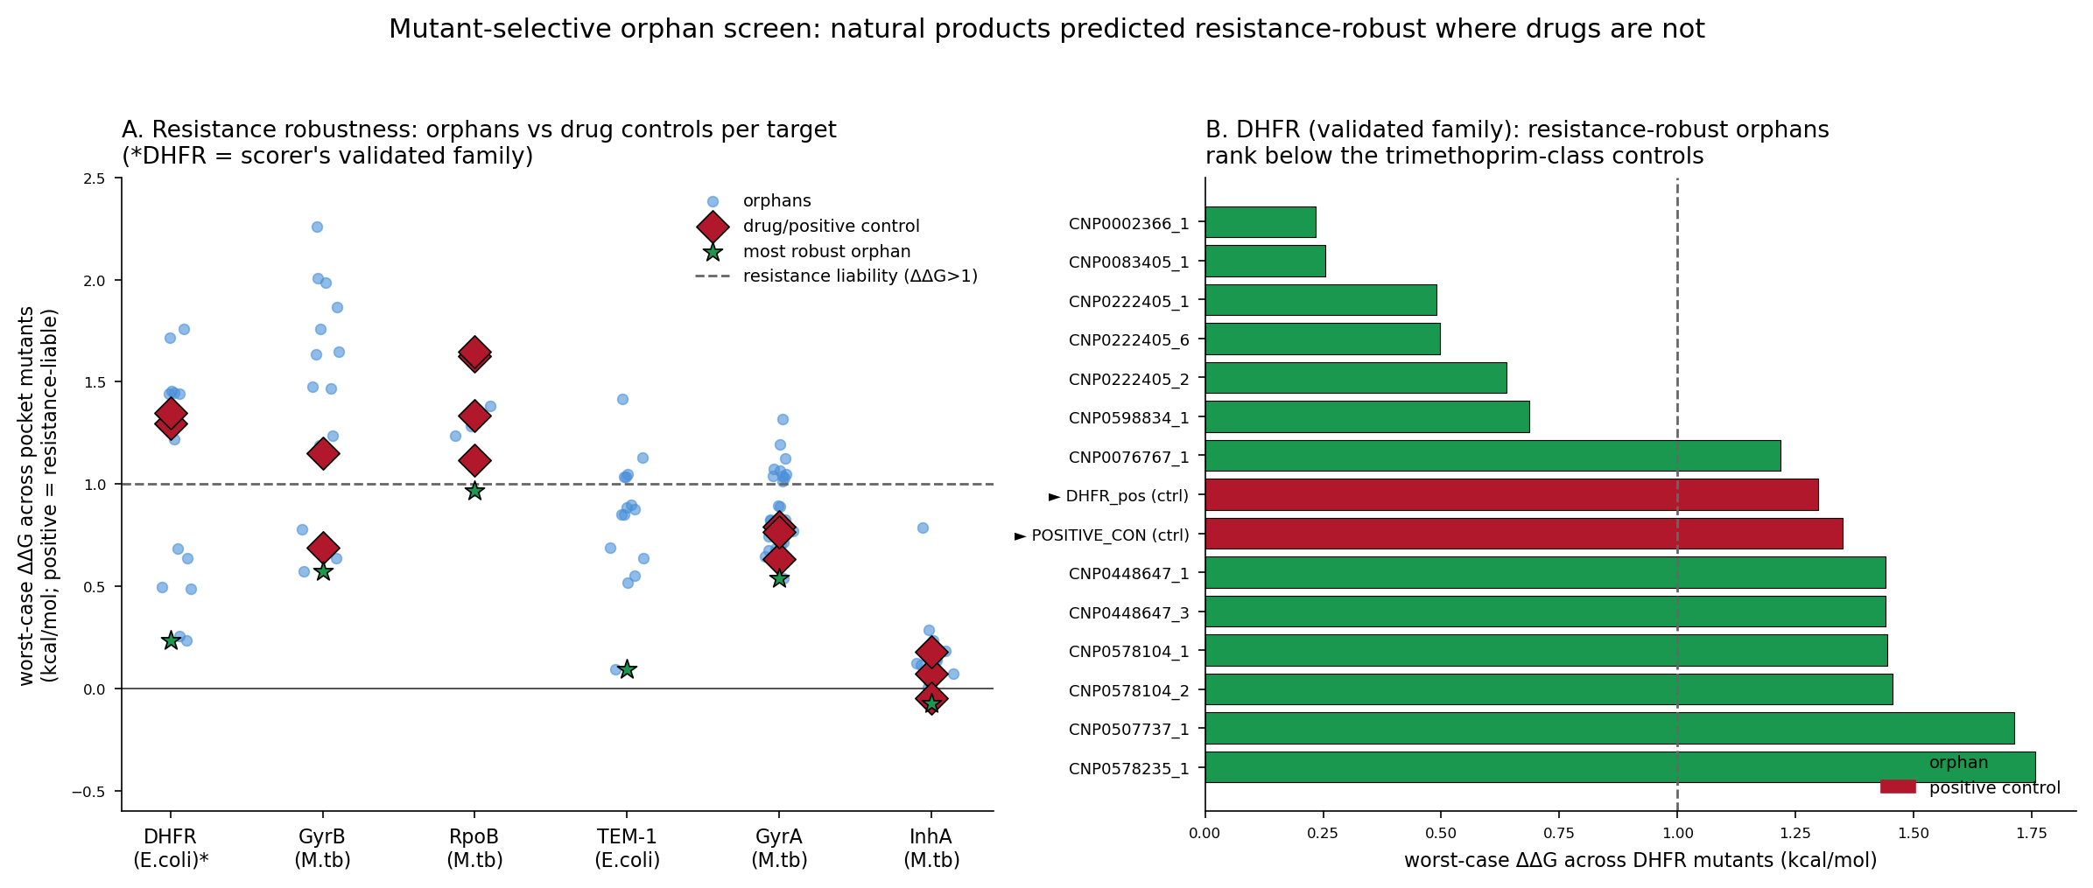
THE EXTENSION THAT MATTERS FOR ANTIBIOTICS
Will the target still be druggable after resistance mutations?
Rigid docking is blind to resistance. We added a mutant-aware database and a control-validated ΔΔG layer.
It passes the mutation test ordinary docking fails, and nominates natural products predicted more resistance-robust than the front-line drug.
Seven on the DHFR family alone.
Notes:
For an antibiotic, naming the target isn't enough. Bacteria fight back, mutating the target until the drug no longer sticks. That's antibiotic resistance, and it's retiring our medicines faster than we invent new ones. So we taught Orphan Finder a harder question: not just does it bind, but does it still bind after the bacteria mutate? We checked it against resistance we already understand, and it correctly reproduced how today's drugs get defeated. Then we turned it on the orphans. Against an enzyme called DHFR, seven orphan natural products are predicted to keep their grip exactly where the frontline drug loses it, holding on through the resistance mutations. Resistance-proof leads, from molecules that had no known target at all.

Slide 6
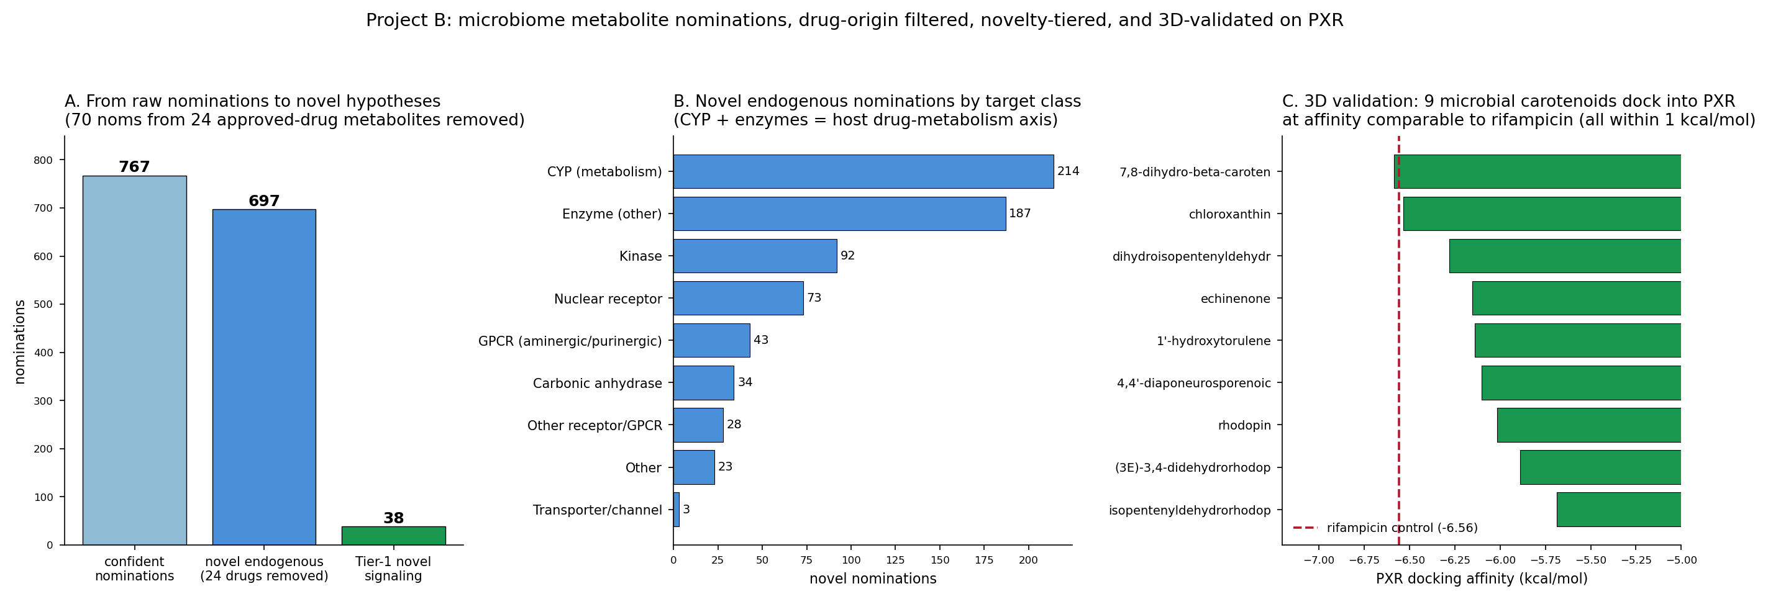
GENERALIZATION | A SECOND APPLICATION
The same engine, pointed at the microbiome
Why we looked
It recovers known biology
The finding
Gut microbes flood the body with molecules. Which of our own proteins do they act on?
The forward screen re-finds established microbe-to-host signaling: niacin to HCAR2, bile acids to FXR and TGR5.
9 microbial carotenoids converge on PXR, the receptor that controls drug clearance. All dock within 1 kcal/mol of the agonist rifampicin.
Notes:
And this isn't a one-trick tool for tuberculosis. To show it generalizes, we pointed the same engine at the microbiome, the molecules our gut bacteria release into us, most of which have no known human target. First, a sanity check: it re-discovered signaling we already know, niacin and bile acids hitting their known receptors. Then the new finding. It flagged a family of microbial carotenoids, the pigments these bacteria make, all converging on one human protein: PXR, the master switch controlling how our bodies clear drugs. All nine dock as tightly as rifampicin, the drug that activates it. A concrete, testable hypothesis: our gut microbes' pigments may be tuning how we metabolize medicine. Same engine, a different frontier.

Slide 7
90% of natural products have no known target. We rank them.
Structure-backed, resistance-aware leads, ready to test. Fully open. Every result reproduces from the repository.
github.com/DocMartin95/analog-wall-target-prediction
Built on Claude Science
Notes:
About ninety percent of nature's molecules have no known target. That's not a dead end, it's an unopened library of medicines. Orphan Finder opens it, turning molecules nobody had a target for into ranked, structure-backed, resistance-aware leads a lab can test. Fully open source, every result reproducible. Built on Claude Science. Thank you.

