Slide 1

Predictive Models to determine the best Interest Rate
Ben MacDonald
Austin Youngblood
Joshlyn Jamerson
LTM

Slide 2
Hypotheses
Null Hypothesis (H0): The FICO score, loan length, and amount requested have no effect on the interest rate.
Alternate Hypothesis (H1): The FICO score, loan length, and amount requested have a significant effect on the interest rate.

Slide 3
The data
Interest Rate
FICO Range
Amount Requested
Amount Funded by Investors
Loan Length
Notes:
`interest_rate`: The interest rate of the loan.
`fico_range`: The FICO score of the borrower. FICO scores are a type of credit score that lenders use to determine the borrower's credit risk.
`amount_requested`: The amount of money requested by the borrower
`amount_funded_by_investors`: The amount of money funded by investors.
`loan_length`: The length of the loan.

Slide 4
Features and Data Issues
The features in our dataset are a mix of numerical and categorical data.
Data Cleaning
Data Manipulation
Notes:
-The features in our dataset are a mix of numerical and categorical data. `fico_range`, `amount_requested`, and `amount_funded_by_investors` are numerical features, while `loan_length` is a categorical feature.
-We encountered some missing data in our dataset. To handle this, we used data imputation techniques to fill in the missing values. For numerical features, we used the mean value of the feature to fill in missing values. For categorical features, we used the most frequent category to fill in missing values.
-We also had to handle the issue of our target variable, `interest_rate`, being a continuous variable. Since we were interested in classification, we transformed `interest_rate` into a categorical variable by binning the interest rates into 'Low', 'Medium', and 'High' categories.

Slide 5
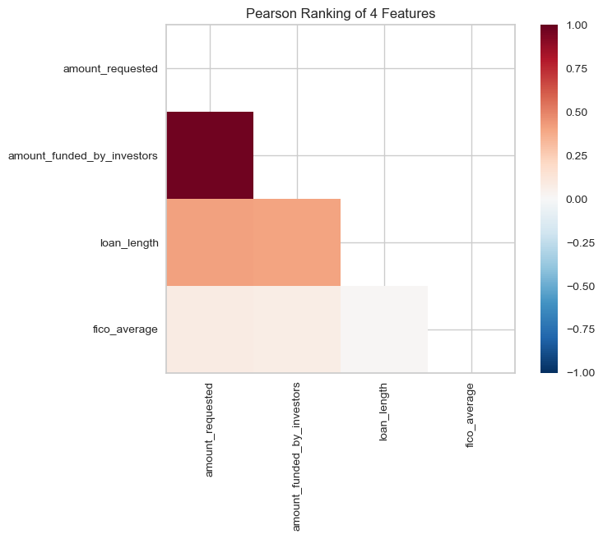
The process
Notes:
-To understand how the features in our dataset relate to each other and to the target variable, we computed the correlation between the features. The correlation is a statistical measure that describes the association between random variables. In our case, it helps us understand how each feature in our dataset influences the interest rate of a loan.
-We visualized these correlations using a heatmap. In the heatmap, each square shows the correlation between the variables on each axis. Correlation values range from -1 to 1. Values close to 1 indicate a strong positive correlation, values close to -1 indicate a strong negative correlation, and values close to 0 indicate no
correlation.

Slide 6
Model Building
1. Data Preprocessing
2. Feature Scaling
3. Train-Test Split
4. Model Selection
5. Model Training
6. Model Evaluation
7. Visualization
Notes:
- We started by preprocessing our data. This involved handling missing values and transforming our target variable into a categorical variable.
- We scaled our features to ensure that they contribute equally to the model. We standardized our features to have mean=0 and variance=1.
- We split our data into a training set and a test set. We used 80% of the data for training the model and set aside 20% for testing.
- We tested several models including Ridge, Lasso, LinearSVC, SGDClassifier, KNeighborsClassifier, and LogisticRegression. We used the F1 score as our metric for model evaluation.
- We trained our selected model (LinearSVC) using the training data.
- We evaluated the performance of our model on the test data. We used the F1 score, the Mean Standard Error, and the R-squared values as our evaluation metrics.
- We visualized the results using a confusion matrix. The confusion matrix gives us a 'clear' picture of how our model is performing and where the misclassifications are happening.

Slide 7
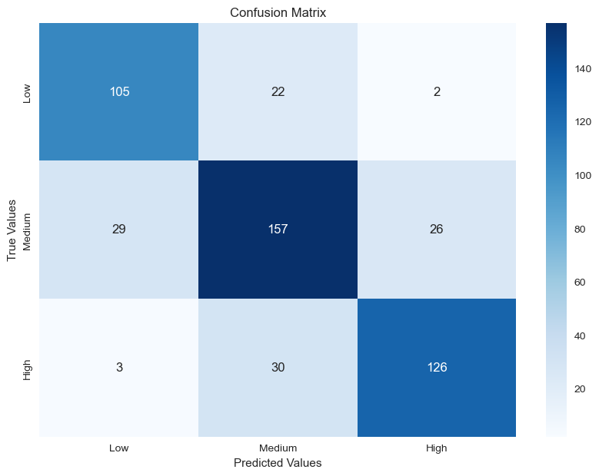
LinearSVC
Notes:
Model Selection: The LinearSVC model performed the best in our analysis. This model can be used to predict the interest rate category ('Low', 'Medium', 'High') based on the features mentioned above.
The F1 score is a measure of a model's performance on a binary classification task.
This F1 score demonstrates that this model will be correct more than 77.5% of the time.
The x-axis represents the predicted labels, and the y-axis represents the actual labels.
The diagonal cells from top-left to bottom-right represent the number of correct predictions made by the model for each class. These are called True Positives (TP) and True Negatives (TN).
The off-diagonal cells represent the incorrect predictions. The top-right cell represents the False Positives (FP) - instances where the model incorrectly predicted the positive class. The bottom-left cell represents the False Negatives (FN) - instances where the model incorrectly predicted the negative class.
The color scale on the right side of the heatmap corresponds to the number of observations. Darker colors typically represent higher values.
In the context of our model, we want the diagonal cells to be darker (higher values) as this indicates more correct predictions. Lighter off-diagonal cells are desirable as they indicate fewer incorrect predictions.

Slide 8

Recommendations

Slide 9
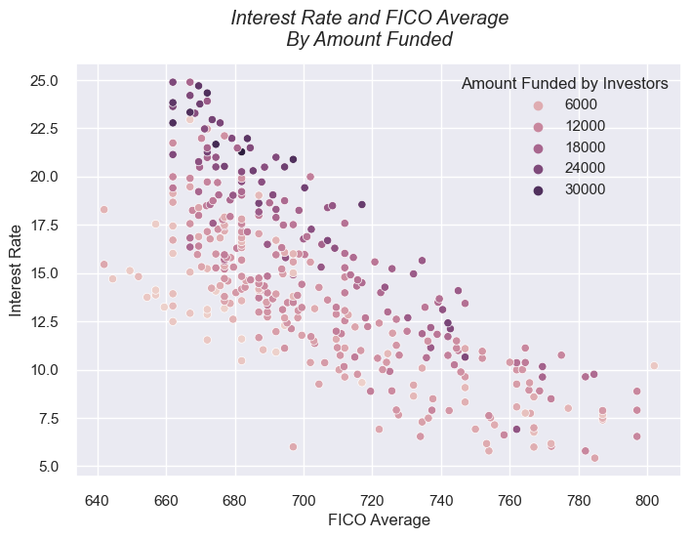
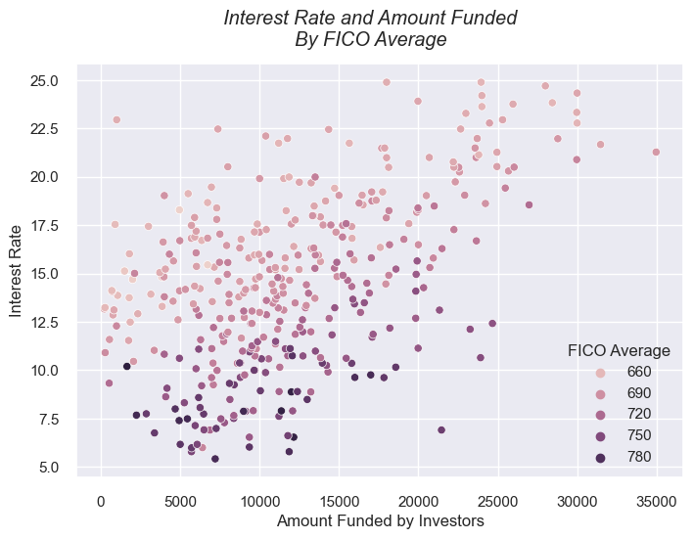
FICO Score
Notes:
: A higher FICO score generally leads to a lower interest rate. Therefore, improving your credit score before applying for a loan could help you secure a better rate.
: Requesting a larger loan amount may lead to a higher interest rate. Be mindful of this when deciding how much funding to request.

Slide 10
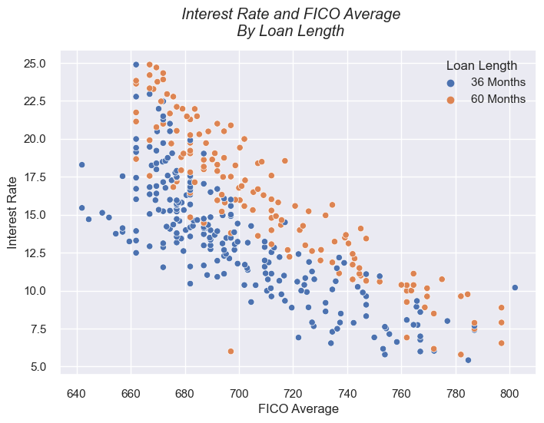
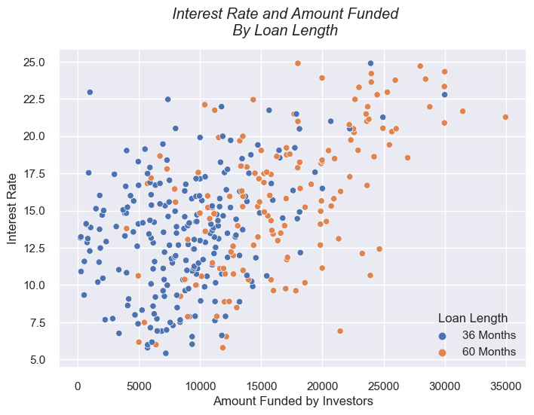
Loan Length
Notes:
: Shorter loan lengths tend to have lower interest rates. If possible, consider choosing a shorter loan length to reduce the total amount of interest you'll pay.
: Requesting a larger loan amount may lead to a higher interest rate. Be mindful of this when deciding how much funding to request.

Slide 11
Wrap-up
Dataset: https://learn-2.galvanize.com/curriculum-download/0c86c7c4bb3bd1a0e0284d49d333a8c0/csv
Github Repo: https://github.com/DocYoungblood/linear_regression_case_study
Contact Info
Austin Youngblood - Austin.m.youngblood@gmail.com
Ben MacDonald - Benjamin.t.macdonald.mil@army.mil
Joshlyn Jamerson - Joshlyn.jamerson@spaceforce.mil
LTM – London.thomson_merriman@spaceforce.mil

