Slide 1

Containers Compromised
Implementing Recent attacks and a security application on container
Presented by Group -8

Slide 2
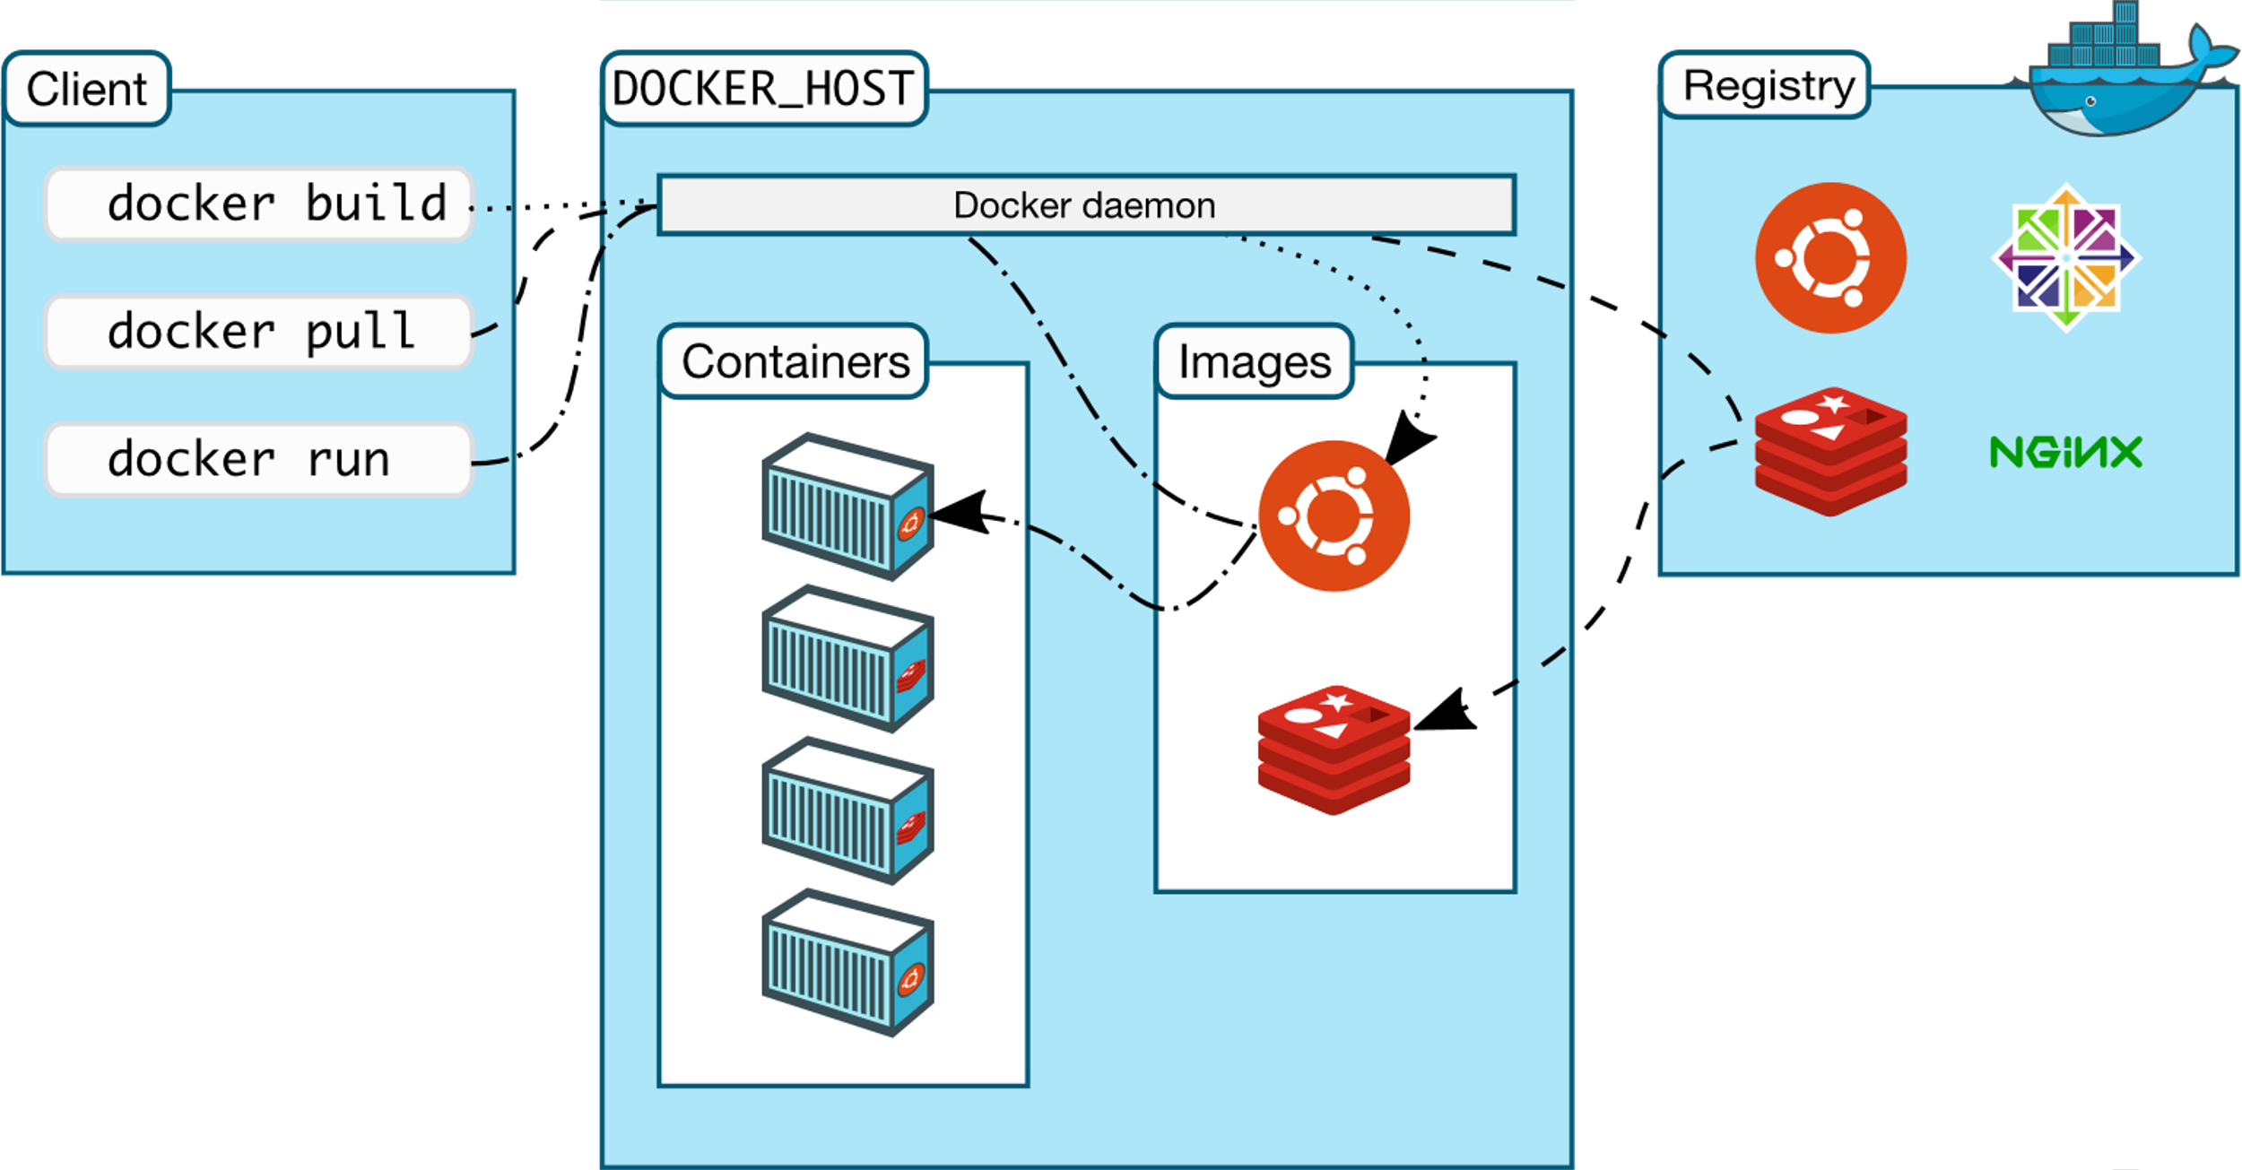
What is docker?
Docker is a Linux-based, open-source containerization platform.
Use to build, run, and package applications for deployment using containers.
Components of Docker: Images Containers Registries Docker Engine.

Slide 3
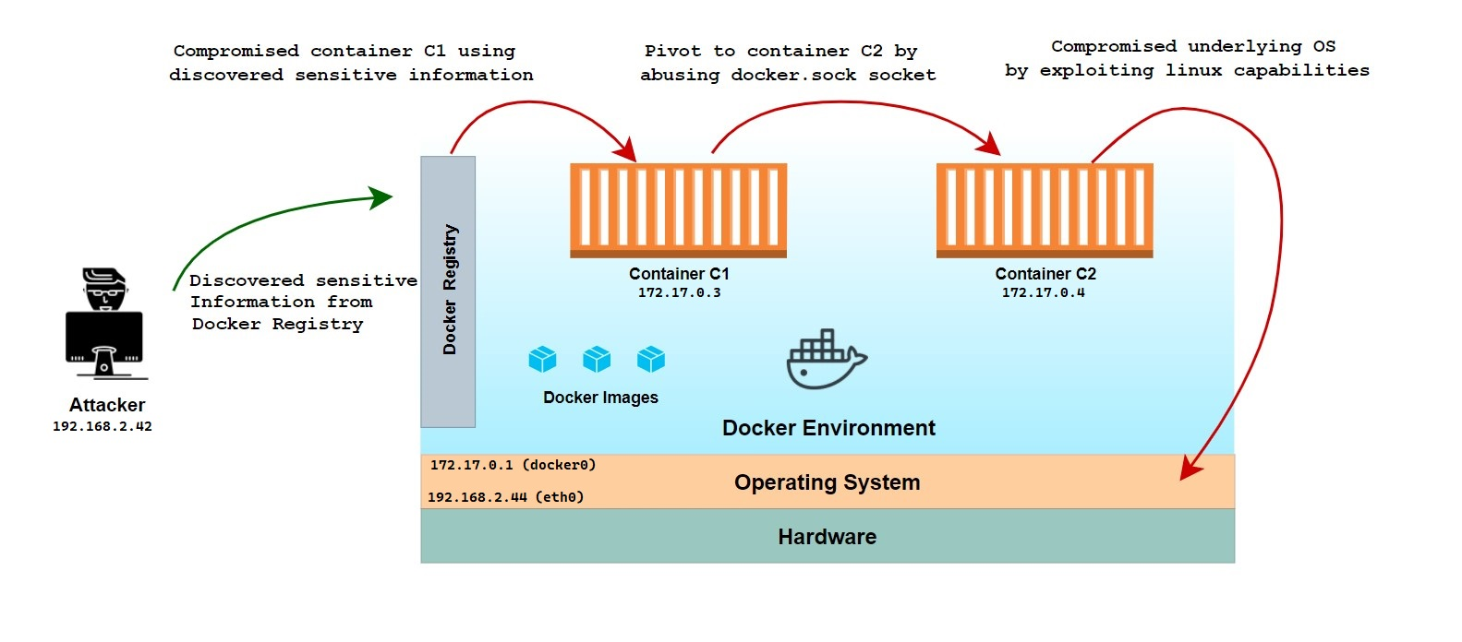
Attack Scenario 1 :
Vulnerabilities:
Unprotected Docker Registry.
Sensitive Information Leakage in Image Manifest.
Docker Socket Mounted inside Docker Container.
Excessive Capabilities.

Slide 4
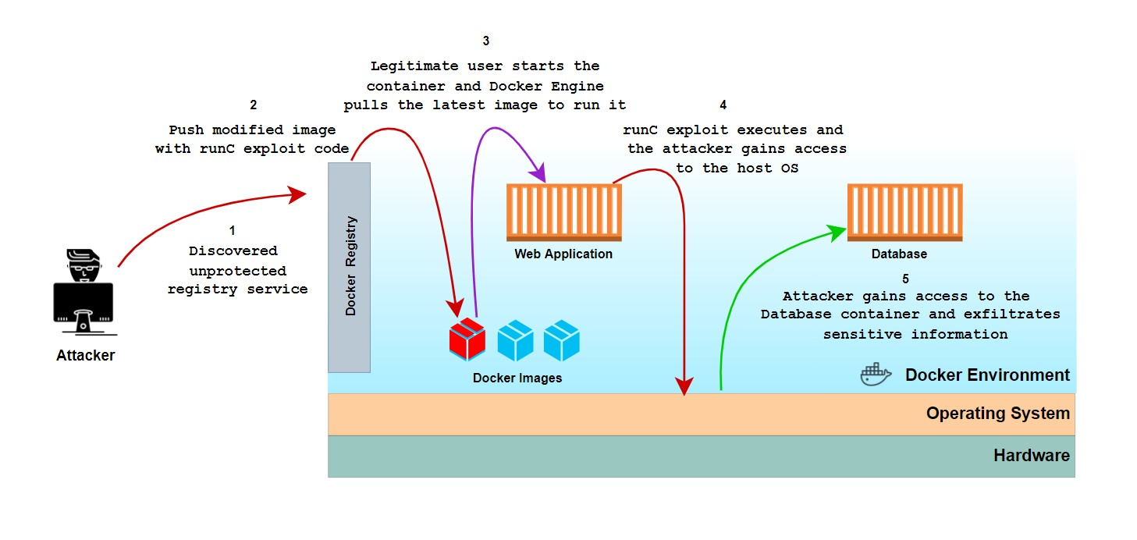
Attack Scenario 2 :
Vulnerabilities:
Unprotected/Writable Docker Registry
Components with Known Vulnerabilities (CVE-2019-5736)
Missing Signature Verification

Slide 5
Security Application:
Image Manifest Scanner - Wrote python script to automatically read and highlight sensitive information in image manifests from docker registry.
IP Based filtering -Implemented IP Address whitelisting on SSH login.
Docker Socket Detector -Python script to check if 'docker.sock' file is present inside any running container.
Capabilities Checker- Checked the capabilities of running containers, with the python script checked if any abusable capability is present inside running containers and deleted the same.
Signature Implementation -Implemented image signature verification in docker environment and wrote python script to detect if image signature does not match.
Docker Socket Detector -Implemented authentication on docker registry.
Security Application Pdf

Slide 6
Member's Contributions:
Attack 1:
Tasks | Contributions
Reading about different known vulnerabilities and misconfigurations in the Docker environment. | All
Prerequisites for Attacks and security (Installing specific versions and implementing misconfigurations). | All
Designing Attack Scenario 1 by chaining different vulnerabilities as per real world context. | Mohit Balu, Harpreet Kaur Milanpreet Kaur
Performing attack on the environment including initial compromise, pivoting to other containers, docker escape, host OS compromise. | Mohit Balu, Harpreet Kaur

Slide 7
Member's Contributions:
Attack 2:
Tasks | Contributions
Designing Attack Scenario 2 by chaining a known vulnerability (CVE-2019-5736) and unprotected registry service. | Mohit Balu, Bikramjeet Singh, Nithya Sri Bommakanti
Figuring out pre-requisites and compatibility of different docker components' versions (Docker Engine, Docker Client, containerd, runC) required for the implementation of runC vulnerability. | Mohit Balu Bikramjeet Singh
Performing attack 2 on the environment by discovering unprotected registry service, pushing modified image with runC exploit. | Bikramjeet Singh, Mohit Balu, Nithya Sri Bommakanti
Created dummy web application and sample database for the exploit. | Bikramjeet Singh, Nithya Sri Bommakanti Mohit Balu.

Slide 8
Member's Contributions:
Security Application:
Tasks | Contributions
Designing security Measures according to vulnerabilities present in Attack Scenerio1 & 2 | Milanpreet Kaur, Mohit Balu
Image Manifest Scanner - Wrote python script to automatically read and highlight sensitive information in image manifests from docker registry. | Mohit Balu Milanpreet Kaur
Capabilities Checker - Checked the capabilities of running containers, with the python script checked if any abusable capability is present inside running containers and deleted the same. | Srividya Poshala Gouresh Chauhan
IP Based filtering - Implemented IP Address whitelisting on SSH login. | Rabiatou Oubbo Modi Milanpreet Kaur
Registry Authentication - Implemented basic authentication on docker registry. | Srividya Poshala Nithya Sri Bommakanti Bikramjeet Singh
Docker Socket Detector - Python script to check if 'docker.sock' file is present inside any running container. | Gouresh Chauhan Milanpreet Kaur
Signature Implementation - Implemented image signature verification in docker environment and wrote python script to detect if image signature does not match. | Milanpreet Kaur

