Slide 1
Docker Performance Benchmarking
Bare Metal vs Hypervisor
Docker Day
Duke University
September 11, 2014

Slide 2

Why?
Because I’m Lazy

Slide 3


Why?
Hypervisor convenience vs Bare Metal performance
vs

Slide 4
What?
Benchmark!
Based on:
KVM and Docker LXC Benchmarking on OpenStack*
Serial Container Boot
Steady-state Container Packing
CPU Performance
MySQL Transactions
MySQL Indexing and Queries
File I/O Operations
Memory Performance
Application Performance - Blogbench (Simulated Blog)
Application Performance - Apache Bench (Raw Served Webpages)
*http://bodenr.blogspot.com/2014/05/kvm-and-docker-lxc-benchmarking-with.html

Slide 5

What?
Hypothesis:
“Bare Metal will beat the pants off of Hypervisor”

Slide 6

How?
Physical Server
Cisco UCS Blade CCSB-B200-M3
Intel E5-2665@2.4 GHz (8 Core)
256 GB 1600 RAM
2 Toshiba 300GB SAS 15K RPM
Host OS
CoreOS
Beta 324.5.0
Hypervisor
Host OS
CoreOS
Beta 324.5.0
Docker
0.11.1, Build fb99f99

Slide 7
How?
Process:
Create Docker images for tests
Push images to Duke Docker repo
PXE Boot CoreOS
Pull runner scripts via CoreOS cloud-config
Run runner scripts as root
Collect data via ssh tunnel to external server

Slide 8

Results!
Hypothesis:
“Bare Metal will beat the pants off of Hypervisor”

Slide 9
RESULTS!
Only 7 out of 12 pants conclusively beaten off
Bare Metal Wins:
MySQL Transactions
MySQL Indexing and Queries
Memory Performance (all three)
Blogbench (Writes only)
Apache Bench

Slide 10
RESULTS!
Only 3 out of 12 pants tied for performance*
Hypervisor Ties Bare Metal:
Serial Boot Tests
Steady State Packing
File I/O
*Google doesn’t have any funny images for this phrase. Who would have thought?

Slide 11
RESULTS!
Surprise! Hypervisor Beats Bare Metal in 2 (or 4)
Hypervisor Wins:
Hypervisor (sort of) Wins:
CPU Performance
Blogbench (Reads only)
Serial Boot Tests (I/O Wait)
Steady State Packing (I/O Wait)

Slide 12
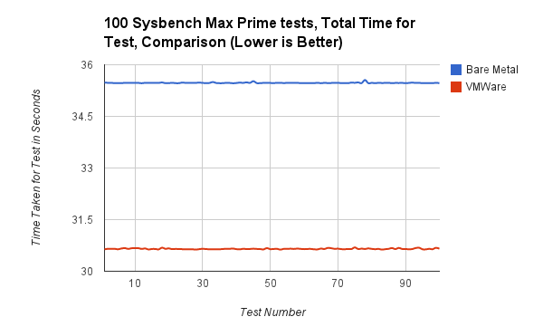
(The Interesting) Details
CPU Max Prime Number Calculations
Hypervisor is faster at
Prime Number
calculations.

Slide 13
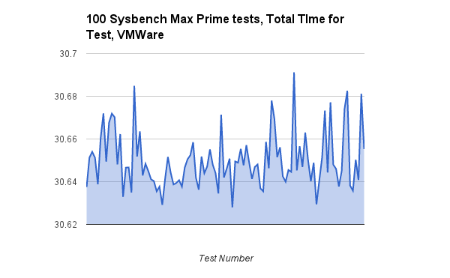
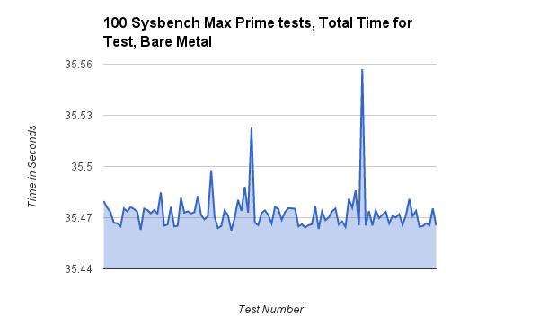
(The Interesting) Details
CPU Max Prime Number Calculations
Hypervisor is (slightly) more consistent at Prime Number calculations
(note the scale)

Slide 14
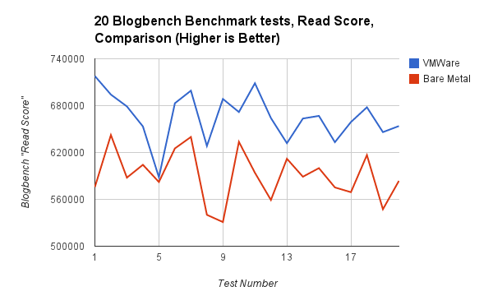
(The Interesting) Details
Blog Bench (simulated blog) Reads
Hypervisor is faster at
(simulated) blog
reads.

Slide 15
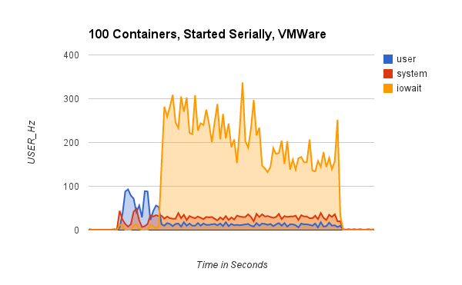
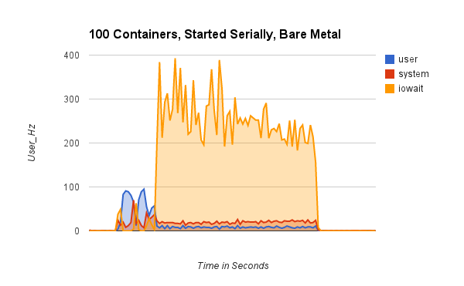
(The Interesting) Details
Serial Container Boot
Negligible difference in CPU, but Hypervisor has (slightly) better I/O Wait

Slide 16
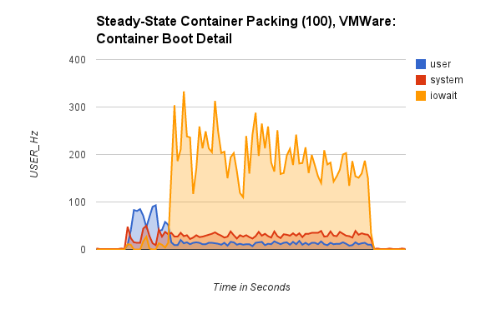
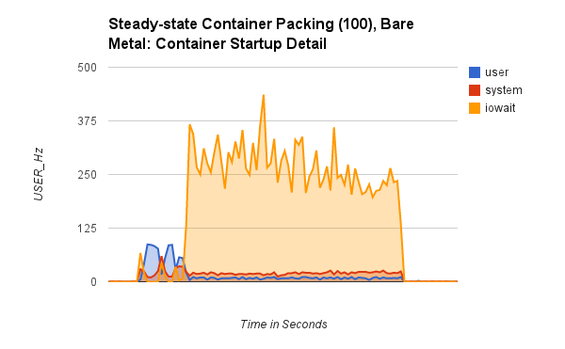
(The Interesting) Details
Steady-State Packing
Same results as Serial Container Boot;
basically the same test with more normalization

Slide 17
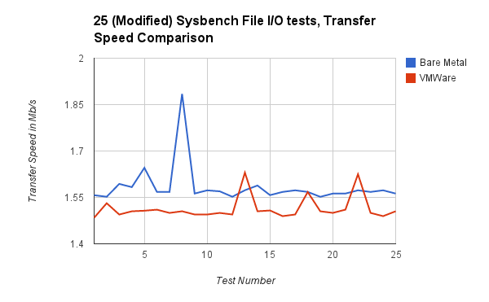
(The Interesting) Details
File I/O Test
Despite previous test
results, the difference
in File I/O here is
negligible.

Slide 18
Tangential Learning Points
Unrelated to testing the hypothesis, I learned:
The addition of Hypervisor has almost no effect on Docker-related tasks
Container Boot
Container Shutdown
Idle Containers
Disk I/O is the largest bottleneck in Docker-related tasks
Considerably more than CPU or RAM
Hypervisor gets a much larger boost in RAM performance by having more physical RAM to write to, even if the same amount is presented to the VM
Enterprise storage arrays that detect “Hot” or active write blocks and adjust accordingly can have a HUGE impact on File I/O

Slide 19
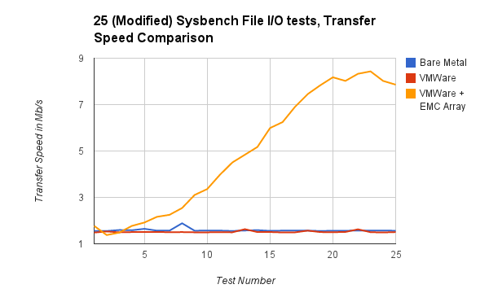
Tangential Learning Points
Re: Enterprise Storage “hot block” detection

Slide 20

Final Thoughts
I do not trust these results
Sample Size Too Small
Surely missed something
Surely misinterpreted something

Slide 21

Final Thoughts
I do not trust these results
Please help:
Review my method, results
Replicate in your own environment
Let me know what you find out
For Science!

Slide 22
Info
GitHub Repo:
Method
Results
Docker Images
CoreOS Cloud-config.yml
Benchmark running scripts
https://github.com/DockerDemos/vm-docker-bench

Slide 23
Info
Me:
Chris Collins
collins.christopher@gmail.com
https://github.com/clcollins

