Slide 1
Introduction to Gaussian Processes
Smartstart Student Retreat
July 2, 2017

Slide 2
Introduction to Gaussian Processes
Coding: Sampling from a Gaussian Process
Gaussian Process Regression
Coding: Curve fitting with a Gaussian Process
Bayesian Optimization
Coding: Gaussian Processes for Global Optimization

Slide 3
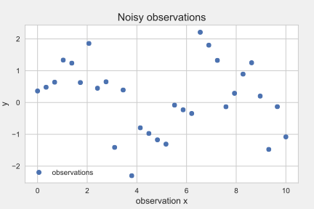
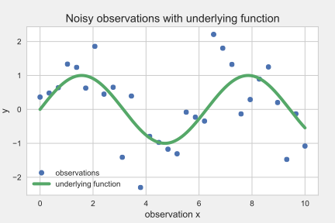

Supervised learning
Input-output mappings from empirical data
robotic control, digit classification, spike sorting
Input vector x, output y mapping data set

Slide 4
Two common approaches
Restrict the class of functions we consider: linear - or quadratic functions, sum of basis functions Problem: How to decide for the correct class?
Give a prior probability to any possible function Problem: How to evaluate infinitely many functions?
Solution: Gaussian Processes

Slide 5



The Gaussian Process
generalization of the Gaussian distribution:
not over a scalar variable:
or a vector,
but over functions

Slide 6


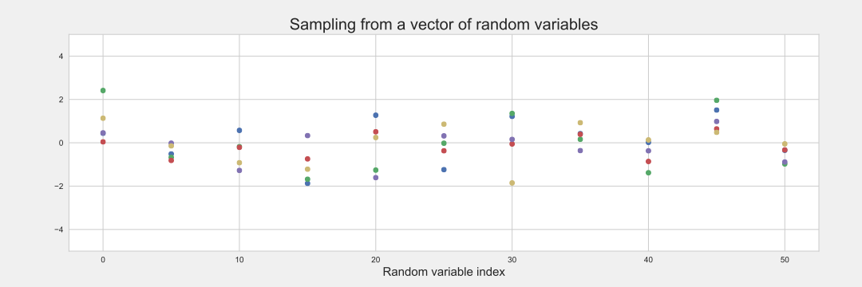
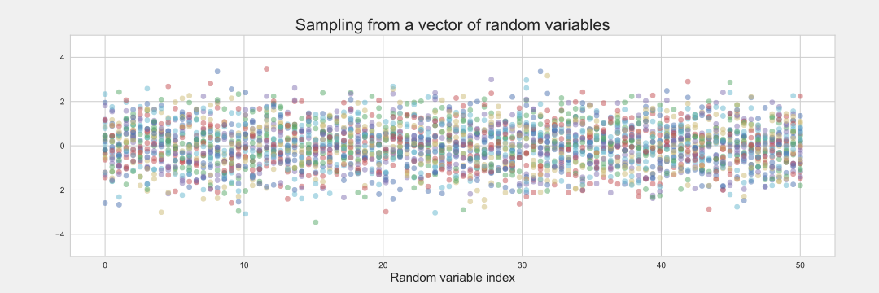
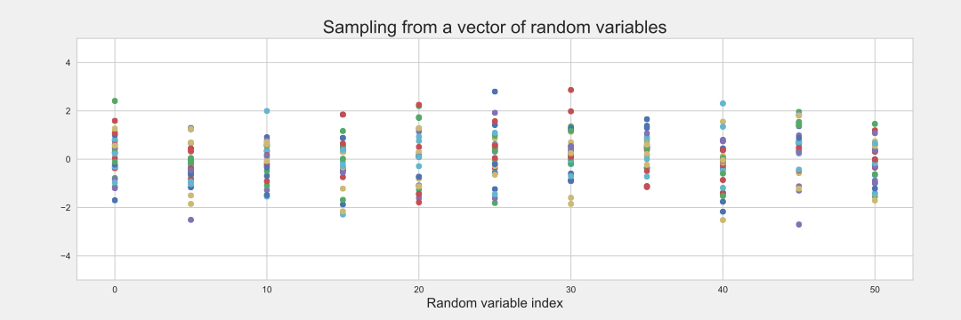
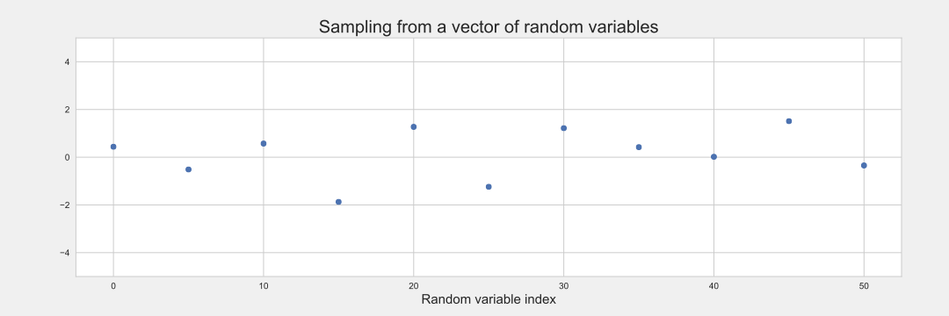
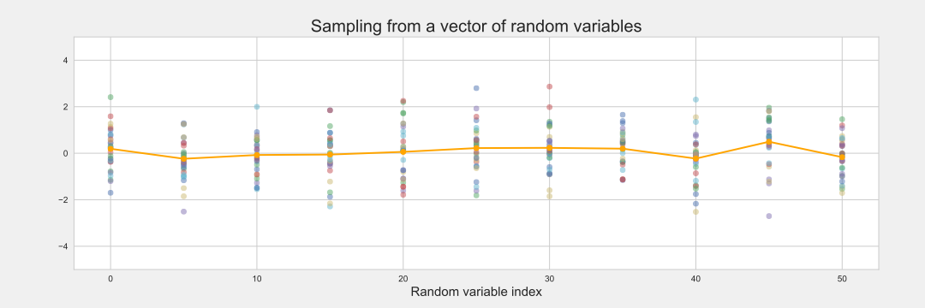
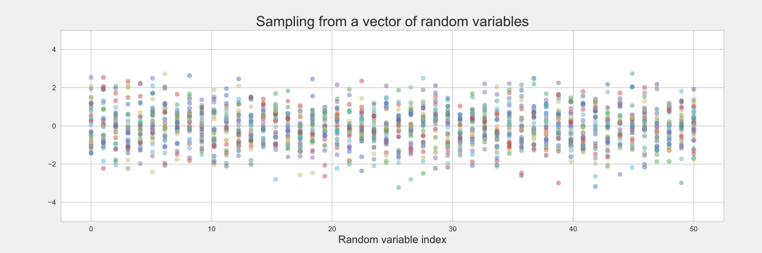
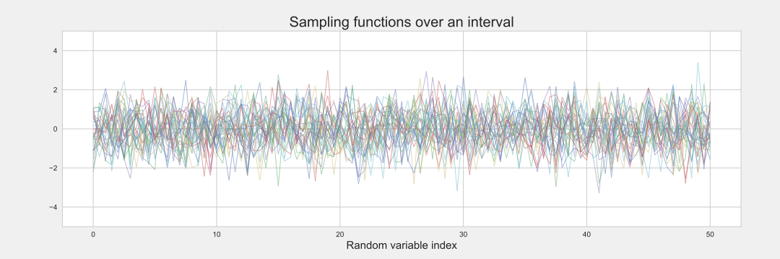
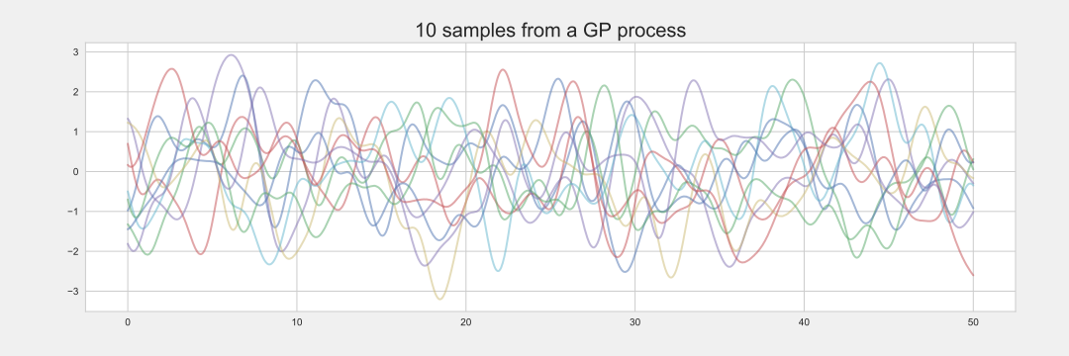
Definition: A Gaussian process is a collection of random variables, any finite number of which have a joint Gaussian distribution

Slide 7
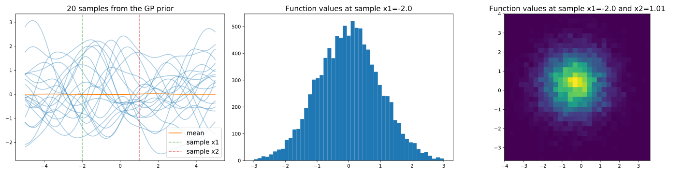
Coding

Slide 8
Introduction to Gaussian processes
Coding: Sampling from a Gaussian process
Gaussian process regression
Coding: Curve fitting with a Gaussian process
Bayesian Optimization
Coding: Gaussian processes for global optimization

Slide 9





Bayesian linear regression
Data set
Standard linear model:
Bayesian approach:

Slide 10



Bayesian linear regression
Make predictions for new data
The crucial Bayesian step: average over all possible parameters

Slide 11


Gaussian process regression
Define the linear model as a Gaussian process, noise free
The mean is zero:
Define a covariance function:

Slide 12


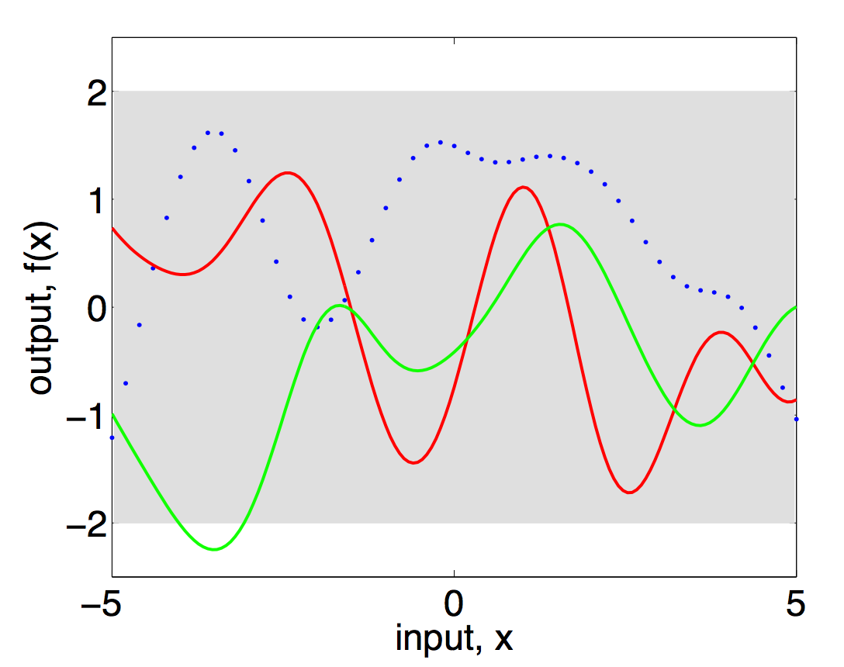
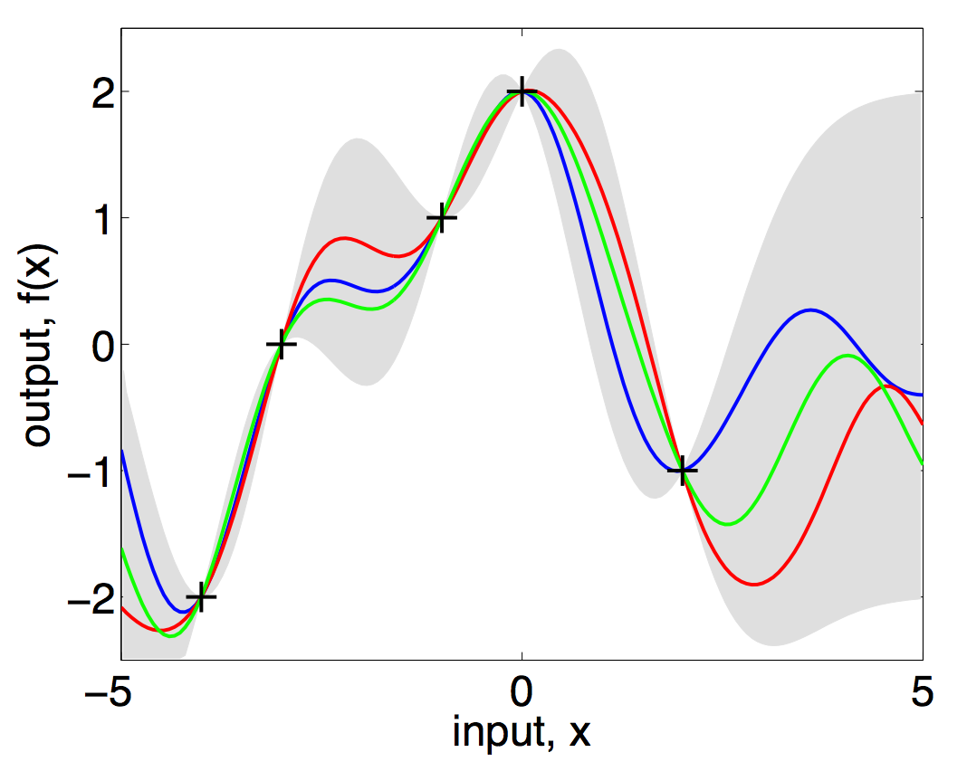
This gives a Gaussian process prior:
But we want a posterior with incorporated training data
condition the prior on the training data
make predictions by evaluating the mean

Slide 13
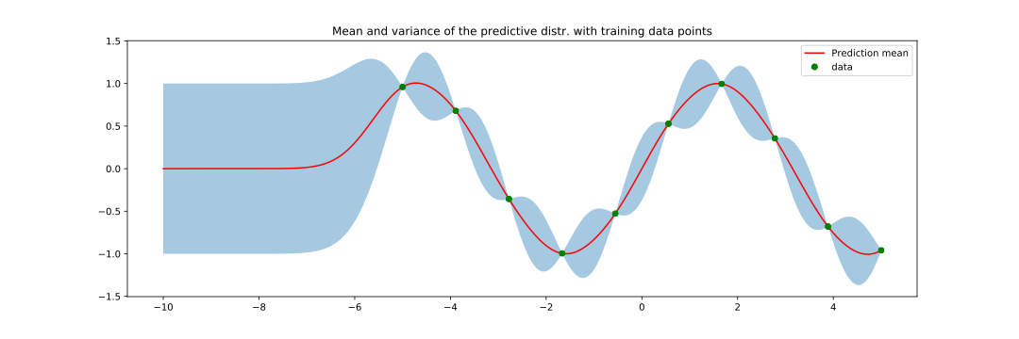
Coding

Slide 14
Introduction to Gaussian processes
Coding: Sampling from a Gaussian process
Gaussian process regression
Coding: Curve fitting with a Gaussian process
Bayesian Optimization
Coding: Gaussian processes for global optimization

Slide 15
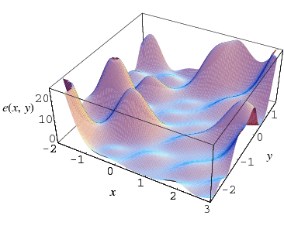
Bayesian Optimization
Global optimization: find extrema of an objective function
What if it is costly to evaluate or non-convex or unknown?
minimize evaluations
build a model of the function to evaluate effectively
combine prior knowledge with current evidence

Slide 16



Estimate given accumulated observations and prior information to calculate the posterior over
Use this model of the objective function to find the next sampling location
What kind of model…?
Gaussian Process

Slide 17

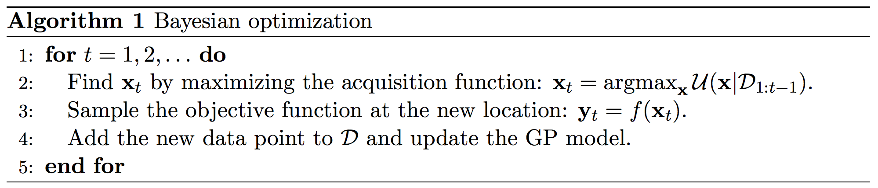
GP for Bayesian optimization
Define a GP with prior information in the covariance fun
Define an acquisition function to decide where to sample:

Slide 18
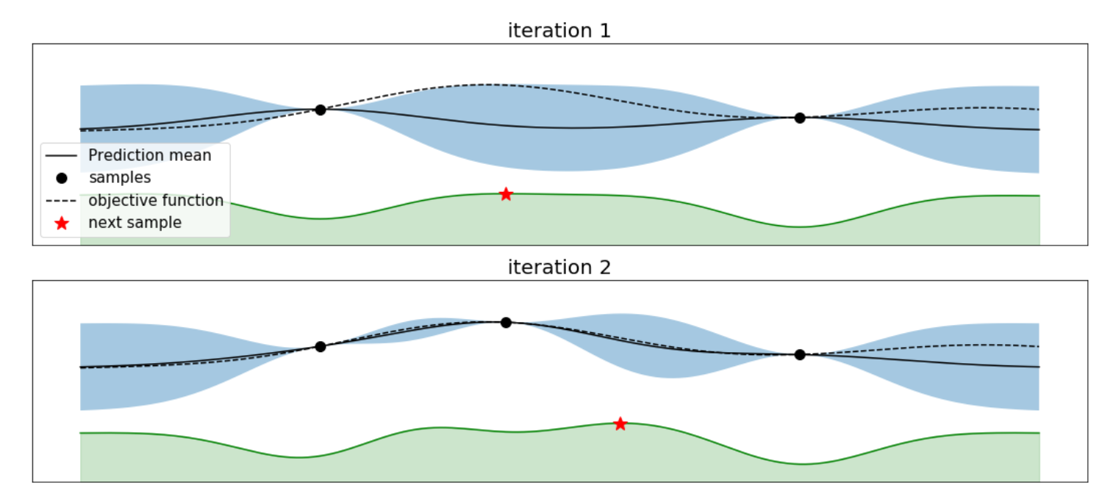
Coding

Slide 19
Thank you!
References:
Rasmussen and Williams. Gaussian Processes for Machine Learning (Adaptive
Computation and Machine Learning). The MIT Press, 2005.
Resources:
Book link: http://www.gaussianprocess.org/gpml/
Podcast: http://www.thetalkingmachines.com/blog/2016/1/28/openai-and-gaussian-processes
Lecture: https://www.youtube.com/watch?v=4vGiHC35j9s

