Slide 1
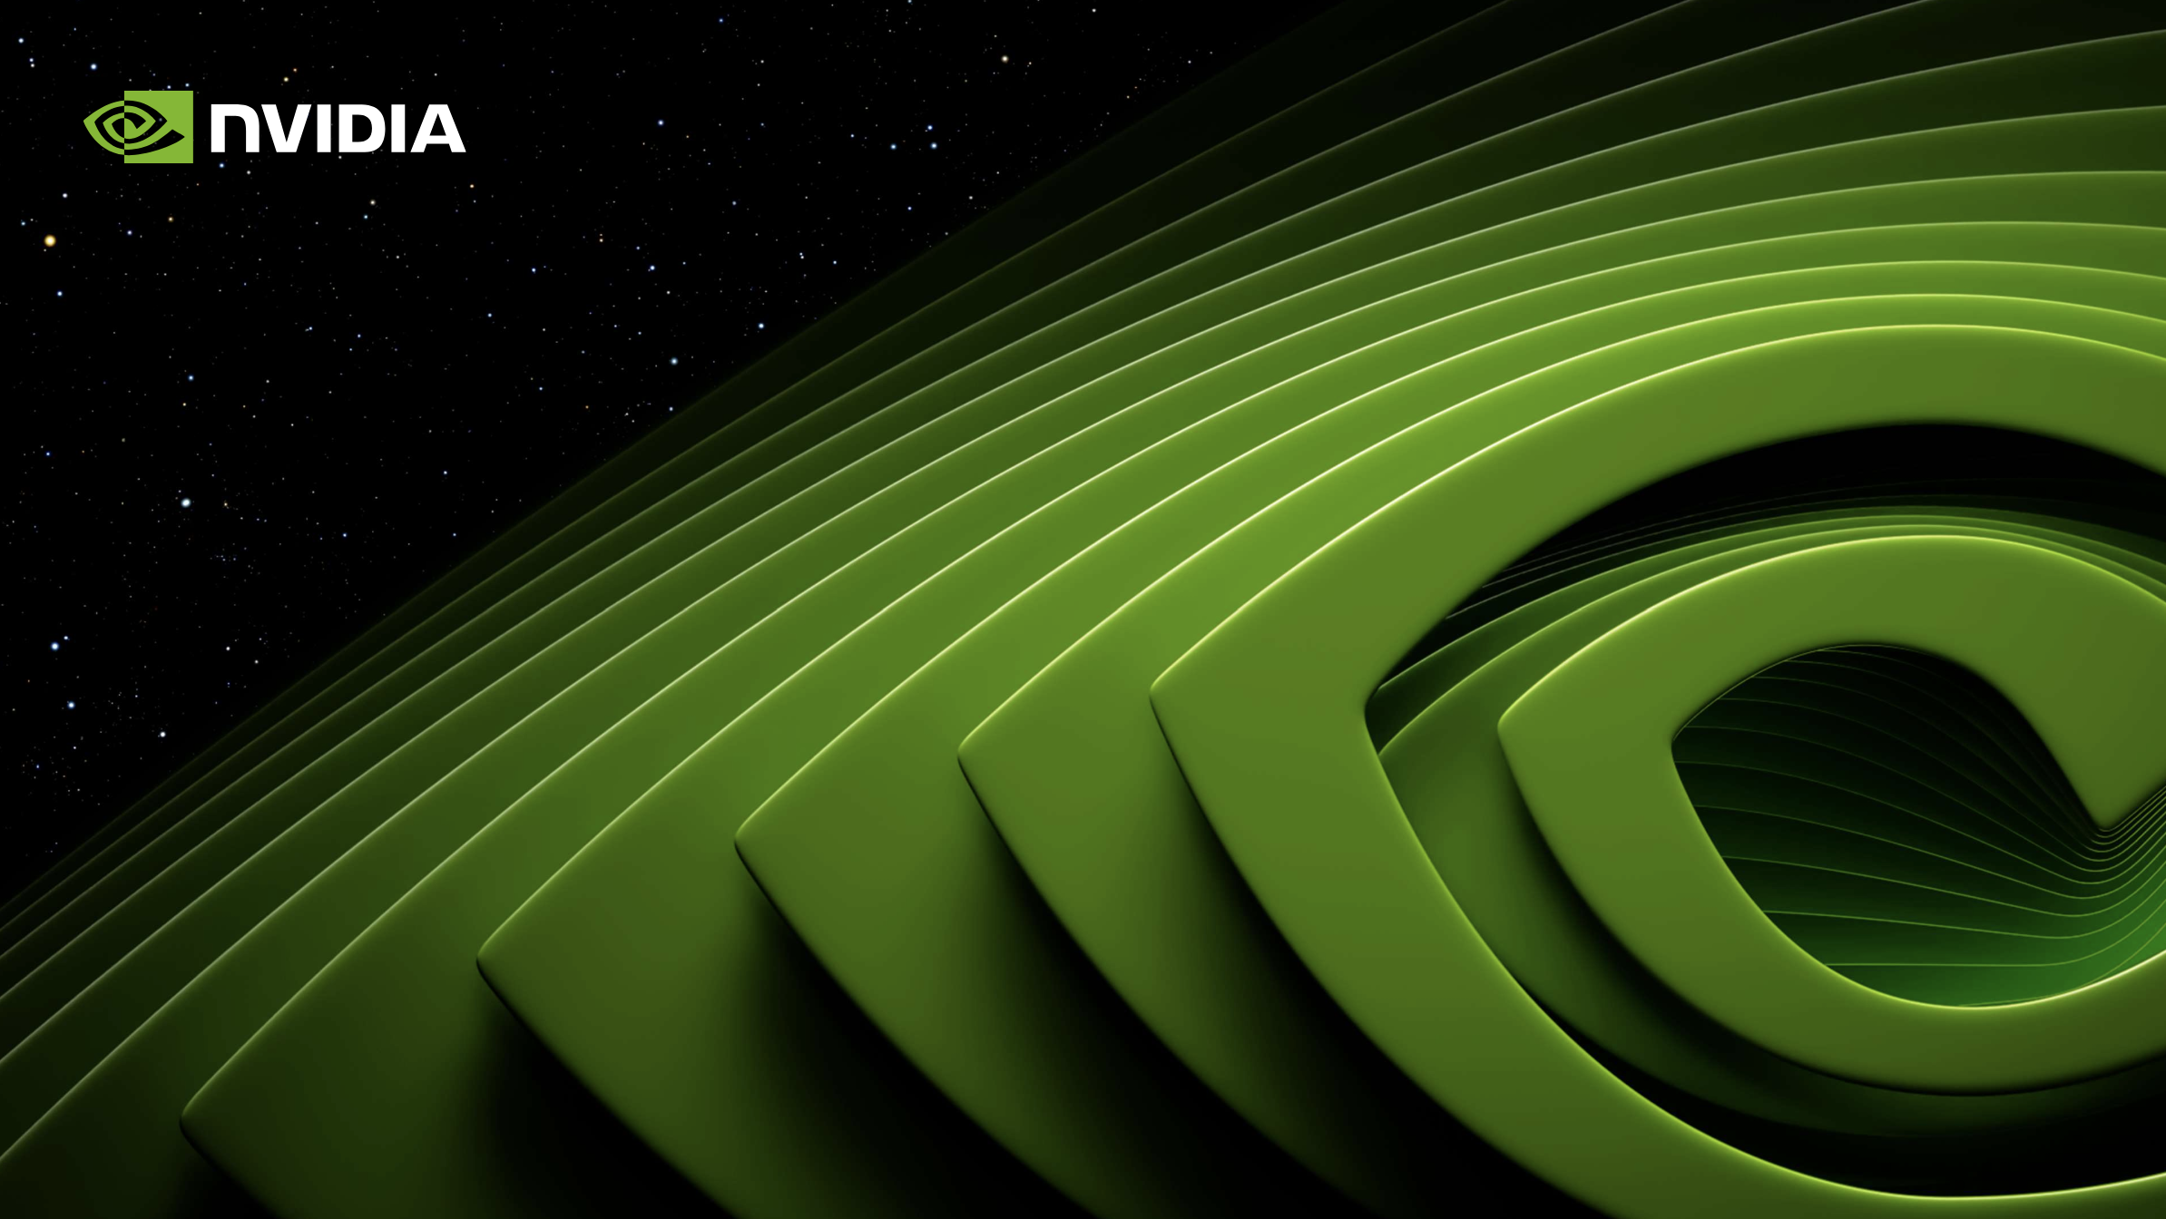

CUDA-AWARE MPI |
GPU – Direct Communication In MPI
Kelch NGOUESSI
18/12/2025

Slide 2
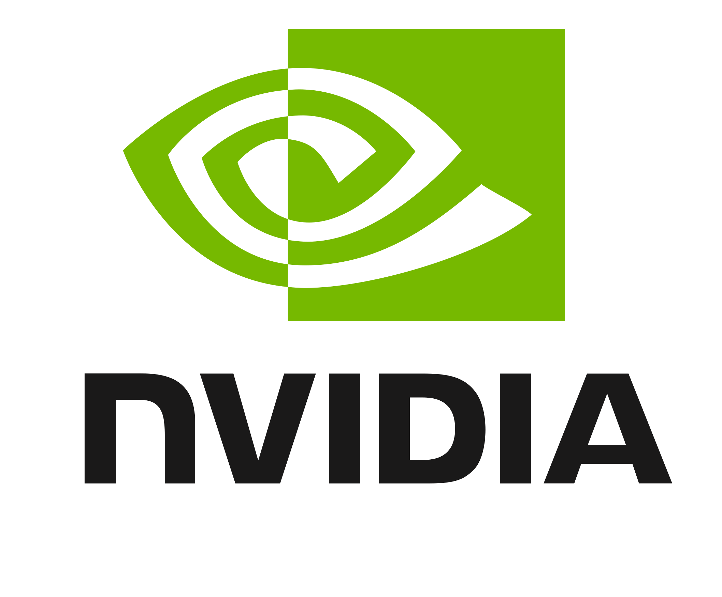
Sommaire
Introduction: Problem & Motivation
Context: The Challenge of Distributed GPU Scaling
Problem: The Cost of Host Staging
Part 1 : Finite Volume
Mesh construction
KEY DIAGRAM: The Optimized GPUDirect RDMA Path
Code Simplicity and Prerequisites
Part 2 : Finite Element
Evaluation Protocol: Standard Benchmarks (OSU)
Result 1: Latency Reduction (Startup Time)
Result 2: Maximizing Bandwidth (Throughput)
Conclusion and Perspectives
Synthesis: Impact on Application Scaling (Overlap)
Conclusion and References

Slide 3
Introduction: Problem &
The Problem :

Slide 4
Mesh structur

Slide 5
Part 1 : Finite Volume Approximation

Slide 6
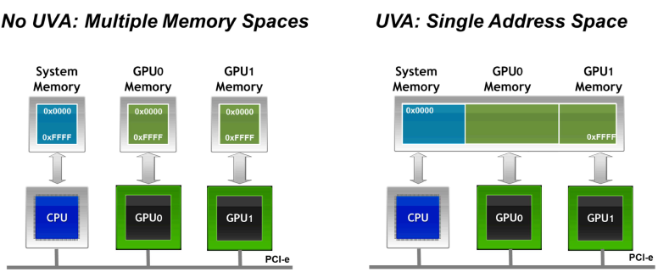
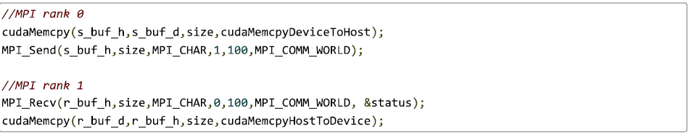
The Core Mechanism: GPUDirect RDMA
The Solution: CUDA-aware MPI and GPUDirect
What is CUDA-Aware MPI?
CUDA-aware MPI allows MPI functions to directly accept GPU memory pointers
MPI becomes aware of GPU memory
//MPI rank 0
MPI_Send(s_buf_d, size, MPI_CHAR, dest, tag, MPI_COMM_WORLD);
//MPI rank 1
MPI_Recv(r_buf_d, size, MPI_CHAR, src, tag, MPI_COMM_WORLD, &status);

Slide 7
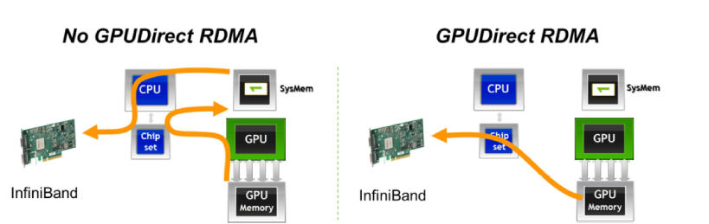
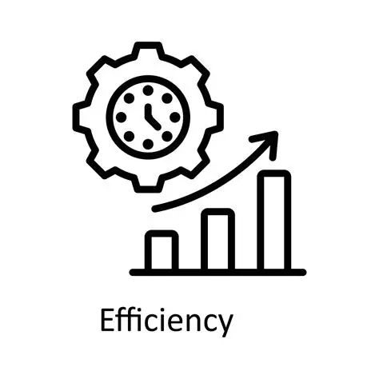
The Core Mechanism: GPUDirect RDMA
KEY DIAGRAM: The Optimized GPUDirect RDMA Path
The Concept: For inter-node communication, CUDA-aware MPI leverages GPUDirect RDMA (Remote Direct Memory Access).
Mechanism: GPUDirect RDMA is the hardware feature that enables the Network Interface Card (NIC, typically InfiniBand or RoCE) to read and write directly into the GPU's memory buffer via the PCIe bus, by passing the Host CPU and Host RAM entirely.
The Optimized Flow: The data path is streamlined to:
Main Advantage: This is the core takeaway—it leads to the complete elimination of Host Staging, drastically reducing latency and increasing effective bandwidth by removing two memory copies.
GPU
NIC
Network
NIC
GPU

Slide 8
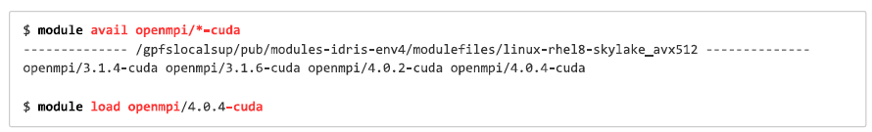
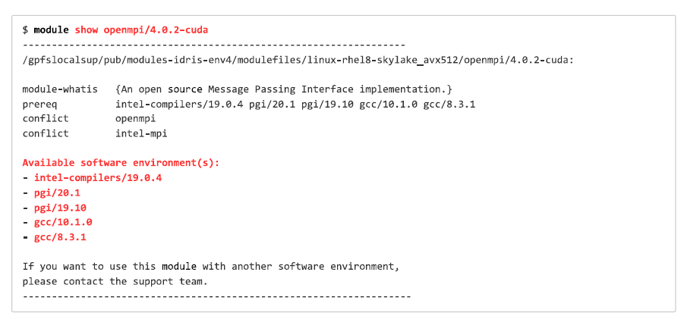
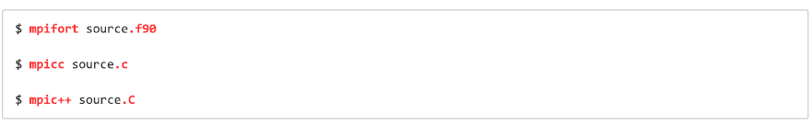
The Core Mechanism: GPUDirect RDMA
Code Simplicity and Prerequisites
Hardware/Software Requirements: The system needs :
A Compatible NVIDIA GPU
An RDMA-capable interconnect (InfiniBand/RoCE),
And the MPI library must be specifically compiled for CUDA-aware/GPUDirect support.
The Crucial Cluster Step: On production HPC environments (like the Jean Zay cluster), the user must load the specific MPI library version that was compiled with the necessary support.

Slide 9
Experimental Evaluation and Performance Proof
Evaluation Protocol: Standard Benchmarks (OSU)
To objectively quantify the benefits of GPUDirect RDMA, we rely on standard, established tools: the OSU Micro-Benchmarks (OMB).
These benchmarks isolate and measure the raw limits of communication performance.
Methodology: We use the bidirectional Ping-Pong test (MPI_Isend/MPI_Irecv) to measure performance under saturation.
Metrics: We focus on:
Latency (for small messages): Measures the overhead and startup time.
Bandwidth (for large messages): Measures the maximum data throughput.
Scenarios Compared: CUDA Staged (The slow baseline) vs. CUDA Aware (The optimized path).
MPI_Request requests[2] = { MPI_REQUEST_NULL , MPI_REQUEST_NULL };
if(rank == 0){
MPI_Isend(d_A, N, MPI_DOUBLE, 1, tag1, MPI_COMM_WORLD, &requests[0]);
MPI_Irecv(d_A_1, N, MPI_DOUBLE, 1, tag2, MPI_COMM_WORLD, &requests[1]);
MPI_Waitall(2, requests, MPI_STATUSES_IGNORE);
}
else if(rank == 1){
MPI_Isend(d_A, N, MPI_DOUBLE, 0, tag2, MPI_COMM_WORLD, &requests[0]);
MPI_Irecv(d_A_1, N, MPI_DOUBLE, 0, tag1, MPI_COMM_WORLD, &requests[1]);
MPI_Waitall(2, requests, MPI_STATUSES_IGNORE);
}

Slide 10
Experimental Evaluation and Performance Proof
Result 1 : Intra-Node Bandwidth (NVLink)
Analysis (H100 Node): This test measures GPU-to-GPU transfer within the same machine.
Observation : The H100 CUDA aware path reaches a max effective bidirectional bandwidth of 220 GB/s.
Contrast: This is significantly faster than the H100 CUDA staged path, which is as usual slower than pure-CPU communication due to manual memory copies.
Conclusion: The massive bandwidth gap confirms that the CUDA-aware MPI is using the high-speed NVLink connection directly via GPUDirect P2P.

Slide 11
Experimental Evaluation and Performance Proof
Result 2 : Maximizing Inter-Node Bandwidth (GPUDirect RDMA Proof)
Analysis (H100 Node): The H100 node had the GPUDirect RDMA driver installed. This test measures communication between two separate nodes.
Observation : The H100 CUDA aware path achieves an effective bidirectional bandwidth of 62 GB/s. This is close to the limit of the associated hardware (1 HCA capable of 50GB/s)
Contrast: Crucially, the H100 CUDA aware path significantly outperforms the slow H100 CUDA staged path.
Conclusion: This result proves that GPUDirect RDMA is active; the data transfer successfully bypassed the CPU staging, pushing the performance to the limit of the high-speed network hardware.

Slide 12
Conclusion and Perspectives
Synthesis: The Key to Scalability (Overlap)
The ultimate goal of CUDA-aware MPI is to allow overlap between computation and communication.
In a "Staged" approach, the CPU is busy copying data, creating a bottleneck that stops the GPU from working.
With GPUDirect RDMA, the GPU can continue its calculations while the Network Card (NIC) handles data transfers in the background.
Result: This parallelism maximizes GPU utilization and is the only way to achieve efficient scaling on thousands of GPUs.

Slide 13
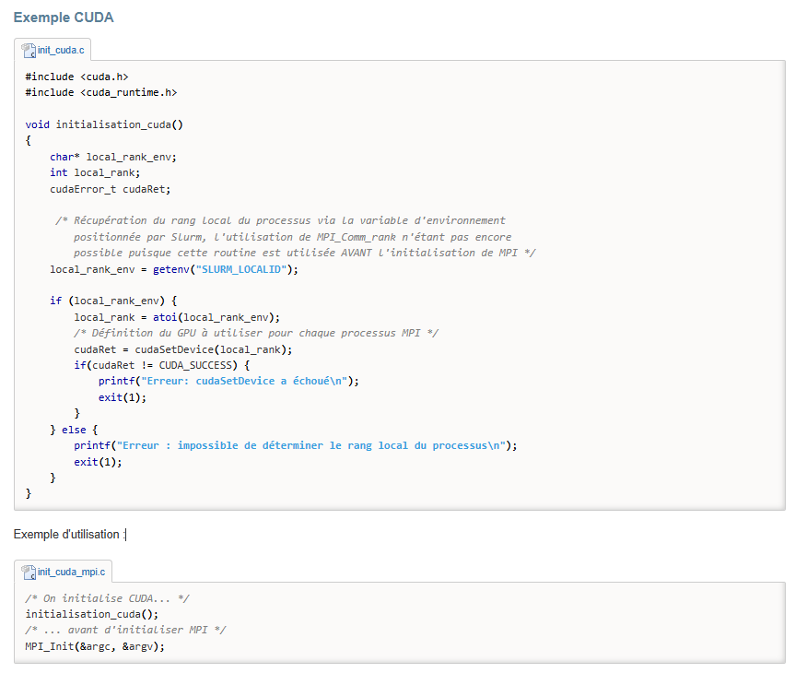
Conclusion and Perspectives
Practical Summary & Best Practices
Initialization: Always initialize CUDA/GPU before MPI to ensure the library detects the hardware correctly.
Environment: On clusters like Jean Zay, always use the -cuda suffixed modules (e.g., openmpi/4.0.4-cuda).
Limit: Remember that GPUDirect is typically optimized for one GPU per MPI rank.
Best Practices :
Initialisation of CUDA or OpenACC
Choice of the GPU which each MPI process should use (binding step)
Initialisation of MPI

Slide 14
Conclusion and Perspectives
Conclusion: The New Standard for HPC
The Problem: Host staging is slow, complex to code, and wastes CPU cycles.
The Solution: CUDA-aware MPI + UVA simplifies code and unlocks hardware acceleration.
The Benefit: GPUDirect RDMA provides a 5x to 6x increase in bandwidth on modern hardware like H100.
Final Word: CUDA-aware MPI is no longer an "option" but a requirement for modern AI and HPC workloads.
Références
**** NVIDIA Developer: MPI Solutions for GPUs.
**** Jiri Kraus (NVIDIA): An Introduction to CUDA-Aware MPI.
**** Aditya Ujeniya: CUDA-Aware-MPI: Understanding Node Topology.
**** IDRIS/Jean Zay Documentation: CUDA-aware MPI and GPUDirect.

Slide 15
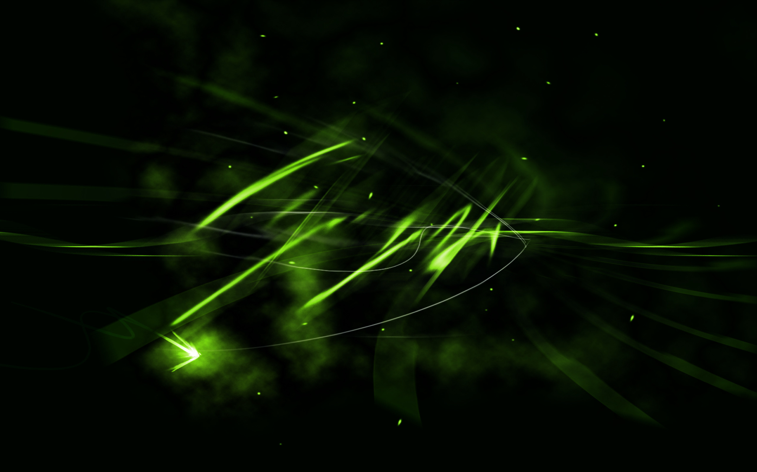
Position of the lower bar:
Merci
Single-line title (4.20)
Two-line title (1.90)
THANK YOU
Three-line title (0.40)
Four-line title (2.70)

Slide 16

Position of the lower bar:
Annexes
Single-line title (4.20)
Two-line title (1.90)
Three-line title (0.40)
Four-line title (2.70)

