Slide 1
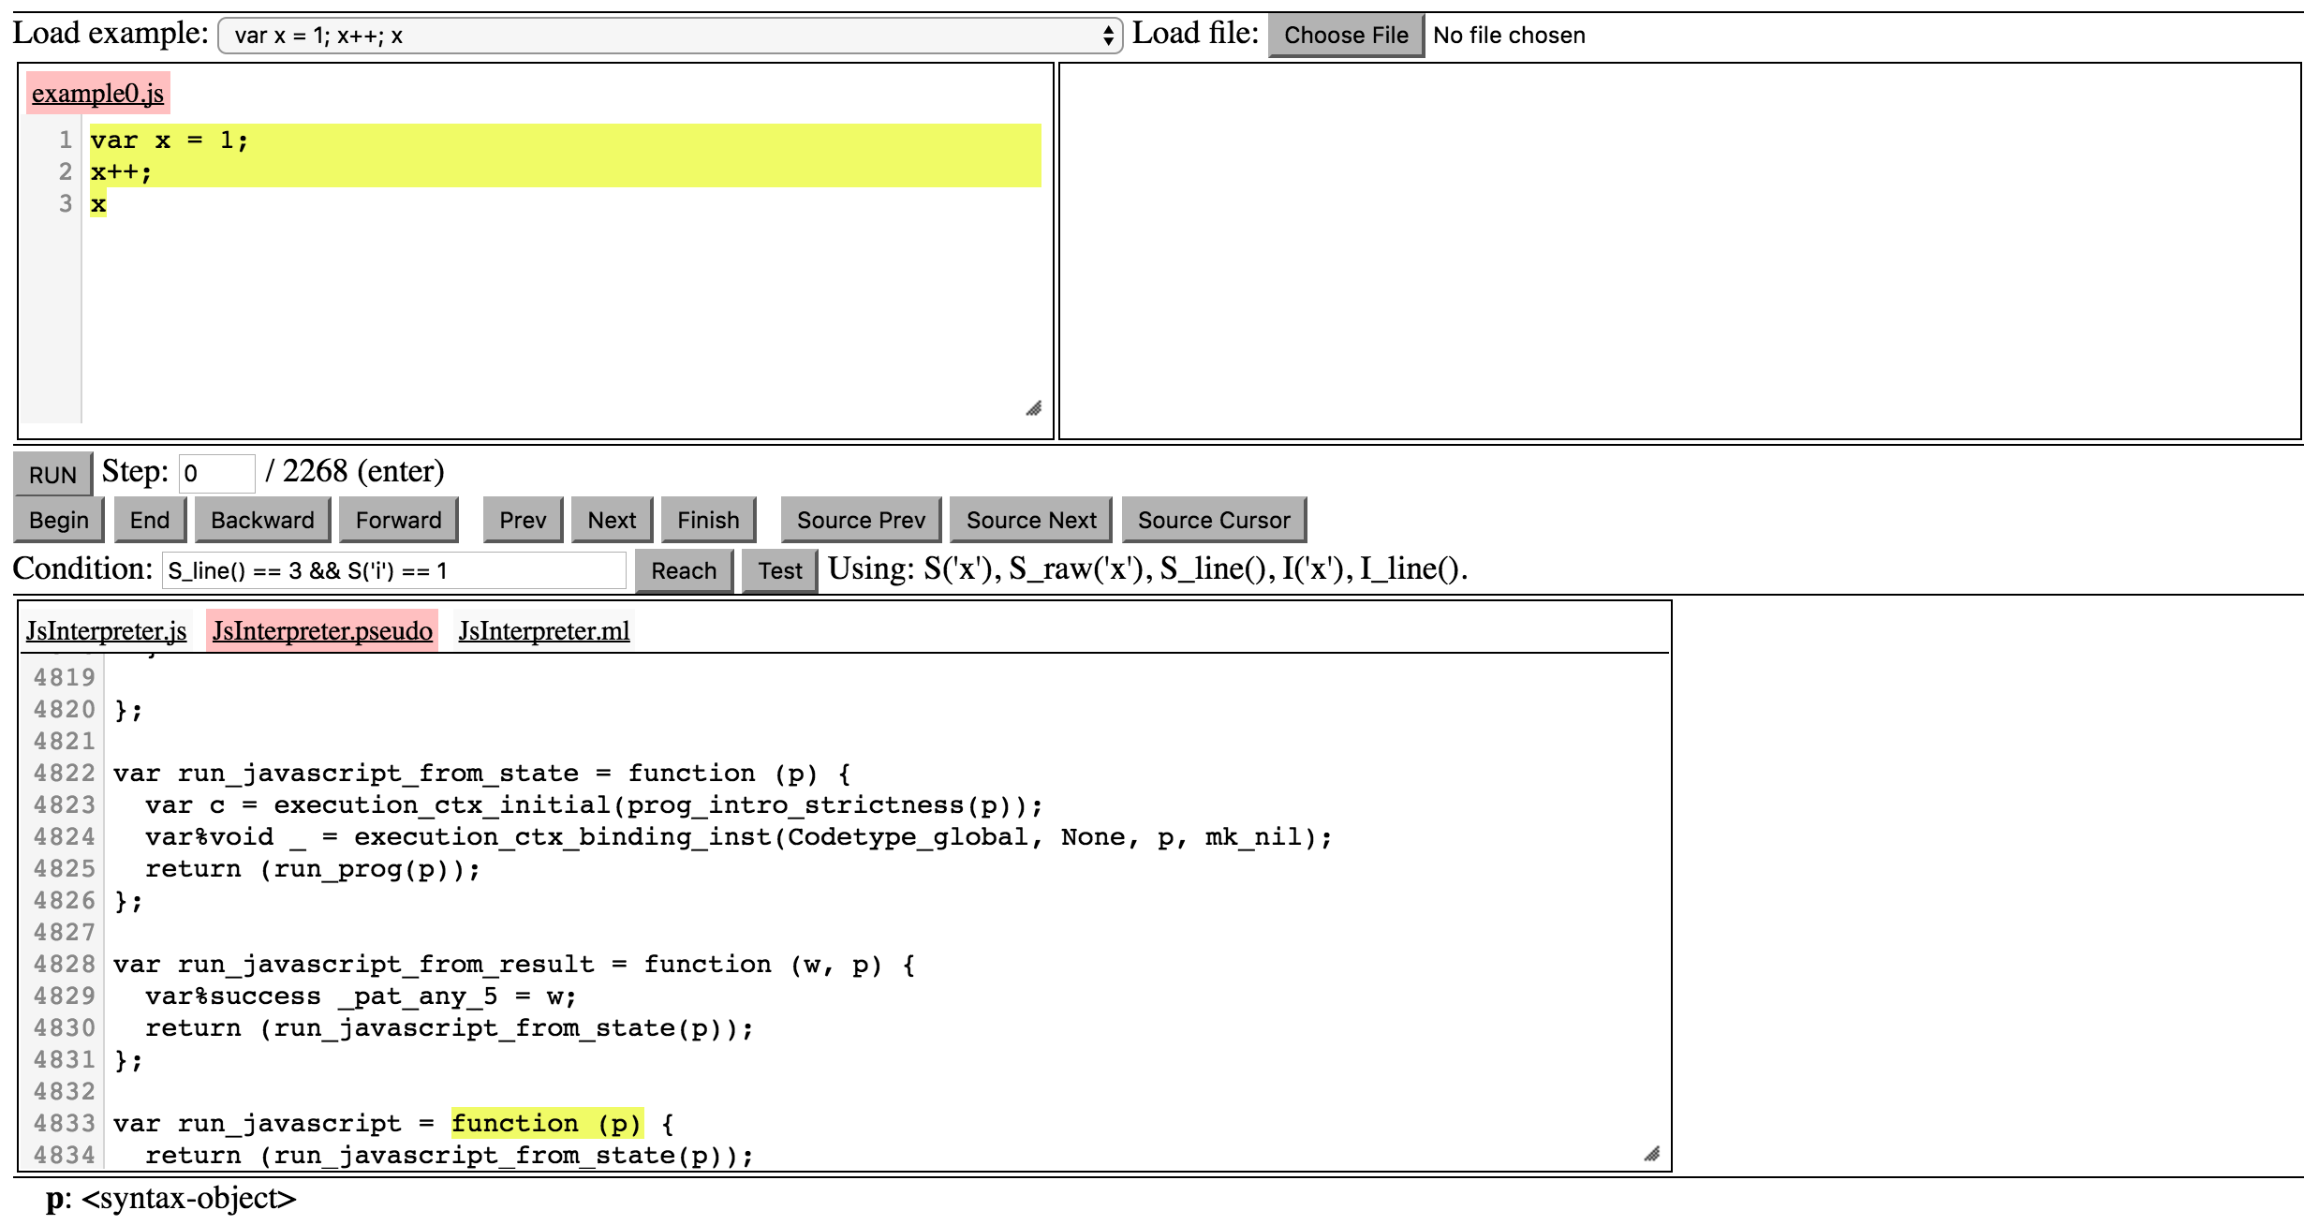
Program selection
Current program
State of the program heap
Navigation panel
Interpreter
State of the interpreter

