Slide 1

Cyber Oracle
Extended Lateral Movement, Host Control and Protection System for Purple-Teaming.

Slide 2
Project Overview

Slide 3
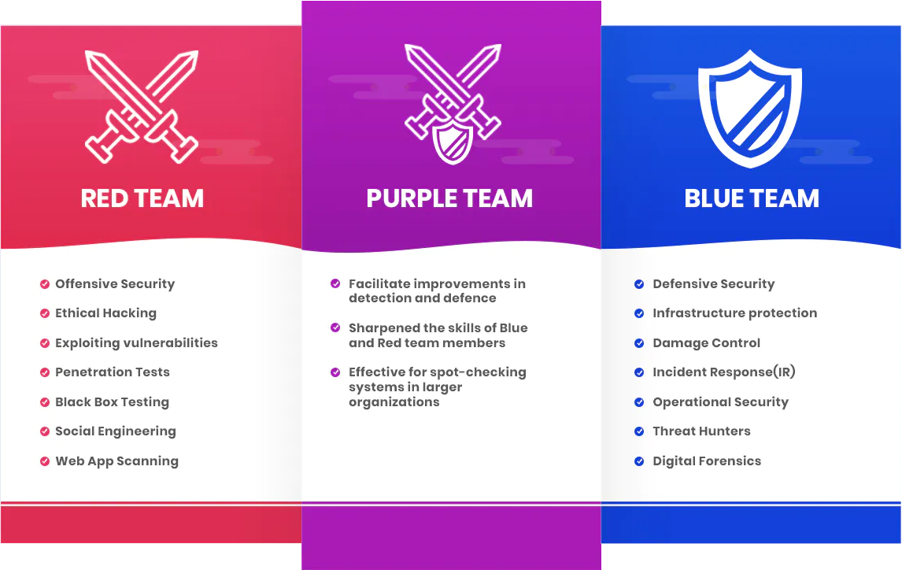

Slide 4
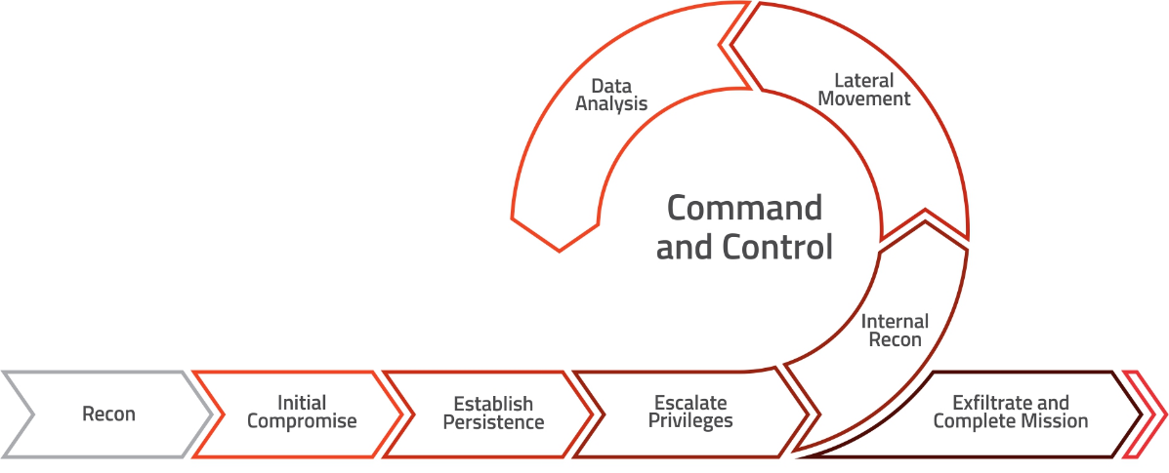

Slide 5
The Goal Of This Project
Provide A Single Integrated Platform That Facilitates and Automates Purple-Teaming Operations

Slide 6

Existing Systems And Solutions

Slide 7

System Description and Usage

Slide 8
