Slide 1
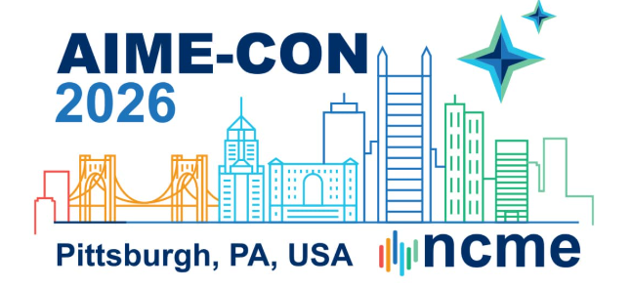
Generative AI for Item Development
A Hands-On Workshop
AIME-Con 2026 | October 5–7 | Pittsburgh
1:00pm – 5:00pm

Slide 2






About Us
Henry Sanmi Makinde, Ph.D. | Hope Adegoke | Mubarak Mojoyinola, Ph.D.
Measurement Scientist PA Education Association | PhD Student University of North Carolina, Greensboro | Psychometrician University of Iowa, Iowa City

Slide 3
Agenda
Introduction of Generative AI and Item Generation
Evolution of AIG
Basic Langchain
Setup
Hands-On
Prompt Engineering
RAG
Fine-tuning
Agents and Evaluation

Slide 4
Application of Artificial Intelligence in Ed Measurement
When we talk about application of AI in Ed measurement, we imply Machine learning, Deep learning, and Large language models
AI Applications
Predicting Student Performance | Detecting Aberrant Responses | Cheating Detection
Predicting Item Difficulty | Identifying Learning Strategies | Enemy Item Detection
Generating Essay | Feature Generation for Predictive models | Automatic Item Generation
Predicting student engagement | Automated Scoring | Content Classification
Automatic Feedback generation | Text Embeddings | AI Tutors

Slide 5
Introduction
Educational measurement and assessment is undergoing a major paradigm shift in the face of rapid advancement in Artificial Intelligence. Our focus today is on Automatic Item Generation
Item Generation
Automatic Item Generation
The systematic creation of test questions based on defined content, skills, or cognitive frameworks (test development, certifications, licensure).
AIG to refer to any technology-assisted item development process, including template-based approaches, Natural Language Processing (NLP) driven methods, and Large language model (LLM)-based generation.
Notes:
Newer methodologies are emerging machine learning, deep learning, automated scoring, automated feedback but the focus of this study is on item generation.
AIG) offers a host of advantages across cost, psychometric quality, security, scalability, and content control

Slide 6
Evolution of AIG
Traditional Method
Template-Based Method
Non-Template Based Method
Early Foundations
(1950s-1970s)
Cognitive Design Era
(1980s-1990s)
Formalization Period
(2000s-2010s)
Neural & Deep Learning Era
(2015-2020s)
Large Language Model Era
(2021-Present)
1.Facet Theory
2. Prose Based
3. Concept Formation
4. Item Forms
1.Cognitive Design System
2. ETS Algorithmic Generation (1998)
3. ETS Seminar
2002: Item generation for test development
Rule Based System
Statistical/ NLP methods
Three Step AIG
Neural Network methods
RNN
LSTM
Finetuning
Prompt Engineering
Finetuning
RAG
Agents
Notes:
Cognitive models provide explicit representations of task requirements and problem-solving processes that examinees must employ when responding to assessment items (Leighton & Gierl, 2007).
The prose-based AIG approach involves transforming key sentences from well-written prose into test questions, particularly WH-questions that seek content information. (Bormuth, 1970);
facet framework emphasized the importance of operationally defining test content domains and systematically varying specific facets to generate item families Guttman, 1953, 1959
Markle and Tiemann's (1970) framework provided systematic methods for analyzing concepts and rapidly producing test items that measured different levels of conceptual mastery
The development of item forms by Hively (1974) advanced the field by introducing fixed syntactic structures that could accommodate systematic content variation.

Slide 7
Template-based and non-template AIG
Template-based
Non-template (LLM-based)
An item model with a stem, options, and auxiliary information
Elements are slots; values are drawn from constrained sets
Generation is an algorithm deterministic and auditable
Content validity inherited from the model, by construction
Every generated item is a sibling of every other
Scaling means writing more models
A natural-language specification instead of a slot template
Generation is probabilistic two runs differ
Enormous range; no inherited guarantee of anything
Content validity must be established after the fact
The constraint work moves from the template into the context and the review
Can be designed to generate unique items
Scaling is free; screening is not
Notes:
This is the conceptual hinge of the foundations section. If they take one sentence away, make it the last one.

Slide 8
AIG Framework For LLM
LLM Cognitive Model
Blueprint
SME's
Choose Model Architecture
Prompt Engineering
RAG
Generate Test Items
SME
SME+Blueprint
Fine-Tuning
Agents
Agentic RAG
+ SME Input
Embeddings
Iterative Refinement
Makinde, H. S. (2026). Automatic item generation using multi-agent large language model [Doctoral dissertation, University of North Carolina Greensboro]. ProQuest Dissertations & Theses Global.

Slide 9
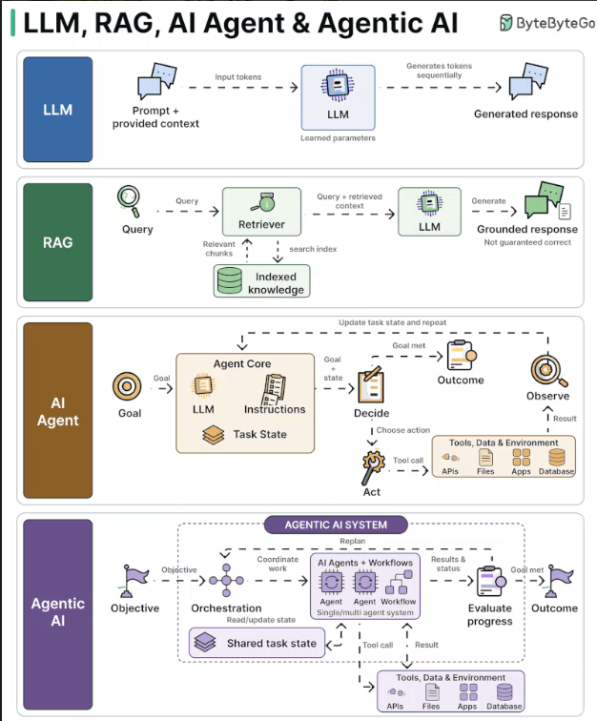

Slide 10
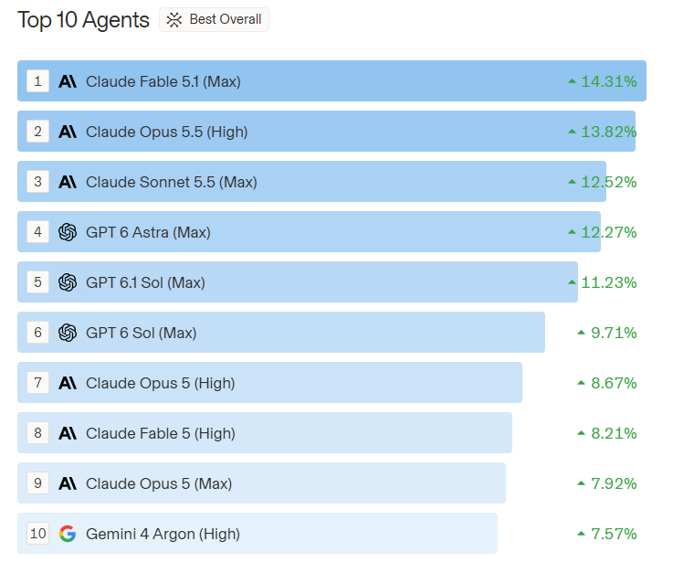
Foundation models
Anthropic · Claude
OpenAI · GPT
Opus 5.5
Sonnet 5.5
Fable 5.1 4
Haiku 4.5
GPT-6 Astra
GPT-5.6 Sol
gpt-oss (open)
Google · Gemini
Open-weight
Gemini 3.1 Pro
Gemini 3.8 Flash
DeepSeek V4
Kimi K3
GLM-5.3
Qwen · MiMo

Slide 11
2
The toolkit
AI framework we build on for the rest of the day
Why we choose the framework as compared to others
Basic training

Slide 12
How to build an AI application
You can build and AI application either using the provider SDK or using a framework
1 · Direct provider SDK and Python
2 · Through a framework
You call one vendor’s client and write everything above it yourself.
You call one interface; it calls the vendor’s client for you.
Your Python
prompts, parsing, retries, batching, the tool loop
Your Python
prompts, and the logic that is yours
▼
Framework
LangChain · LangGraph · LlamaIndex · Haystack
▼
▼
Provider SDK
openai · anthropic · google-genai
Provider SDK
called for you
▼
▼
Model API
the HTTPS endpoint
Model API
the HTTPS endpoint

Slide 13
Choosing a framework
Framework | Built for | Why not the default for today
LangChain | General composition of LLM applications, provider-agnostic | This is what we build on today
LangGraph | Stateful, multi-step agent graphs | We do use it, but reached through LangChain’s agent constructor rather than directly
LlamaIndex | Indexing and retrieval first | Excellent at retrieval, narrower once you step outside it
CrewAI | Role-based multi-agent orchestration | Assumes the multi-agent pattern before you have established you need it
Haystack | Production search and RAG pipelines | More setup than a four-hour room allows
DSPy | Programmatic optimization of prompts | Powerful, but it optimizes against a metric you must already be able to measure
Provider SDKs | Direct access to one vendor’s API | Nothing wrong with them but every provider swap becomes a rewrite

Slide 14


Basic Langchain Training

Slide 15
Introduction to LangChain
A framework for building applications on top of large language models: pre-built components for the parts every such application needs, and a common interface so they compose.
What it gives you
One object per provider, built from a model ID
Prompts as reusable templates, not string concatenation
Components that compose with a single operator
Typed, validated output instead of text you must parse
Retrieval, tools and agents in the same vocabulary
Why use a framework
Everything in this workshop could be written against a provider SDK directly. We use LangChain so that when a model is retired and one will be the fix is a single argument rather than a rebuild of every notebook.

Slide 16
Langchain Ecosystem
Langchain Ecosystem
LangChain: A framework that provides pre-built components and abstractions to quickly build applications using Large Language Models.
LangGraph: A library for building stateful, multi-actor applications with LLMs using graph-based workflows where nodes represent actions and edges represent transitions.
LangSmith: A platform for debugging, testing, evaluating, and monitoring LLM applications with tracing, datasets, and performance analytics.

Slide 17
The eight core components of LangChain
This is the spine of the essentials notebook, and every notebook after it is some arrangement of these eight.
Models
Messages
Tools
Agents
One object per provider, built from a model ID. Swapping providers is one argument.
System, human, and AI roles instead of one flat string. Your standing policy lives in the system message.
Python functions the model may call: look up a standard, run a check, query a bank.
A loop that chooses which tool to call, reads the result, and decides whether to stop.
Structured output
Short-term memory
Streaming
Middleware
A schema bound to the model, so it returns a typed object instead of text you must parse.
State carried across turns of one thread, so a workflow can refer to what came earlier.
Tokens as they arrive instead of one long wait. What makes a slow generation bearable.
Hooks around the agent loop: call limits, PII redaction, summarization, approval gates.
Two more sit alongside that list rather than inside it, and you will reach for both constantly: prompt templates and chaining.

Slide 18
Prompt templates and chaining
A template is a prompt with named holes. A chain is what happens when you join components with a single operator and it is the shape almost every notebook today takes.
prompt = ChatPromptTemplate.from_messages([
("system", "You write {grade} {subject} items. One key, four options."),
("human", "Write one item on {standard}."),
])
chain = prompt | model | parser
chain.invoke({"grade": 8, "subject": "science", "standard": "PS.3.2"})
chain.batch([...], config={"max_concurrency": 4})

Slide 19
Keep Learning:
LangChain overview (here)
Short-term memory (here)
Middleware (here)
Streaming and event streaming (here)
v1 migration guide (here)
LangChain Academy (here)

