Slide 1

Distributed Bloons Tower Defense
Students: Bar Coehn Aharonson, Noam Navon Course: Functional Programming in Concurrent and Distributed Systems Professor: Dr. Yehuda Ben-Shimol Teaching Assistant: Mr. Guy Peretz

Slide 2
Introduction
Project Goal: Real-time distributed BTD game
Implementation: Built with Erlang, OTP and Mnesia
Core Concepts Demonstrated: Concurrent, Distrubuted, Share Data base, FSM and supervision

Slide 3
System Architecture
In our system there is 5 Nodes:
Main Node (main)
4 workers Nodes (worer1 ,worker2 and etc)
Every Node is supervised

Slide 4
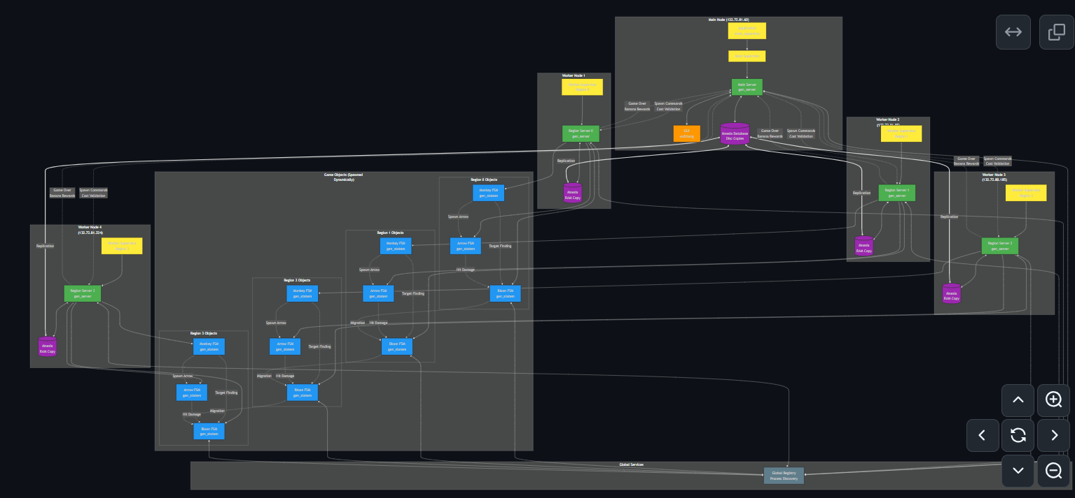
Game Architecture
Notes:
https://mermaid.live/view#pako:eNqtWAtP4zgQ_itWViuBlPYS230KkKCw0NMVVhQO3bXo5LZuyZFHlaQHPZb_fnbsNE6ctpuDIGQ388145ht77PjNmAYzanSNRUiWT-DubOwD9nz9Co75A75f_THs905_A6e3vav-3UXv7v72QsgEMlpNhOrYGBDHB9fMHDiwEay3YL1t15vW4dgQUP5wzOlyOWL_rjMlsRP4R5PwlxOPvf8rWi1p-I8TBeFjXmPIBaPE_nArhr3egJJ-YnhBmd3kp4K_vO-P2H8CeHm9CF3iL1RzPo0cwi2NDkQfnJOYTEhEE5VzJ5qCXrB0aHSoqGlRglrtJPO_JKQMkHhYFhA44hjm7HZh5q7AUH8mOlqGHoLwmWklObLVLNnNVi5NAmgzJ0dSJ-M9oeCWLljqgKWEL17ZIymSHlrbsyD8frBTkoXh0wGndl1ObOZXQp0cUvNB5eXBrsIKVFlpN0pIgXtJsTVSYIEUey8psDIpME8K1HzIkQKrkIIyUqy6XcoK2ssK1FhBBVbgXlZQZVZQnhWk-ZBjBVVhBatTBUJcwgreywrSWMEFVtBeVnBlVnCeFaz5kGMFl7Ky2SIuTwcX4ObsV7Y3DMHB-donnjMF38NgSqOIVcgtu8Ul8Si4mfxNp3EEDoZL8uLTGZDqxHXXOT4VxbT0pMoqjD9nbsDLUNKAb8NBxl9MYuo95tGDwH-ma3sk2v340zAMXuxR0uxGb_jKZ0CPxN4ZCawWCawWCfzUSODOSFC1SFC1SNCnRoJ2RoKrRYKrRYIrRbJtWfZurq_ZkuzfXA_VFcjkyhEJxIFc8pEQK2eLWr128mNsJCuTVRTPI_4sShzqBVEMfieuM0sOcGPjR34n_pgR-BlG0GcYwQViJVOcNIVDIU5PHnIYUd3SQ-gZ8dkfw7yQcBbxAYqHvnSP_pA6-pg6_r_qGkFRQvKCmwnkMsqTxDYXUab197Ig6wJRedURN6Sl5qD-XlZFXSDKn24OZeaQ_l6WJl0gapBuDmfmsP5e1gddIApBgV5lywR9P6YhmcbK0hXEpUm8I-GCxuCb488cf8HTpjJeAItVkQzKkSrVop8Cr5yYfQt5ZEGLFlW7cI8TsBRc5gRUnIA7nIC6E2iPE6gUXOYEUpxAO5xAuhN4jxO4FFzmBFacwDucKE6aM3aW4nvVwGFbHJ8u4KAXBlFUE9PtUABFJlOzG2yRX9HfDkMKDG2HFX2UH9m3dHMpIGnZfNmCo-NjbkuF8EqU-8T7WTisBkfV4NqqdYMJcZPVHcXhWj8ICzkvqA47MqsHDiFimqOCkaQwyyM24NcRASvG68fSE4F2l5AazZfY7TK4Q4Z2yHCpTM60rSK4XYS2i8rH2uRgGK9dvuyS31OXRNE5nYPsvgnMHdftfpnP6QRNTMZw8Ey7XxBCsl97cWbxUxcuX4smBLFCHU_JvGFVUZ9HntSFdqc5R1V0Fytn43anbVUadyavs6SBzhS2JlbVuNlslfpNqzVr_wxvipX0kszc3IaZ2e2Omd1pmNmHvKl8vWa5K9oUc92U81q2ULbITOdmpBxghLKYmaaYhaJBosGm3C9lC2WLZItNsUuKBooGmbJWsySrw1ze93nucm5vSouZVrS0A9MOSjt4k72c1XTmp6kZ-4ZpLEJnZnTjcEVNw6OhR_hP440rjo34iXps3-iy7oyEz7zwvDOdJfH_DAIvVQuD1eLJ6M6JG7FfqyUbnJ47hFWvDMIqDg17wcqPja5t2YkNo_tmvBrdmt3o1C2IGh0bdTqowR7TWDMYxHWEG7DVajTb0IK4_W4a_ybj2nULt5u4Y7Vhuwkhgvj9P2gX_Io

Slide 5
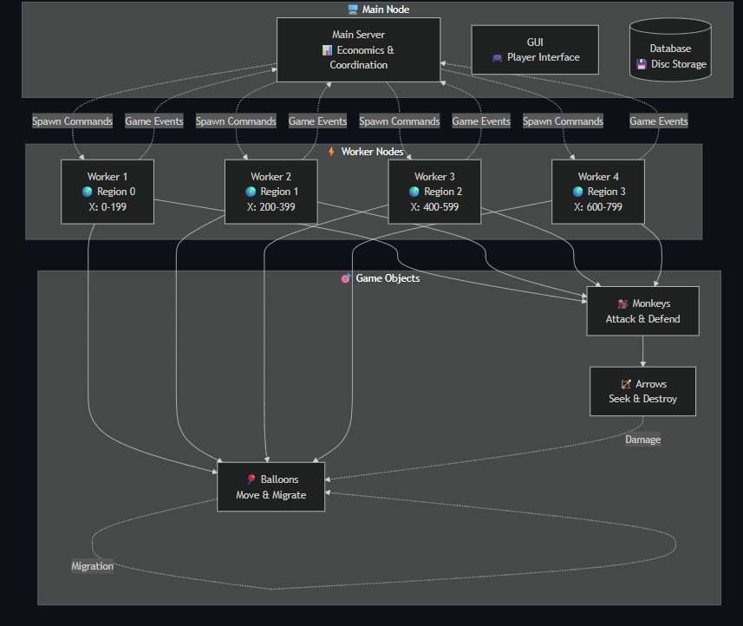

Slide 6
Main Node
Run the Gui and the main server:

Slide 7
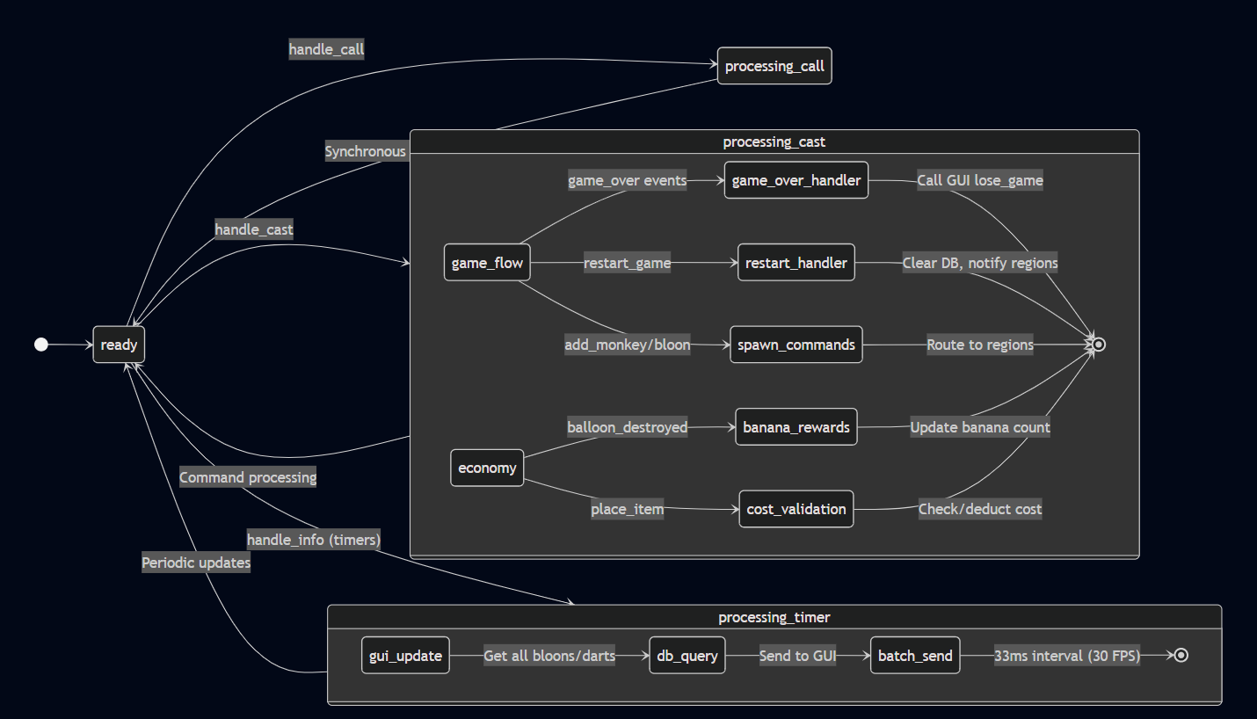
Main Server (gen_server)

Slide 8
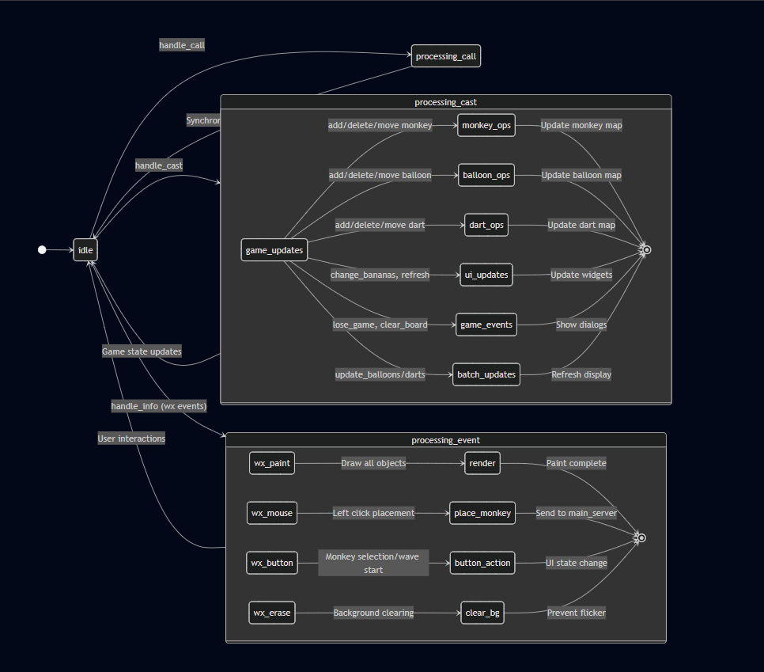
Gui(gen_server)

Slide 9
Workers Node
Run the Region server and the FSM’s:

Slide 10
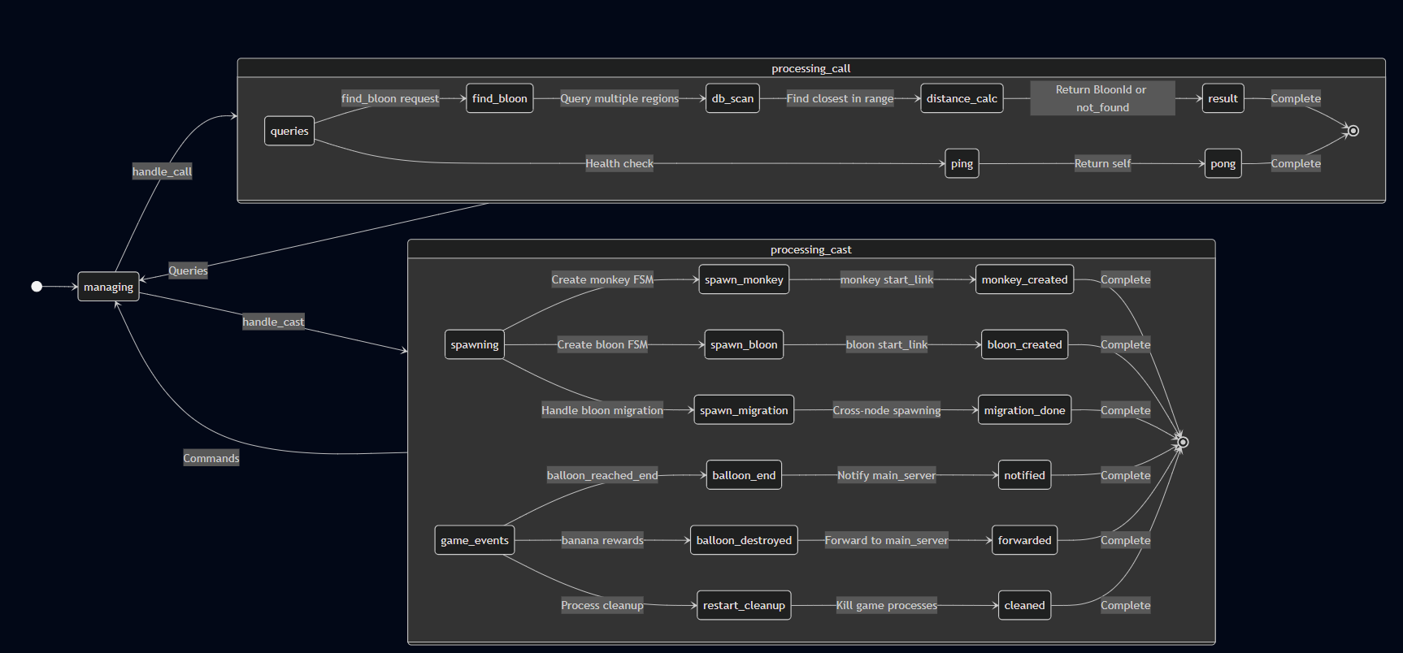
Region server (gen_server)

Slide 11
FSMs
Balloon
Monkey
Arrow

Slide 12
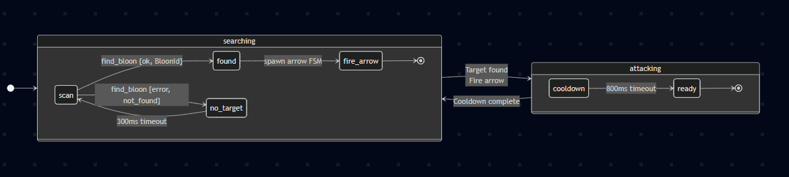
Monkey FSM

Slide 13
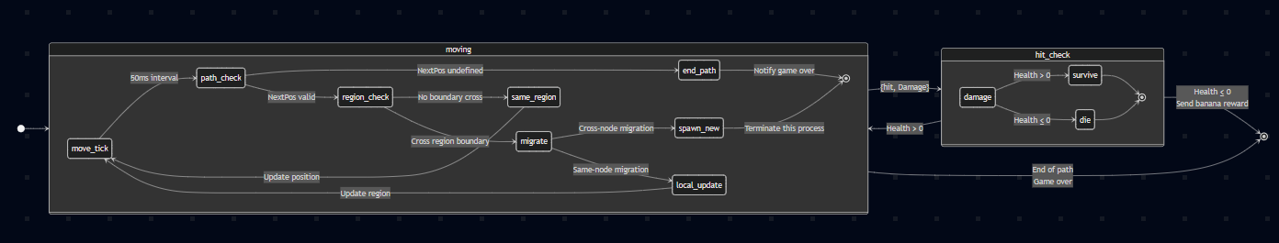
Balloon FSM

Slide 14
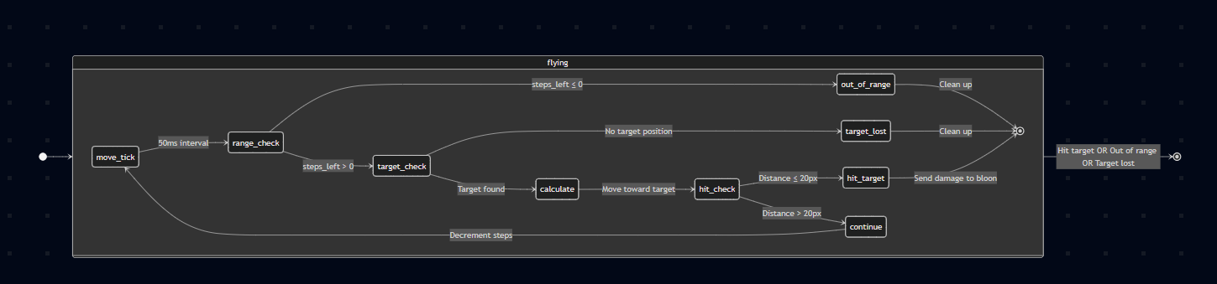
Arrow FSM

Slide 15

Hope you enjoyed!

