Slide 1

End project presentation
By Bar-Bar

Slide 2
What we have on the menu
What is my project?
What problems I had
Solutions
Future Work
A cat

Slide 3
What is even my project about?

Slide 4
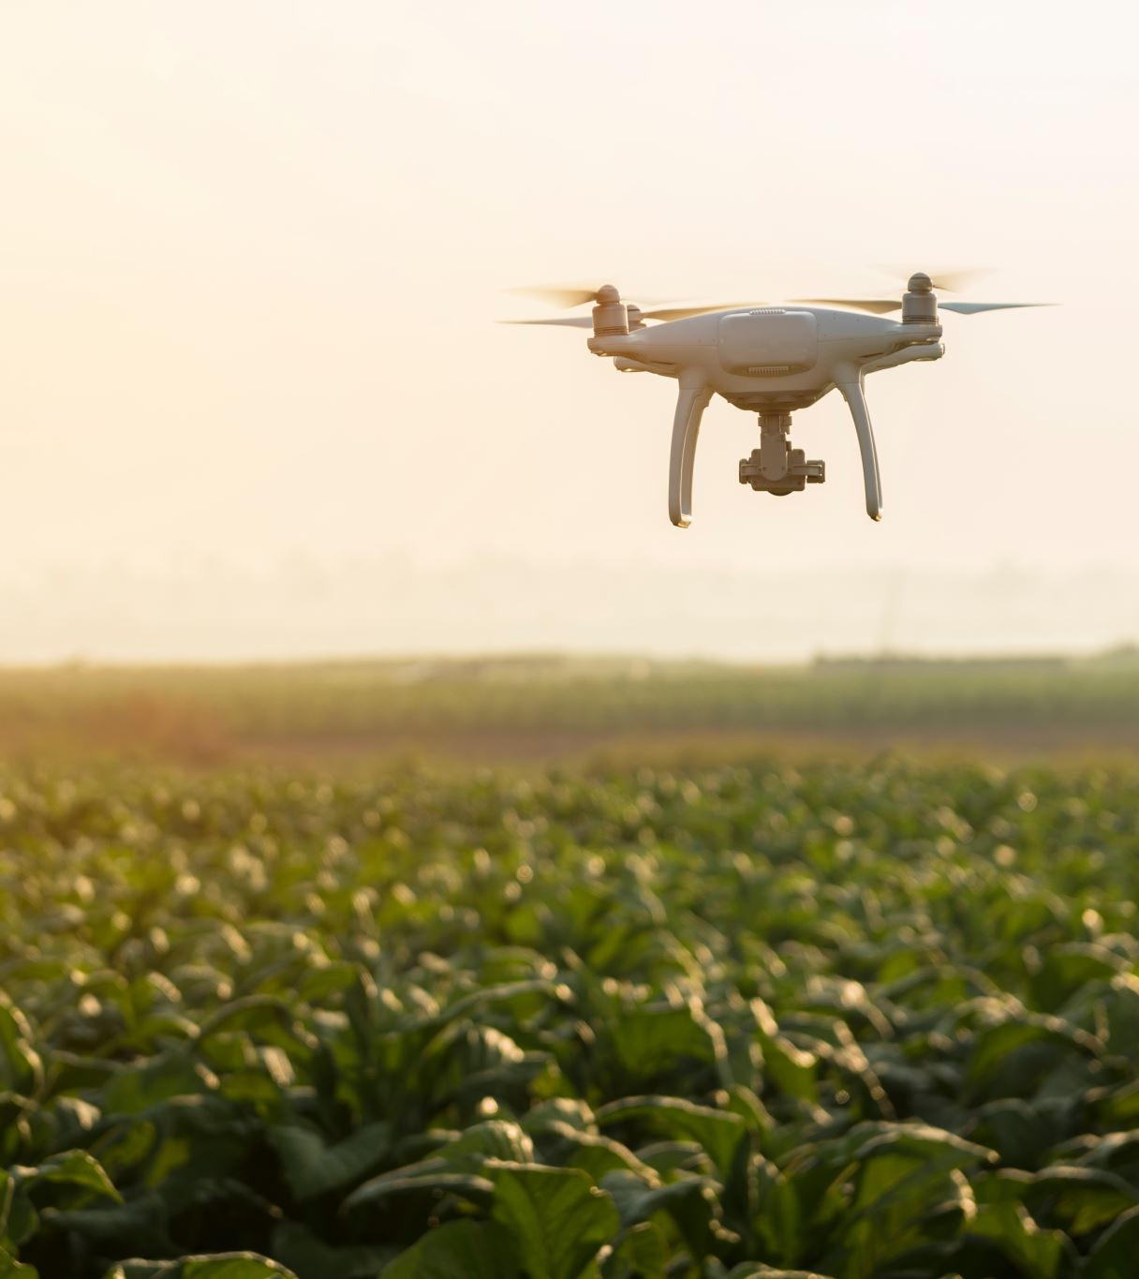
introduction
Typically drones work with Wi-Fi technology.
Cheap
Reliable
BUT : short range
More advance drones - expensive

Slide 5
My approach
Cellular
Low cost
patch for commercial drones
Controlling a mesh

Slide 6
Technology used
AWS server
Wiregaurd – VPN
Batman adv – mesh protocol

Slide 7

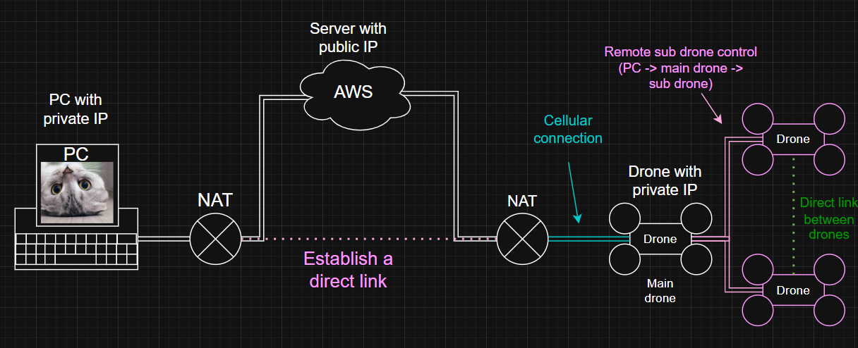
How the architecture look

Slide 8
Video!

Slide 9
PROBLOMS

Slide 10
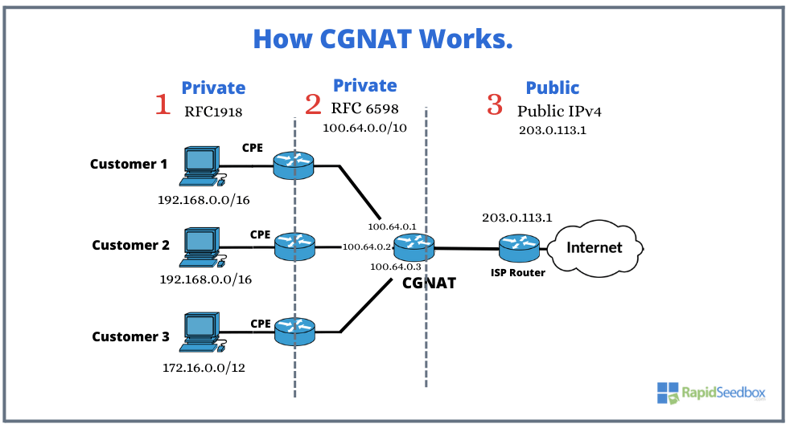
NAT (CGNAT)
A nat that usaly at cellular copmanys
Logicaly is like nat of nat
Nat for millions of users
save a lot of money and ip address
Make Hole Punching almost impossible

Slide 11
NAT (CGNAT)
Solution: using a server as middle man

Slide 12

UNDER VOLT
Not enough power
Impact performance and video
Heavy
Pricy
Solution: stronger drone (Hawk)

Slide 13

Thank you very meow!

