Slide 1

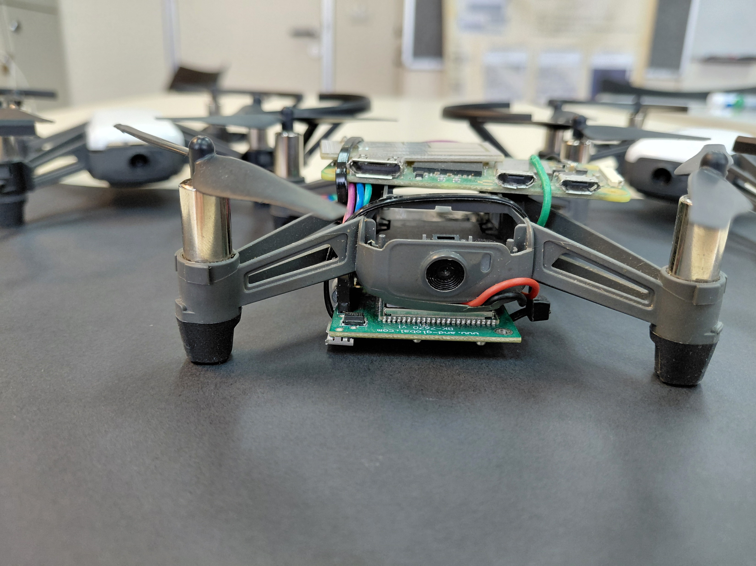
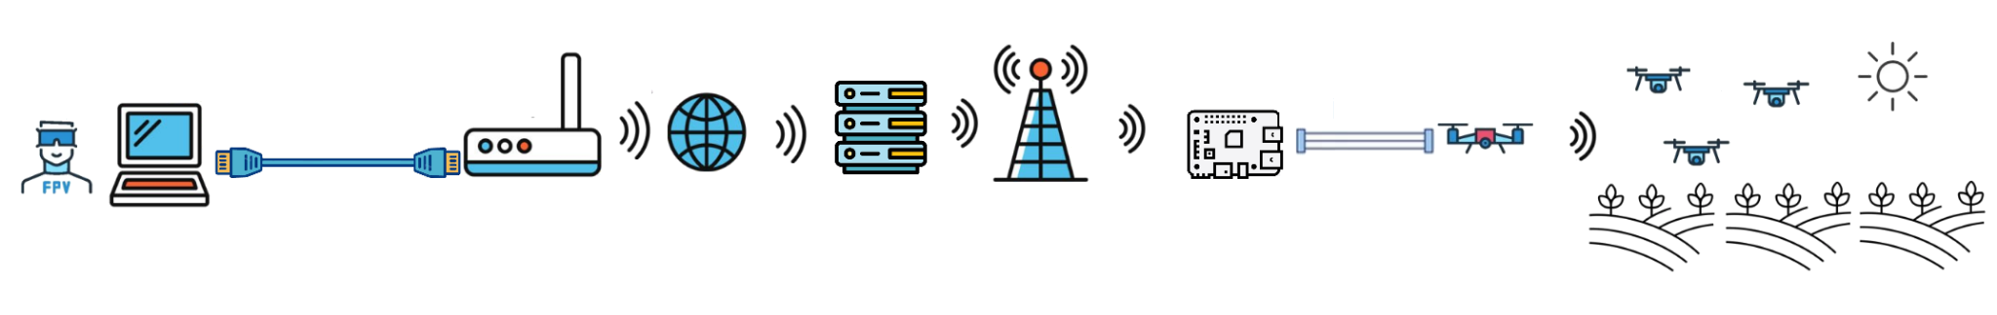
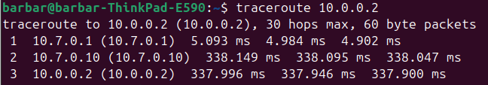
P-2025b-001
Faculty of Engineering Sciences
School of Electrical & Computer Engineering
Swarm Over Cellular
Bar Cohen Aharonson
Adviser: Prof. Omer Gurewitz
Objectives
Swarm over cellular is a project about building a cost-effective swarm from commercial drones, using cellular and mesh technology for extending the number of drones and the controlling distance by hundreds of km
Implementation
We soldered a Rasbery pi to Tello commercial drones and connect them to their drones by Wi-Fi. The pi’s can send command to the drones and get back video.
The pi’s can pass and send to each other messages by a dynamic mesh network that we created (BATMAN-adv)
The Leader of the swarm, soldered to a cellular module, give the swarm access to the internet across all the field
Because of cellular sit behind CG- NAT we must use server for making connection between a PC and the Leader. We make it secure and easy to use (Wireguard –VPN)
Topology
Drones
PC
Router (NAT)
Server
Cellular (CG-NAT)
Pi
Leader
Network Configuration
As
Network Latency
As we saw at the Topology, he have several entities between the directed drone and the pc.
Packets travel from the control station to the drone (10.0.0.2) via the server (10.7.0.1) and via the leader drone (10.7.0.10)
The round‐trip time to the any drone in the mesh on average is about 350 ms.
The bottleneck of the network is the cellular of the leader drone
Network Configuration
Summery
We created a swarm out of commercial drones by just the price of 25$ per drone (36$ for the leader+ addition 3$ monthly data plan) that can work and move freely almost everywhere in the country

