Slide 1

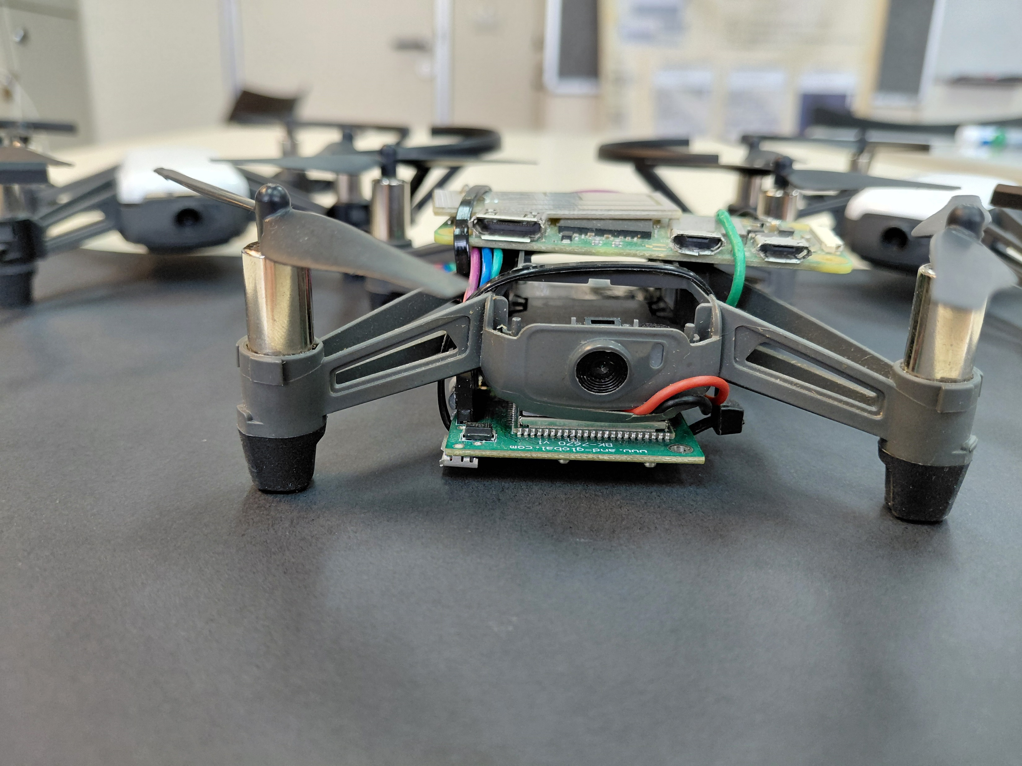
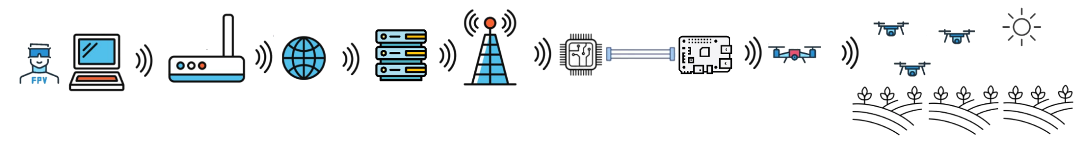
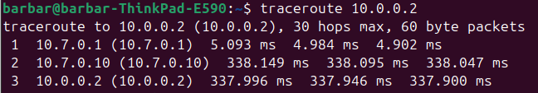
P-2025b-001
Faculty of Engineering Sciences
School of Electrical & Computer Engineering
Swarm Over Cellular
Bar Cohen Aharonson
Adviser: Prof. Omer Gurewitz
Objectives
Swarm over cellular is a project about building a cost-effective swarm from commercial drones, using cellular and mesh technology to extending the number of drones and the controlling distance by hundreds of km
Implementation
We soldered a Rasbery pi onto Tello commercial drones and connect the Pi’s to the drones by Wi-Fi. The Pi’s can send command to the drones and receive back video.
The Pis can also send messages to each other over a dynamic mesh network that we created using BATMAN-adv
The swarm leader, which is connected to a cellular module, provides the swarm with internet access across the field.
Because of cellular sit behind CG- NAT we must use a server to make a connection between a PC and the Leader. We make it secure and easy to use using Wireguard –VPN
Topology
Drones
PC
Router (NAT)
Server
Cellular (CG-NAT)
Cellular modem
Pi
Leader
Comparing Protocols
As
Network Evaluating
As shown in the topology, there are several entities between the controlled drone and the PC.
Packets travel from the control station (10.7.0.2) to distention drone (10.0.0.2).
They first pass through the server (10.7.0.1)
Then they move to the leader drone over the cellular link (10.7.0.10)
Finally, they reach the target drone inside the mesh network(10.0.0.2)
The average round-trip time to any drone in the mesh is approximately 350 ms.
Network Configuration
Summery
We created a swarm out of commercial drones by just the price of 25$ per drone* that can operate and move freely almost everywhere in the country! *(addition 11$ for the leader+ additional 3$ monthly data plan)

