Slide 1

Internet Sales Dashboard for Adventure Work Cycles
By
Malik Hassan Qayum
Course
Data Visualization
Professor
Nipa
Doctordatah.com

Slide 2

Overview
About Company
Data source
OLTP Database
Datawarehouse
Business Questions
Tools Used
Connectivity
Visualizations and dashboard
Insights
Conclusion

Slide 3
About Company

Slide 4

Advanture Work Cycles
The company manufactures and sells metal and composite bicycles to North American, European and Asian commercial markets. While its base operation is in Bothell, Washington with 290 employees, several regional sales teams are located throughout their market base.

Slide 5
Data Source

Slide 6
OLTP –Transactional Database
Sales
Person
Production
Purchasing
Human Resource

Slide 7
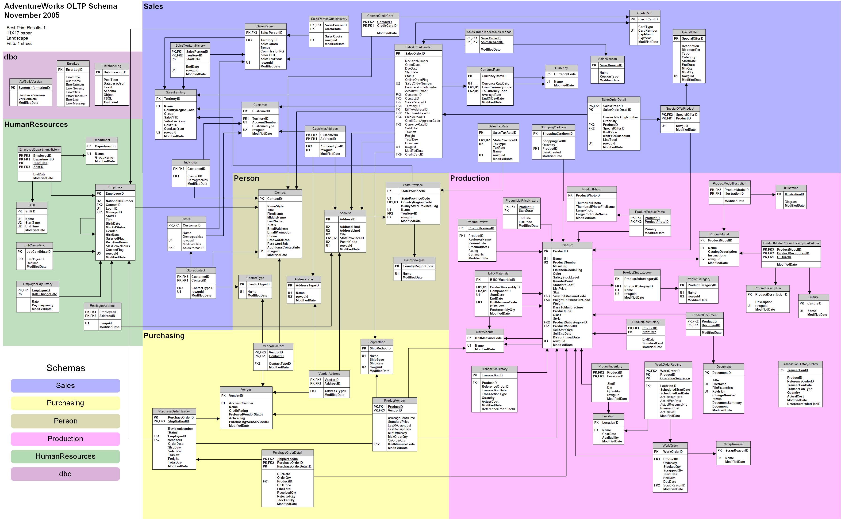

Slide 8
Datawarehouse schema

Slide 9
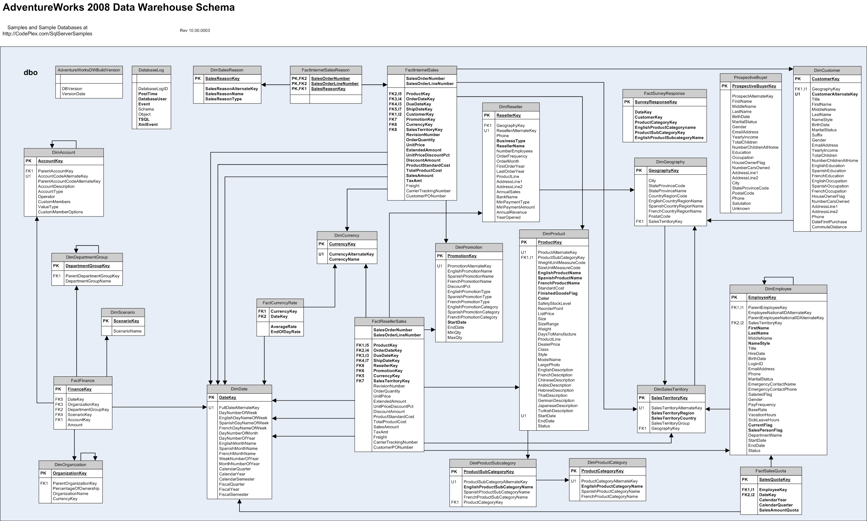

Slide 10
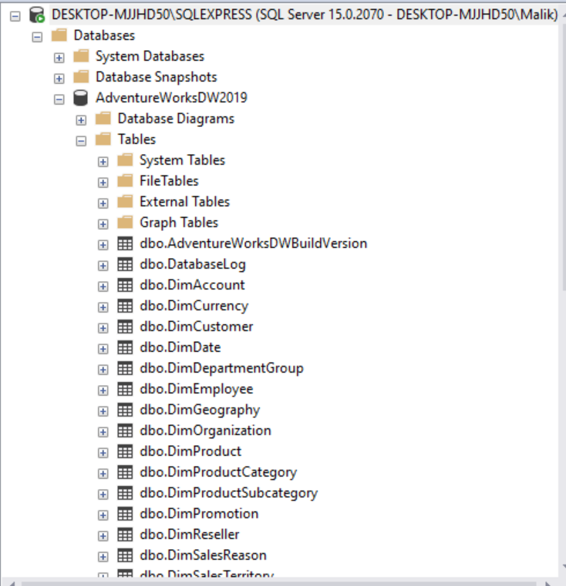
SQL Server

Slide 11
Business Questions

Slide 12
Internet sales Business Questions
Let's say VP of internet sales USA would like to have answer for following business question:
Total online sales
Percentage Sales by Country
Sales by different sates of countries
Sales by Year
Sales by product category
Sales by product Sub-category
Units sold by year
Top products in term of sales
Goal:
By the answering these question VP would be able to find weak areas and strong areas of sales and to make better business decisions and marketing strategies.

Slide 13
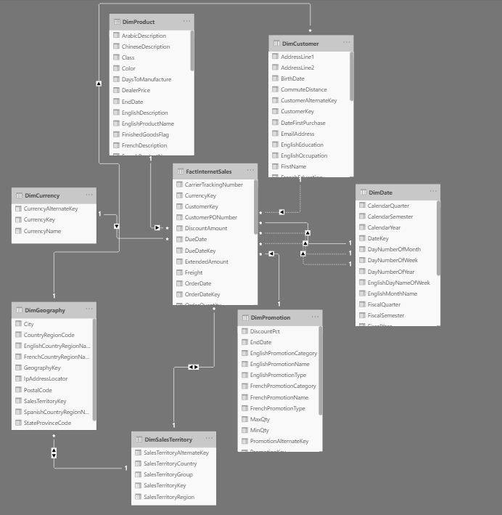
Data form dates:
Dec 2010 – Jan 2014

Slide 14
Connection

Slide 15
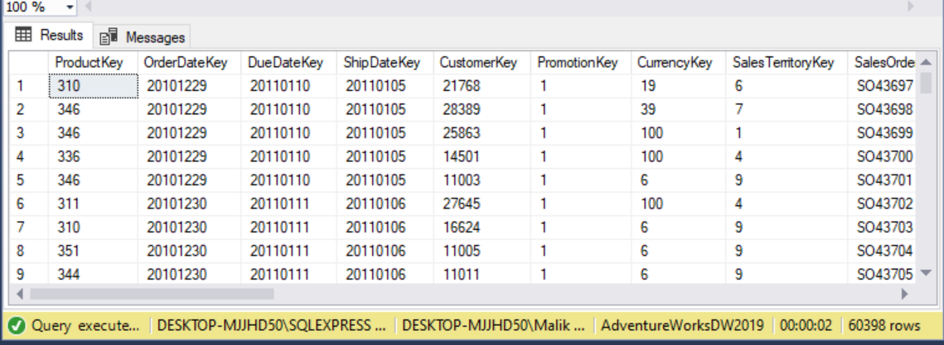
Fact Internet Sales
60398 records

Slide 16
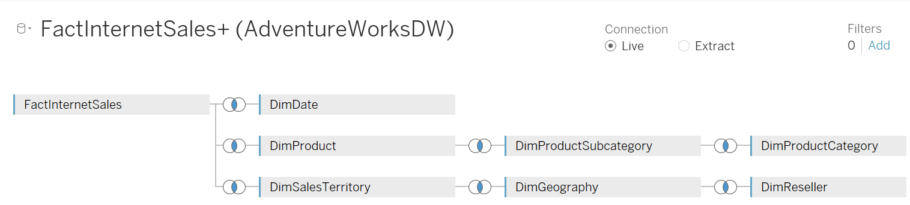
Tableau Data Source Connection

Slide 17
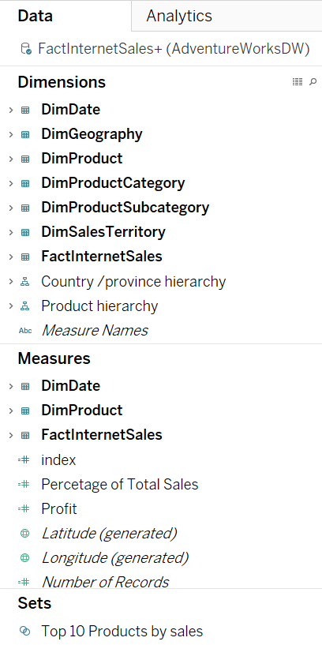
Dimensions and Measures

Slide 18
Dashboard Design

Slide 19
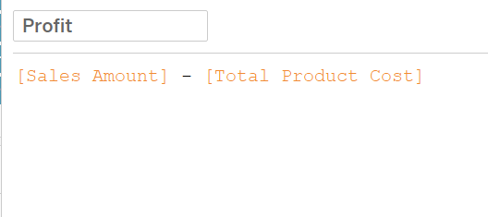
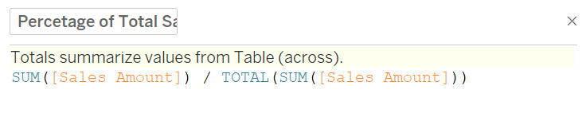
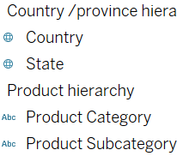
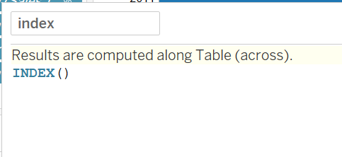
Calculated Fields and Hierarchies

Slide 20
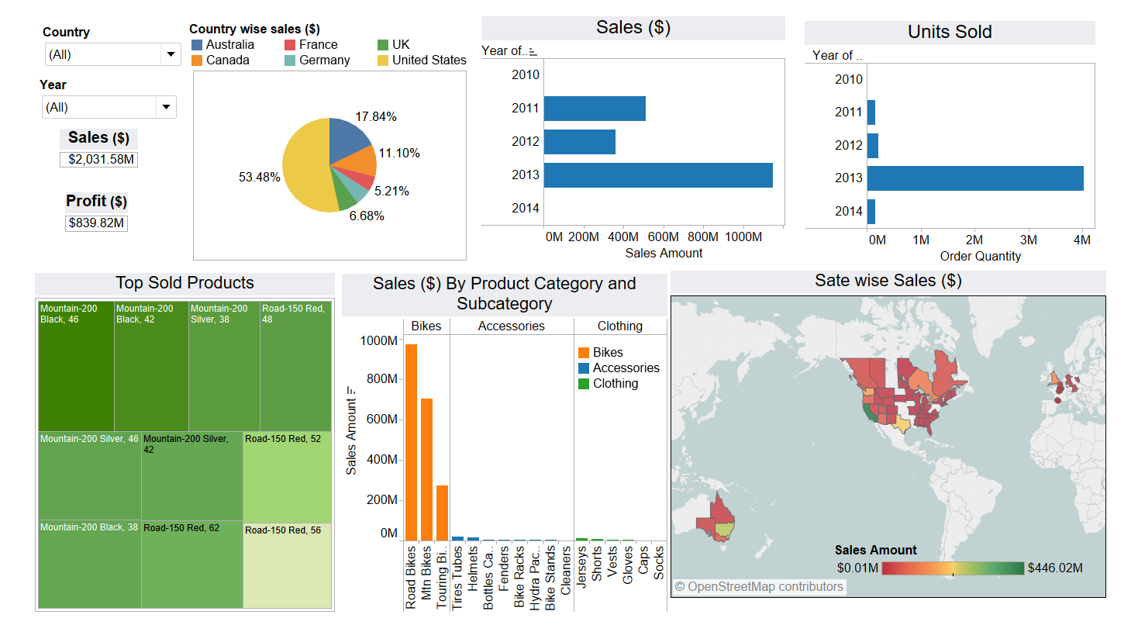
Dashboard

Slide 21
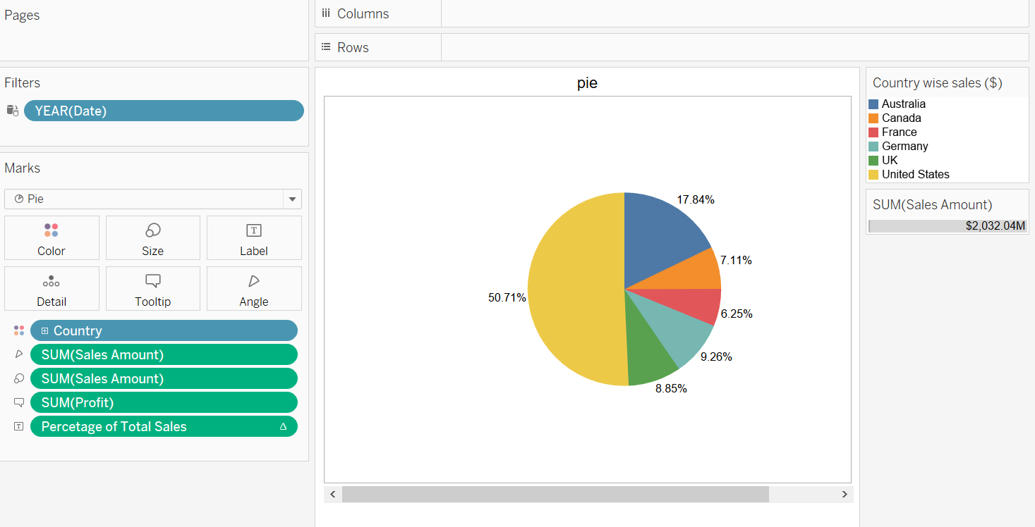
Pie chart of overall sales and profit

Slide 22
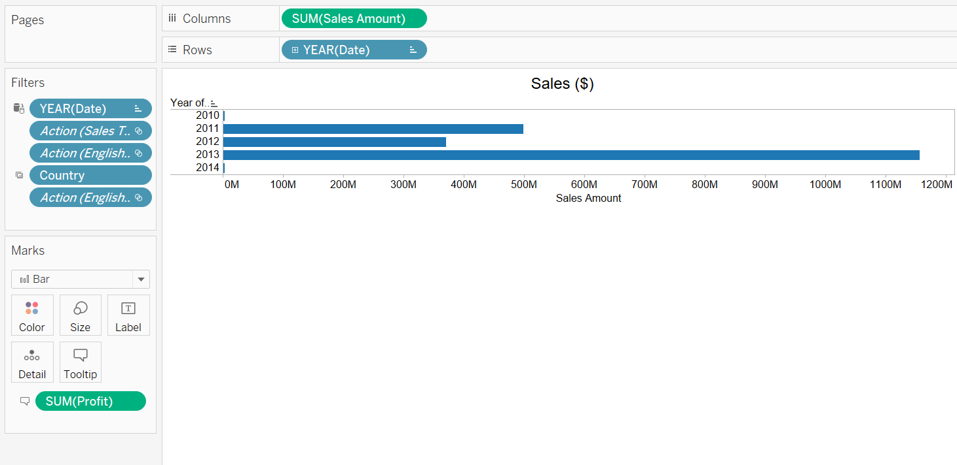
Sales by year

Slide 23
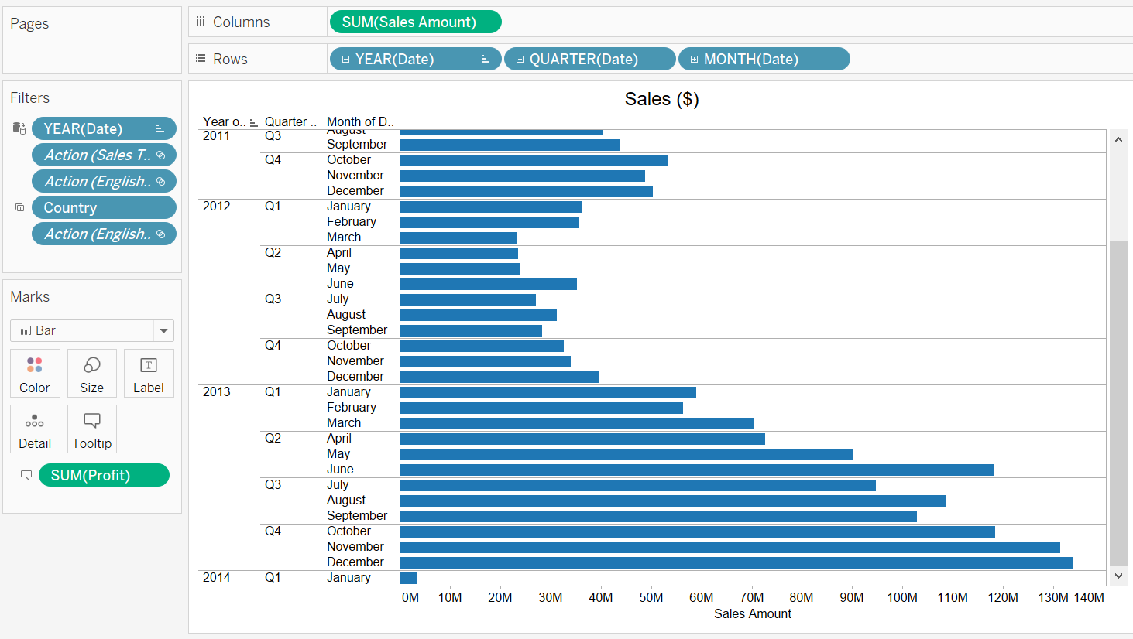
Sales by Date drilldown

Slide 24
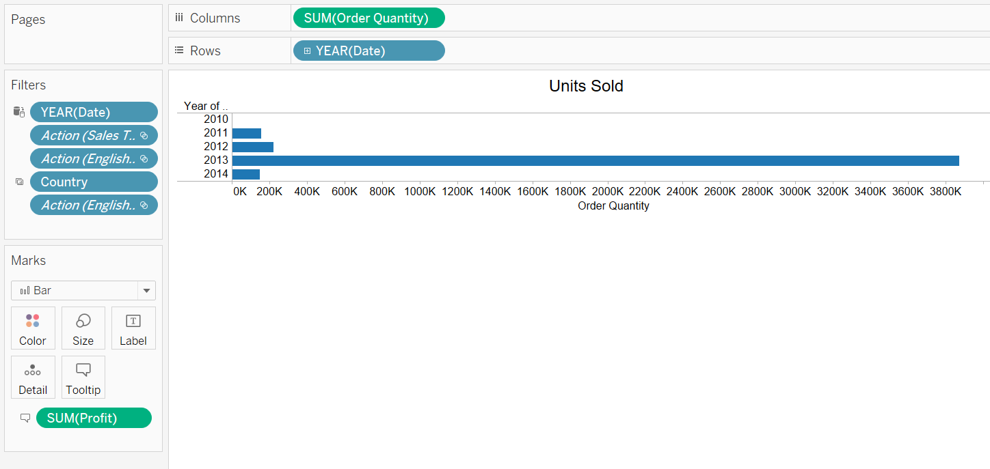
Units sold

Slide 25
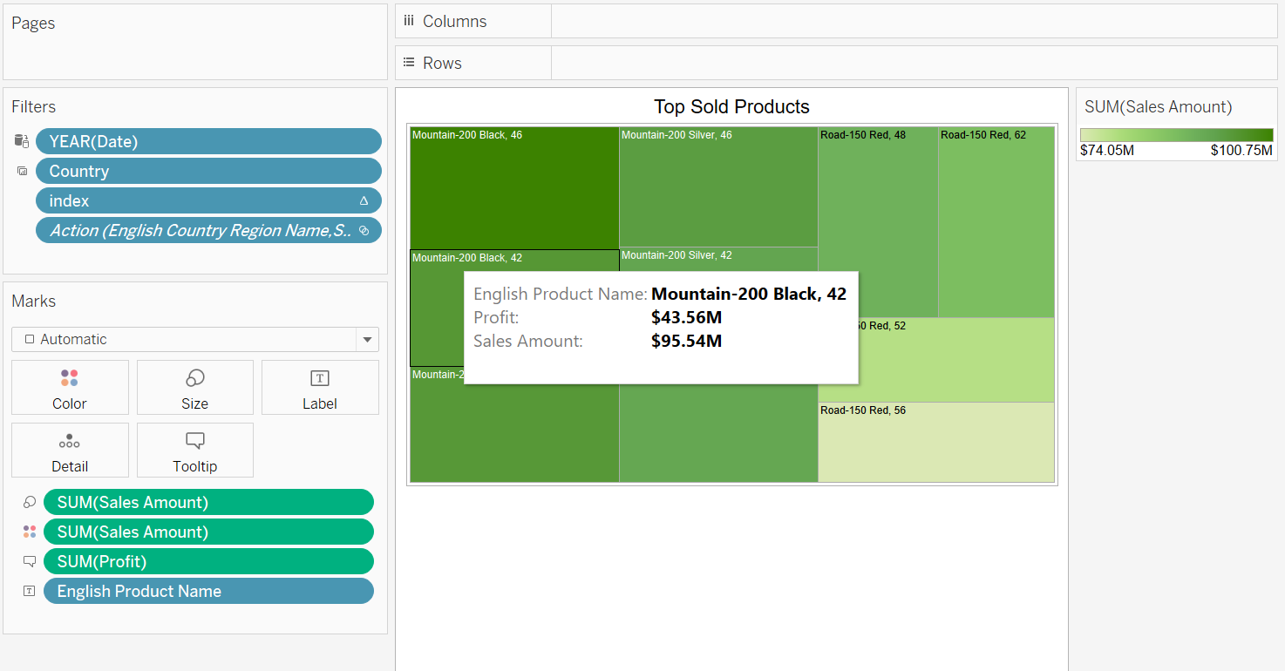
Top sold product

Slide 26
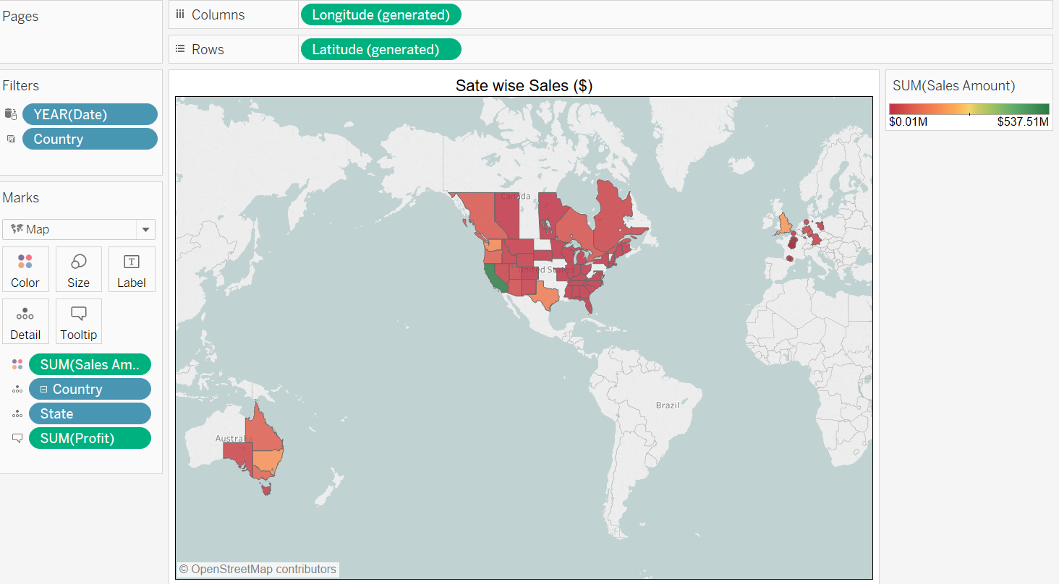
Sales by sates

Slide 27
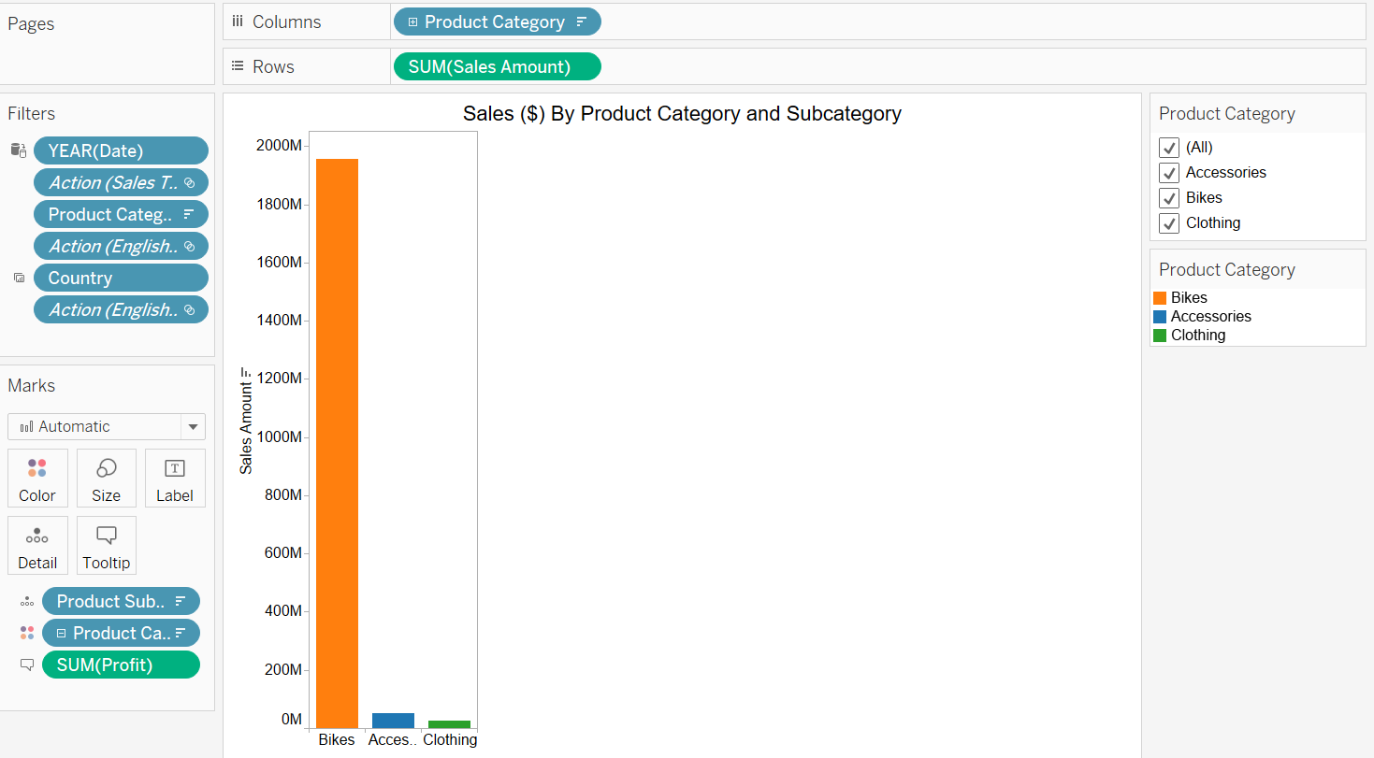
Sales by categories and subcategories

Slide 28
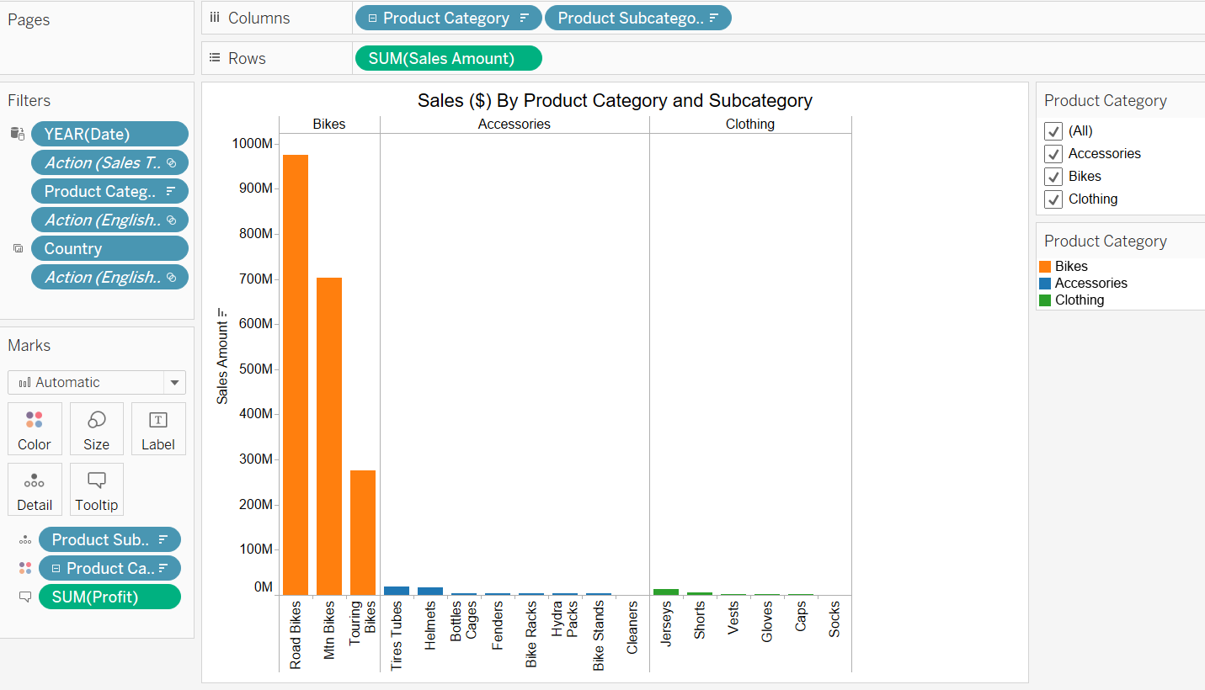
Sales by categories and subcategories drill down

Slide 29
Dashboard

Slide 30
Insights

Slide 31
Insights
Based on Exploring the dashboard.
USA has more then 50% of overall sales. We have sales in Almost every state.
Other countries has less sales as compared to USA because:
Smaller area and lesser population.
No sales in some regions
Overall for USA, sales of 1031.41 million USD

Slide 32
Insights 2010
For USA:
2010 December stared selling online.
Only Bikes were sold at that time.
South East, mid west, north east has no sales.
Overall, sales of 1.7 million USD

Slide 33
Insights 2011
Kept selling bikes only.
Still no sales in South East and a few states in mid west.
Overall, sales of 271.41 million USD

Slide 34
Insights 2012
Added new products of categories accessories and clothing
Also expanded to south east and north east sides of USA
Overall, sales of 154.72 million USD dropped from 271.41 million.

Slide 35
Insights 2013
All 3 categories kept selling with the spike in mountain bikes.
Sales from accessories and cloths also has raised to approx.. 9 and 6 million USD.
No further expansion to other areas.
Overall, sales of 600.72 million USD

Slide 36
Insights 2014
Just the January of 2014.
So far, no sales for bikes. That’s maybe because of cold weather.

Slide 37
Conclusion

Slide 38
Conclusion
We need to conduct research on the central sates of USA where we have no sales. It could be weather or local popular brand or maybe people don’t do cycling that much.
Need marketing and awareness campaigns in such area to increase sales.
Expending to other regions drops the overall sales. May need to look at marketing budget sate wise. Or focus more on hot sates where more sales are made.
Mountain bikes has given more profit than road bikes. However, road bikes has more sales. We might need to look for adding other products related to road bikes. Which could sell along with road bikes.

Slide 39
Tools Data Source
SQL Server
Tableau
Link

Slide 40
Thank you Any Question?
Doctordatah.com

