Slide 1

Insurance Redlining
Chicago
Presenter
Malik Hassan Qayyum
Data Analytics Graduate Student At Drew University

Slide 2
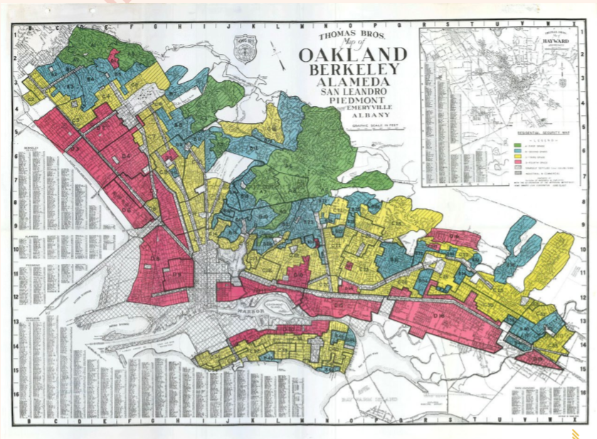
What is Redlining?
The Term originates from the 1930s practice of color coding maps of cities based on different neighborhoods’ eligibility to receive a loan or mortgage.
The lowest ranked neighborhoods were often literally lined in red, and were almost always a community of color or other marginalized identity.
A red lined map of Oakland, California, created by Home Owner’s Loan Corporation.
Notes:
THE TERM REDLINING, or red-lining, originates from the 1930s practice of color coding maps of cities based on different neighborhoods’ eligibility to receive a loan or mortgage. The lowest ranked neighborhoods were often literally lined in red, and were almost always a community of color or other marginalized identity.
Redlining began in 1935 when the Home Owner’s Loan Corporation began producing maps of virtually every major city upon request of the Federal Home Loan Bank Board.
Neighborhoods were color coded based on their desirability, from “A - First Grade” to “D - Fourth Grade.” Most often the “D” ranking neighborhoods were black communities, or other communities of minorities, while the “A” ranking neighborhoods were affluent white suburbs.1
The maps were used by both public and private banks and loan offices to directly discriminate and refuse loans to residents of the “D” neighborhoods.
The Fair Housing Act of 1968 made discrimination during the process of selling a house illegal, yet redlining was not effectively outlawed until 1977. The Home Mortgage Disclosure Act of 1975 required transparency thus making redlining unfeasible, and was followed by the Community Reinvestment Act of 1977 that finally prohibited it

Slide 3
HomeOwership Rate (2014)
73%
White
46%
Hispanic
44%
Black
Center for Global Policy Solutions, 2014

Slide 4
U.S. Commission Civil Rights (Study)
Illinois Department of Insurance
Chicago Police Department
DATA
Chicago Fire Department
US Bureau of the census

Slide 5
Variables
race racial: composition in percent minority
fire: ﬁres per 100 housing units
theft: theft per 1000 population
age: percent of housing units built before 1939
volact: new homeowner policies plus renewals minus cancellations and non-renewals per 100 housing units
involact: new FAIR plan policies and renewals per 100 housing units
income: median family income

Slide 6

Business Goal!

Slide 7
Initial Data Analysis

Slide 8
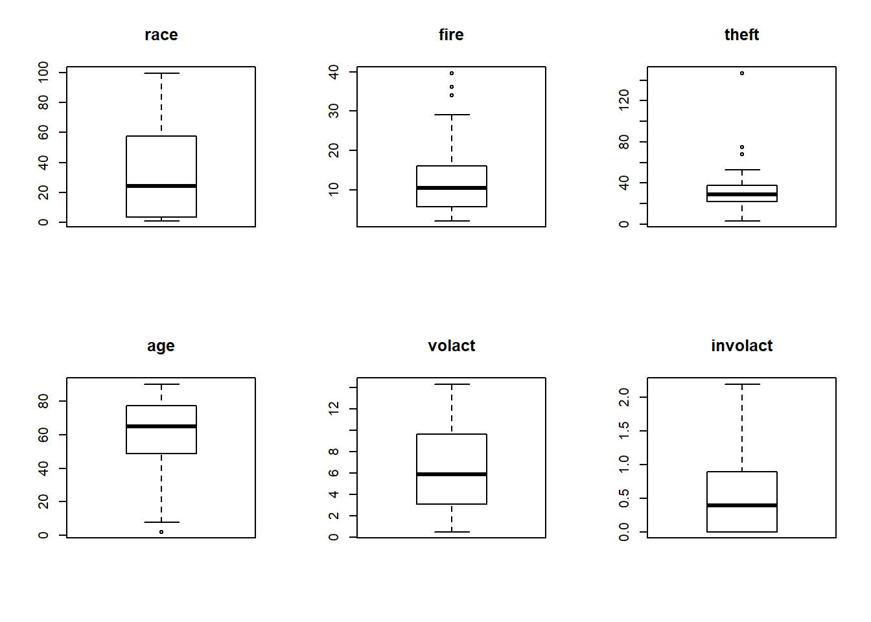
Initial Data Analysis

Slide 9
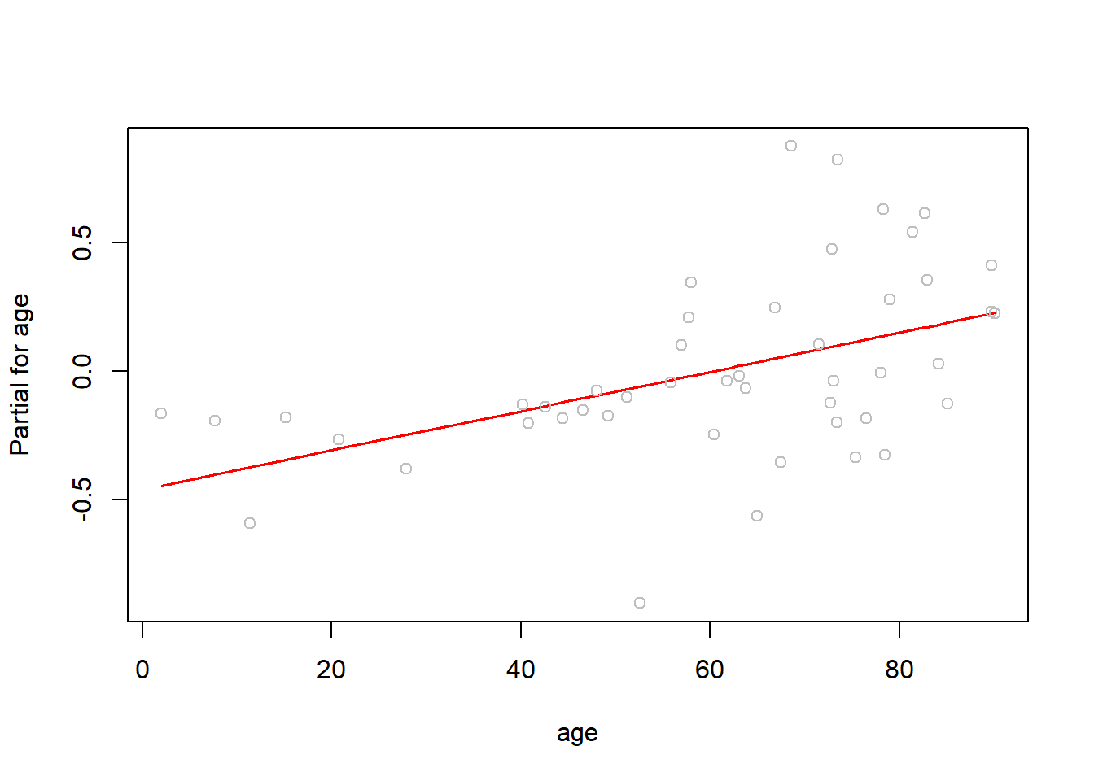
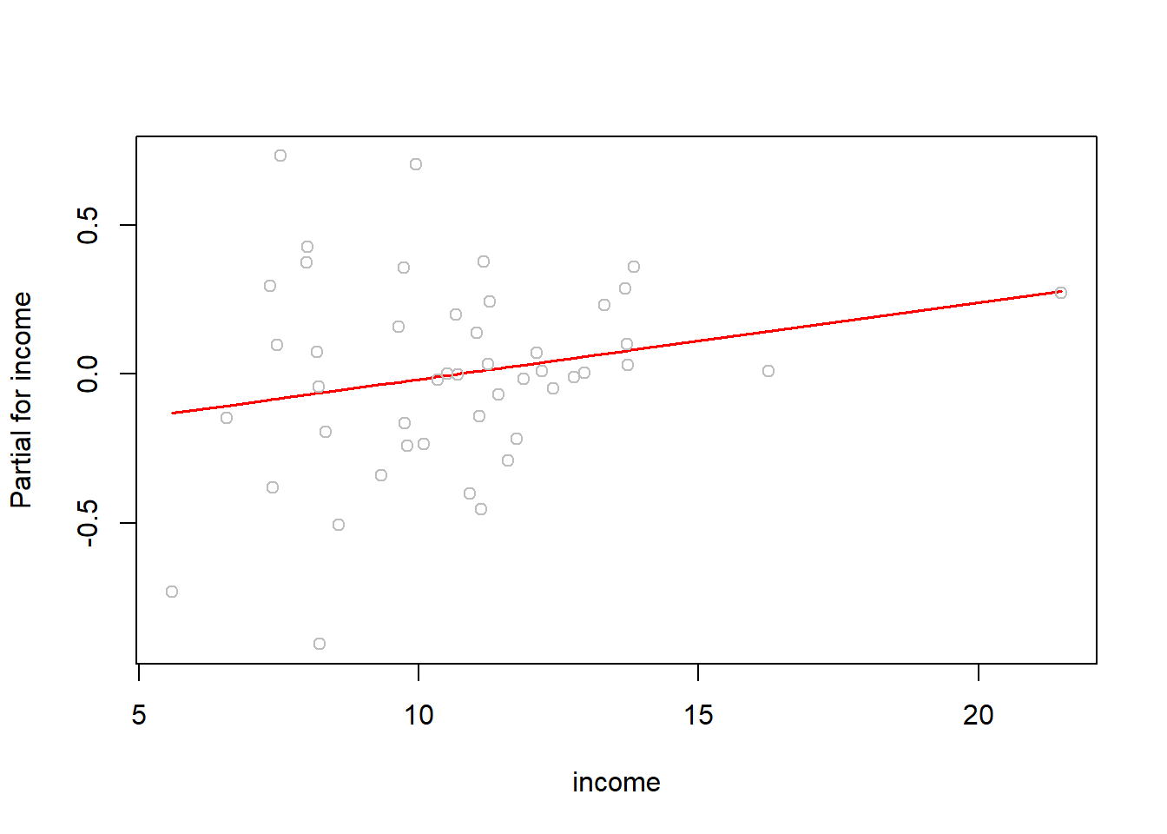
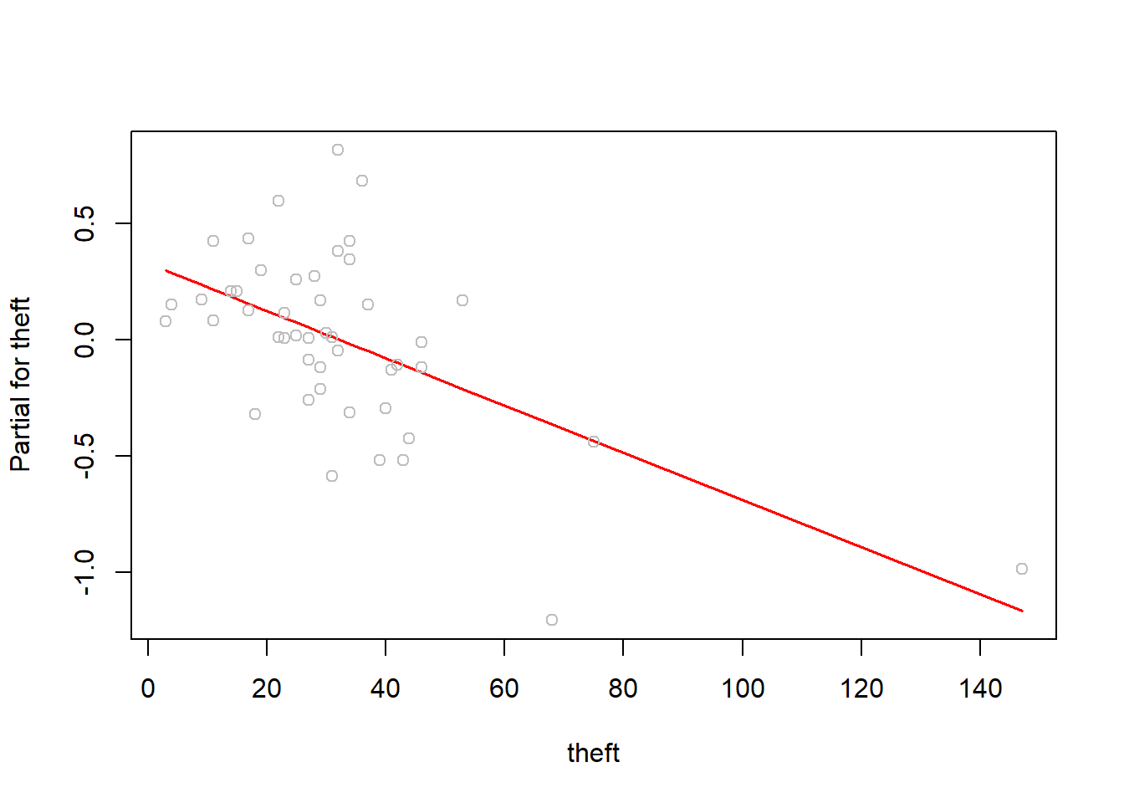
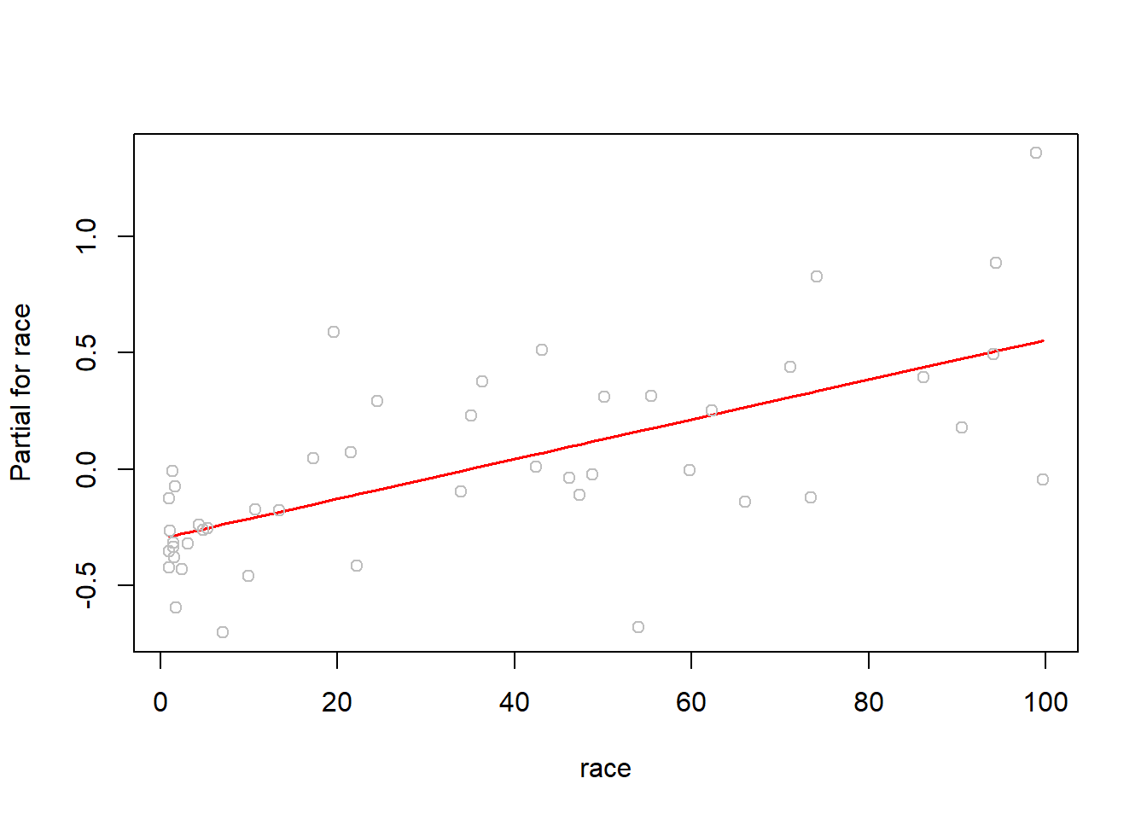
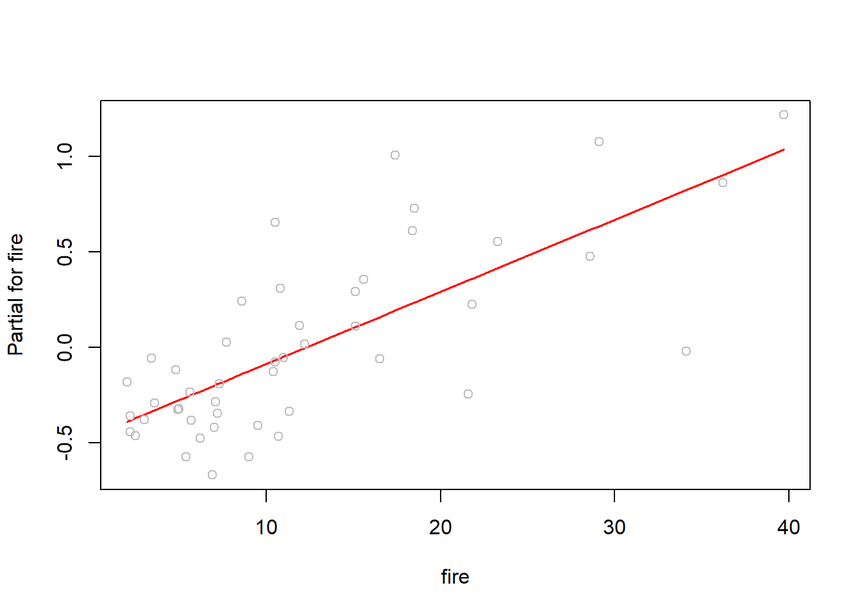
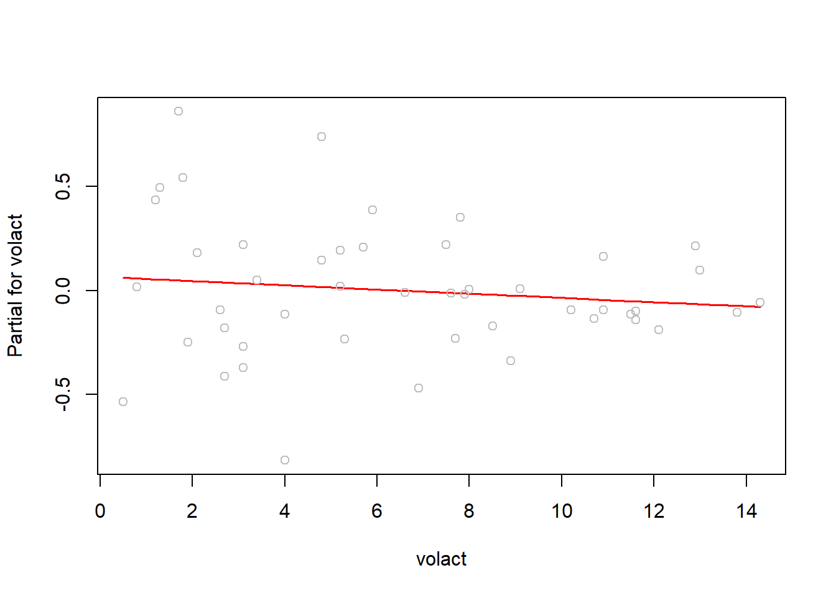
Assumption: Linearity

Slide 10
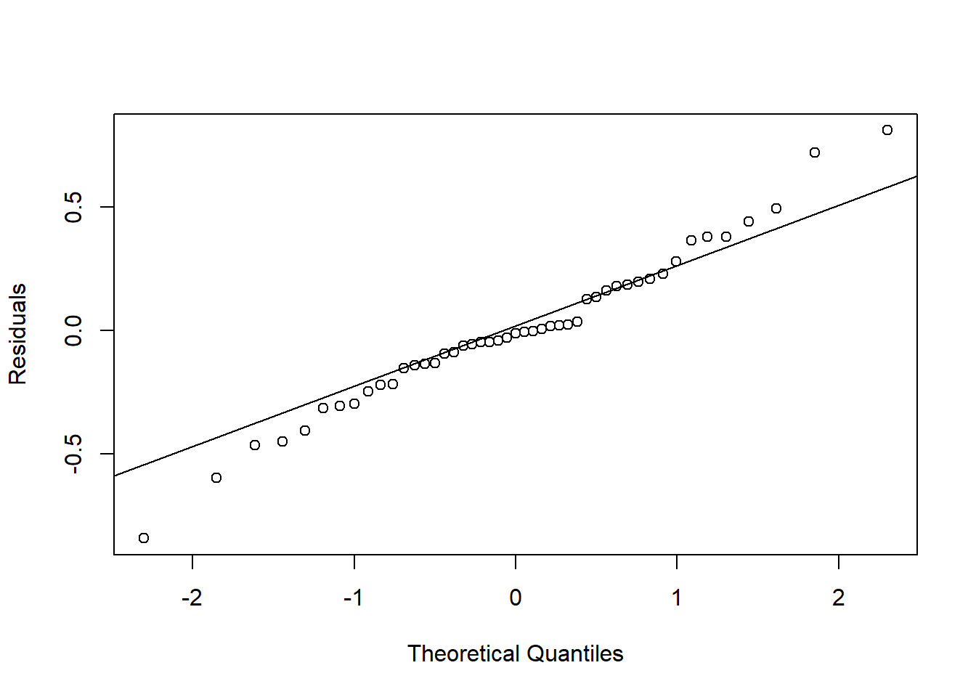
Assumption: Normality

Slide 11
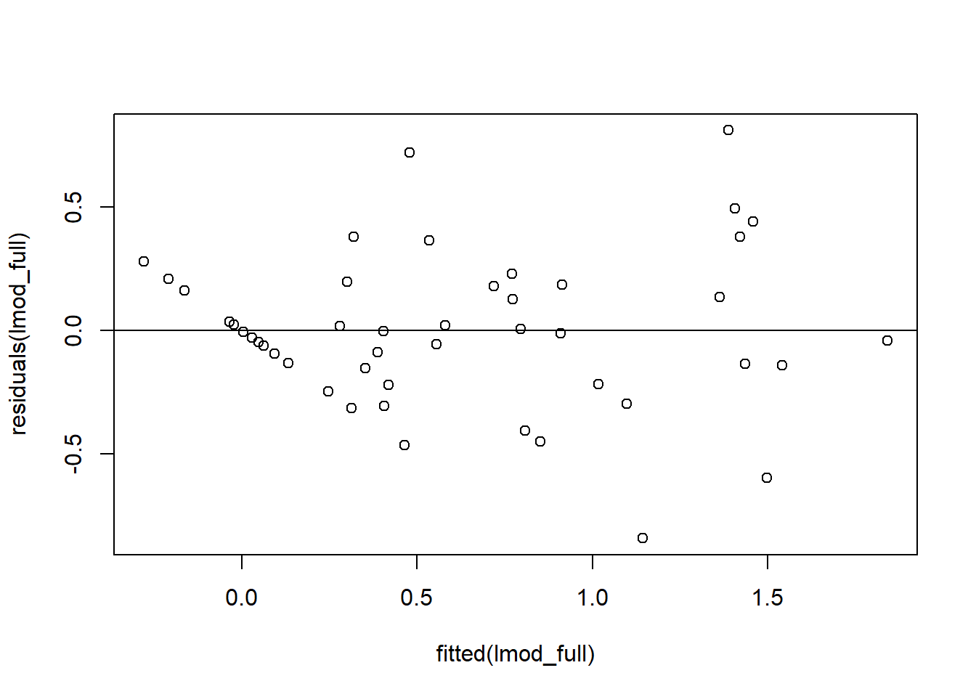
Assumption: Constant Variance

Slide 12
Collinearity Check
Model without Volact performs well as it have relatively high VIF
Income also proved to be insignificant

Slide 13
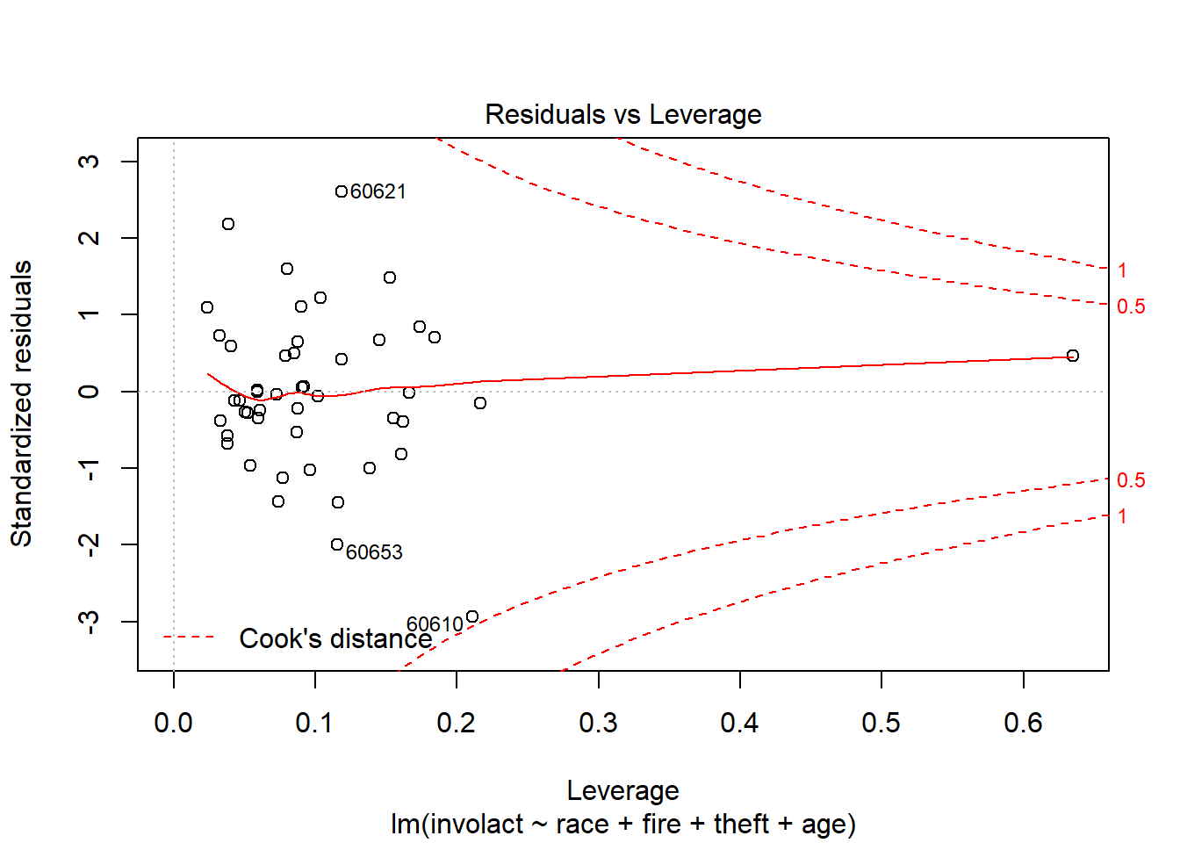
Influential Observations
After validating by removing and adding back different outliers
No Influential Observations

Slide 14
Final Model
involact ~ 0.007628 race
+ 0.039080 fire
+ (-1.415081) poly(theft,3) 1
+ (-0.074267) poly(theft,3) 2
+ (0.562725) poly(theft,3) 3
+ 0.005282 age
R-squared: 0.7603, Adjusted R-squared: 0.7244

Slide 15

References
Jackson, Kenneth T. Crabgrass Frontier: The Suburbanization of the United States. New York: Oxford UP, 1985. Print.
Squires, Gregory D. “Racial Profiling, Insurance Style: Insurance Redlining and the Uneven Development of Metropolitan Areas.” Journal of Urban Affairs 25.4 (2003): 391-410. Print.
Badger, Emily. “Redlining: Still a thing.” The Washington Post. WP Company, 28 May 2015. Web. 19 Dec. 2016.
Tootell, G. M. B. “Redlining in Boston: Do Mortgage Lenders Discriminate Against Neighborhoods?” The Quarterly Journal of Economics 111.4 (1996): 1049-079. Print.
Full Report
www.doctordatah.com/Chicago-redlining-regression-report

Slide 16
Thank You ☺
Any Questions?

