Slide 1
DATA 503 – Applied Regression Analysis Lecture 14: Diagnostics, Collinearity, Transformation, and Missing Data Highlights
By Dr. Ellie Small

Slide 2
Overview
Topics:
Diagnostics:
Checking Error Variance
Checking for Normality of the Errors
Checking the Structure of the Model
Categorical Predictors
Collinearity
Transformations:
Box-Cox and Logtrans
Polynomials
Missing Data

Slide 3
Checking Error Variance
To verify constant symmetrical variance, or homoscedasticity (vs. heteroscedasticity, or non-constant variation), we plot the residuals (or standardized residuals) vs. the fitted values, with a horizontal line at residual=0. The points should be randomly spread around the center line. We look for:
“cone shape” – variance appears to be either increasing or decreasing with increasing fitted values
“nonlinearity” – data points do not seem to be randomly spread around the center line but appears to be following a pattern
The graph can be created manually using plot(fitted(lmod), residuals(lmod); abline(h=0), or via plot(lmod), where it will be the first plot.
If there are any doubts, a magnified view can be obtained by plotting the square root of the residuals versus the fitted values (the third plot in plot(lmod)).
Also plot the predictors vs. the residuals using plot(predictor, residuals(lmod); abline(h=0); these data points should also be randomly spread around the center line.
Plotting a predictor that was not included in the model vs. the residuals could indicate that the predictor should be included if a relationship appears to exist in the plot.

Slide 4
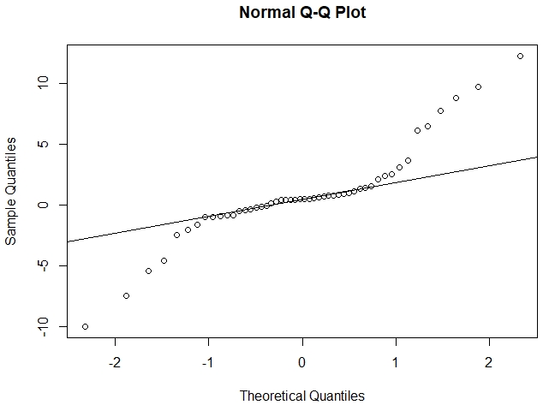
Checking for Normality of the Errors
We check for normality using qqnorm(residuals(lmod)) and qqline(residuals(lmod)), or via plot(lmod), where it will be the second plot. For large sample sizes (>30), we are only concerned with a plot that starts below the line and ends above, indicating a long-tailed distribution. In that case we should run Shapiro’s test for normality using shapiro.test(residuals(lmod)). If the p-value is large (greater than .05), we can assume normality. If the p-value is small, we need to deal with non-normality of the data.
Plot of a long-tailed distribution

Slide 5
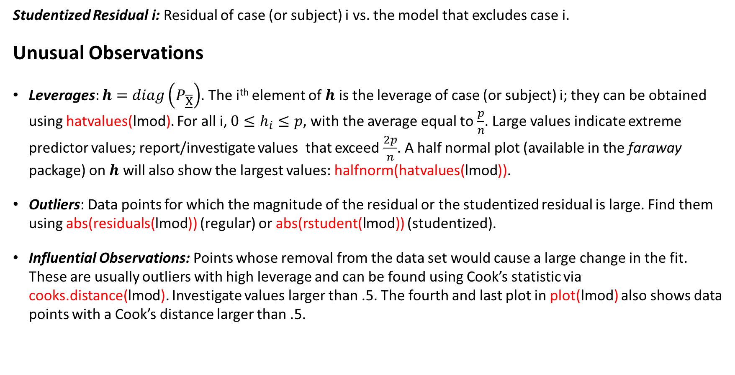
Finding Unusual Observations
Studentized Residual i: Residual of case (or subject) i vs. the model that excludes case i.
Unusual Observations
Leverages: $h=diag\left(P_{\underline{\overline{X}}}\right)$. The i^{th} element of $h$ is the leverage of case (or subject) i; they can be obtained using hatvalues(lmod). For all i, $0≤h_{i}≤p$, with the average equal to $\frac{p}{n}$. Large values indicate extreme predictor values; report/investigate values that exceed $\frac{2p}{n}$. A half normal plot (available in the faraway package) on $h$ will also show the largest values: halfnorm(hatvalues(lmod)).
Outliers: Data points for which the magnitude of the residual or the studentized residual is large. Find them using abs(residuals(lmod)) (regular) or abs(rstudent(lmod)) (studentized).
Influential Observations: Points whose removal from the data set would cause a large change in the fit. These are usually outliers with high leverage and can be found using Cook’s statistic via cooks.distance(lmod). Investigate values larger than .5. The fourth and last plot in plot(lmod) also shows data points with a Cook’s distance larger than .5.

Slide 6
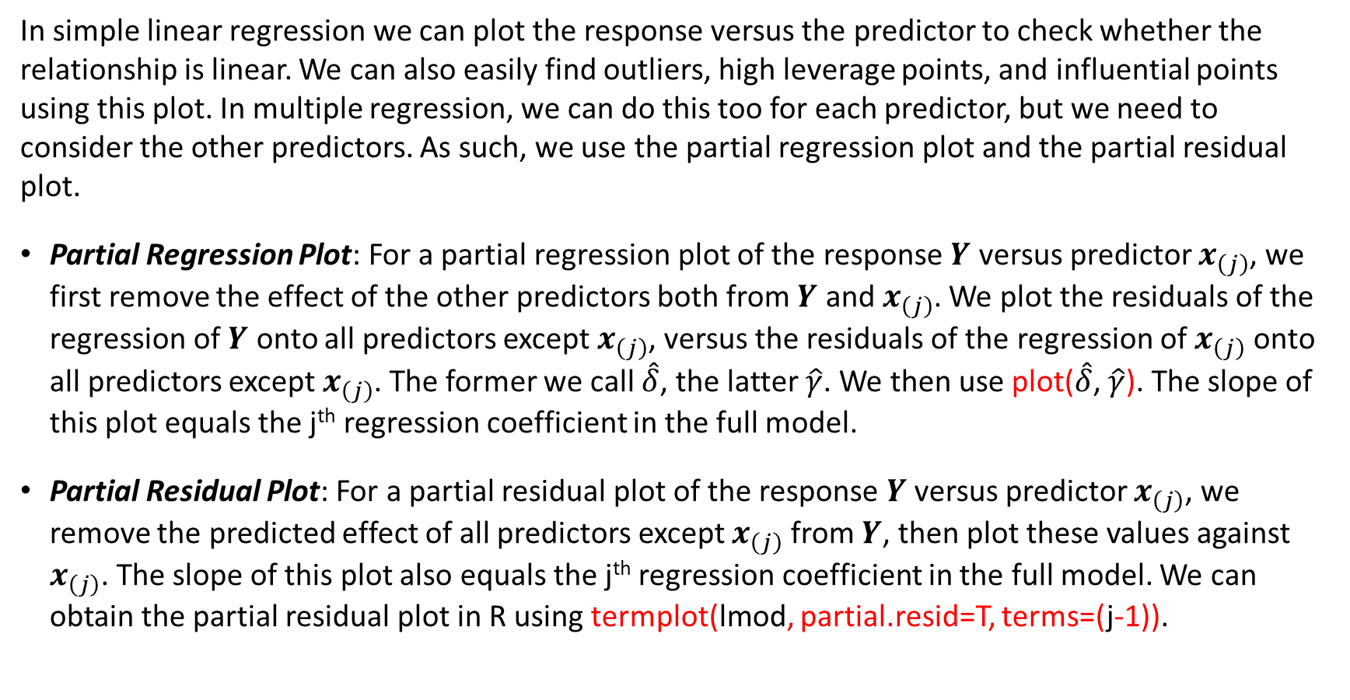
Checking the Structure of the Model
In simple linear regression we can plot the response versus the predictor to check whether the relationship is linear. We can also easily find outliers, high leverage points, and influential points using this plot. In multiple regression, we can do this too for each predictor, but we need to consider the other predictors. As such, we use the partial regression plot and the partial residual plot.
Partial Regression Plot: For a partial regression plot of the response $Y$ versus predictor $x_{\left(j\right)}$, we first remove the effect of the other predictors both from $Y$ and $x_{\left(j\right)}$. We plot the residuals of the regression of $Y$ onto all predictors except $x_{\left(j\right)}$, versus the residuals of the regression of $x_{\left(j\right)}$ onto all predictors except $x_{\left(j\right)}$. The former we call $\hat{δ}$, the latter $\hat{γ}$. We then use plot($\hat{δ}$, $\hat{γ}$). The slope of this plot equals the j^{th} regression coefficient in the full model.
Partial Residual Plot: For a partial residual plot of the response $Y$ versus predictor $x_{\left(j\right)}$, we remove the predicted effect of all predictors except $x_{\left(j\right)}$ from $Y$, then plot these values against $x_{\left(j\right)}$. The slope of this plot also equals the j^{th} regression coefficient in the full model. We can obtain the partial residual plot in R using termplot(lmod, partial.resid=T, terms=(j-1)).

Slide 7
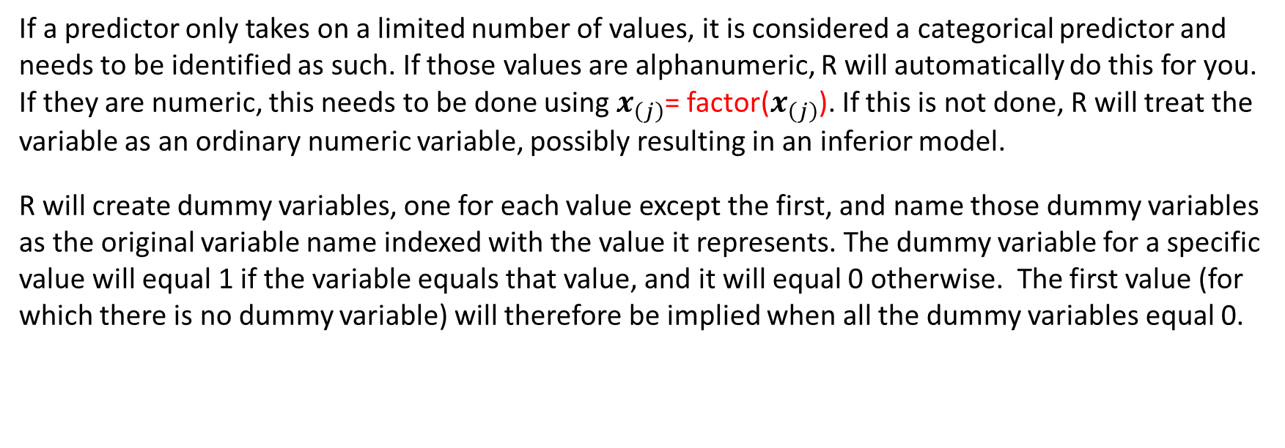
Categorical Predictors
If a predictor only takes on a limited number of values, it is considered a categorical predictor and needs to be identified as such. If those values are alphanumeric, R will automatically do this for you. If they are numeric, this needs to be done using $x_{\left(j\right)}$= factor($x_{\left(j\right)}$). If this is not done, R will treat the variable as an ordinary numeric variable, possibly resulting in an inferior model.
R will create dummy variables, one for each value except the first, and name those dummy variables as the original variable name indexed with the value it represents. The dummy variable for a specific value will equal 1 if the variable equals that value, and it will equal 0 otherwise. The first value (for which there is no dummy variable) will therefore be implied when all the dummy variables equal 0.

Slide 8
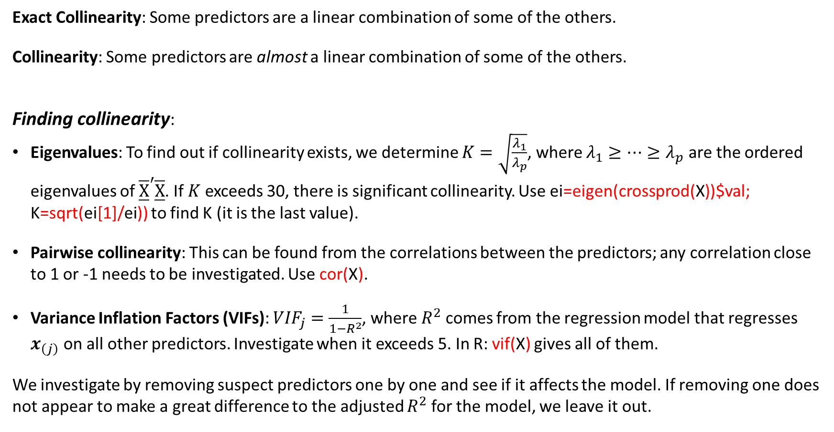
Collinearity
Exact Collinearity: Some predictors are a linear combination of some of the others.
Collinearity: Some predictors are almost a linear combination of some of the others.
Finding collinearity:
Eigenvalues: To find out if collinearity exists, we determine $K=\sqrt{\frac{λ_{1}}{λ_{p}}}$, where $λ_{1}≥⋯≥λ_{p}$ are the ordered eigenvalues of ${\underline{\overline{X}}}^{′}\underline{\overline{X}}$. If $K$ exceeds 30, there is significant collinearity. Use ei=eigen(crossprod(X))$val; K=sqrt(ei[1]/ei)) to find K (it is the last value).
Pairwise collinearity: This can be found from the correlations between the predictors; any correlation close to 1 or -1 needs to be investigated. Use cor(X).
Variance Inflation Factors (VIFs): ${VIF}_{j}=\frac{1}{1−R^{2}}$, where $R^{2}$ comes from the regression model that regresses $x_{\left(j\right)}$ on all other predictors. Investigate when it exceeds 5. In R: vif(X) gives all of them.
We investigate by removing suspect predictors one by one and see if it affects the model. If removing one does not appear to make a great difference to the adjusted $R^{2}$ for the model, we leave it out.

Slide 9
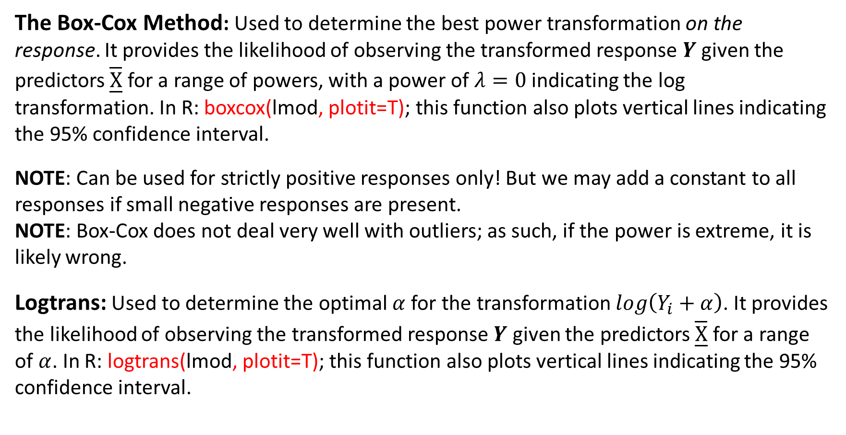
Transformations
The Box-Cox Method: Used to determine the best power transformation on the response. It provides the likelihood of observing the transformed response $Y$ given the predictors $\underline{\overline{X}}$ for a range of powers, with a power of $λ=0$ indicating the log transformation. In R: boxcox(lmod, plotit=T); this function also plots vertical lines indicating the 95% confidence interval.
NOTE: Can be used for strictly positive responses only! But we may add a constant to all responses if small negative responses are present.
NOTE: Box-Cox does not deal very well with outliers; as such, if the power is extreme, it is likely wrong.
Logtrans: Used to determine the optimal $α$ for the transformation $log\left(Y_{i}+α\right)$. It provides the likelihood of observing the transformed response $Y$ given the predictors $\underline{\overline{X}}$ for a range of $α$. In R: logtrans(lmod, plotit=T); this function also plots vertical lines indicating the 95% confidence interval.

Slide 10
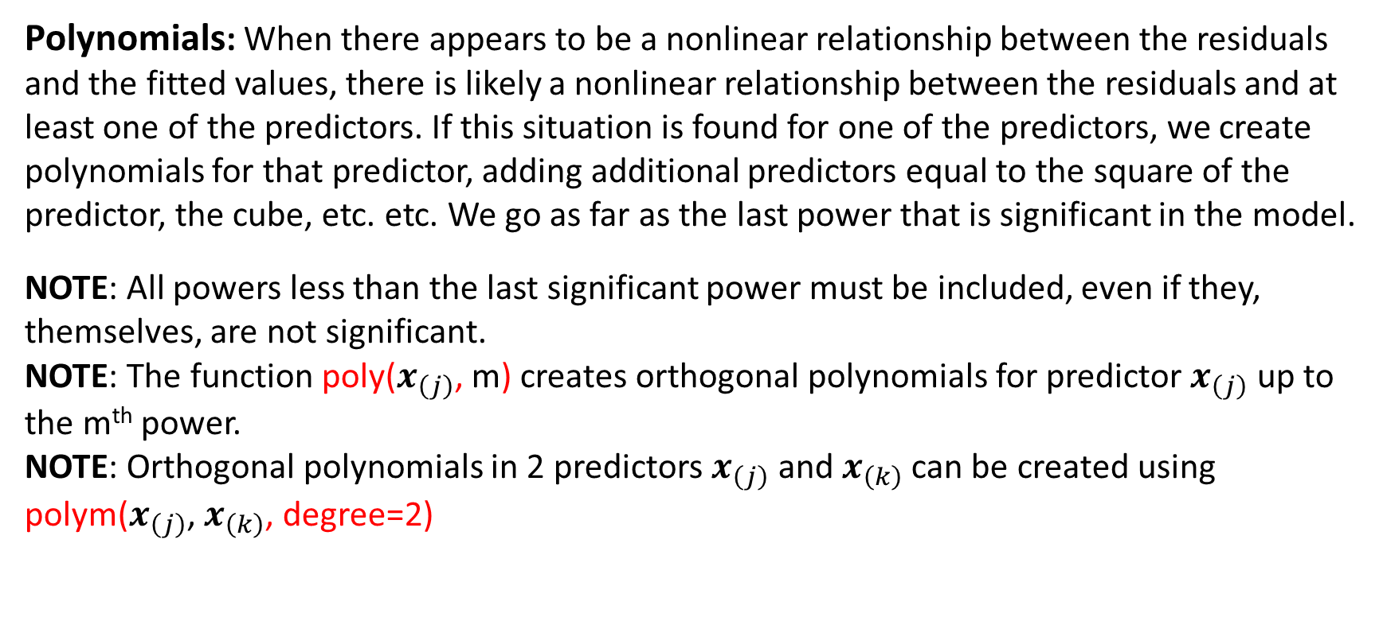
Transformations - 2
Polynomials: When there appears to be a nonlinear relationship between the residuals and the fitted values, there is likely a nonlinear relationship between the residuals and at least one of the predictors. If this situation is found for one of the predictors, we create polynomials for that predictor, adding additional predictors equal to the square of the predictor, the cube, etc. etc. We go as far as the last power that is significant in the model.
NOTE: All powers less than the last significant power must be included, even if they, themselves, are not significant.
NOTE: The function poly($x_{\left(j\right)}$, m) creates orthogonal polynomials for predictor $x_{\left(j\right)}$ up to the m^{th} power.
NOTE: Orthogonal polynomials in 2 predictors $x_{\left(j\right)}$ and $x_{\left(k\right)}$ can be created using polym($x_{\left(j\right)}$, $x_{\left(k\right)}$, degree=2)

Slide 11
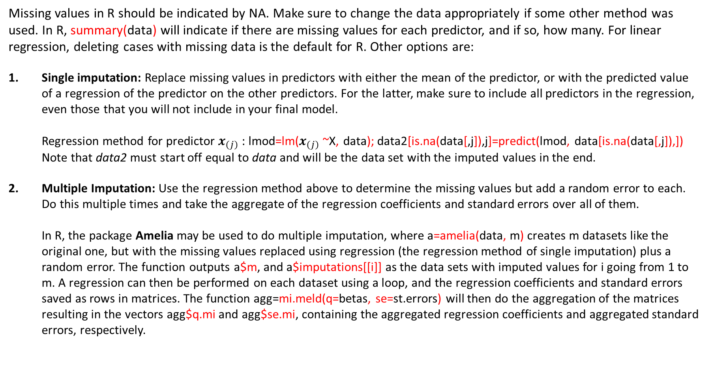
Missing Data
Missing values in R should be indicated by NA. Make sure to change the data appropriately if some other method was used. In R, summary(data) will indicate if there are missing values for each predictor, and if so, how many. For linear regression, deleting cases with missing data is the default for R. Other options are:
Single imputation: Replace missing values in predictors with either the mean of the predictor, or with the predicted value of a regression of the predictor on the other predictors. For the latter, make sure to include all predictors in the regression, even those that you will not include in your final model. Regression method for predictor $x_{\left(j\right)}$: lmod=lm($x_{\left(j\right)}$~X, data); data2[is.na(data[,j]),j]=predict(lmod, data[is.na(data[,j]),]) Note that data2 must start off equal to data and will be the data set with the imputed values in the end.
Multiple Imputation: Use the regression method above to determine the missing values but add a random error to each. Do this multiple times and take the aggregate of the regression coefficients and standard errors over all of them. In R, the package Amelia may be used to do multiple imputation, where a=amelia(data, m) creates m datasets like the original one, but with the missing values replaced using regression (the regression method of single imputation) plus a random error. The function outputs a$m, and a$imputations[[i]] as the data sets with imputed values for i going from 1 to m. A regression can then be performed on each dataset using a loop, and the regression coefficients and standard errors saved as rows in matrices. The function agg=mi.meld(q=betas, se=st.errors) will then do the aggregation of the matrices resulting in the vectors agg$q.mi and agg$se.mi, containing the aggregated regression coefficients and aggregated standard errors, respectively.

