Slide 1
STAT 504 – Network and Text Analytics Lecture 7: Centrality
By Dr. Ellie Small

Slide 2
Overview
Topics:
Review
Measures and Metrics
Vertex Centrality
Hubs and Authorities
Edge Centrality
Network Cohesion
Assortative Mixing

Slide 3
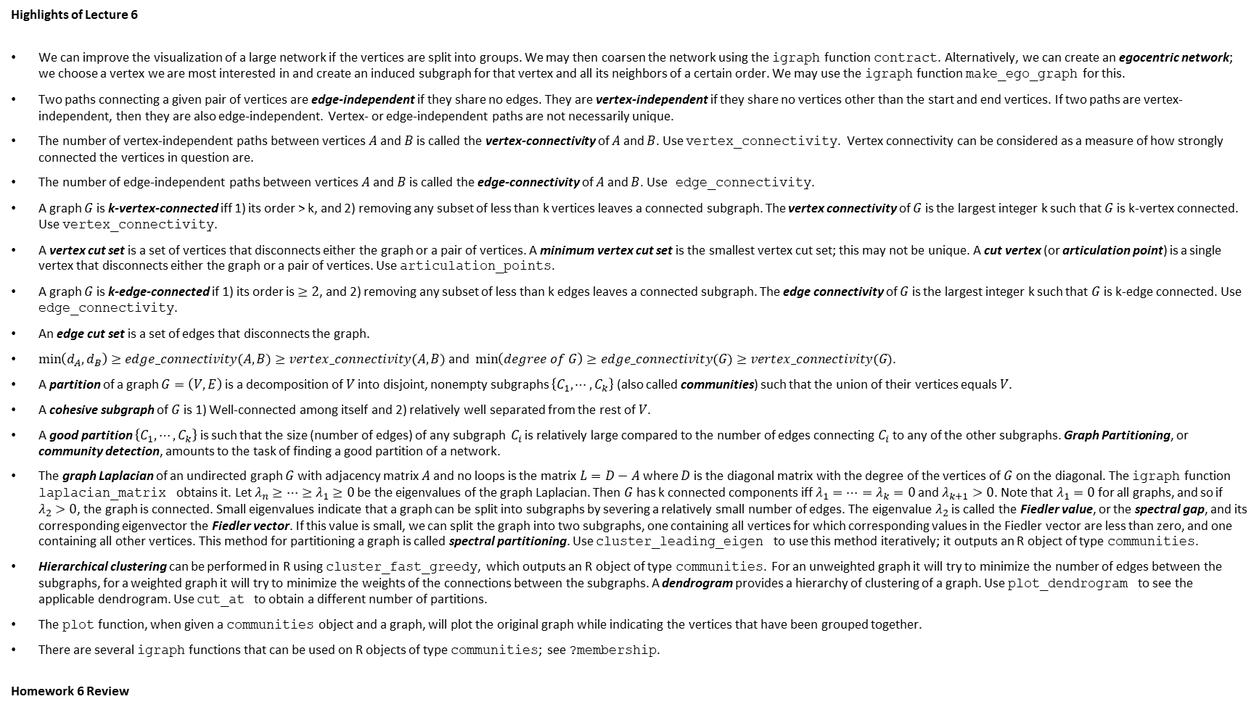
Review
Highlights of Lecture 6
We can improve the visualization of a large network if the vertices are split into groups. We may then coarsen the network using the igraph function contract. Alternatively, we can create an egocentric network; we choose a vertex we are most interested in and create an induced subgraph for that vertex and all its neighbors of a certain order. We may use the igraph function make_ego_graph for this.
Two paths connecting a given pair of vertices are edge-independent if they share no edges. They are vertex-independent if they share no vertices other than the start and end vertices. If two paths are vertex-independent, then they are also edge-independent. Vertex- or edge-independent paths are not necessarily unique.
The number of vertex-independent paths between vertices $A$ and $B$ is called the vertex-connectivity of $A$ and $B$. Use vertex_connectivity. Vertex connectivity can be considered as a measure of how strongly connected the vertices in question are.
The number of edge-independent paths between vertices $A$ and $B$ is called the edge-connectivity of $A$ and $B$. Use edge_connectivity.
A graph $G$ is k-vertex-connected iff 1) its order > k, and 2) removing any subset of less than k vertices leaves a connected subgraph. The vertex connectivity of $G$ is the largest integer k such that $G$ is k-vertex connected. Use vertex_connectivity.
A vertex cut set is a set of vertices that disconnects either the graph or a pair of vertices. A minimum vertex cut set is the smallest vertex cut set; this may not be unique. A cut vertex (or articulation point) is a single vertex that disconnects either the graph or a pair of vertices. Use articulation_points.
A graph $G$ is k-edge-connected if 1) its order is $≥2$, and 2) removing any subset of less than k edges leaves a connected subgraph. The edge connectivity of $G$ is the largest integer k such that $G$ is k-edge connected. Use edge_connectivity.
An edge cut set is a set of edges that disconnects the graph.
$\min\left(d_{A},d_{B}\right)≥edge_connectivity(A,B)≥vertex_connectivity(A,B)$ and $\min\left(degree of G\right)≥edge_connectivity(G)≥vertex_connectivity(G)$.
A partition of a graph $G=\left(V,E\right)$ is a decomposition of $V$ into disjoint, nonempty subgraphs $\left\{C_{1},⋯,C_{k}\right\}$(also called communities) such that the union of their vertices equals $V$.
A cohesive subgraph of $G$ is 1) Well-connected among itself and 2) relatively well separated from the rest of $V$.
A good partition $\left\{C_{1},⋯,C_{k}\right\}$ is such that the size (number of edges) of any subgraph $C_{i}$ is relatively large compared to the number of edges connecting $C_{i}$ to any of the other subgraphs. Graph Partitioning, or community detection, amounts to the task of finding a good partition of a network.
The graph Laplacian of an undirected graph $G$ with adjacency matrix $A$ and no loops is the matrix $L=D−A$ where $D$ is the diagonal matrix with the degree of the vertices of $G$ on the diagonal. The igraph function laplacian_matrix obtains it. Let $λ_{n}≥⋯≥λ_{1}≥0$ be the eigenvalues of the graph Laplacian. Then $G$ has k connected components iff $λ_{1}=⋯=λ_{k}=0$ and $λ_{k+1}>0$. Note that $λ_{1}=0$ for all graphs, and so if $λ_{2}>0$, the graph is connected. Small eigenvalues indicate that a graph can be split into subgraphs by severing a relatively small number of edges. The eigenvalue $λ_{2}$ is called the Fiedler value, or the spectral gap, and its corresponding eigenvector the Fiedler vector. If this value is small, we can split the graph into two subgraphs, one containing all vertices for which corresponding values in the Fiedler vector are less than zero, and one containing all other vertices. This method for partitioning a graph is called spectral partitioning. Use cluster_leading_eigen to use this method iteratively; it outputs an R object of type communities.
Hierarchical clustering can be performed in R using cluster_fast_greedy, which outputs an R object of type communities. For an unweighted graph it will try to minimize the number of edges between the subgraphs, for a weighted graph it will try to minimize the weights of the connections between the subgraphs. A dendrogram provides a hierarchy of clustering of a graph. Use plot_dendrogram to see the applicable dendrogram. Use cut_at to obtain a different number of partitions.
The plot function, when given a communities object and a graph, will plot the original graph while indicating the vertices that have been grouped together.
There are several igraph functions that can be used on R objects of type communities; see ?membership.
Homework 6 Review

Slide 4
Measures and Metrics
Mathematical measures and metrics capture interesting features of network structure quantitatively, boiling down large volumes of complex structural data into simple numbers.
The most common of these measures is centrality. We will focus primarily on vertex centrality (rather than edge centrality), which aims to find the most important, central vertices in a network.
For digraphs, hubs and authorities are very informative and are central in different ways.
Network Cohesion includes dyads, classifying pairs of vertices, triads classifying triples of vertices, transitivity indicating the probability that a connected triple is closed, and reciprocity, indicating the probability that a connection in a digraph is reciprocated.
Assortative Mixing gives a numerical value indicating the extend vertices tend to move with or against a grouping variable.

Slide 5
Vertex Centrality
We may ask ourselves which vertices in a network are “important”: Which actors in a social network are most influential? Who has more access to information, or more prestige? Or, for the internet, how critical is a certain computer to the flow of traffic on the internet? In a citation network, which paper is cited the most?
All those questions come down to the following: which vertex is most central in the network? We identify four types of vertex centrality:
Degree centrality
Closeness centrality
Betweenness centrality
Eigenvector Centrality (and PageRank)

Slide 6
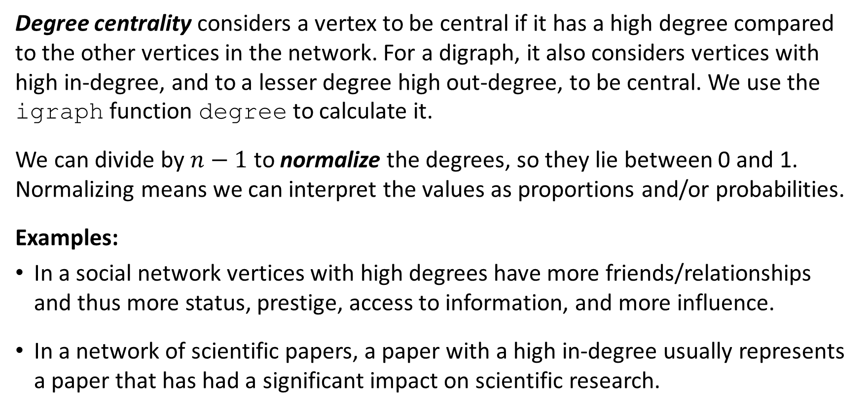
Vertex Centrality Degree Centrality
Degree centrality considers a vertex to be central if it has a high degree compared to the other vertices in the network. For a digraph, it also considers vertices with high in-degree, and to a lesser degree high out-degree, to be central. We use the igraph function degree to calculate it.
We can divide by $n−1$ to normalize the degrees, so they lie between 0 and 1. Normalizing means we can interpret the values as proportions and/or probabilities.
Examples:
In a social network vertices with high degrees have more friends/relationships and thus more status, prestige, access to information, and more influence.
In a network of scientific papers, a paper with a high in-degree usually represents a paper that has had a significant impact on scientific research.

Slide 7
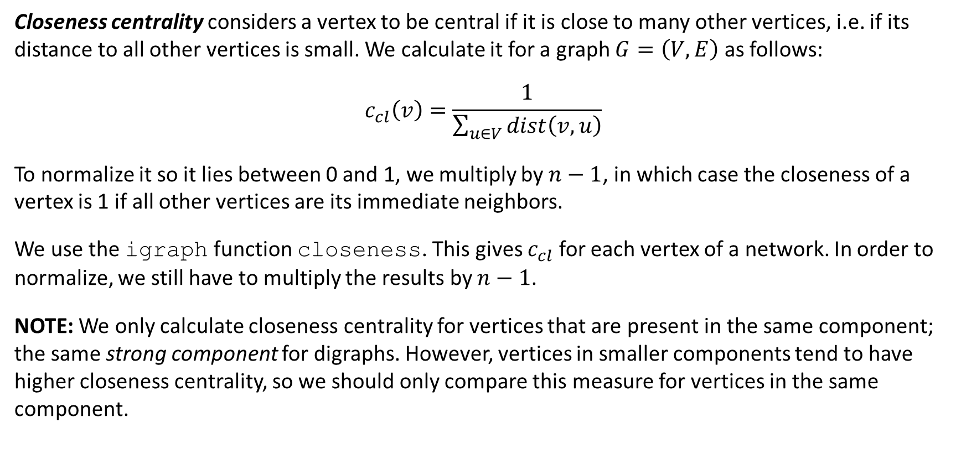
Vertex Centrality Closeness Centrality
Closeness centrality considers a vertex to be central if it is close to many other vertices, i.e. if its distance to all other vertices is small. We calculate it for a graph $G=\left(V,E\right)$ as follows:
$$c_{cl}\left(v\right)=\frac{1}{\sum_{u∈V}{dist\left(v,u\right)}}$$
To normalize it so it lies between 0 and 1, we multiply by $n−1$, in which case the closeness of a vertex is 1 if all other vertices are its immediate neighbors.
We use the igraph function closeness. This gives $c_{cl}$ for each vertex of a network. In order to normalize, we still have to multiply the results by $n−1$.
NOTE: We only calculate closeness centrality for vertices that are present in the same component; the same strong component for digraphs. However, vertices in smaller components tend to have higher closeness centrality, so we should only compare this measure for vertices in the same component.

Slide 8
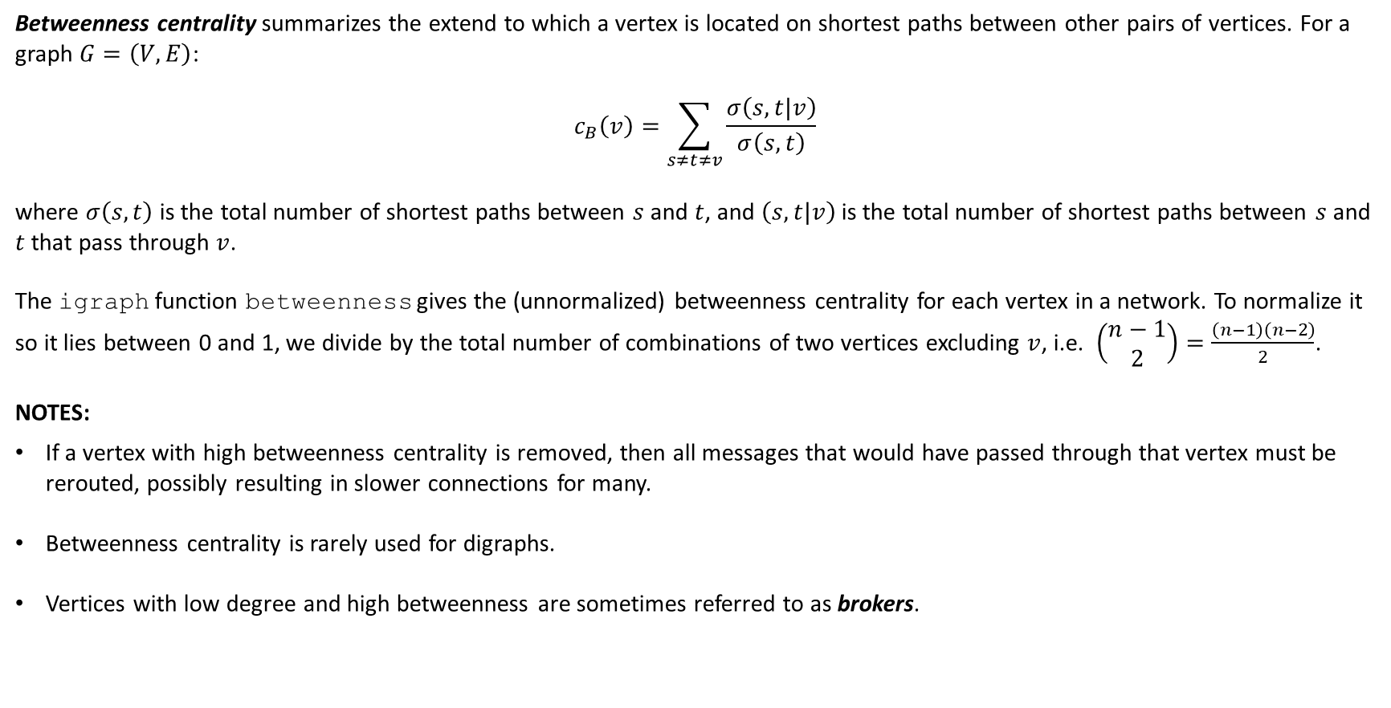
Vertex Centrality Betweenness Centrality
Betweenness centrality summarizes the extend to which a vertex is located on shortest paths between other pairs of vertices. For a graph $G=\left(V,E\right)$:
$$c_{B}\left(v\right)=\sum_{s≠t≠v}{\frac{σ\left(s,t|v\right)}{σ\left(s,t\right)}}$$
where $σ\left(s,t\right)$ is the total number of shortest paths between $s$ and $t$, and $\left(s,t|v\right)$ is the total number of shortest paths between $s$ and $t$ that pass through $v$.
The igraph function betweenness gives the (unnormalized) betweenness centrality for each vertex in a network. To normalize it so it lies between 0 and 1, we divide by the total number of combinations of two vertices excluding $v$, i.e. $\left(\begin{matrix}n−1 \\ 2\end{matrix}\right)=\frac{\left(n−1\right)\left(n−2\right)}{2}$.
NOTES:
If a vertex with high betweenness centrality is removed, then all messages that would have passed through that vertex must be rerouted, possibly resulting in slower connections for many.
Betweenness centrality is rarely used for digraphs.
Vertices with low degree and high betweenness are sometimes referred to as brokers.

Slide 9
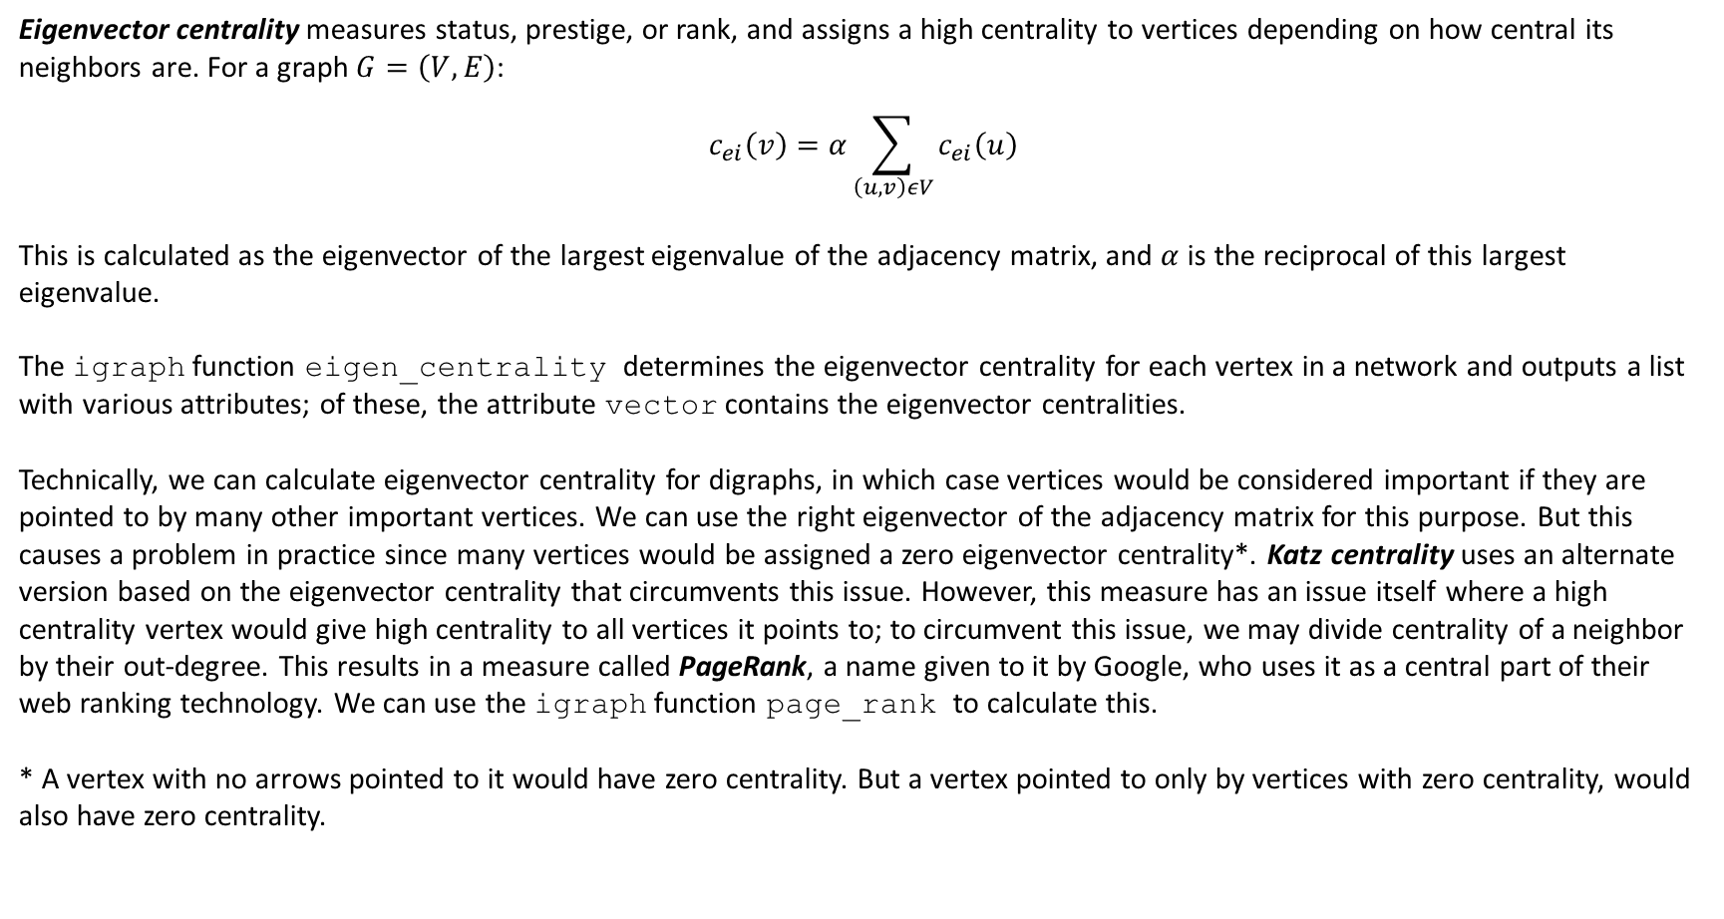
Vertex Centrality Eigenvector Centrality and PageRank
Eigenvector centrality measures status, prestige, or rank, and assigns a high centrality to vertices depending on how central its neighbors are. For a graph $G=\left(V,E\right)$:
$$c_{ei}\left(v\right)=α\sum_{\left(u,v\right)εV}{c_{ei}\left(u\right)}$$
This is calculated as the eigenvector of the largest eigenvalue of the adjacency matrix, and $α$ is the reciprocal of this largest eigenvalue.
The igraph function eigen_centrality determines the eigenvector centrality for each vertex in a network and outputs a list with various attributes; of these, the attribute vector contains the eigenvector centralities.
Technically, we can calculate eigenvector centrality for digraphs, in which case vertices would be considered important if they are pointed to by many other important vertices. We can use the right eigenvector of the adjacency matrix for this purpose. But this causes a problem in practice since many vertices would be assigned a zero eigenvector centrality*. Katz centrality uses an alternate version based on the eigenvector centrality that circumvents this issue. However, this measure has an issue itself where a high centrality vertex would give high centrality to all vertices it points to; to circumvent this issue, we may divide centrality of a neighbor by their out-degree. This results in a measure called PageRank, a name given to it by Google, who uses it as a central part of their web ranking technology. We can use the igraph function page_rank to calculate this.
* A vertex with no arrows pointed to it would have zero centrality. But a vertex pointed to only by vertices with zero centrality, would also have zero centrality.

Slide 10
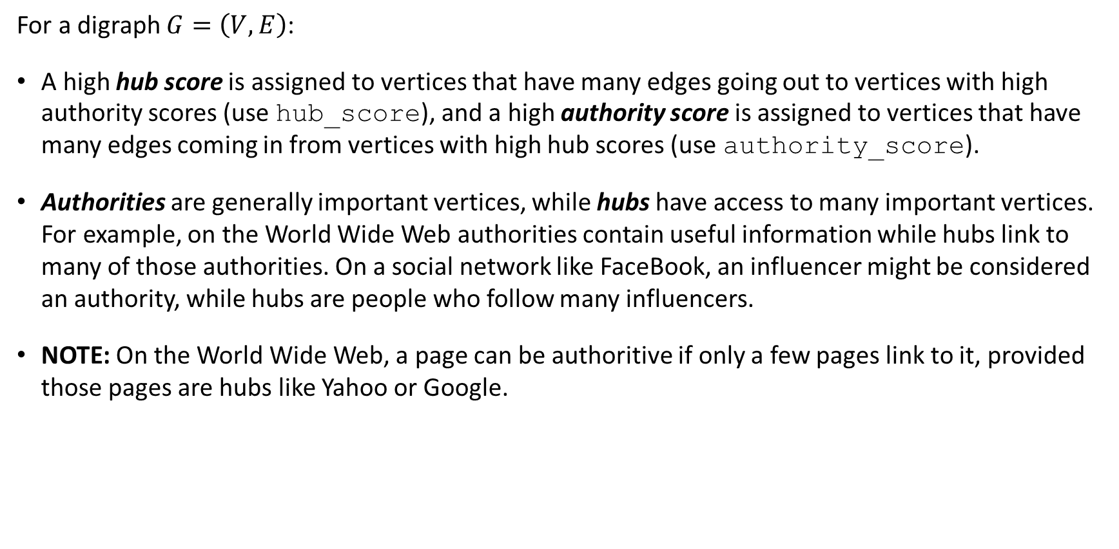
Hubs and Authorities
For a digraph $G=\left(V,E\right)$:
A high hub score is assigned to vertices that have many edges going out to vertices with high authority scores (use hub_score), and a high authority score is assigned to vertices that have many edges coming in from vertices with high hub scores (use authority_score).
Authorities are generally important vertices, while hubs have access to many important vertices. For example, on the World Wide Web authorities contain useful information while hubs link to many of those authorities. On a social network like FaceBook, an influencer might be considered an authority, while hubs are people who follow many influencers.
NOTE: On the World Wide Web, a page can be authoritive if only a few pages link to it, provided those pages are hubs like Yahoo or Google.

Slide 11
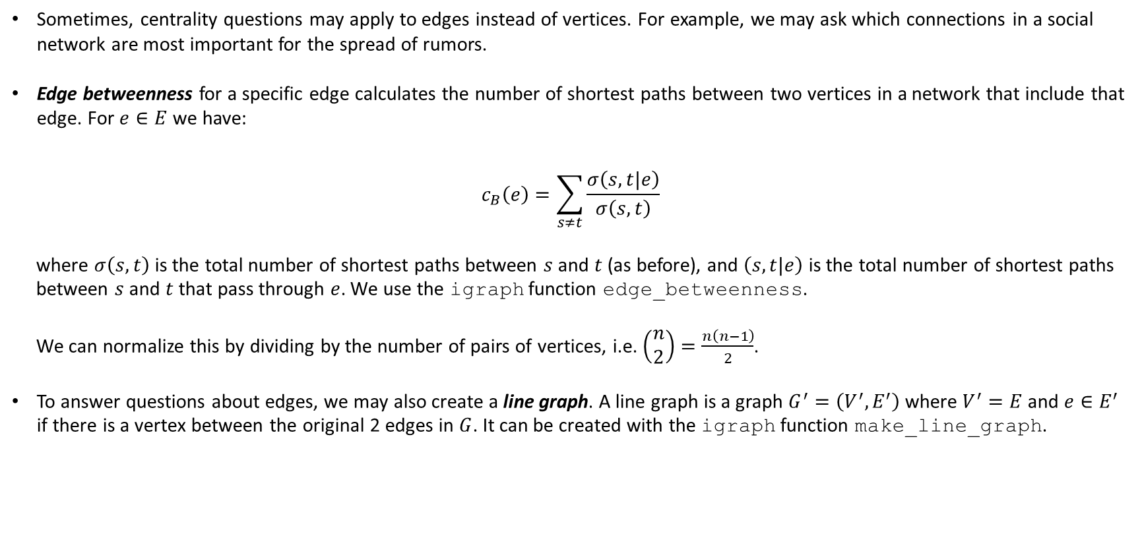
Edge Centrality
Sometimes, centrality questions may apply to edges instead of vertices. For example, we may ask which connections in a social network are most important for the spread of rumors.
Edge betweenness for a specific edge calculates the number of shortest paths between two vertices in a network that include that edge. For $e∈E$ we have:
$$c_{B}\left(e\right)=\sum_{s≠t}{\frac{σ\left(s,t|e\right)}{σ\left(s,t\right)}}$$
where $σ\left(s,t\right)$ is the total number of shortest paths between $s$ and $t$ (as before), and $\left(s,t|e\right)$ is the total number of shortest paths between $s$ and $t$ that pass through $e$. We use the igraph function edge_betweenness.
We can normalize this by dividing by the number of pairs of vertices, i.e. $\left(\begin{matrix}n \\ 2\end{matrix}\right)=\frac{n\left(n−1\right)}{2}$.
To answer questions about edges, we may also create a line graph. A line graph is a graph $G^{′}=\left(V^{′},E^{′}\right)$ where $V^{′}=E$ and $e∈E^{′}$ if there is a vertex between the original 2 edges in $G$. It can be created with the igraph function make_line_graph.

Slide 12
Network Cohesion
Network Cohesion is the extend to which subsets of vertices are cohesive with respect to the relationship that defines the edges of the network. For example, do friends of a person in a social network tend to be friends with each other as well? What collections of proteins in a cell appear to be working closely together?
Dyads are pairs of vertices, which in a digraph can take on three states: null (no directed edges), asymmetric (one directed edge) or mutual (two directed edges). Use dyad.census.
Triads are triples of vertices that can take on 16 states, from having no directed edges to having three mutually directed edges. Use triad_census.

Slide 13
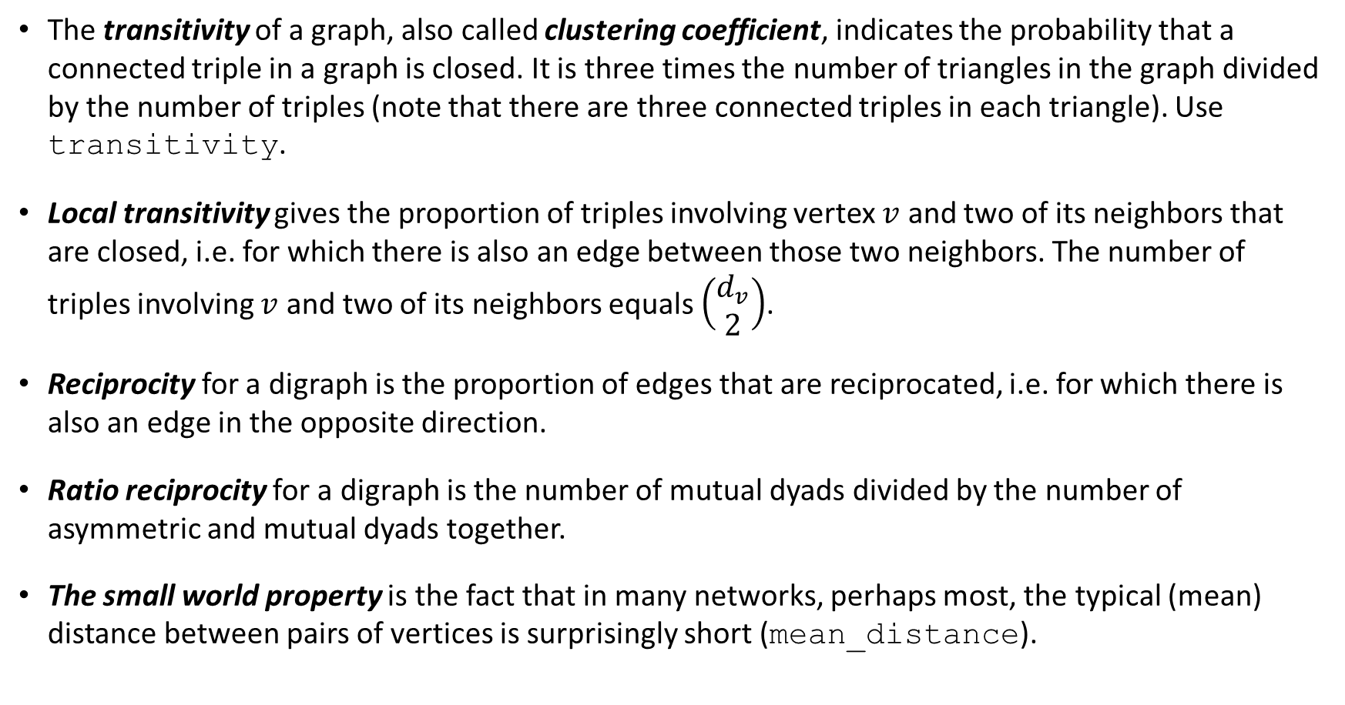
Network Cohesion - 2
The transitivity of a graph, also called clustering coefficient, indicates the probability that a connected triple in a graph is closed. It is three times the number of triangles in the graph divided by the number of triples (note that there are three connected triples in each triangle). Use transitivity.
Local transitivity gives the proportion of triples involving vertex $v$ and two of its neighbors that are closed, i.e. for which there is also an edge between those two neighbors. The number of triples involving $v$ and two of its neighbors equals $\left(\begin{matrix}d_{v} \\ 2\end{matrix}\right)$.
Reciprocity for a digraph is the proportion of edges that are reciprocated, i.e. for which there is also an edge in the opposite direction.
Ratio reciprocity for a digraph is the number of mutual dyads divided by the number of asymmetric and mutual dyads together.
The small world property is the fact that in many networks, perhaps most, the typical (mean) distance between pairs of vertices is surprisingly short (mean_distance).

Slide 14
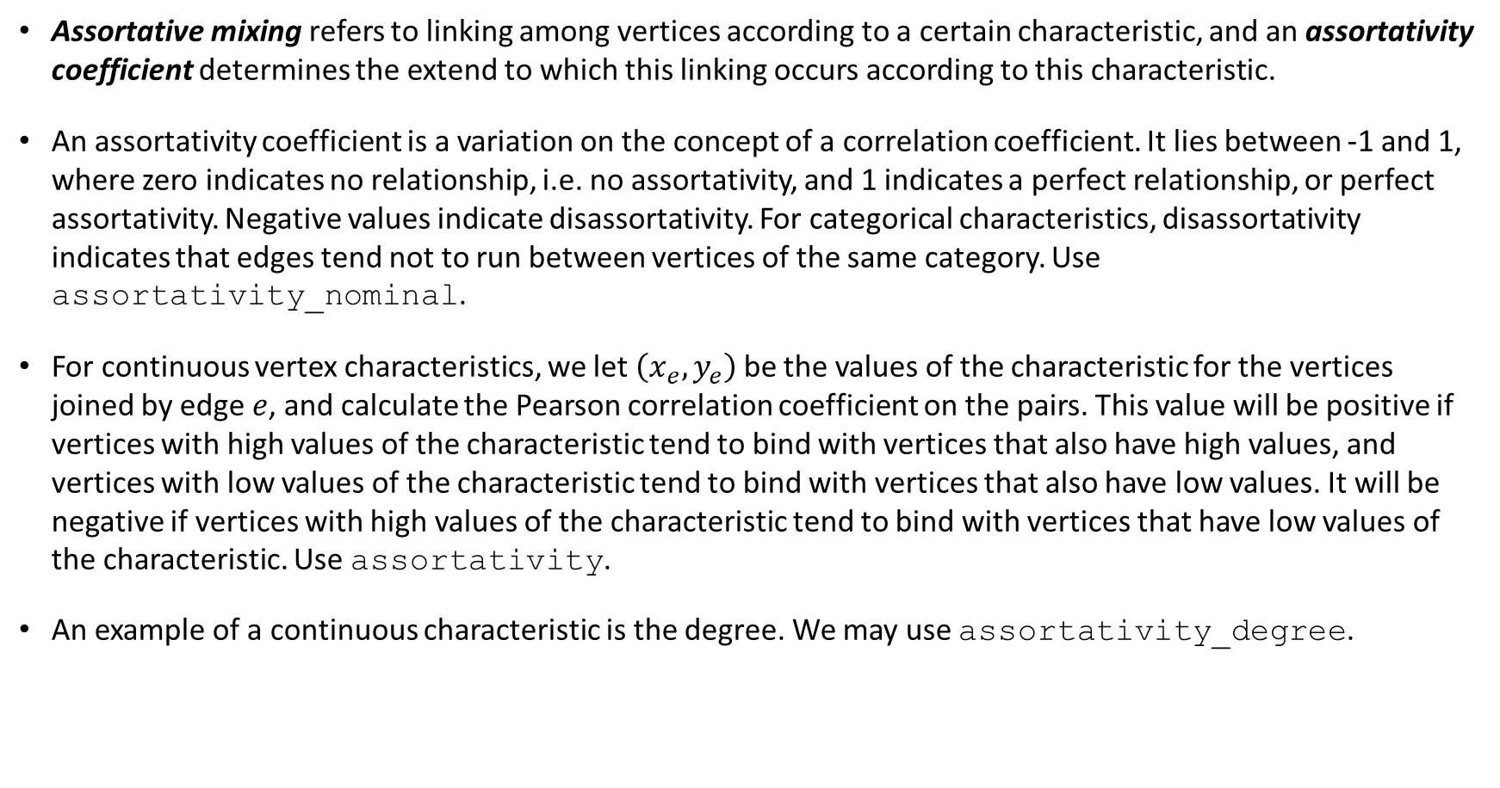
Assortative Mixing
Assortative mixing refers to linking among vertices according to a certain characteristic, and an assortativity coefficient determines the extend to which this linking occurs according to this characteristic.
An assortativity coefficient is a variation on the concept of a correlation coefficient. It lies between -1 and 1, where zero indicates no relationship, i.e. no assortativity, and 1 indicates a perfect relationship, or perfect assortativity. Negative values indicate disassortativity. For categorical characteristics, disassortativity indicates that edges tend not to run between vertices of the same category. Use assortativity_nominal.
For continuous vertex characteristics, we let $\left(x_{e},y_{e}\right)$ be the values of the characteristic for the vertices joined by edge $e$, and calculate the Pearson correlation coefficient on the pairs. This value will be positive if vertices with high values of the characteristic tend to bind with vertices that also have high values, and vertices with low values of the characteristic tend to bind with vertices that also have low values. It will be negative if vertices with high values of the characteristic tend to bind with vertices that have low values of the characteristic. Use assortativity.
An example of a continuous characteristic is the degree. We may use assortativity_degree.

Slide 15
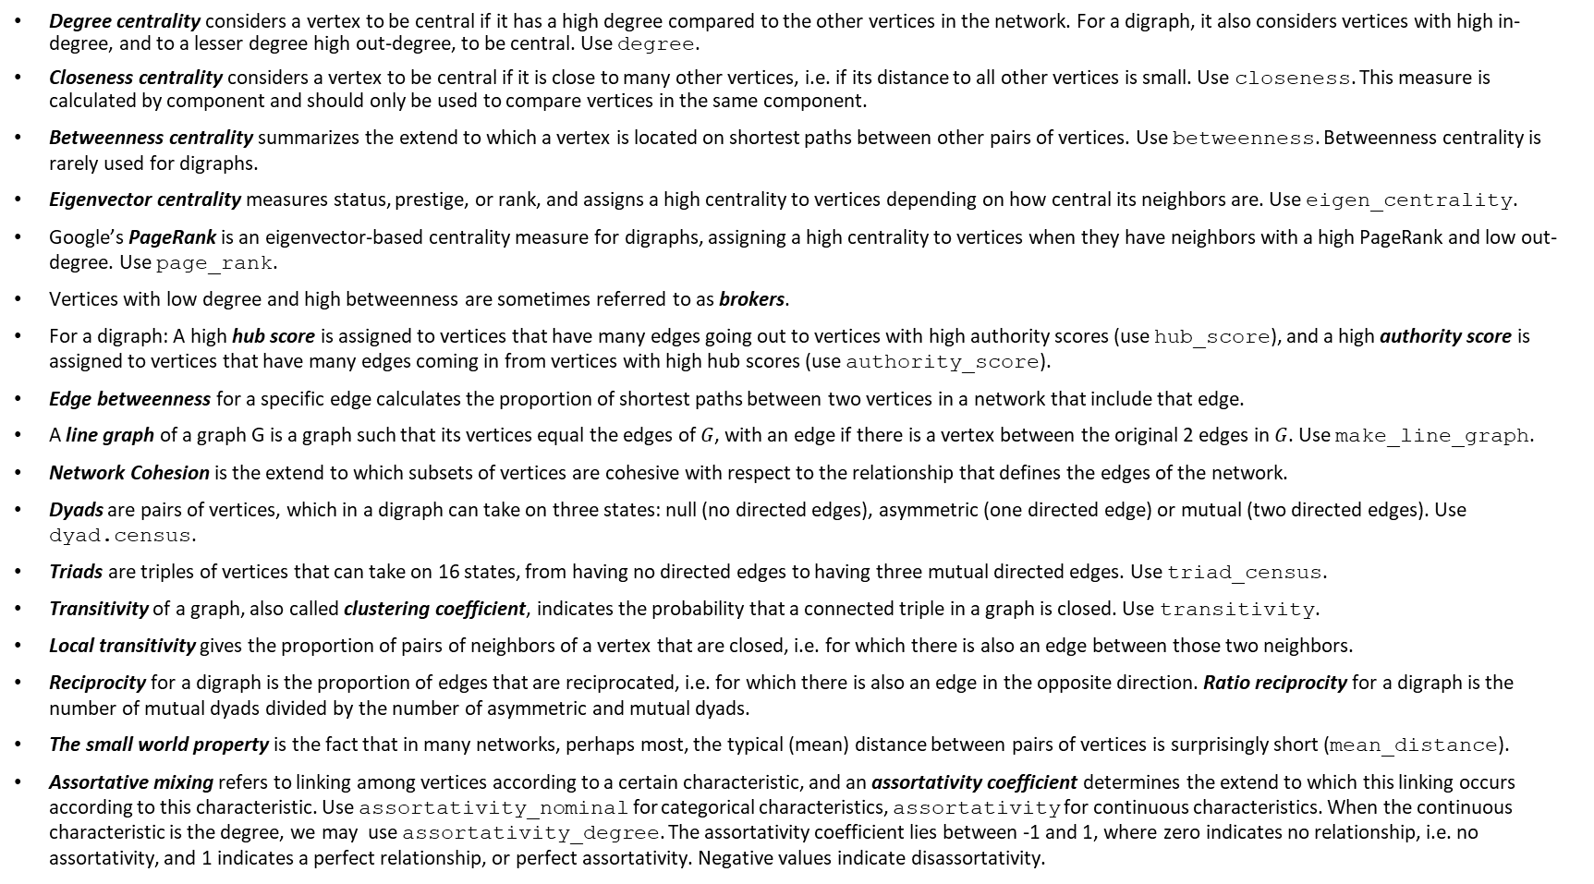
Today’s Summary
Degree centrality considers a vertex to be central if it has a high degree compared to the other vertices in the network. For a digraph, it also considers vertices with high in-degree, and to a lesser degree high out-degree, to be central. Use degree.
Closeness centrality considers a vertex to be central if it is close to many other vertices, i.e. if its distance to all other vertices is small. Use closeness. This measure is calculated by component and should only be used to compare vertices in the same component.
Betweenness centrality summarizes the extend to which a vertex is located on shortest paths between other pairs of vertices. Use betweenness. Betweenness centrality is rarely used for digraphs.
Eigenvector centrality measures status, prestige, or rank, and assigns a high centrality to vertices depending on how central its neighbors are. Use eigen_centrality.
Google’s PageRank is an eigenvector-based centrality measure for digraphs, assigning a high centrality to vertices when they have neighbors with a high PageRank and low out-degree. Use page_rank.
Vertices with low degree and high betweenness are sometimes referred to as brokers.
For a digraph: A high hub score is assigned to vertices that have many edges going out to vertices with high authority scores (use hub_score), and a high authority score is assigned to vertices that have many edges coming in from vertices with high hub scores (use authority_score).
Edge betweenness for a specific edge calculates the proportion of shortest paths between two vertices in a network that include that edge.
A line graph of a graph G is a graph such that its vertices equal the edges of $G$, with an edge if there is a vertex between the original 2 edges in $G$. Use make_line_graph.
Network Cohesion is the extend to which subsets of vertices are cohesive with respect to the relationship that defines the edges of the network.
Dyads are pairs of vertices, which in a digraph can take on three states: null (no directed edges), asymmetric (one directed edge) or mutual (two directed edges). Use dyad.census.
Triads are triples of vertices that can take on 16 states, from having no directed edges to having three mutual directed edges. Use triad_census.
Transitivity of a graph, also called clustering coefficient, indicates the probability that a connected triple in a graph is closed. Use transitivity.
Local transitivity gives the proportion of pairs of neighbors of a vertex that are closed, i.e. for which there is also an edge between those two neighbors.
Reciprocity for a digraph is the proportion of edges that are reciprocated, i.e. for which there is also an edge in the opposite direction. Ratio reciprocity for a digraph is the number of mutual dyads divided by the number of asymmetric and mutual dyads.
The small world property is the fact that in many networks, perhaps most, the typical (mean) distance between pairs of vertices is surprisingly short (mean_distance).
Assortative mixing refers to linking among vertices according to a certain characteristic, and an assortativity coefficient determines the extend to which this linking occurs according to this characteristic. Use assortativity_nominal for categorical characteristics, assortativity for continuous characteristics. When the continuous characteristic is the degree, we may use assortativity_degree. The assortativity coefficient lies between -1 and 1, where zero indicates no relationship, i.e. no assortativity, and 1 indicates a perfect relationship, or perfect assortativity. Negative values indicate disassortativity.

