Slide 1
STAT 504 – Network and Text Analytics Lecture 1: Introduction to Networks
By Dr. Ellie Small

Slide 2
Overview
Topics:
Getting Ready
What is a Network?
Network Basics
Types of Networks
Why are Networks Important?
Networks in R - Basics

Slide 3
Getting Ready
The instructions in the Startup Instructions document should be completed first.
You will now have a data504 folder on your host system, with a DATA504R folder within it.
Create the folder data in data504; this will contain all your data files. You may add other folders to data504.
The folder DATA504R will contain all your code (R-scripts). Make sure to save any new files containing R-code in this directory.
Keep your folders clean, everything in its place. This will avoid confusion and errors.

Slide 4
What is a Network?
A network is group or system of interconnected people or things.
Those people or things are called vertices or nodes, and the connections between them are called edges or links.
Networks are visualized using graphs.
A graph representing a network is a collection of points (the vertices) joined by lines or arrows (the edges).
NOTE: the book definition of a network is really the definition of a graph representing a network.

Slide 5
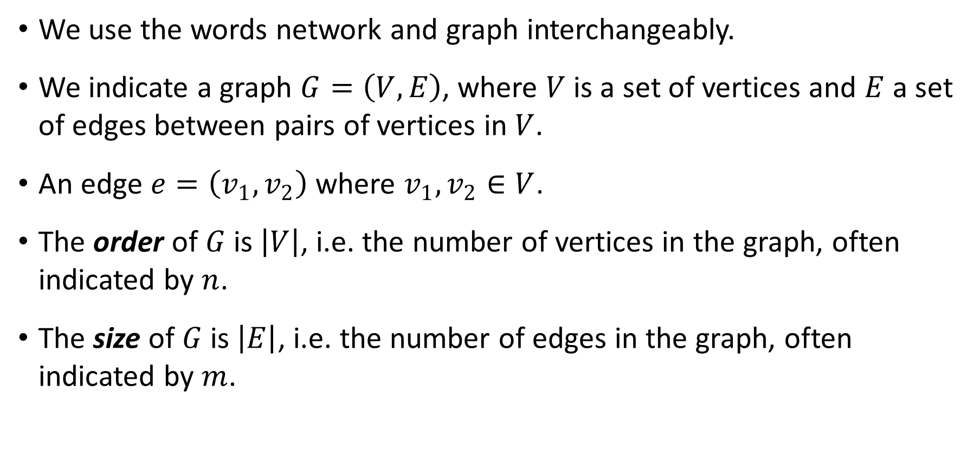
Network Basics
We use the words network and graph interchangeably.
We indicate a graph $G=\left(V,E\right)$, where $V$ is a set of vertices and $E$ a set of edges between pairs of vertices in $V$.
An edge $e=\left(v_{1},v_{2}\right)$ where $v_{1},v_{2}∈V$.
The order of $G$ is $\left|V\right|$, i.e. the number of vertices in the graph, often indicated by $n$.
The size of $G$ is $\left|E\right|$, i.e. the number of edges in the graph, often indicated by $m$.

Slide 6
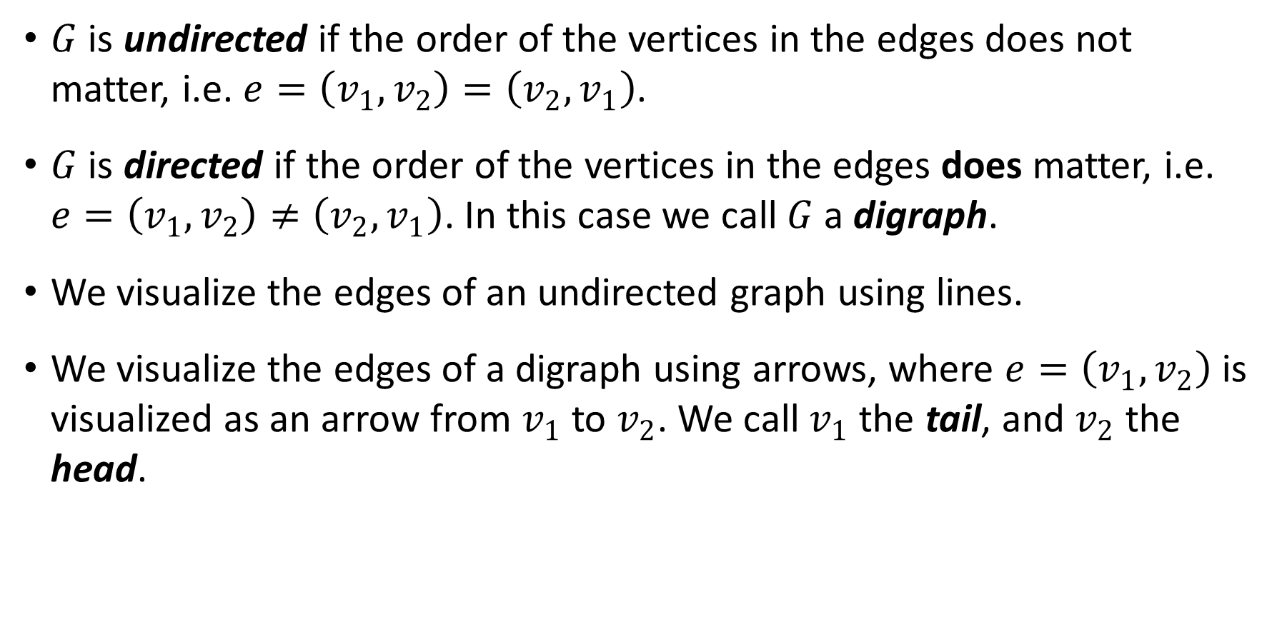
Network Basics - 2
$G$ is undirected if the order of the vertices in the edges does not matter, i.e. $e=\left(v_{1},v_{2}\right)=\left(v_{2},v_{1}\right)$.
$G$ is directed if the order of the vertices in the edges does matter, i.e. $e=\left(v_{1},v_{2}\right)≠\left(v_{2},v_{1}\right)$. In this case we call $G$ a digraph.
We visualize the edges of an undirected graph using lines.
We visualize the edges of a digraph using arrows, where $e=\left(v_{1},v_{2}\right)$ is visualized as an arrow from $v_{1}$ to $v_{2}$. We call $v_{1}$ the tail, and $v_{2}$ the head.

Slide 7
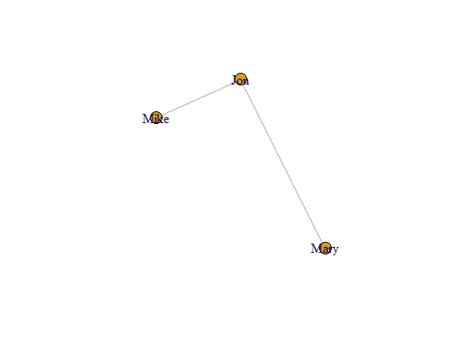
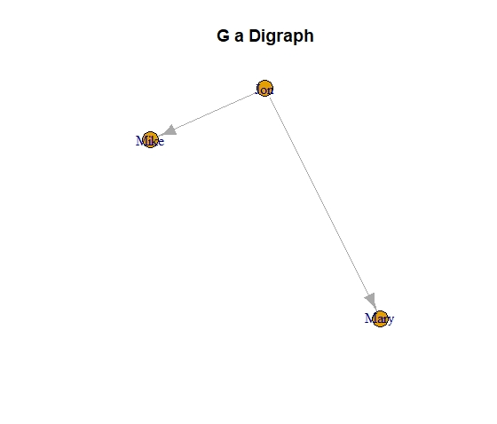
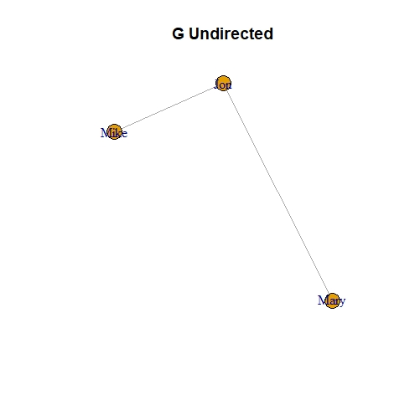
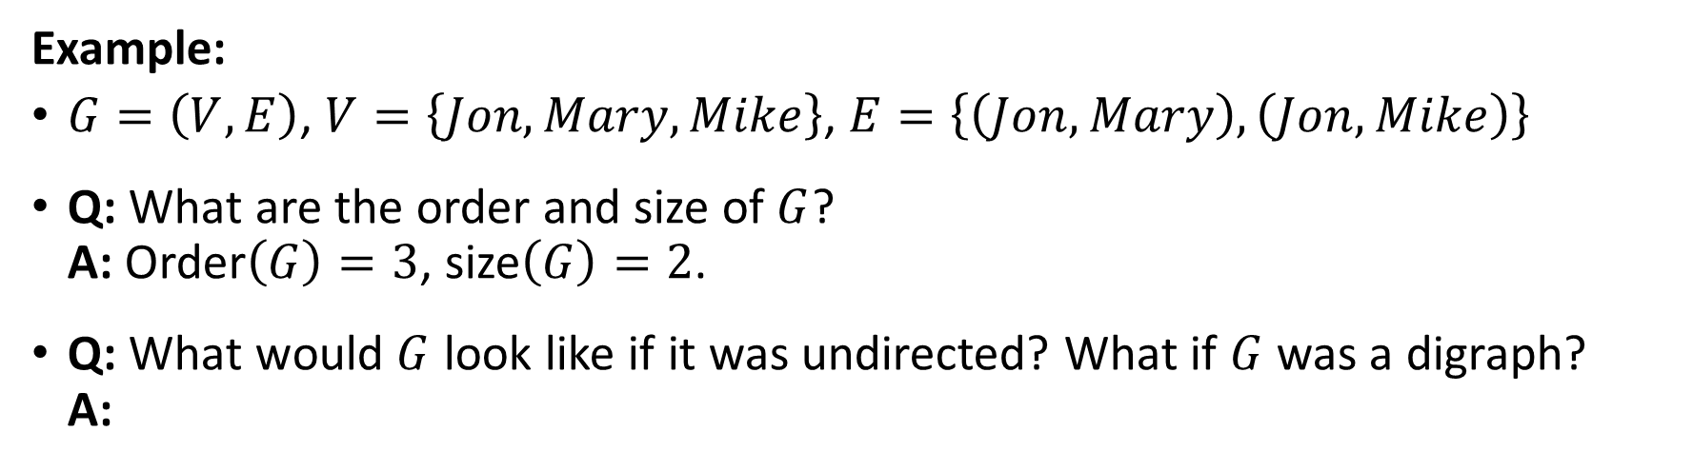
Network Basics - 3
Example:
$G=\left(V,E\right)$, $V=\left\{Jon, Mary, Mike\right\}$, $E=\left\{\left(Jon,Mary\right), \left(Jon, Mike\right)\right\}$
Q: What are the order and size of $G$?
A: Order$\left(G\right)=3$, size$\left(G\right)=2$.
Q: What would $G$ look like if it was undirected? What if $G$ was a digraph?
A:

Slide 8

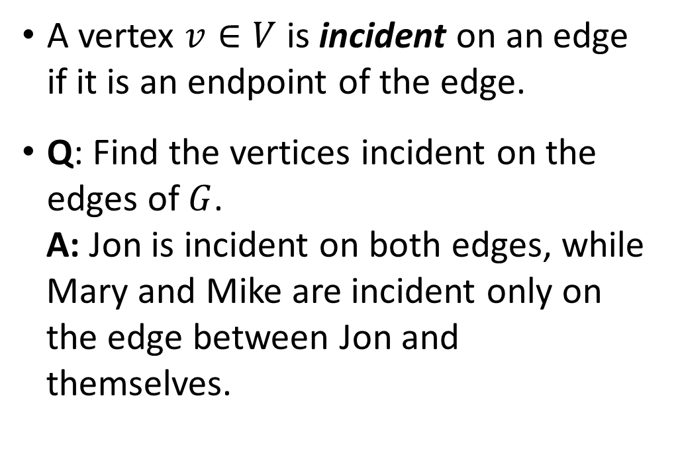
Network Basics - 4
A vertex $v∈V$ is incident on an edge if it is an endpoint of the edge.
Q: Find the vertices incident on the edges of $G$.
A: Jon is incident on both edges, while Mary and Mike are incident only on the edge between Jon and themselves.

Slide 9
Network Basics - 5
Vertices can be connected to themselves; we call those kind of edges self-edges or self-loops or loops.
A graph can have multiple edges between the same pair of vertices; we call the collective set of multiple edges between the same vertices a multi-edge.
A network with loops and/or multi-edges is called a multi-graph.
A network that is not a multi-graph is a simple network or simple graph, and its edges are proper edges.
A weighted network has weights associated with its edges. The weights represent strengths, weights, or some other kind of value associated with the connection between the vertices.
Weights can be real numbers and may be positive or negative.
A graph with multi-edges and no loops can be transformed to a simple weighted graph where the weights represent the number of edges between a pair of vertices.

Slide 10
Types of Networks
Technological networks, e.g. internet (computers with cables or radio links), telephone network, roads, electricity grids, sewerage pipes, etc.
Information networks, e.g. World Wide Web (webpages with hyperlinks between them; note that this is a directed network), citation networks, etc.
Social networks, generally people (or groups) with social connections, e.g. clubs, organizations, friendships, schools, FaceBook, Twitter, etc.
Biological networks, e.g. brain (neural networks), food web (predator-prey; directed), biochemical (protein-protein, metabolic networks-metabolites and reactions)
NOTE: Many of these networks can be weighted. For example, weights can represent amount of data flowing between computers on the internet, total energy flow between predator and prey, frequency of contact between actors in a social network, number of miles between crossings on a road, etc.

Slide 11
Why are Networks Important?
The pattern of interactions in a system can have a big effect on the behavior of the system.
Examples:
Transport systems: routes between destinations determine efficiency and speed of delivery/cost.
Friendship networks indicate how people learn, form opinions, and gather news. They influence radicalization, spread of disease, political inclination.
The connections between computers on the internet affects the efficiency with which the network transports data.

Slide 12
Why are Networks Important? - 2
Visualization of a network can answer many questions.
In addition, there are measures and metrics that can answer different questions.
Examples:
Centrality
Hubs and authorities
The small-world effect
Clusters
We will get back to these later on in the course.
NOTE: We model a system consisting of interconnected “things” using a network. Like with all models, this means not all information is kept, some of it is lost.

Slide 13
Networks in R - Basics
We will use the igraph package. If needed, install the package, then attach it using library(igraph). Check it out using ?igraph and help(package="igraph").
R can handle many different colors:
colors()
R also keeps a palette with colors for which the indices can be used in plots, rather than the whole name:
palette()
Running this command with a vector of colors changes the current palette. You may return the palette to its default with palette(“default”).
[1] "black" "red" "green3" "blue" "cyan" "magenta" "yellow" "gray"

Slide 14
Networks in R – Basics - 2
To create the graph we looked at earlier:
g <- graph_from_literal(Jon-Mary, Jon-Mike)
Type g to see how the graph is printed in R.
To create the plot:
set.seed(23);plot(g,main="G Undirected")
The digraph:
dg <- graph_from_literal(Jon-+Mary, Jon-+Mike)
dg
set.seed(23);plot(g,main="G a Digraph")
Vertices can be shown with V(g); edges with E(g). Summary information using summary(g).
To get the order of a graph: gorder(g). To get the size: gsize(g).
The incident function, incident(g,v), gives the edges that are incident on the vertices in v. Try incident(g,”Jon”).
IGRAPH 8465d12 UN-- 3 2 –
+ attr: name (v/c)
+ edges from 8465d12 (vertex names): [1] Jon--Mary Jon--Mike
IGRAPH c9c361f DN-- 3 2 –
+ attr: name (v/c)
+ edges from c9c361f (vertex names): [1] Jon->Mary Jon->Mike
+ 2/2 edges from 8465d12 (vertex names): [1] Jon--Mary Jon--Mike

Slide 15
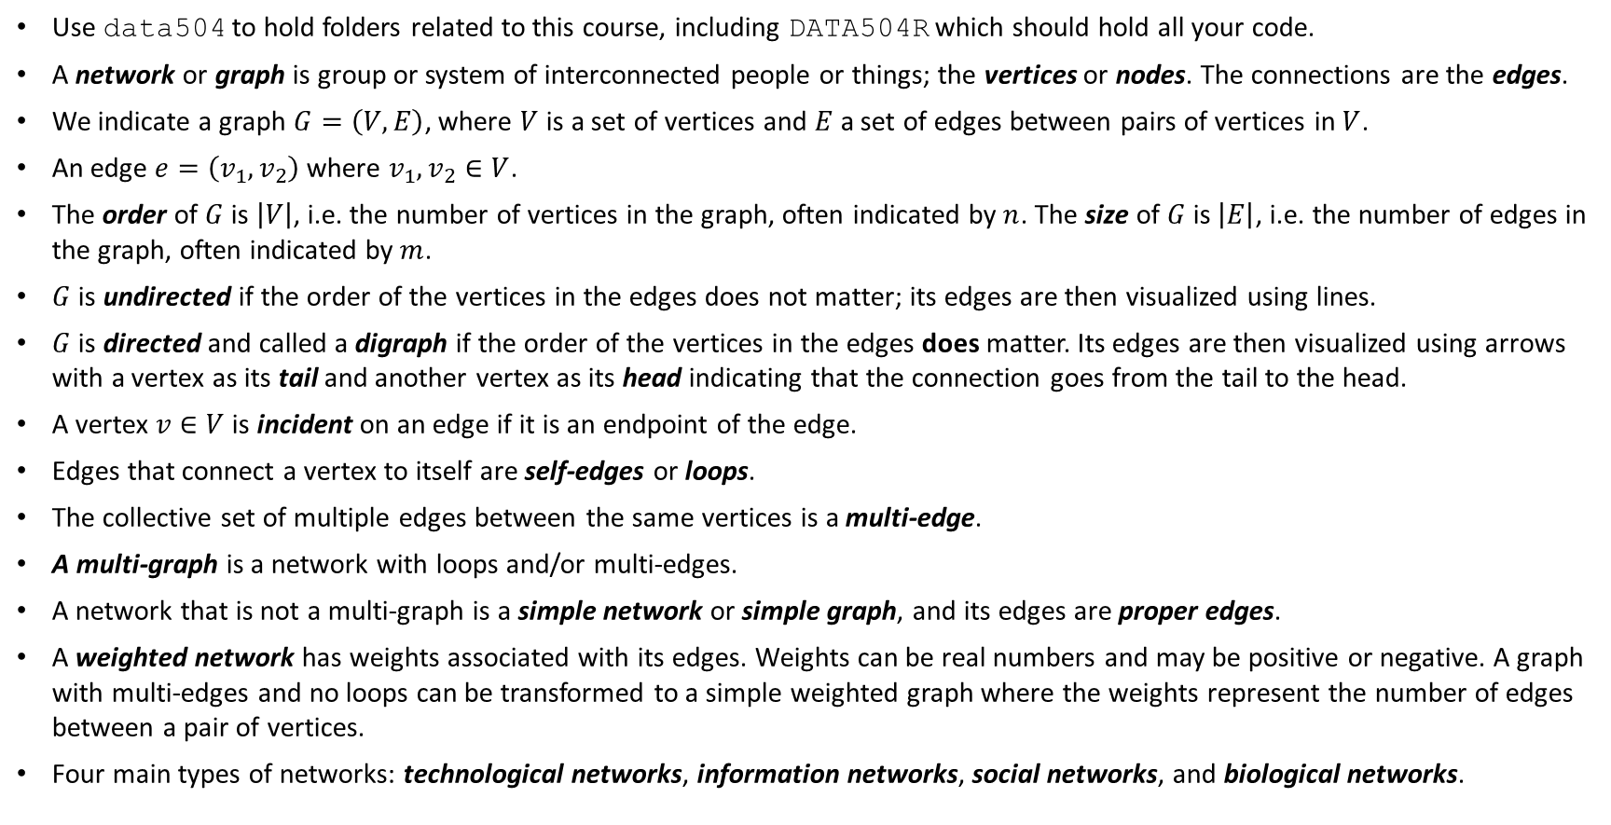
Today’s Summary
Use data504 to hold folders related to this course, including DATA504R which should hold all your code.
A network or graph is group or system of interconnected people or things; the vertices or nodes. The connections are the edges.
We indicate a graph $G=\left(V,E\right)$, where $V$ is a set of vertices and $E$ a set of edges between pairs of vertices in $V$.
An edge $e=\left(v_{1},v_{2}\right)$ where $v_{1},v_{2}∈V$.
The order of $G$ is $\left|V\right|$, i.e. the number of vertices in the graph, often indicated by $n$. The size of $G$ is $\left|E\right|$, i.e. the number of edges in the graph, often indicated by $m$.
$G$ is undirected if the order of the vertices in the edges does not matter; its edges are then visualized using lines.
$G$ is directed and called a digraph if the order of the vertices in the edges does matter. Its edges are then visualized using arrows with a vertex as its tail and another vertex as its head indicating that the connection goes from the tail to the head.
A vertex $v∈V$ is incident on an edge if it is an endpoint of the edge.
Edges that connect a vertex to itself are self-edges or loops.
The collective set of multiple edges between the same vertices is a multi-edge.
A multi-graph is a network with loops and/or multi-edges.
A network that is not a multi-graph is a simple network or simple graph, and its edges are proper edges.
A weighted network has weights associated with its edges. Weights can be real numbers and may be positive or negative. A graph with multi-edges and no loops can be transformed to a simple weighted graph where the weights represent the number of edges between a pair of vertices.
Four main types of networks: technological networks, information networks, social networks, and biological networks.

