Slide 1
STAT 504 – Network and Text Analytics Lecture 4: Trees and Degree Distributions
By Dr. Ellie Small

Slide 2
Overview
Topics:
Review
Trees
Degree
Data Sets
Problems

Slide 3
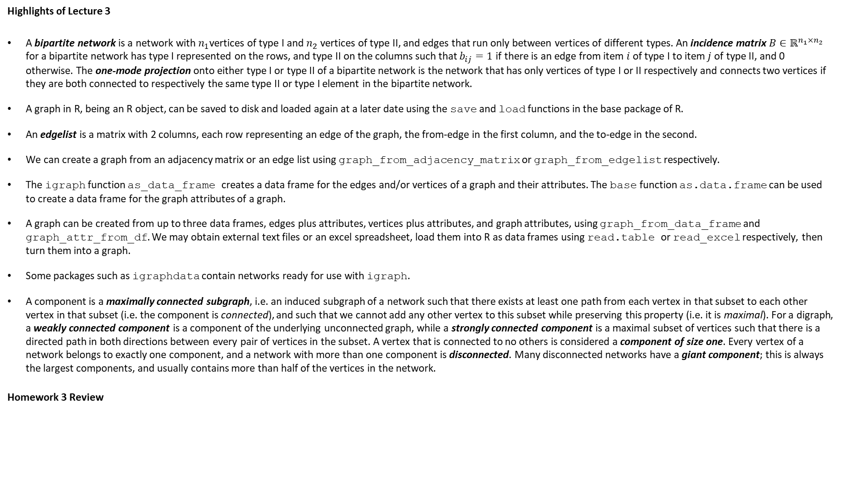
Review
Highlights of Lecture 3
A bipartite network is a network with $n_{1}$vertices of type I and $n_{2}$ vertices of type II, and edges that run only between vertices of different types. An incidence matrix $B∈ℝ^{n_{1}×n_{2}}$ for a bipartite network has type I represented on the rows, and type II on the columns such that $b_{ij}=1$ if there is an edge from item $i$ of type I to item $j$ of type II, and 0 otherwise. The one-mode projection onto either type I or type II of a bipartite network is the network that has only vertices of type I or II respectively and connects two vertices if they are both connected to respectively the same type II or type I element in the bipartite network.
A graph in R, being an R object, can be saved to disk and loaded again at a later date using the save and load functions in the base package of R.
An edgelist is a matrix with 2 columns, each row representing an edge of the graph, the from-edge in the first column, and the to-edge in the second.
We can create a graph from an adjacency matrix or an edge list using graph_from_adjacency_matrix or graph_from_edgelist respectively.
The igraph function as_data_frame creates a data frame for the edges and/or vertices of a graph and their attributes. The base function as.data.frame can be used to create a data frame for the graph attributes of a graph.
A graph can be created from up to three data frames, edges plus attributes, vertices plus attributes, and graph attributes, using graph_from_data_frame and graph_attr_from_df. We may obtain external text files or an excel spreadsheet, load them into R as data frames using read.table or read_excel respectively, then turn them into a graph.
Some packages such as igraphdata contain networks ready for use with igraph.
A component is a maximally connected subgraph, i.e. an induced subgraph of a network such that there exists at least one path from each vertex in that subset to each other vertex in that subset (i.e. the component is connected), and such that we cannot add any other vertex to this subset while preserving this property (i.e. it is maximal). For a digraph, a weakly connected component is a component of the underlying unconnected graph, while a strongly connected component is a maximal subset of vertices such that there is a directed path in both directions between every pair of vertices in the subset. A vertex that is connected to no others is considered a component of size one. Every vertex of a network belongs to exactly one component, and a network with more than one component is disconnected. Many disconnected networks have a giant component; this is always the largest components, and usually contains more than half of the vertices in the network.
Homework 3 Review

Slide 4
Trees
Recall: A tree is a connected, undirected network with no cycles.
A forest is a disconnected union of trees.
Recall: A directed acyclic network, or DAG, is a digraph without directed cycles.
A directed tree is a DAG whose underlying undirected graph is a tree.
A root is the only vertex in a directed tree from which there is a directed path to every other vertex in the graph.
A rooted tree is a directed tree with a root.
An ancestor is a vertex preceding another vertex on a path from the root of a rooted tree.
A descendant is a vertex that follows another vertex on a path from the root of a rooted tree.
Parents are immediate ancestors.
Children are immediate descendants.
A leaf is a vertex without children.
The depth of a rooted tree is the distance from the root to the farthest leaf.
NOTE: Rooted trees are not always shown with arrows since they are not needed.

Slide 5
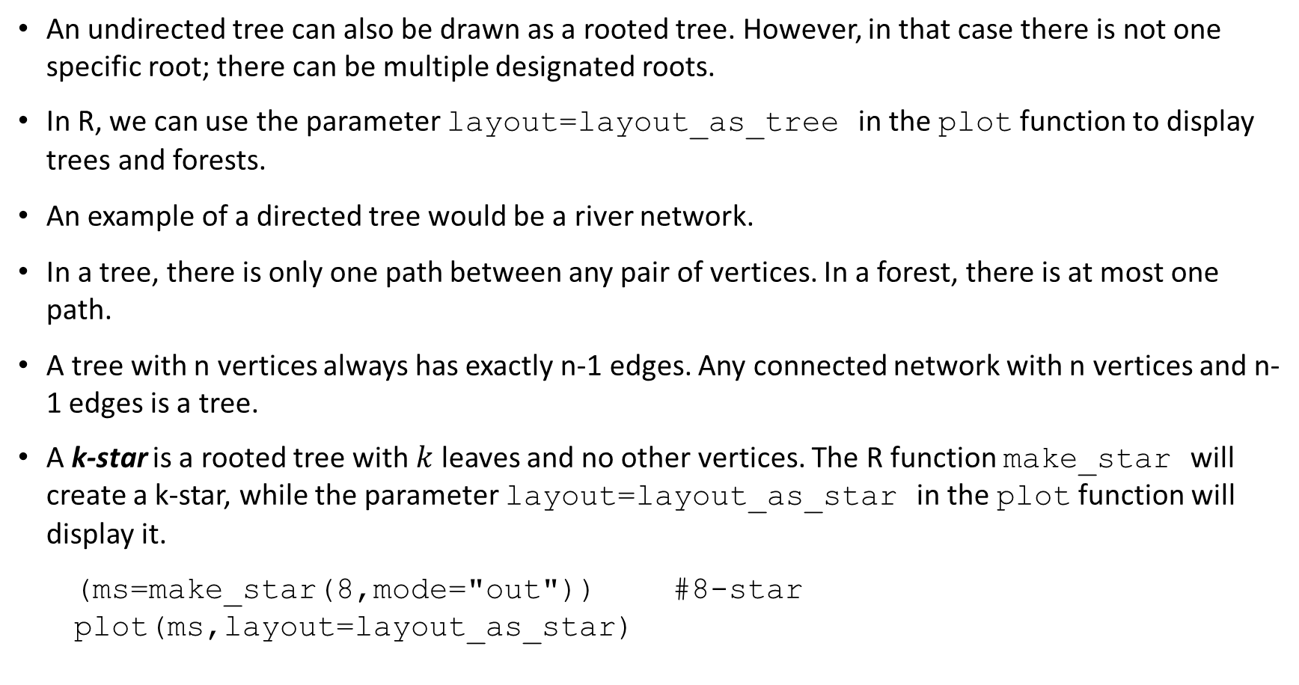
Trees - 2
An undirected tree can also be drawn as a rooted tree. However, in that case there is not one specific root; there can be multiple designated roots.
In R, we can use the parameter layout=layout_as_tree in the plot function to display trees and forests.
An example of a directed tree would be a river network.
In a tree, there is only one path between any pair of vertices. In a forest, there is at most one path.
A tree with n vertices always has exactly n-1 edges. Any connected network with n vertices and n-1 edges is a tree.
A k-star is a rooted tree with $k$ leaves and no other vertices. The R function make_star will create a k-star, while the parameter layout=layout_as_star in the plot function will display it.
(ms=make_star(8,mode="out")) #8-star
plot(ms,layout=layout_as_star)

Slide 6

Degree
Recall that the degree $d_{i}$ of a vertex $i$ in an undirected network is the number of edges incident on it.
Note that we are counting the number of edges, not the number of neighboring vertices. The difference is observable for multigraphs.
Since every edge is incident on two vertices and we have $m$ edges, we have $2m$ ends of edges. This equals the sum of the degrees over all vertices in the network.
The mean degree $c$ of an undirected network equals the sum of the degrees over all vertices in the network divided by the number of vertices in the network, i.e.
$$c=\frac{2m}{n}$$
The sum of the in-degrees over all vertices of a digraph equals the number of edges, and also equals the sum of the out-degrees over all vertices in a digraph.
The mean in-degree $c_{in}$ of a vertex in a digraph equals the sum of the in-degrees over all vertices in the network divided by the number of vertices in the network, which is also equal to the mean out-degree of a vertex in a digraph. So:
$$c_{in}=c_{out}=\frac{m}{n}$$

Slide 7
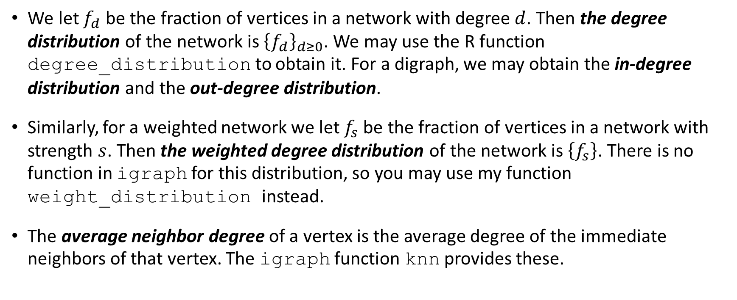
Degree - 2
We let $f_{d}$ be the fraction of vertices in a network with degree $d$. Then the degree distribution of the network is ${\left\{f_{d}\right\}}_{d≥0}$. We may use the R function degree_distribution to obtain it. For a digraph, we may obtain the in-degree distribution and the out-degree distribution.
Similarly, for a weighted network we let $f_{s}$ be the fraction of vertices in a network with strength $s$. Then the weighted degree distribution of the network is $\left\{f_{s}\right\}$. There is no function in igraph for this distribution, so you may use my function weight_distribution instead.
The average neighbor degree of a vertex is the average degree of the immediate neighbors of that vertex. The igraph function knn provides these.

Slide 8
Data Sets
One of the (decorated) undirected networks in the package igraphdata is Wayne Zachary’s karate club. This club is mentioned in our book on page 5; it represents the pattern of friendships among the members of a karate club at a North American university, reconstructed from observations of social interactions between them. We can access it using data(karate); however, we will use a slightly different version that we load instead from our data directory using load("../data/karate.RData"). You may obtain additional information about the data set using ?karate.
The aidsblog graph is a snapshot of the pattern of citation among 146 unique blogs related to AIDS, patients, and their support networks, collected by Suchi Gopal (see reference below) over a randomly selected three-day period in August 2005. A directed edge from one blog to another indicates that the former has a link to the latter in their web page (more specifically, the former refers to the latter in their so-called ‘blogroll’). We will load this digraph from our data directory using load("../data/aidsblog.RData").
Reference: S. Gopal, The evolving social geography of blogs. In Societies and Cities in the Age of Instant Access, ed. by H. Miller (Springer, Berlin, 2007), 139 pp. 275-294.

Slide 9
Problems
Find the in-degree distribution of the aidsblog digraph. Then plot both the in-degree distribution and the out-degree distribution side-by-side. What do these distributions tell us?
Load and plot the g graph again, find its strength distribution and plot that, too. Then find its average neighbor degrees and plot those versus the regular degrees. Put the regular degrees on the x-axis. Do you see a trend?

Slide 10
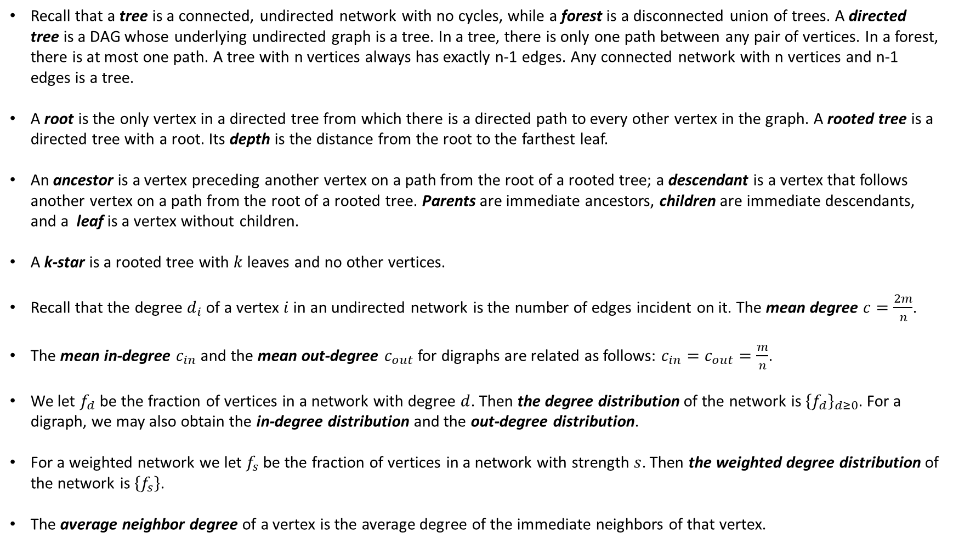
Today’s Summary
Recall that a tree is a connected, undirected network with no cycles, while a forest is a disconnected union of trees. A directed tree is a DAG whose underlying undirected graph is a tree. In a tree, there is only one path between any pair of vertices. In a forest, there is at most one path. A tree with n vertices always has exactly n-1 edges. Any connected network with n vertices and n-1 edges is a tree.
A root is the only vertex in a directed tree from which there is a directed path to every other vertex in the graph. A rooted tree is a directed tree with a root. Its depth is the distance from the root to the farthest leaf.
An ancestor is a vertex preceding another vertex on a path from the root of a rooted tree; a descendant is a vertex that follows another vertex on a path from the root of a rooted tree. Parents are immediate ancestors, children are immediate descendants, and a leaf is a vertex without children.
A k-star is a rooted tree with $k$ leaves and no other vertices.
Recall that the degree $d_{i}$ of a vertex $i$ in an undirected network is the number of edges incident on it. The mean degree $c=\frac{2m}{n}$.
The mean in-degree $c_{in}$ and the mean out-degree $c_{out}$for digraphs are related as follows: $c_{in}=c_{out}=\frac{m}{n}$.
We let $f_{d}$ be the fraction of vertices in a network with degree $d$. Then the degree distribution of the network is ${\left\{f_{d}\right\}}_{d≥0}$. For a digraph, we may also obtain the in-degree distribution and the out-degree distribution.
For a weighted network we let $f_{s}$ be the fraction of vertices in a network with strength $s$. Then the weighted degree distribution of the network is $\left\{f_{s}\right\}$.
The average neighbor degree of a vertex is the average degree of the immediate neighbors of that vertex.

