Slide 1
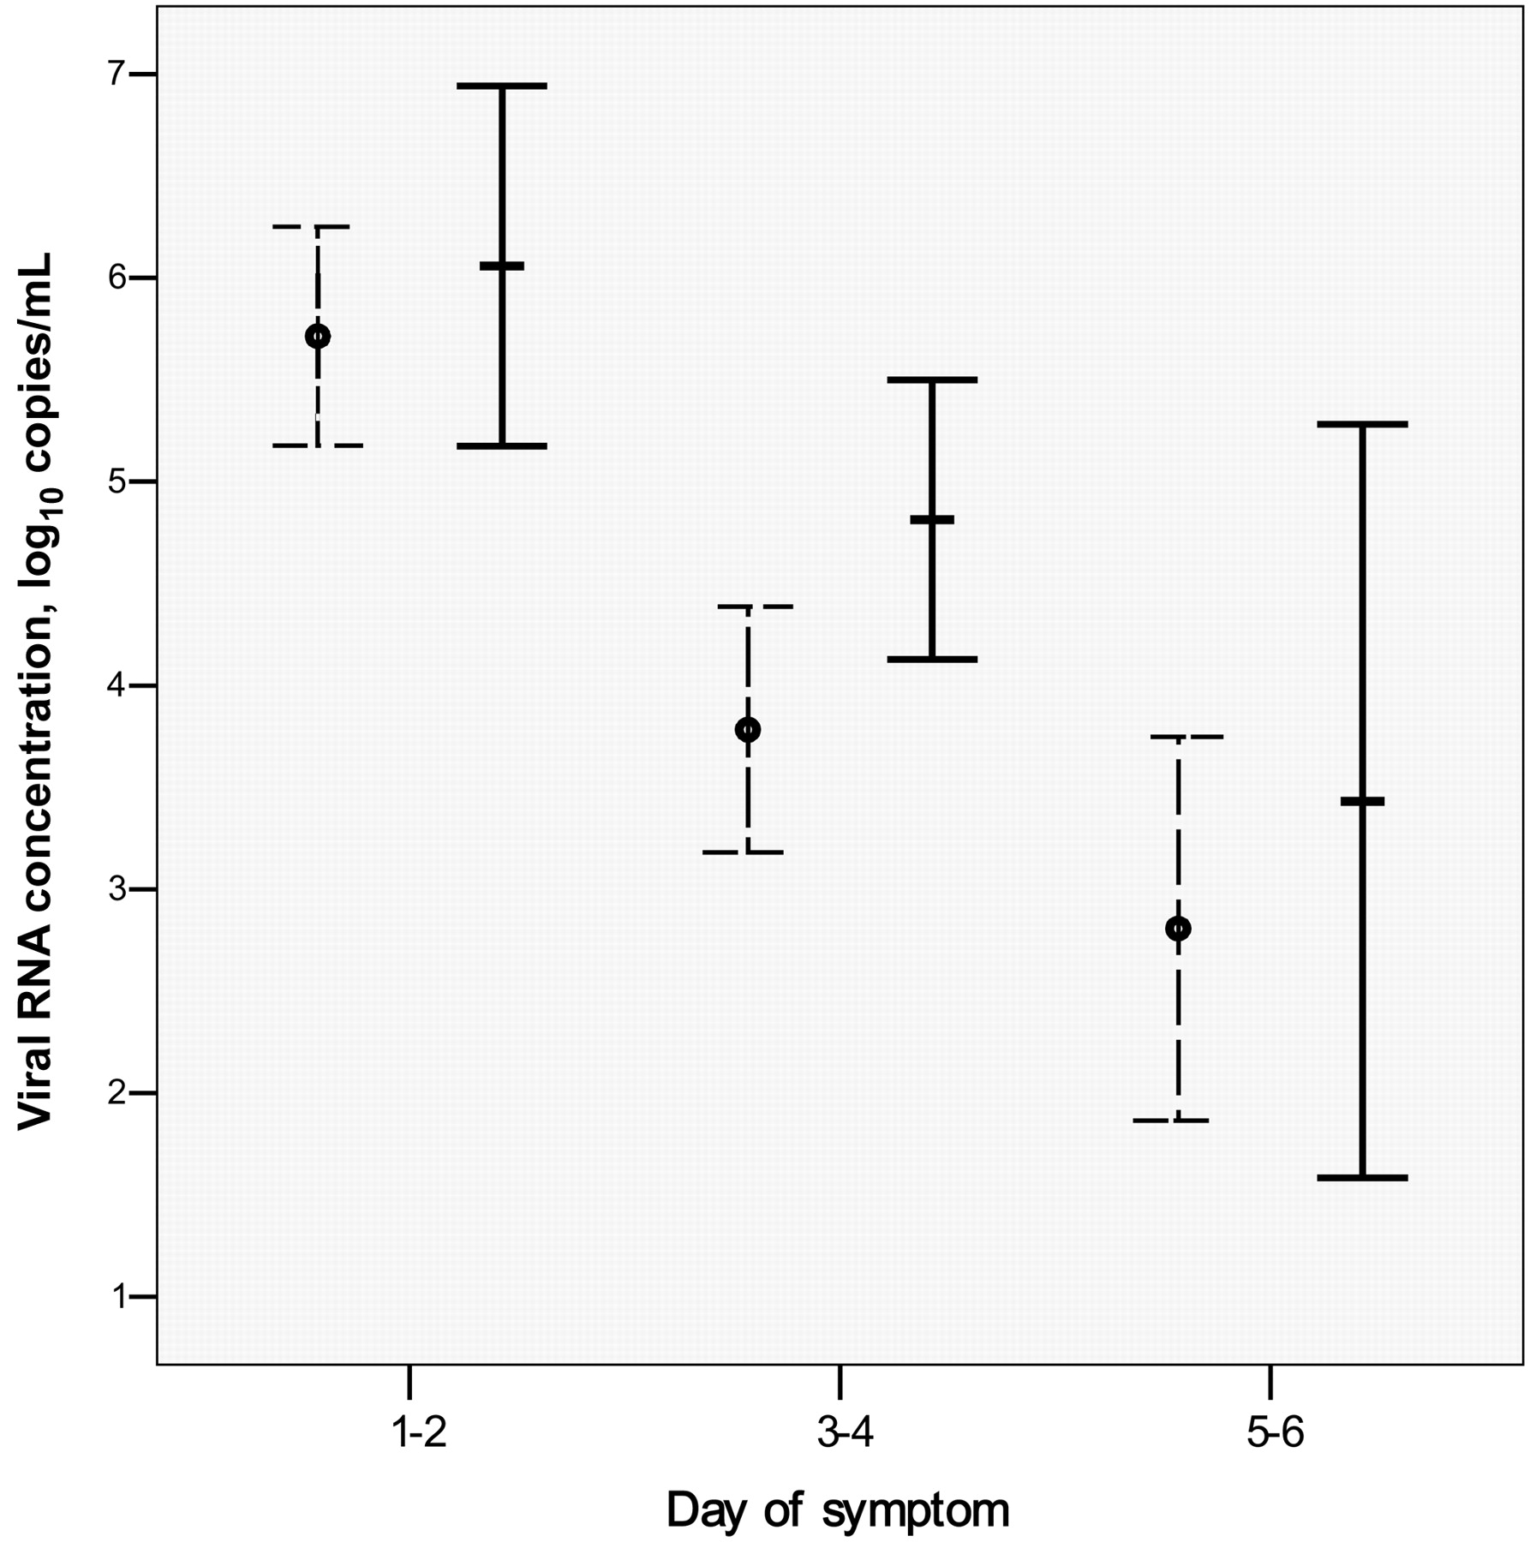

Figure 1 Influenza A viral RNA concentration at time of presentation shown according to day of symptom in patients ...
Notes:
Figure 1 Influenza A viral RNA concentration at time of presentation shown according to day of symptom in patients with (solid lines) or without (hatched lines) major comorbidities. Error bars represent the standard error of the mean. Major comorbidity refers to chronic systemic medical illnesses, including congestive heart failure; cerebrovascular, neoplastic, chronic liver and renal diseases; and use of immunosuppressants (table 1)
Unless provided in the caption above, the following copyright applies to the content of this slide: © 2009 by the Infectious Diseases Society of America

