Slide 1
Acoustic Analysis Dashboard
Full‑stack application for Genesys Cloud contact center acoustic metrics
Tech Stack: React · Node.js · MySQL · Genesys Cloud · Docker (optional)

Slide 2
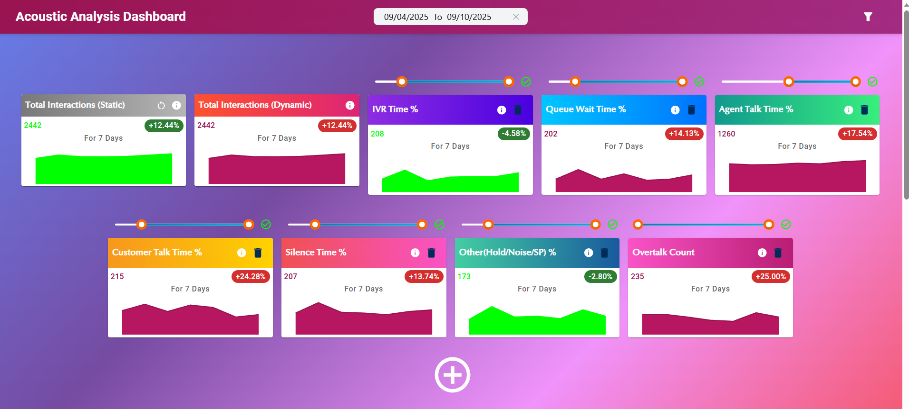
Statistical Cards — Overview
Real-time high-level metrics for acoustic KPIs (Call Duration, IVR Time %, Queue Wait %, Agent Talk %, Customer Talk %, Silence %, Overtalk Count, Other%).
Each card shows: total count for selected interval, % change vs previous equivalent interval, and daily counts (small sparkline).
Designed for quick trend-spotting and to identify outliers at glance.
Visuals: compact cards with sparkline and delta badges — ideal for executive dashboards.

Slide 3
Statistical Cards — Technical Details
8 independent acoustic data cards; thresholds are card‑specific and do not affect other cards by default.
Calculations: % trend = (current_total / previous_total) - 1; daily totals aggregate to card total.
Handles nulls: 'Total interactions' card includes nulls; ADC cards exclude nulls for threshold counts.
Reset behavior: reset clears card thresholds but respects global filters.
Designed for accuracy and verifiability — values cross-checked against downloads (Summary tab).

Slide 4
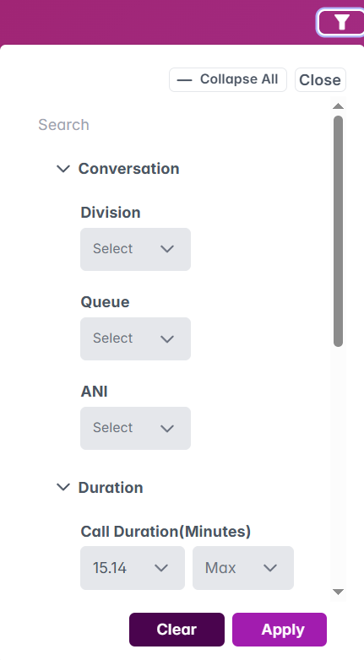
Global Pre‑Filters — Unified Control
Apply filters once (LOB, Division, Queue, Agent, Work Teams, Date range, Call Duration bounds, etc.) to affect all dashboard components.
Top-down behavior: filter chips appear at top; closing a parent chip clears dependent selections.
Options sorted alphabetically; NULL values explicitly represented.
Global filters enable consistent cross-component analysis and faster root-cause exploration.

Slide 5
Grouped Bar Chart — Overview
Compare groups (Agent Name, Division, Queue, Client ID, Work Teams) based on a selected acoustic KPI.
Supports sorting by selected KPI and switching tabs to analyze different acoustic metrics.
Ideal for identifying top/bottom performers and grouping patterns.
Interactive grouping + sorting enables targeted investigations.

Slide 6
Grouped Bar Chart — Technical & Enhancements
Groups show aggregate counts for the active acoustic tab; users can drill via filters to verify totals.
Planned: Download preview per group (show conversations for each group sorted by active KPI) and export group data as Excel.
Planned: Relative scoring mode to normalize for volume bias (score = selected_threshold_count / total_interactions).
These enhancements improve fairness and make comparisons volume‑agnostic.

Slide 7
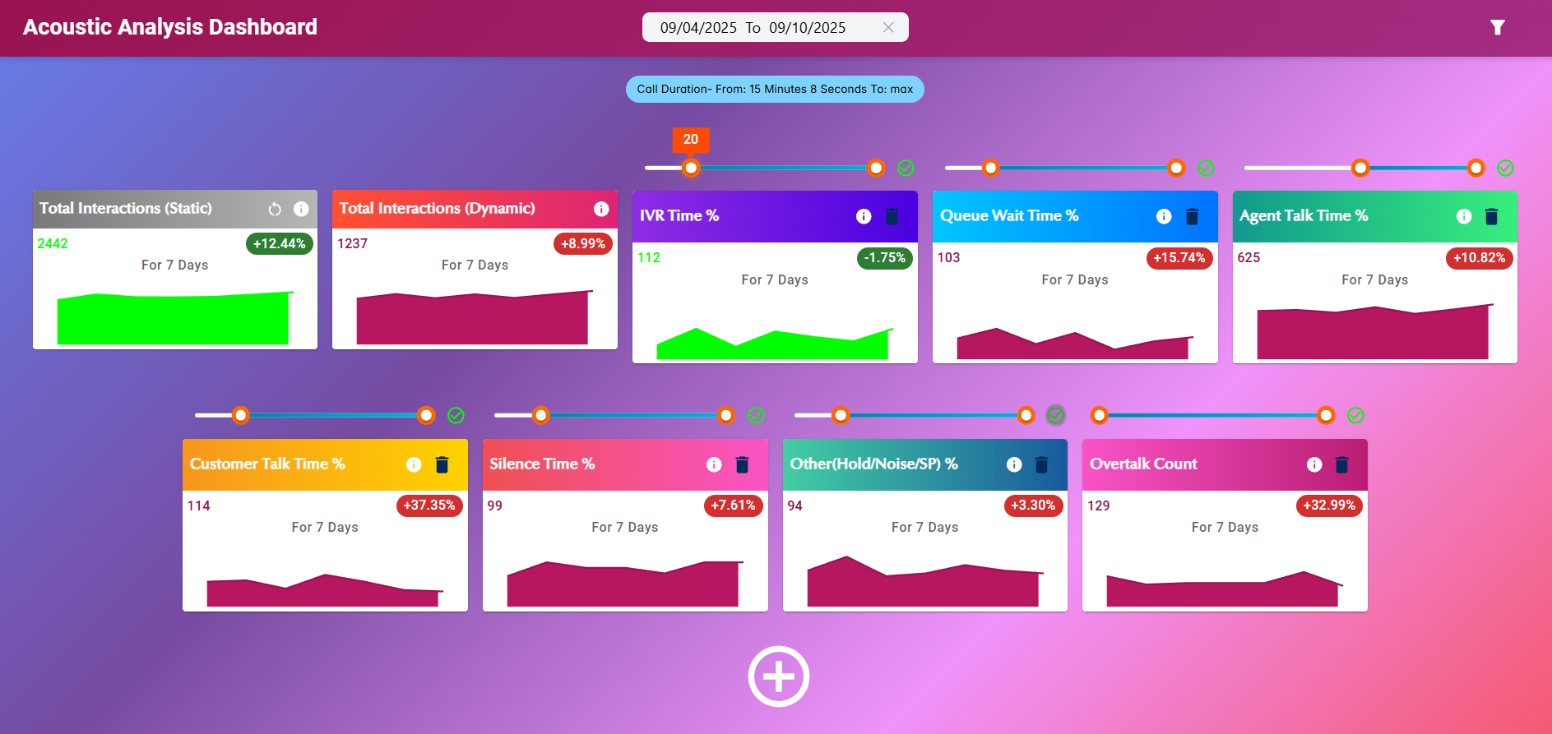
Stacked Bar Chart — Conversation Composition
Visualizes percentage/time composition of a call across acoustic metrics (e.g., Agent Talk vs Customer Talk vs Silence vs Queue Wait).
Shows per-day interactions and lets analysts spot dominant components in calls.
Hover reveals conversation-level details; click redirects to Genesys interaction for deep inspection.
Stacked view helps understand where time is being spent across interaction lifecycle.

Slide 8
Stacked Bar Chart — Features & Constraints
Filters by active acoustic tab; sorts groups by selected KPI.
Hover provides full conversation breakdown (used for verification against Genesys).
Limits: shows top 1,000 interactions per acoustic tab in UI; downloads allow up to 5,000 records.
Planned: relative-mode toggle to compare %-based rankings vs absolute time (minutes).
Usability focus: fast visual scanning + ability to drill to single interaction for verification.

Slide 9
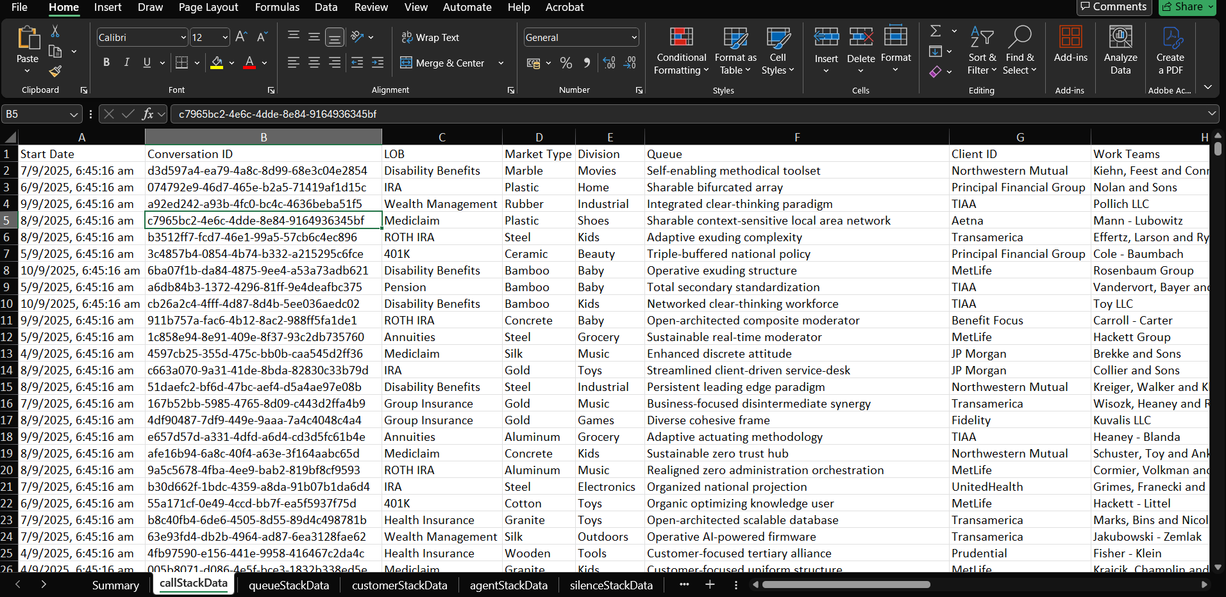
Download Preview & Export
Preview full conversation details in a tabular modal before export (Search & column control available).
Export to Excel for chosen acoustic tab or chart (supports filtering and date-range selection).
Summary tab in preview provides quick verification of aggregates and % computations.
Exports facilitate offline analysis, audit, and cross-validation with Genesys cloud.

Slide 10
Business Impact — Strategic Advantages
Single source of truth for acoustic performance across contact center operations.
Enables data-driven decisions: staffing, training, IVR tuning, and queue management.
Quickly surface systemic issues (high silence, high overtalk, long queue-wait) and drive remediation.
Bridges high-level KPIs with conversation-level evidence for audits and coaching.
Transforms acoustic telemetry into operational actions and measurable outcomes.

Slide 11
ROI & Measurable Outcomes
Faster root-cause: Reduce mean time to detect issues by consolidating acoustic signals.
Improve agent effectiveness through targeted coaching informed by real conversation examples.
Operational gains: lower average handle time, reduced queue wait, and improved customer experience scores.
Scalable exports enable monthly/quarterly reports and support for KPI-driven SLAs.
Recommend tracking: time-to-insight, % reduction in silence/overtalk, AHT improvements, CSAT uplift.

Slide 12
Client Feedback
Please capture client comments and suggested enhancements here.

