Slide 1
Genesys CI/CD Pipeline Using Terraform CLOUD
Notes:
---
This slide references information from the following file: https://voya0.sharepoint.com/sites/EnterpriseDataGovernance/_layouts/15/Doc.aspx?sourcedoc=%7B5759F2CB-C2FC-47BD-9FFD-9A8580815A43%7D&file=TrainingDeck_Data_Accountability_022725.pptx&action=edit&mobileredirect=true&DefaultItemOpen=1,https://voya0-my.sharepoint.com/personal/susanna_tem_voya_com/_layouts/15/Doc.aspx?sourcedoc=%7BEEBD2A96-79BB-441F-B765-D05FDFD4BEFA%7D&file=New%20Design%20of%20Voya%20PAL%20STA%20Dashboard%20FINAL%201.pptx&action=edit&mobileredirect=true&DefaultItemOpen=1
Overview, Initial Deployment Process, CI/CD Pipeline Flow Diagram, Terraform Behavior, Risks & Considerations, Conclusion & Roadmap

Slide 2
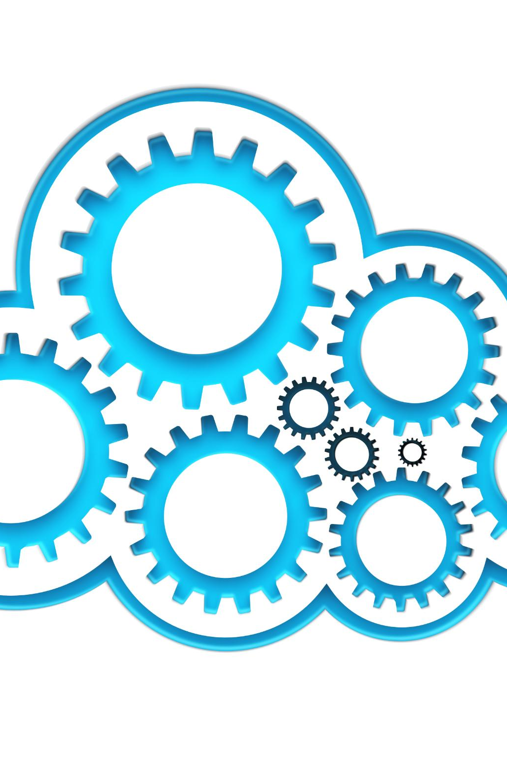
Overview
CI/CD Pipeline Integration
  GitHub Actions and Terraform Cloud streamline the deployment process, making it repeatable and efficient.
  Infrastructure as Code (CX as CODE)
  Terraform enables declarative management of Genesys Cloud resources, improving deployment consistency.
Environment Promotion
  The pipeline promotes configurations from development to production, reducing manual errors.
Notes:
---
This slide references information from the following file: https://voya0.sharepoint.com/sites/EnterpriseDataGovernance/_layouts/15/Doc.aspx?sourcedoc=%7B5759F2CB-C2FC-47BD-9FFD-9A8580815A43%7D&file=TrainingDeck_Data_Accountability_022725.pptx&action=edit&mobileredirect=true&DefaultItemOpen=1,https://voya0-my.sharepoint.com/personal/susanna_tem_voya_com/_layouts/15/Doc.aspx?sourcedoc=%7BEEBD2A96-79BB-441F-B765-D05FDFD4BEFA%7D&file=New%20Design%20of%20Voya%20PAL%20STA%20Dashboard%20FINAL%201.pptx&action=edit&mobileredirect=true&DefaultItemOpen=1
Automating Genesys Cloud deployments using Terraform introduces a robust CI/CD pipeline that ensures consistency, scalability, and automation across environments. This approach leverages Infrastructure as Code (IaC) principles, allowing teams to define and manage Genesys resources declaratively. By integrating GitHub Actions and Terraform Cloud, the deployment process becomes streamlined and repeatable. The pipeline orchestrates the promotion of configurations and flows from development to production environments, reducing manual intervention and minimizing errors. This methodology not only enhances operational efficiency but also aligns with modern DevOps practices, fostering collaboration and transparency among development and operations teams.

Slide 3
CI/CD Pipeline Flow
Stage | Description
1] Genesys Dev Region | Source of architect flows and configurations
2] GitHub Actions | Triggers CI workflows for deployment
3] Terraform Cloud | Applies configurations and manages state
4] Genesys Prod Region | Target environment for final deployment
Notes:
---
This slide references information from the following file: https://voya0.sharepoint.com/sites/EnterpriseDataGovernance/_layouts/15/Doc.aspx?sourcedoc=%7B5759F2CB-C2FC-47BD-9FFD-9A8580815A43%7D&file=TrainingDeck_Data_Accountability_022725.pptx&action=edit&mobileredirect=true&DefaultItemOpen=1,https://voya0-my.sharepoint.com/personal/susanna_tem_voya_com/_layouts/15/Doc.aspx?sourcedoc=%7BEEBD2A96-79BB-441F-B765-D05FDFD4BEFA%7D&file=New%20Design%20of%20Voya%20PAL%20STA%20Dashboard%20FINAL%201.pptx&action=edit&mobileredirect=true&DefaultItemOpen=1
The CI/CD pipeline for Genesys Cloud using Terraform follows a structured flow: Genesys Dev Region → GitHub Actions → Terraform Cloud → Genesys Prod Region. This flow begins with changes made in the development region, which are committed to a GitHub repository. GitHub Actions then triggers workflows that interact with Terraform Cloud, applying configurations and deploying architect flows and dependencies. Finally, the changes are reflected in the Genesys production region. This diagrammatic representation emphasizes the automation and control embedded in the pipeline, ensuring that deployments are consistent and traceable across environments.

Slide 4
DEMO

Slide 5
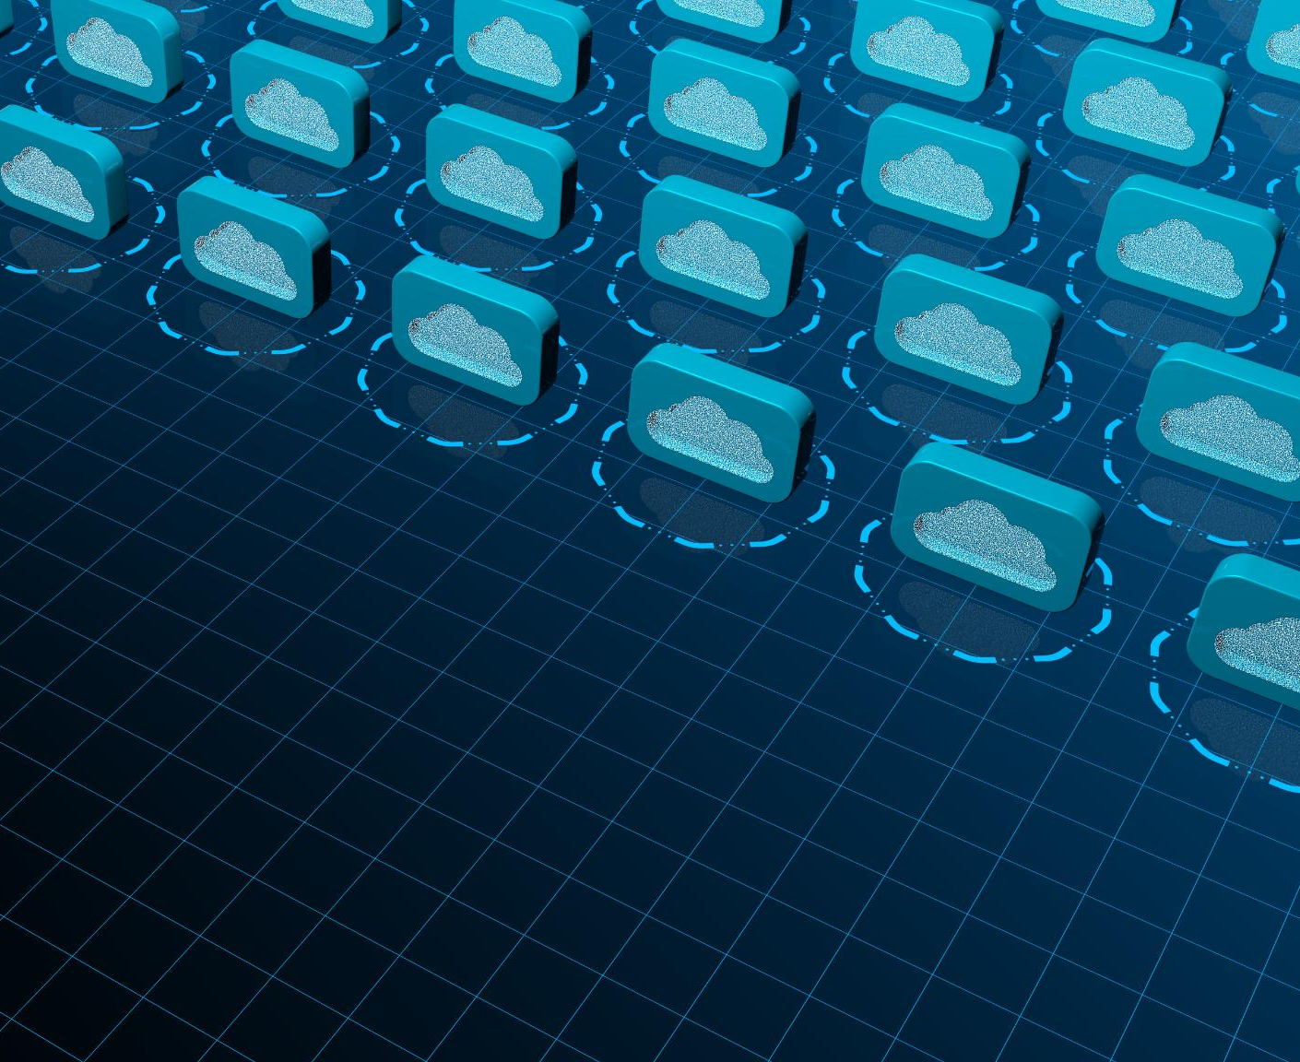
Initial Deployment Process
Resource Import and State Management
  Terraform imports architect flows and dependent resources, creating a state file to track them accurately.
Resource Creation in Production
  Terraform creates or manages existing resources in the production environment, ensuring consistency and control.
Deployment Tools and Version Control
  Archy CLI deploys architect flows while CX as Code modules enable version-controlled, reproducible configurations.
Notes:
---
This slide references information from the following file: https://voya0.sharepoint.com/sites/EnterpriseDataGovernance/_layouts/15/Doc.aspx?sourcedoc=%7B5759F2CB-C2FC-47BD-9FFD-9A8580815A43%7D&file=TrainingDeck_Data_Accountability_022725.pptx&action=edit&mobileredirect=true&DefaultItemOpen=1,https://voya0-my.sharepoint.com/personal/susanna_tem_voya_com/_layouts/15/Doc.aspx?sourcedoc=%7BEEBD2A96-79BB-441F-B765-D05FDFD4BEFA%7D&file=New%20Design%20of%20Voya%20PAL%20STA%20Dashboard%20FINAL%201.pptx&action=edit&mobileredirect=true&DefaultItemOpen=1
The initial deployment process begins with importing architect flows and their dependent resources from a lower Genesys region. This can be done manually or through a Terraform import module. Terraform then creates its own state file to track these resources. Once the state is established, Terraform proceeds to create the resources in the Genesys production environment. If resources with the same name already exist, they can be brought under Terraform management and subsequently overwritten. The deployment of architect flows is facilitated by Archy, a command-line tool that interacts with Genesys Cloud. For resource creation and updates, CX as Code modules are utilized, ensuring that all configurations are version-controlled and reproducible. This process lays the foundation for a reliable and maintainable infrastructure setup.

Slide 6
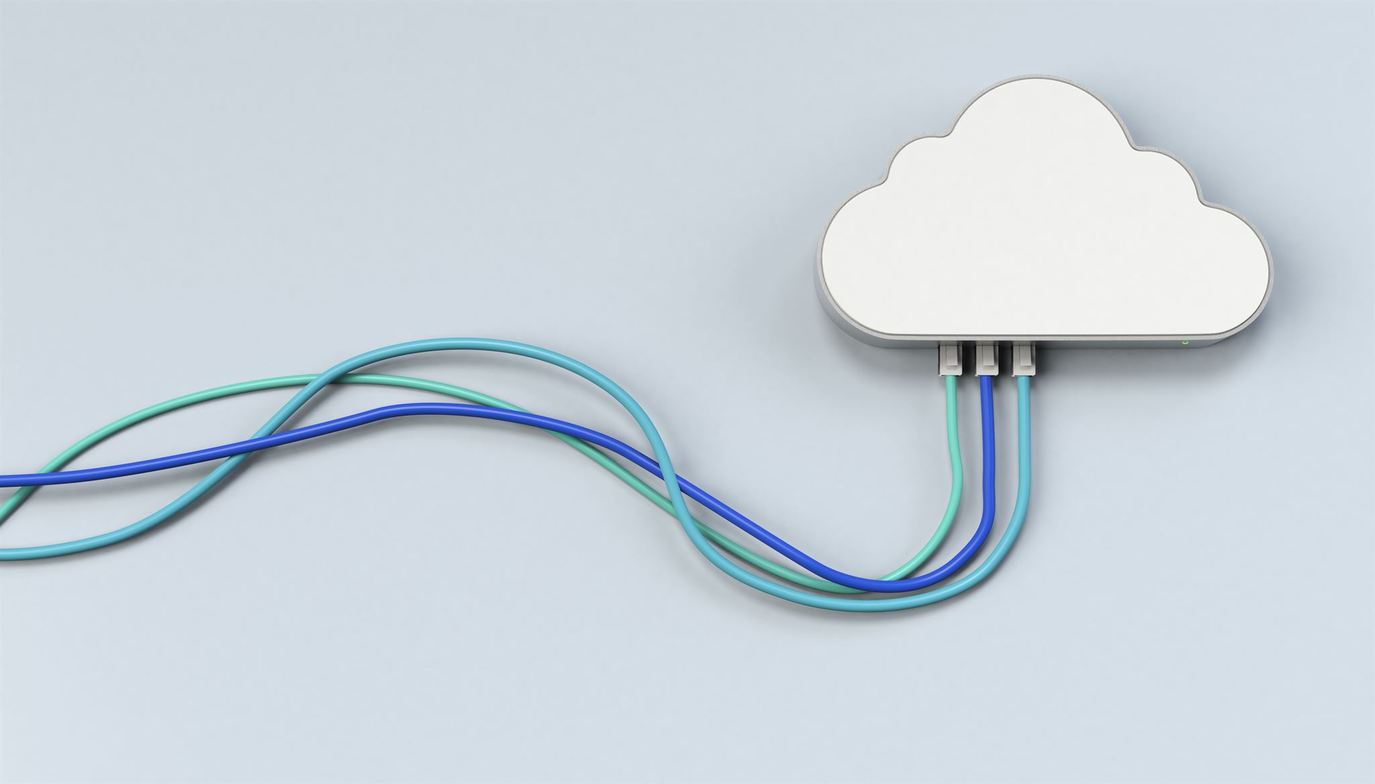
Terraform Behavior
Efficient Incremental Updates
  Terraform updates only resources that differ from the desired state, minimizing disruptions and unnecessary changes.
State Comparison Mechanism
  Terraform compares current resource states with configurations to detect changes and maintain consistency.
Automatic Drift Correction
  Terraform tracks all changes and corrects any drift from the desired configuration automatically.
Stable Infrastructure Setup
  This behavior supports a stable and predictable infrastructure setup, especially in complex cloud environments.
Notes:
---
This slide references information from the following file: https://voya0.sharepoint.com/sites/EnterpriseDataGovernance/_layouts/15/Doc.aspx?sourcedoc=%7B5759F2CB-C2FC-47BD-9FFD-9A8580815A43%7D&file=TrainingDeck_Data_Accountability_022725.pptx&action=edit&mobileredirect=true&DefaultItemOpen=1,https://voya0-my.sharepoint.com/personal/susanna_tem_voya_com/_layouts/15/Doc.aspx?sourcedoc=%7BEEBD2A96-79BB-441F-B765-D05FDFD4BEFA%7D&file=New%20Design%20of%20Voya%20PAL%20STA%20Dashboard%20FINAL%201.pptx&action=edit&mobileredirect=true&DefaultItemOpen=1
Terraform's behavior on subsequent runs is designed to ensure efficient and minimal updates. After the initial deployment, Terraform compares the current state of resources with the desired state defined in the configuration files. Only those resources that differ from the lower region are updated, reducing unnecessary changes and potential disruptions. This differential approach maintains consistency across environments and supports incremental updates. Terraform's state management ensures that all changes are tracked, and any drift from the desired configuration is corrected automatically. This behavior is crucial for maintaining a stable and predictable infrastructure setup in Genesys Cloud.

Slide 7

Risks & Considerations
Initial Setup Complexity
  Setting up Terraform CI/CD pipelines requires managing modules, state, and integration points, which is resource intensive.
Strict Change Management
  All infrastructure changes must be done through the pipeline to avoid conflicts with manual updates.
Risk of State Loss
  Accidental deletion of Terraform workspace can lead to loss of state and removal of all managed resources.
Need for Governance
  Robust planning, backup strategies, and governance are essential to maintain infrastructure integrity.
Notes:
---
This slide references information from the following file: https://voya0.sharepoint.com/sites/EnterpriseDataGovernance/_layouts/15/Doc.aspx?sourcedoc=%7B5759F2CB-C2FC-47BD-9FFD-9A8580815A43%7D&file=TrainingDeck_Data_Accountability_022725.pptx&action=edit&mobileredirect=true&DefaultItemOpen=1,https://voya0-my.sharepoint.com/personal/susanna_tem_voya_com/_layouts/15/Doc.aspx?sourcedoc=%7BEEBD2A96-79BB-441F-B765-D05FDFD4BEFA%7D&file=New%20Design%20of%20Voya%20PAL%20STA%20Dashboard%20FINAL%201.pptx&action=edit&mobileredirect=true&DefaultItemOpen=1
Implementing a CI/CD pipeline with Terraform for Genesys Cloud introduces several risks and considerations. First, the initial setup requires significant overhead, including configuring modules, state management, and integration points. Once resources are under Terraform management, all changes must be made through the pipeline to avoid conflicts. Direct modifications in the production environment will be overwritten by the version present in Terraform, potentially leading to loss of manual updates. Additionally, if the Terraform workspace containing the state is deleted, it can result in the deletion of all associated resources in Genesys. These risks necessitate careful planning, robust backup strategies, and strict governance to ensure infrastructure integrity and continuity.

Slide 8
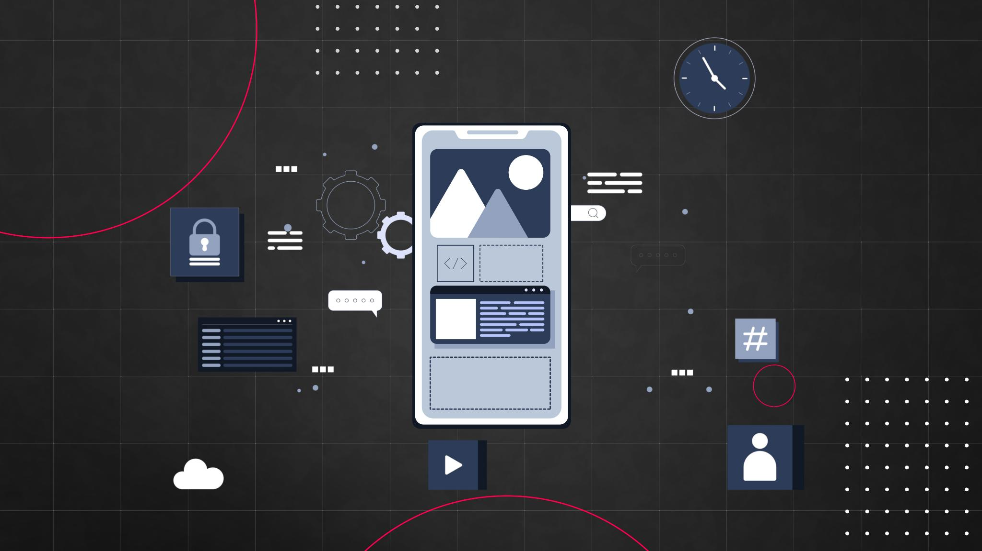
Conclusion & Roadmap
Testing for Reliability
  Testing the import module for resources and architect flows ensures the pipeline is reliable and resilient.
User Interface Development
  Creating an interface to select and trigger specific flows improves pipeline usability and flexibility.
Backup and Risk Management
  Research into edge cases and risks guides the development of a comprehensive backup and implementation plan.
Granularity of Control
  Decisions on control levels define whether changes apply division-wide, by flow class, or individually.
Notes:
---
This slide references information from the following file: https://voya0.sharepoint.com/sites/EnterpriseDataGovernance/_layouts/15/Doc.aspx?sourcedoc=%7B5759F2CB-C2FC-47BD-9FFD-9A8580815A43%7D&file=TrainingDeck_Data_Accountability_022725.pptx&action=edit&mobileredirect=true&DefaultItemOpen=1,https://voya0-my.sharepoint.com/personal/susanna_tem_voya_com/_layouts/15/Doc.aspx?sourcedoc=%7BEEBD2A96-79BB-441F-B765-D05FDFD4BEFA%7D&file=New%20Design%20of%20Voya%20PAL%20STA%20Dashboard%20FINAL%201.pptx&action=edit&mobileredirect=true&DefaultItemOpen=1
The conclusion and ongoing development plan for the Genesys CI/CD pipeline using Terraform focuses on enhancing functionality and resilience. Key initiatives include testing the import module for both resources and architect flows to ensure reliability. Developing an interface that allows users to select specific flows and trigger the pipeline will improve usability and flexibility. Further research into edge cases and potential risks will inform the creation of a comprehensive backup and implementation plan. As part of the roadmap, decisions must be made regarding the granularity of control—whether changes can be applied at the division level, for specific classes of flows, or individual flows. These steps will ensure that the pipeline remains robust, scalable, and aligned with organizational needs.

